Slide 1


Slide 3

Left or right?
1)
2)
3)
4)
5)
6)

Slide 4
Left or right?
1)
Left
2)
3)
Left
Right
4)
5)
6)
Left
Right
Right

Slide 6
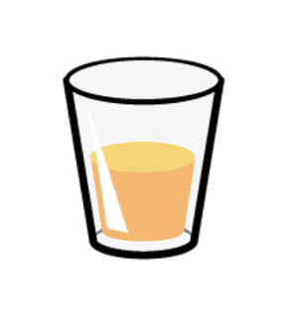
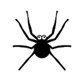

The spider and the bee can only move 2 squares forwards.
Where on the grid can the spider start to get the juice and where can the bee start to get the apple?

Slide 8
The bee moves 1 square forwards,
1 square right, 2 squares forwards

Slide 9
The bee moves 1 square forwards,
1 square , 2 squares forwards.
left

Slide 10

Have a think
The bee moves square and
squares .
1
left
2
forwards

Slide 11

How could the spider or the bee
get to the food and drink?
Does it make it more difficult if the animals are not facing the same direction?

Slide 12
Have a go at the questions on the worksheet

