Slide 1
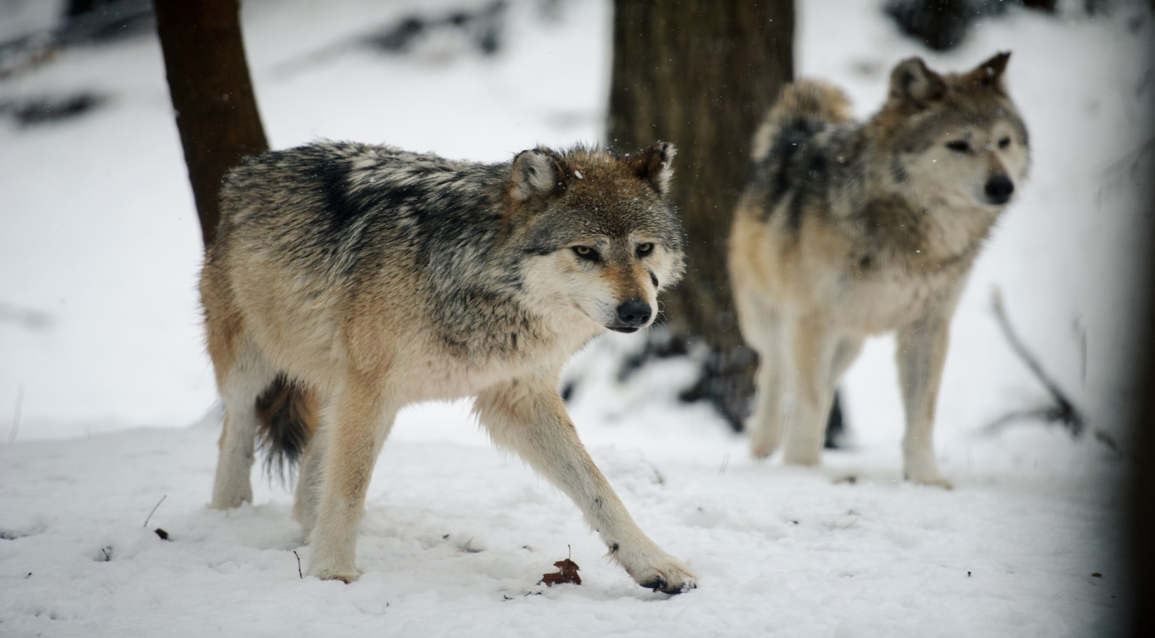
Thursday 6th May
L.O. To find out facts about wolves and record as short notes.

Slide 2
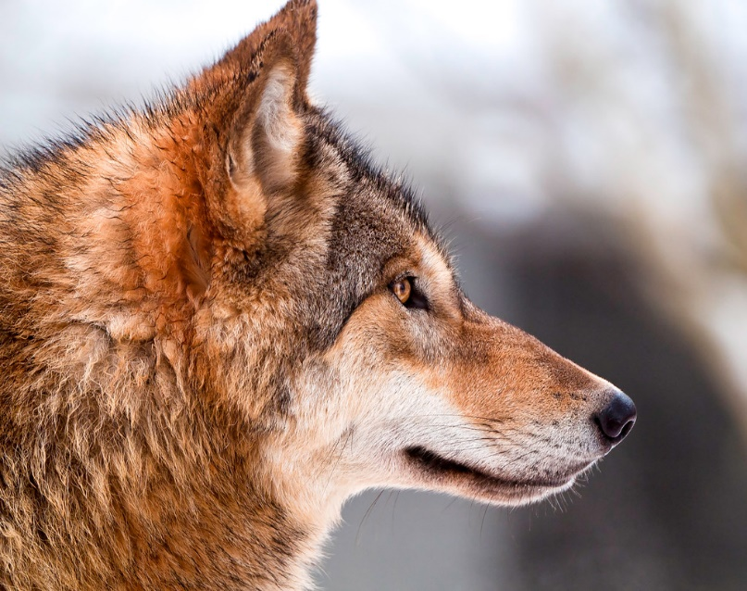
We are going to learn about wolves by watching a video.
We are going to ‘write notes’ to help us remember the information.
‘Notes’ do not need to be full sentences.
They might be just a few words to help us remember a fact.

Slide 3
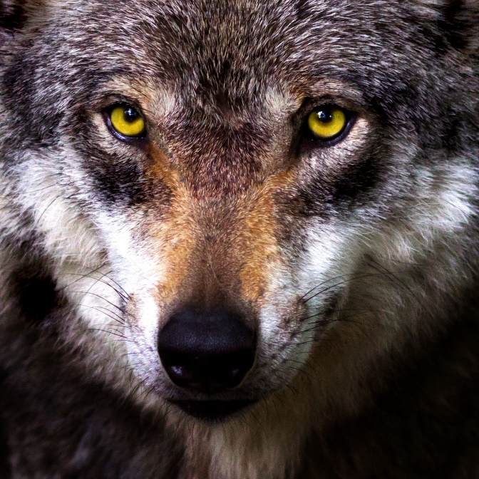
We will watch the whole video first.
We will then watch it again and pause to write our notes.
https://www.youtube.com/watch?v=bVx4vY1-0cM
We can arrange our notes into different sections.
We can use a question or a sub-heading to label a section.

Slide 4
Thursday 6th May: Writing notes to record facts.
What type of animal are wolves? | Where do they live? | Are they dangerous to humans?
What do they eat? | How do they hunt? | How does the pack leader keep the pack together?
Other facts about wolves.

Slide 5
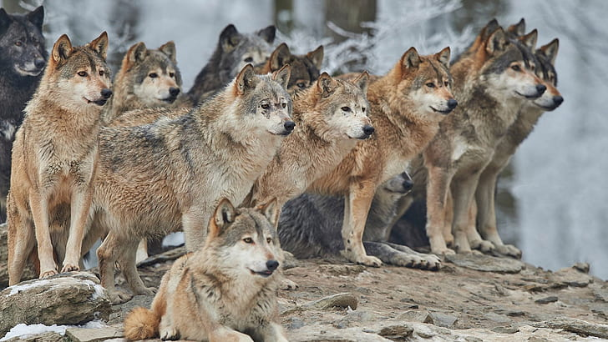
Tomorrow we will use our notes to write full sentences about wolves.
We will write a report about wolves.

