Slide 1


Slide 3
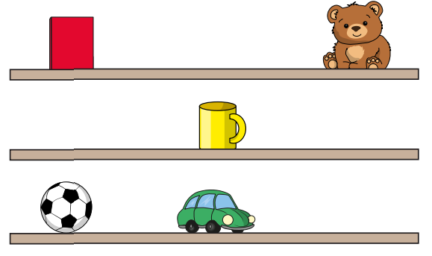
Opposites!
Above
Below
Left
Right
The mug is above the car.
Therefore the car is the mug.
1)
The book is on the left of the bear.
Therefore the bear is on the of the book.
2)

Slide 4
Opposites!
Above
Below
below
Left
Right
right
The mug is above the car.
Therefore the car is the mug.
1)
The book is on the left of the bear.
Therefore the bear is on the of the book.
2)

Slide 6
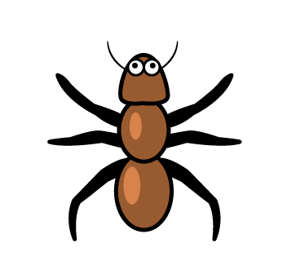

Slide 8
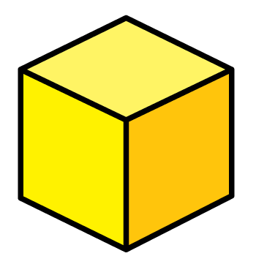

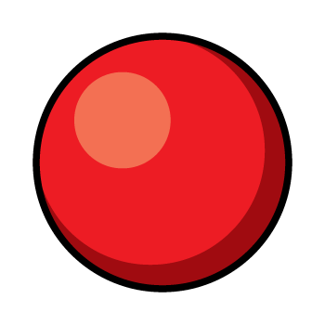


A half turn
Have a think
How can we get the ant to face the cuboid?

Slide 9




Slide 10
Have a go at questions 1 - 3 on the worksheet

Slide 11
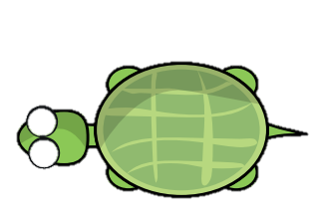

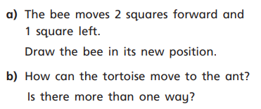


Slide 12
Have a go at the rest of the questions on the worksheet

