Slide 1


Slide 3
Which of these words can be
used to describe position?
Above
Left
Right
Turn
Smaller
Biggest
Below

Slide 4


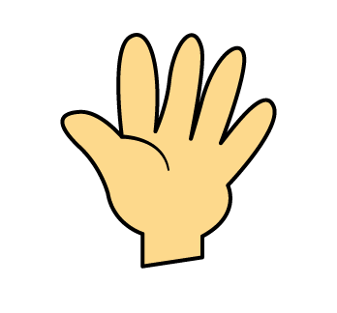
Which of these words can be
used to describe position?
Above
Left
Right
Below

Slide 6

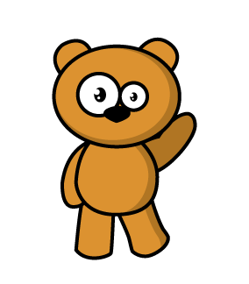
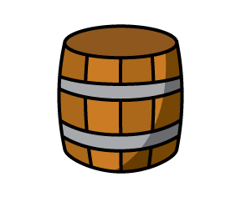
Here is a bear.
There is a balloon above the bear.
There is a barrel below the bear.

Slide 7
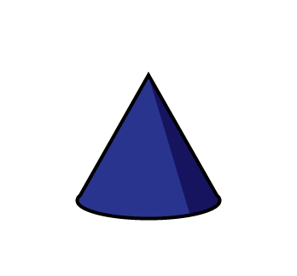


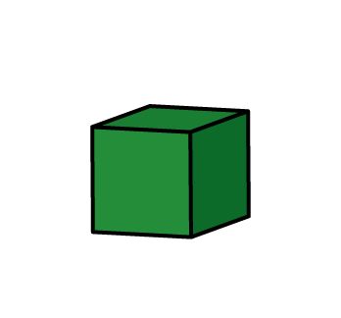
Have a go
The is above the
The is above the
The is below the
The is below the

Slide 8
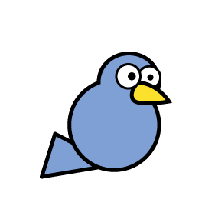
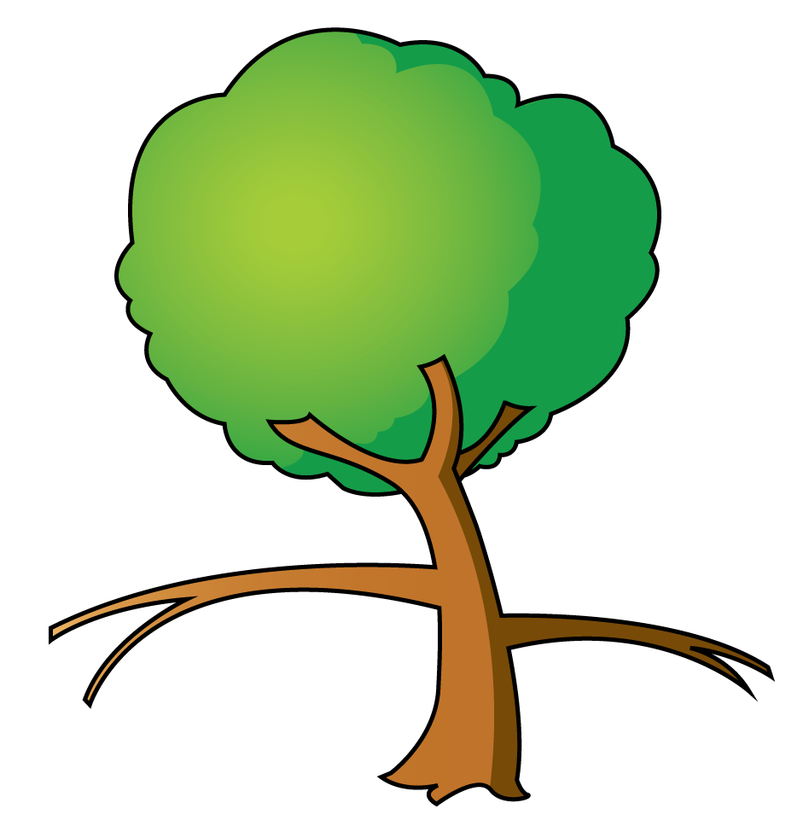

The is on the left branch.
The is on the right branch.

Slide 9

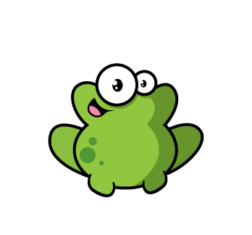
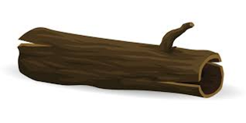
Have a go
There is a to the left of the
There is a to the right of the
The jumped to the left onto the

Slide 10

Have a go
Draw a in the middle of your page.
Draw a to the left of the
Draw a above the
Draw a to the right of the
Draw a below the

Slide 12
Have a go at the questions on the worksheet

