Slide 1
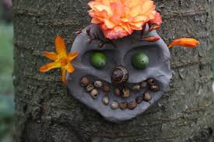
Tuesday 4th May
L.O. To make a clay boggart

Slide 2
Your Task
Today you are going to use clay and natural materials to make a clay Boggart. Boggarts are mischievous creatures that live in the woods. They are annoyed by humans who endanger their homes.
If you have ever had something fall on your head or tripped over an invisible tree root in the forest that’s a Boggart playing tricks on you.
You can make them happy by making clay models of them and attaching the models to trees.

Slide 3
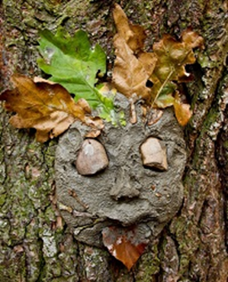
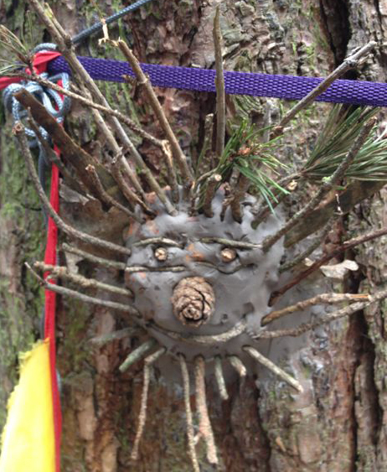
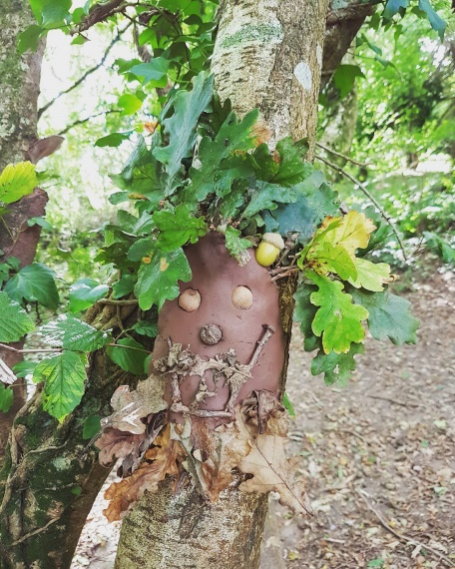
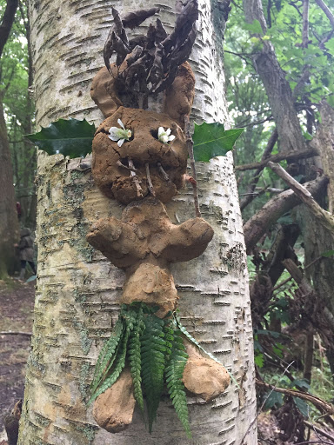
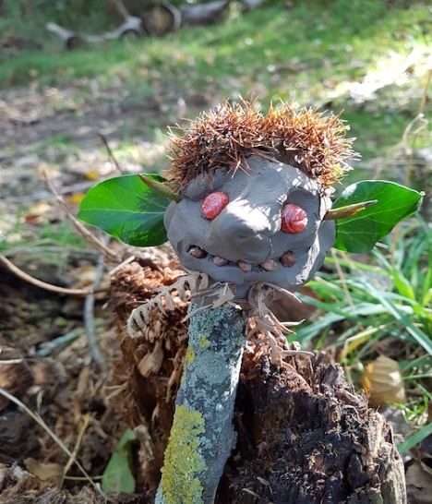
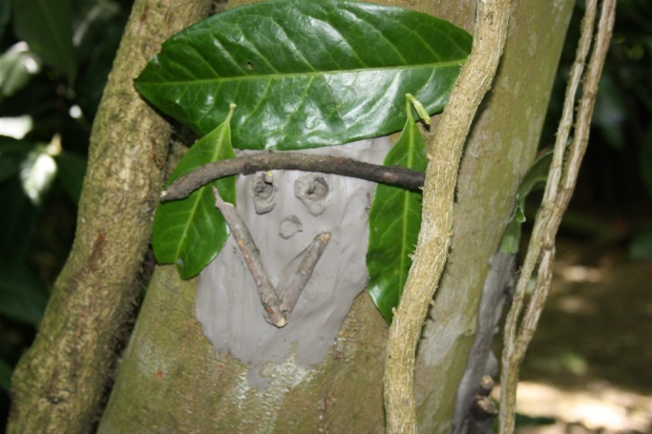
Here are some examples of tree Boggarts children have made.

Slide 4
Watch this video to find out how to make a simple tree Boggart.
https://www.youtube.com/watch?v=qXY1pW1Rs2g

Slide 5
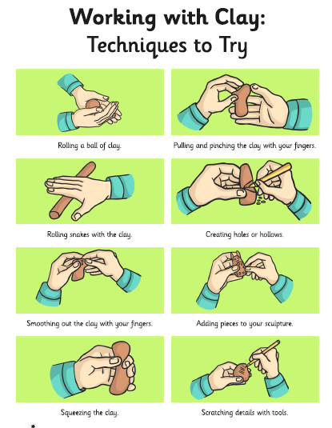

Slide 6
Watch this video to listen to a story about a Boggart.
https://www.youtube.com/watch?v=bgM4KHk9o3w

