Slide 1


Slide 3
Which words can we use to describe position?
Right
Left
Red
Bigger
Backwards
Forwards
Yellow
Smallest

Slide 5


Which hand?
Left
Right
L

Slide 6

Which hand do you write with?
Left
Right

Slide 7



left
right
Where is …?
left
The is to the of the
right
The is to the of the
right
The is to the of the

Slide 8




left
right
Where is …?
Have a go
left
The is to the of the
right
The is to the of the
left
The is to the of the

Slide 9

Forwards or backwards ?
Backwards
Forwards

Slide 10

Which way is the ladybird going?
Forwards or backwards ?
The ladybird is going backwards.

Slide 11
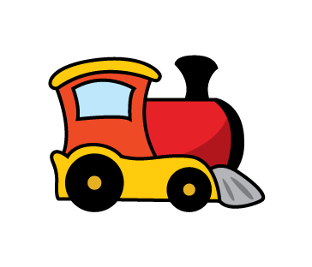
Which way is the train going?
Forwards or backwards ?
The train is going forwards.

Slide 12

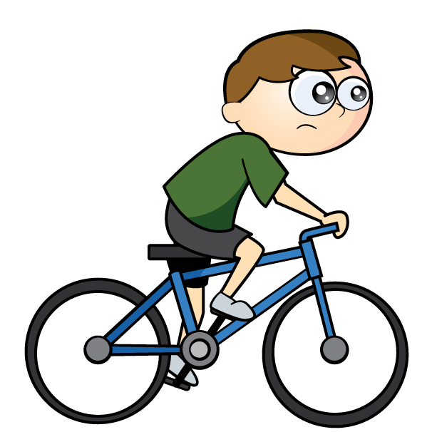
Jill is going…
Jack is going…
Forwards or backwards ?
They are both going forwards.

Slide 13
Have a go at the questions on the worksheet

