Slide 1
This week’s literacy is based on a story from Oxford Owl, the scheme that Bishopton have arranged for you to access as your home reading books.
It might be a book that you have chosen already.
Either search Dragon Tales or select it from 9-11.
The story is available to read on screen or as an audio book to listen to.
There are 6 further slides for this week’s literacy.
You may do one a day and have the last one as an extension.
It is entirely up to you.
Please answer the questions in your school exercise book so there is no need to print anything out.

Slide 2
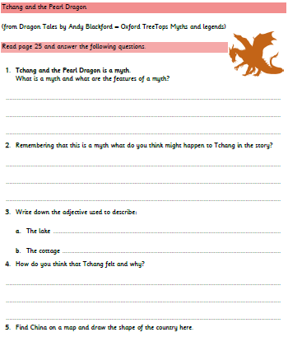
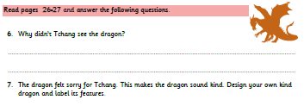

Slide 3
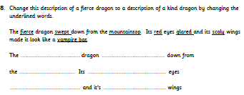
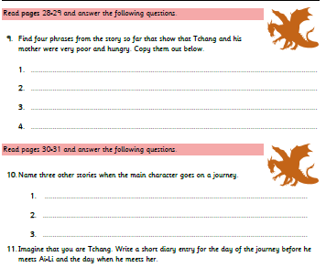

Slide 4
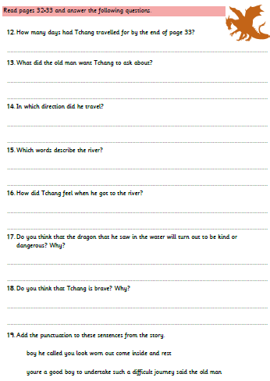


Slide 5
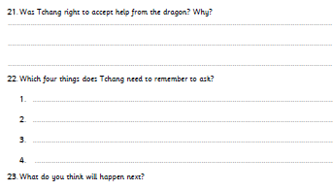
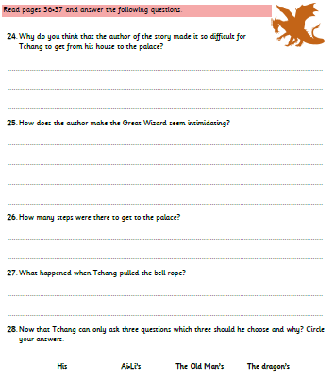

Slide 6
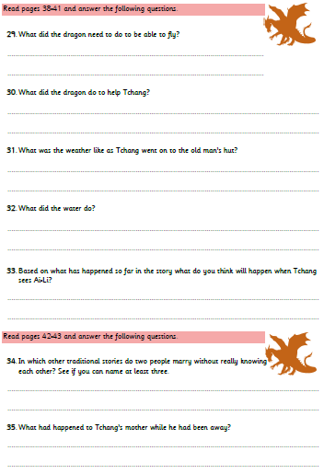
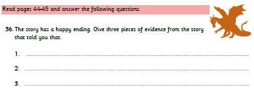

Slide 7


