Slide 1
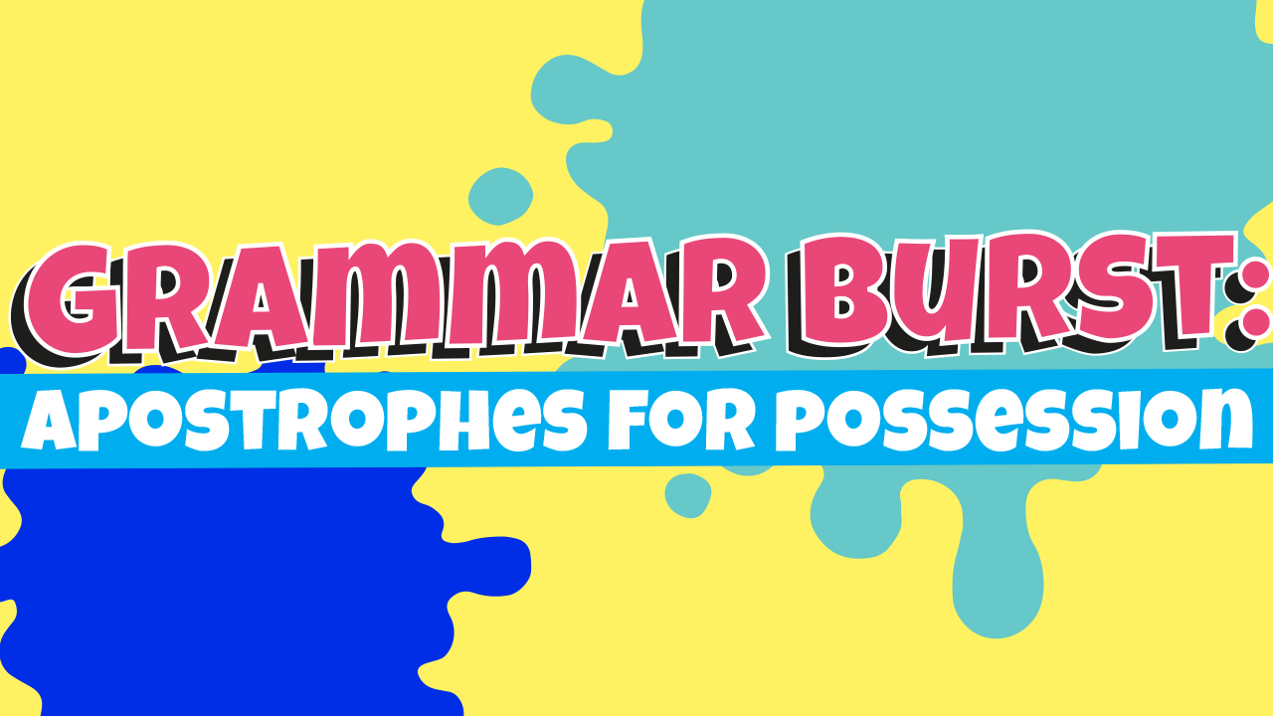
Apostrophes for Possession
MONDAY 8TH JUNE
Design note: grammar burst will be a series of 20+ resources.
Could we have a cool graphic on the front page please?
It might also be a neat idea to have a character (like art or science to introduce these).

Slide 2

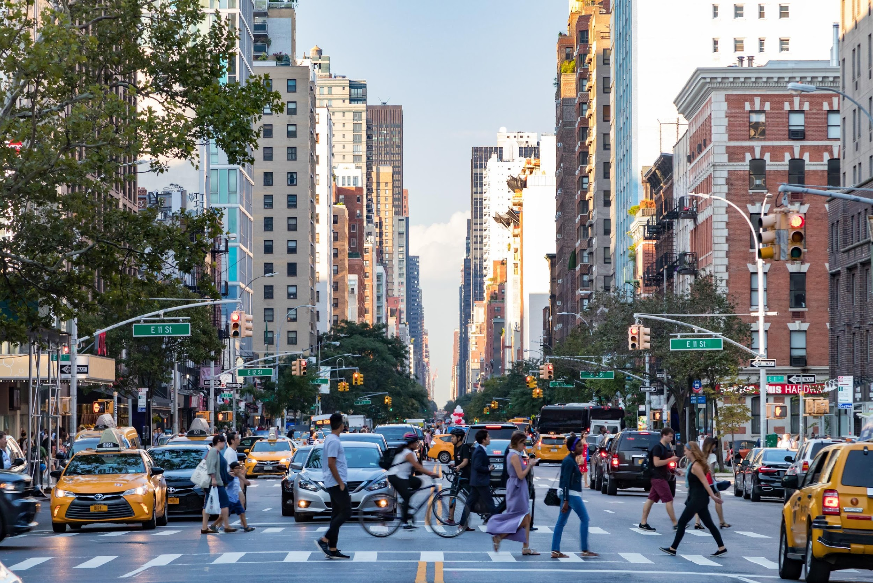

Look and learn
Sunil’s directions did not help us find the train station.
The city’s streets were crowded.
The day’s activities were fun but tiring.
Cars’ horns could be heard blaring from every direction.
The tourists’ experiences were all good.
I was not impressed with the taxi-drivers’ manners.
Copyright 2019

Slide 3

The cows heavy feet churned up the ground as they lumbered across the wet field.
The police officers found three suspects fingerprints in the locked room.
My parents wedding anniversary is tomorrow.
The queens carriage passed by.
The zookeepers made sure that the zebras food was shared out equally.
Because he spends a lot of time caring for it, my neighbours flower garden is immaculate.
Where should these possessive apostrophes go?
Write out the sentences with them.
Copyright 2019

Slide 4
Only one of these apostrophes is in the correct place. Can you tell which one and write it out correctly?
The childrens’ coats were scattered across the corridor.
The dog buried it’s bone in the garden.
Graemes’ hat was left behind on the train.
The cats’ bowls needed filling.
The womens’ football match was cancelled.
Copyright 2019

Slide 5
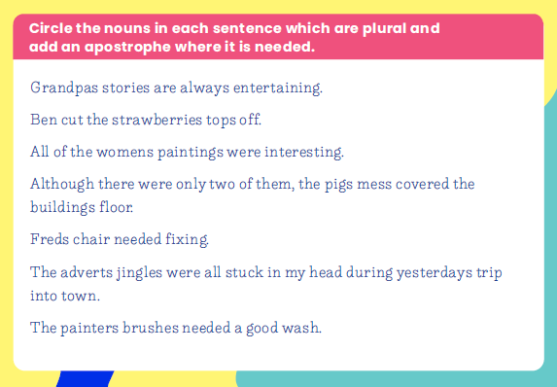
Circle the nouns and add the apostrophes if you print this out.
OR
Write just the nouns out with the apostrophes.

Slide 6
Apostrophes for Possession
TUESDAY 9TH JUNE
Design note: grammar burst will be a series of 20+ resources.
Could we have a cool graphic on the front page please?
It might also be a neat idea to have a character (like art or science to introduce these).

Slide 7
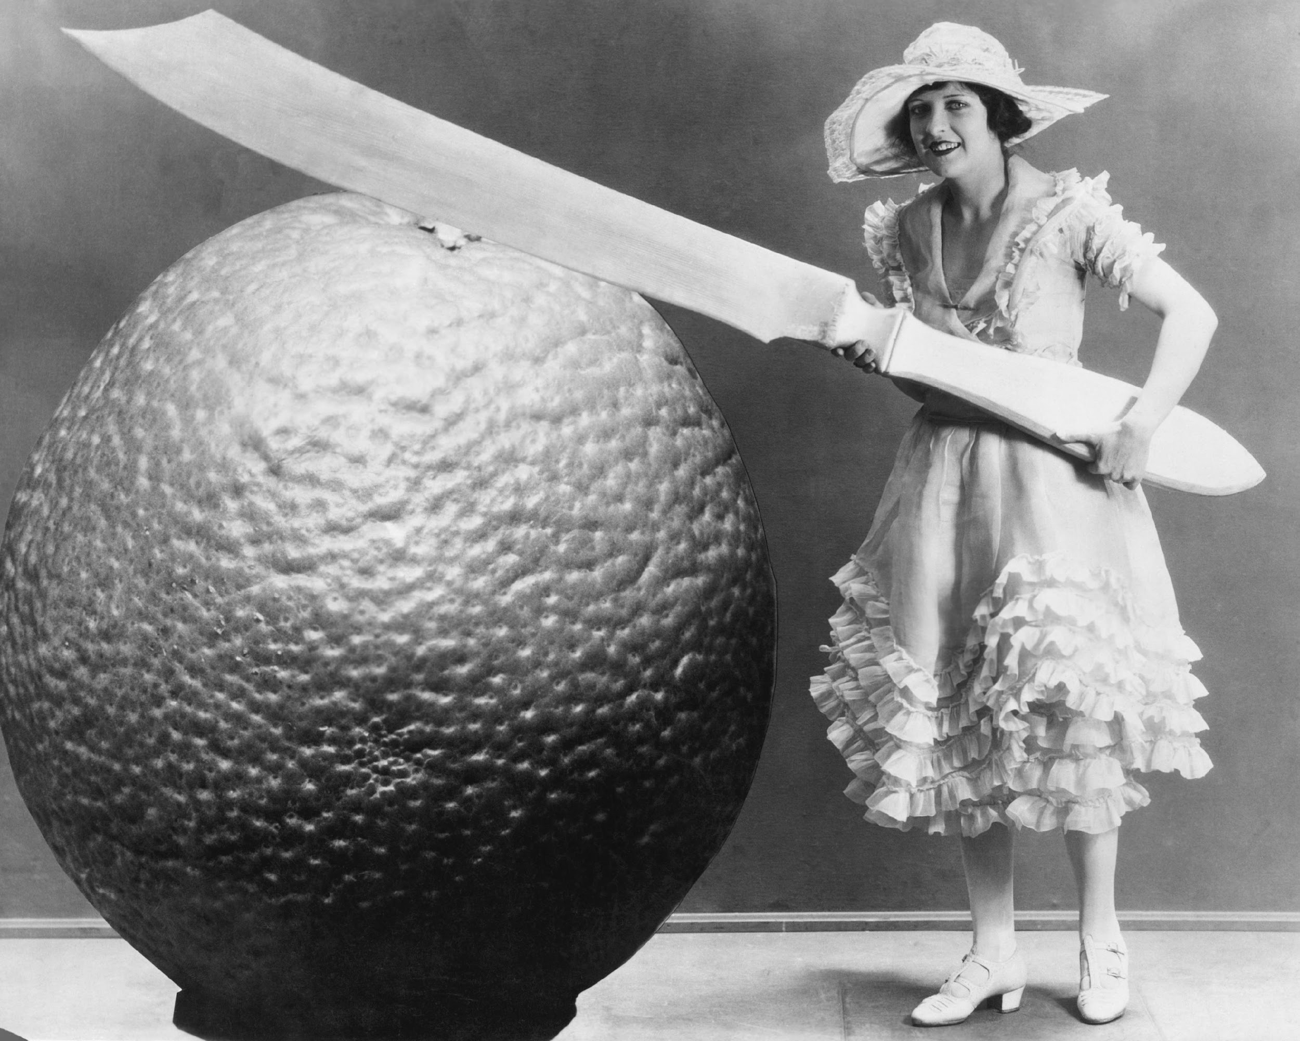
Can you write a sentence about this picture which uses a possessive apostrophe?
Copyright 2019

Slide 8
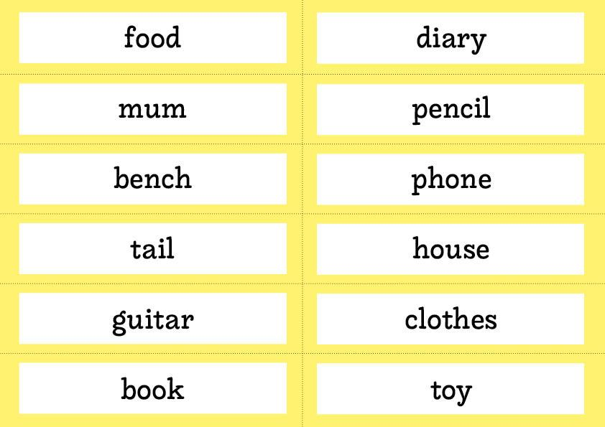
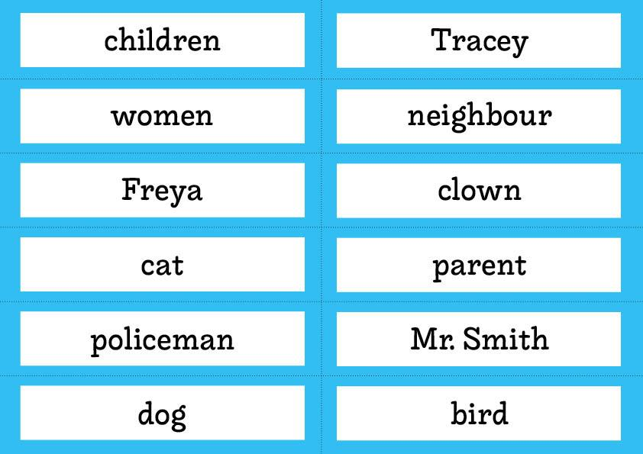
Choose pairs of nouns.
One noun should be in yellow and one noun should be in blue. Use them in a sentence which also includes a possessive apostrophe.
Repeat with other pairs of nouns
Copyright 2019

Slide 9
Write a story. Try to include as many nouns from the blue and yellow cards as you can.
Make sure your story includes at least three possessive apostrophes.

Slide 10
Apostrophes for Possession
WEDNESDAY 10TH JUNE
Design note: grammar burst will be a series of 20+ resources.
Could we have a cool graphic on the front page please?
It might also be a neat idea to have a character (like art or science to introduce these).

Slide 11
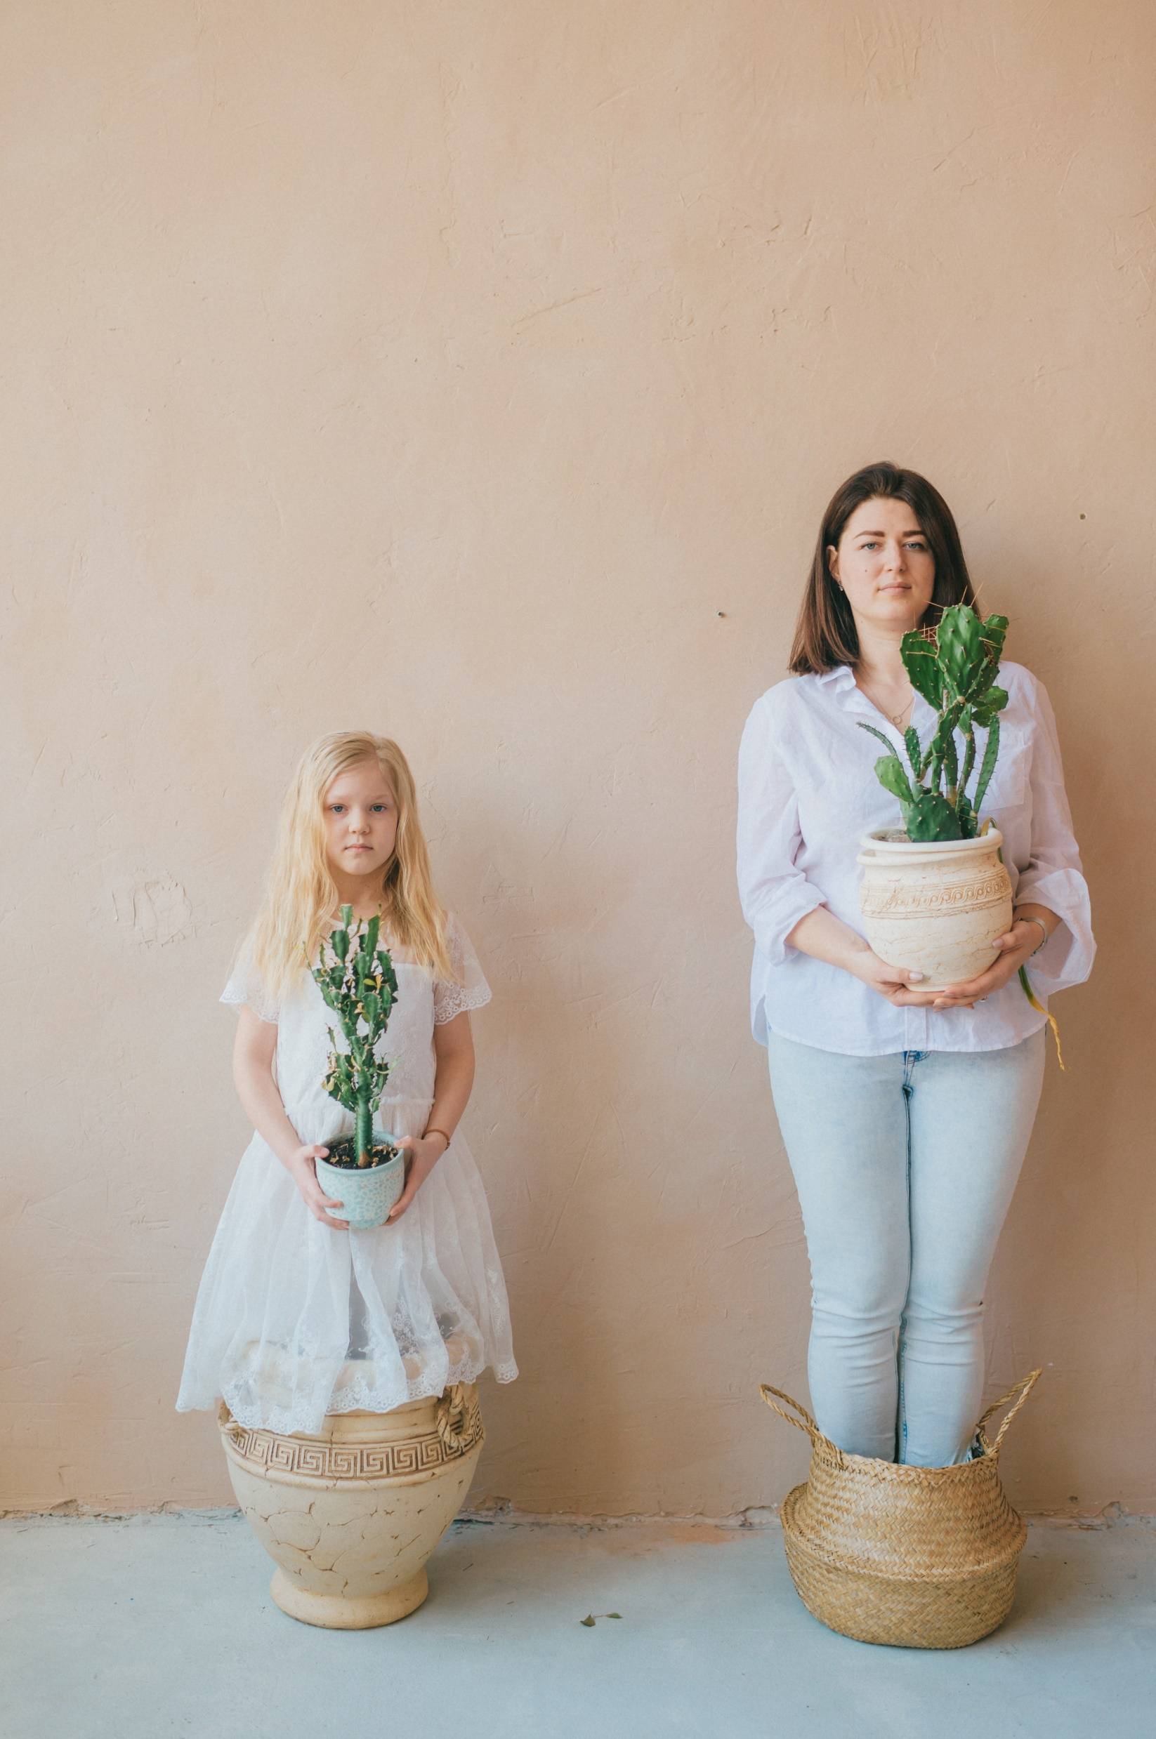
Can you write 1 or 2 sentences about this picture which use a possessive apostrophe?
Copyright 2019

Slide 12
The babies’ cries woke me up.
The plumbers’ teas all had lots of sugar.
The tree’s leaves were scattered across the woodland floor.
The airplane lowered it’s wheels as it approached the runway.
Which of the sentences uses the possessive apostrophe incorrectly?
Rewrite it correctly.

Slide 13
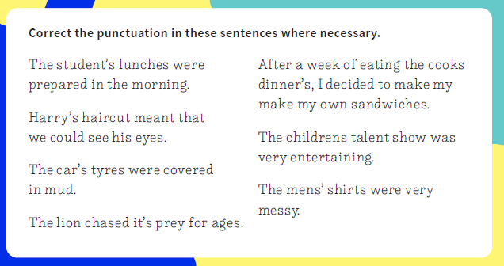

Slide 14
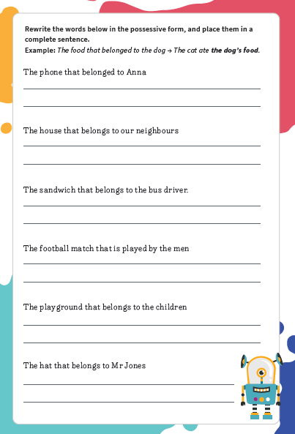

Slide 15
Apostrophes for Possession
THURSDAY 11TH JUNE
Design note: grammar burst will be a series of 20+ resources.
Could we have a cool graphic on the front page please?
It might also be a neat idea to have a character (like art or science to introduce these).

Slide 16
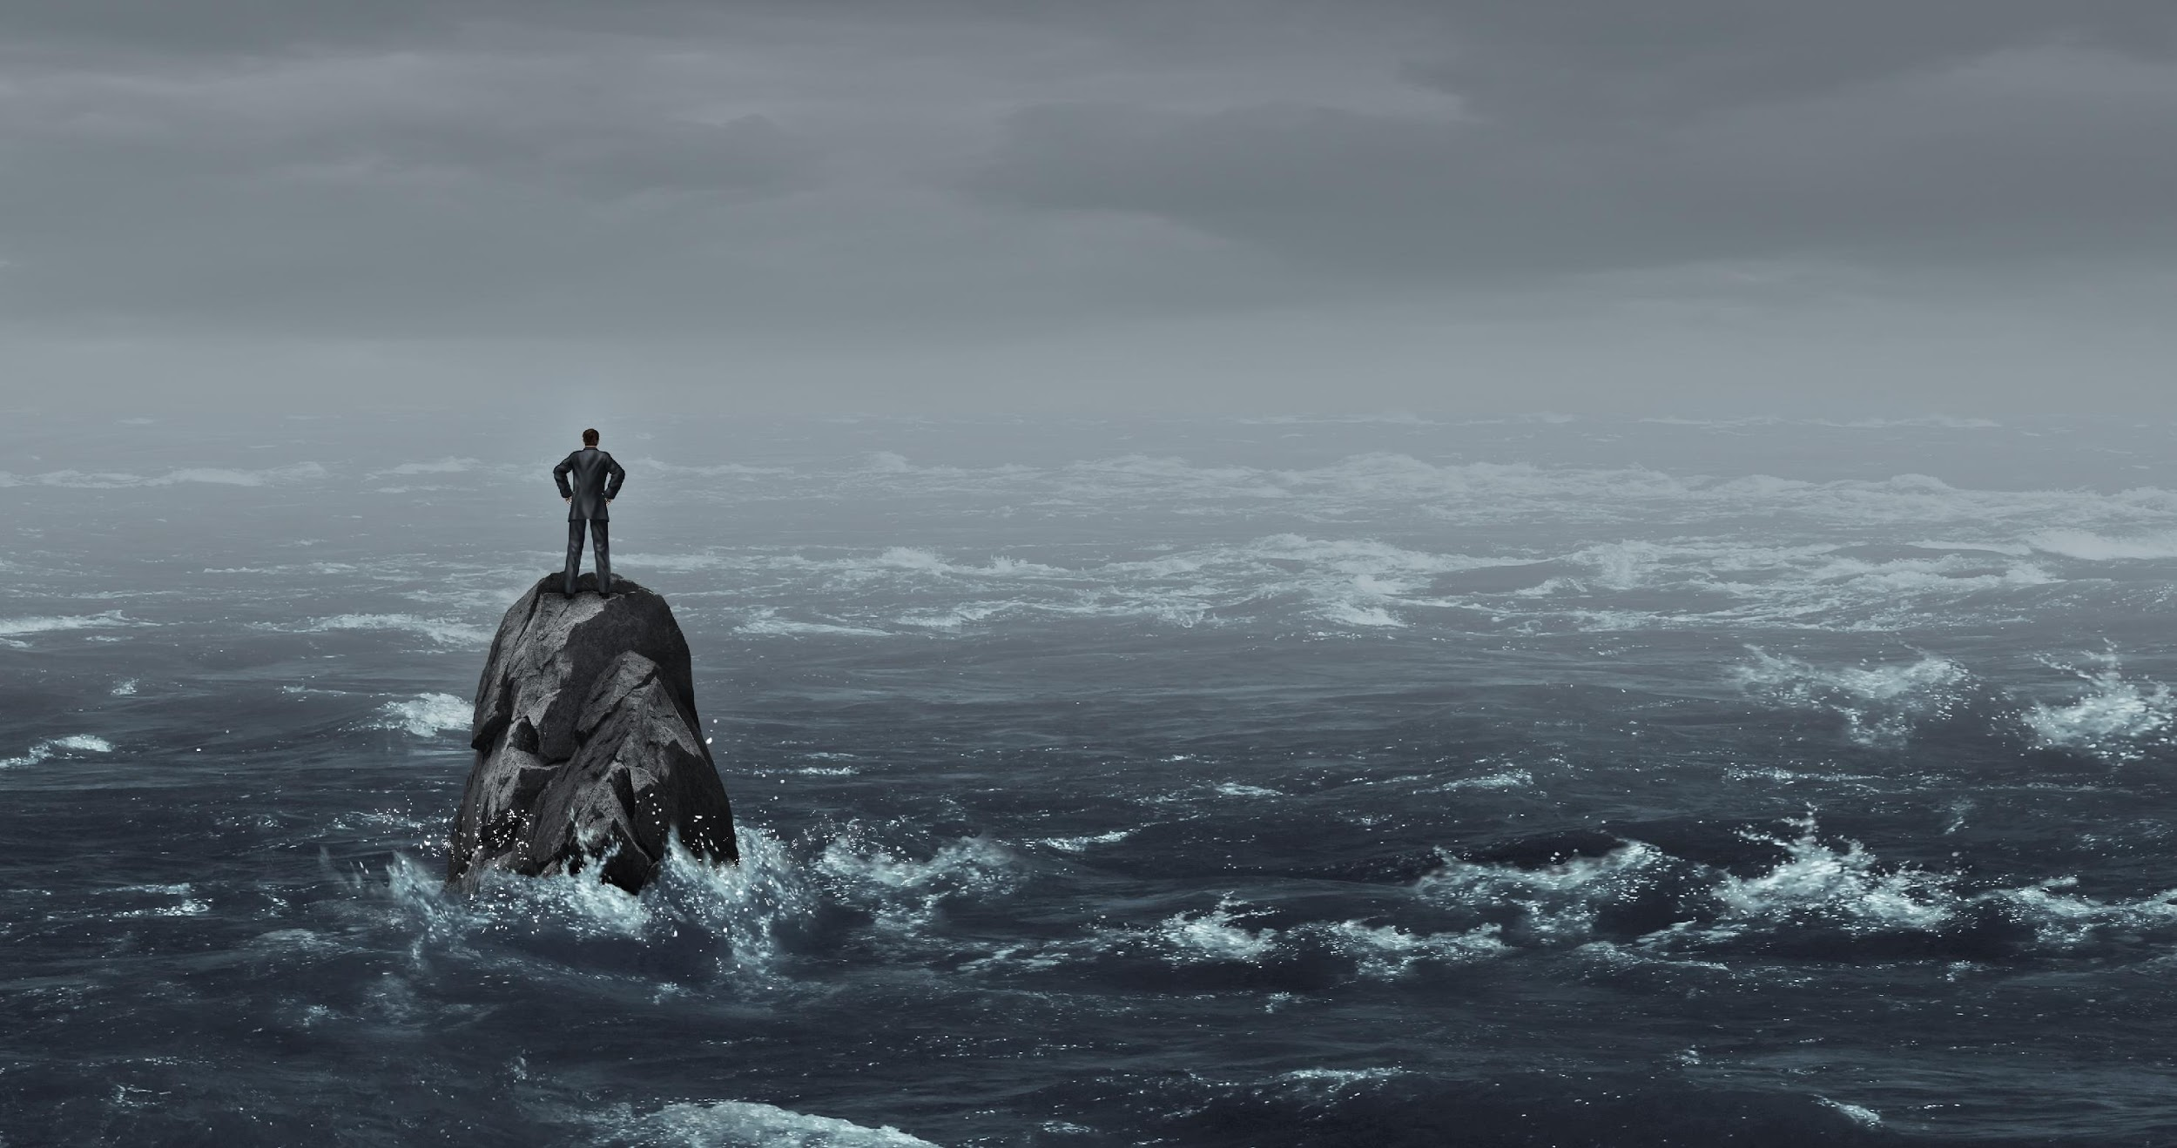
Can you write 1 or 2 sentences about this picture which use a possessive apostrophe?
Copyright 2019

Slide 17
The boys’ shorts reached his knees.
After the girls’ game finished, they went inside and ate lunch.
The childrens’ uniforms needed sorting.
Which of the sentences use the possessive apostrophe incorrectly?
Write the sentence out, correct it and explain what was wrong.
Copyright 2019

Slide 18
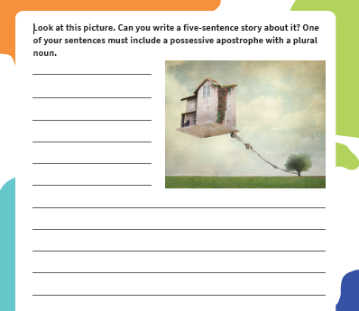

Slide 19
Apostrophes for Possession
FRIDAY 12TH JUNE
Design note: grammar burst will be a series of 20+ resources.
Could we have a cool graphic on the front page please?
It might also be a neat idea to have a character (like art or science to introduce these).

Slide 20
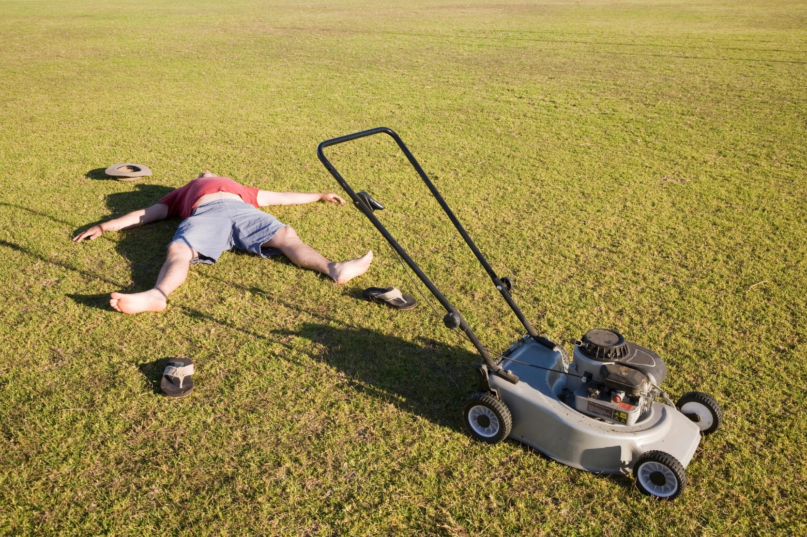
Can you write 1 or 2 sentences about this picture which use a possessive apostrophe?
Copyright 2019

Slide 21
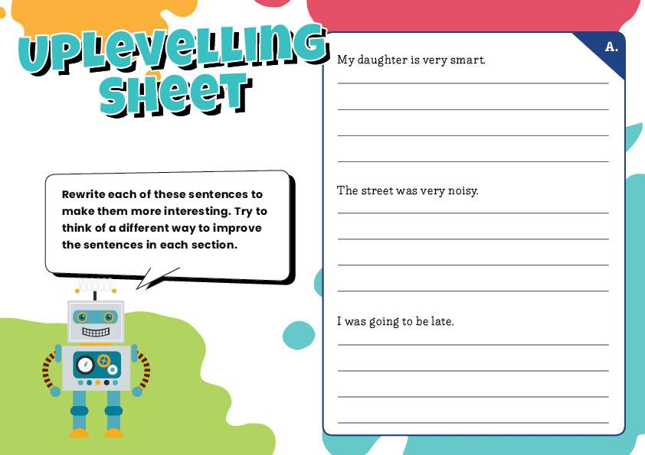
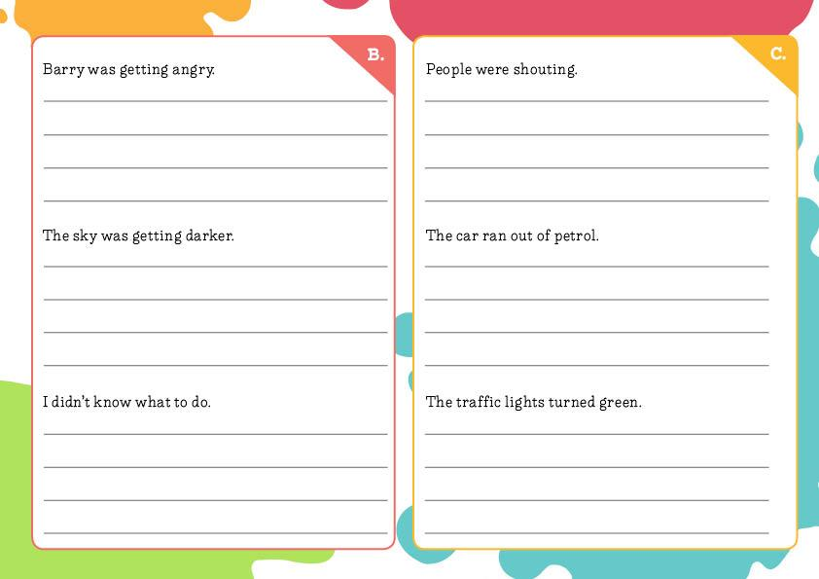
Can you improve these sentences?
Use a possessive apostrophe for one sentence in each section but practise your other skills too!
Copyright 2019

Slide 22
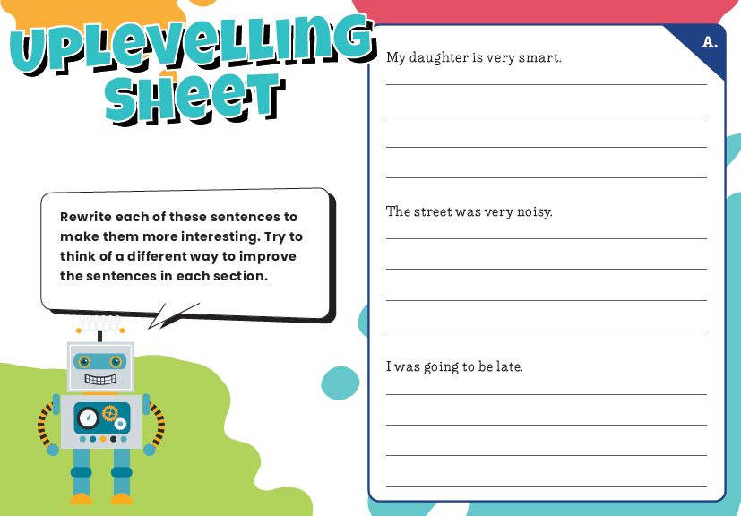

Slide 23


