Slide 1
Thursday 7th January
L.O: To respond to text through book talk.

Slide 2
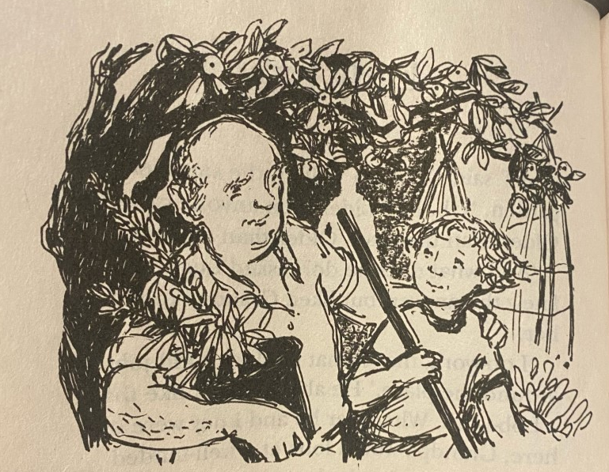
Who might these people be?
What might their relationship be?
Does it match our early thoughts based on the first lesson?

Slide 3
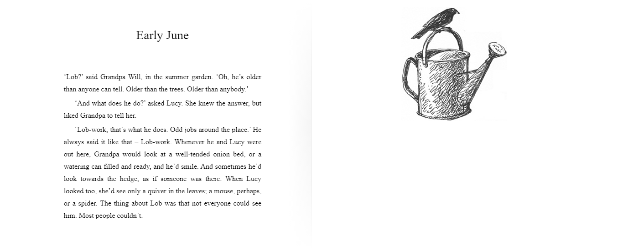

Slide 4
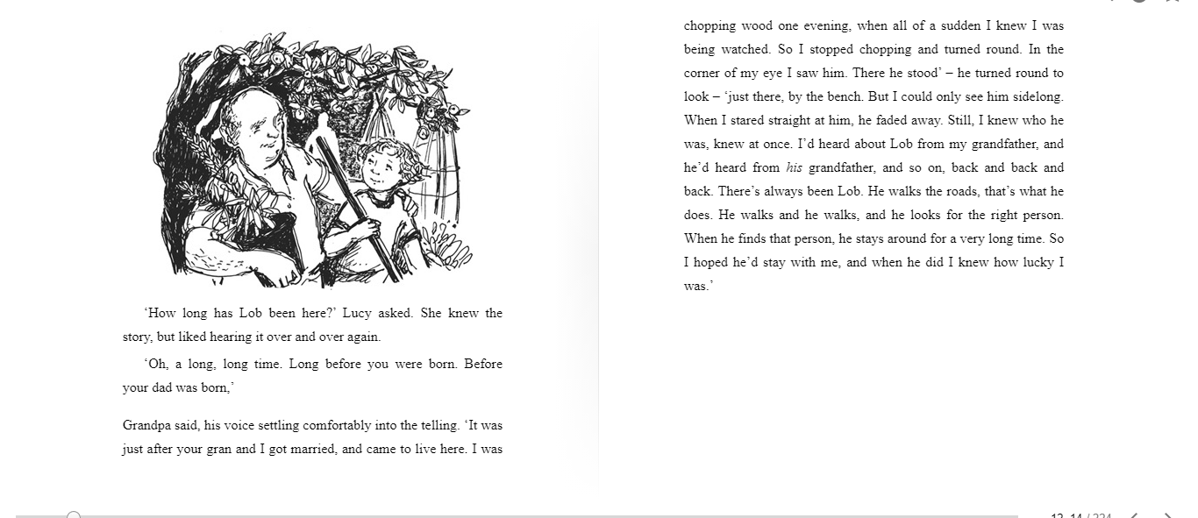

Slide 5
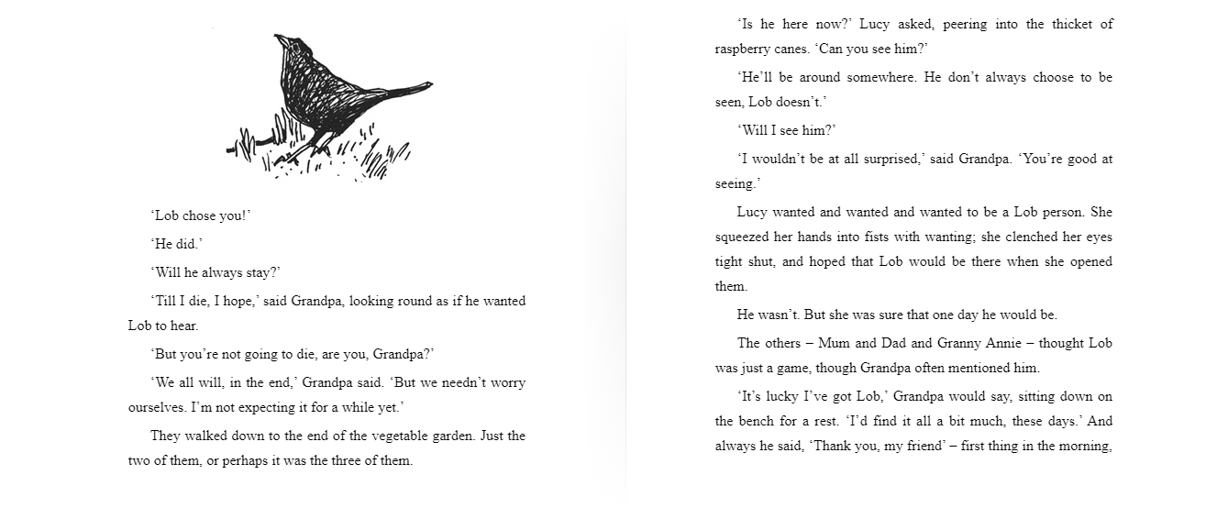

Slide 6
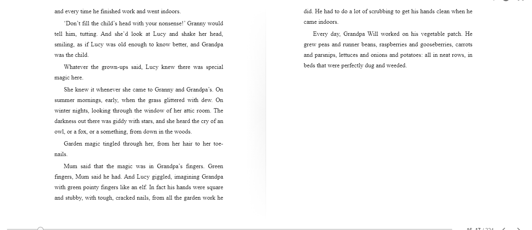

Slide 7
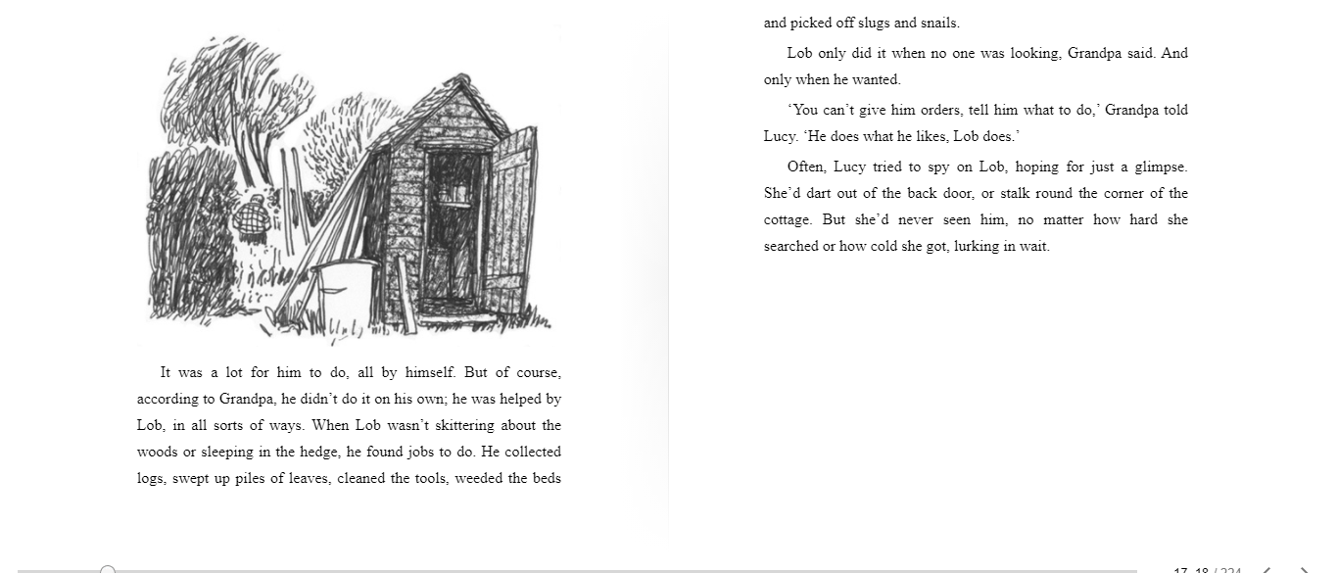

Slide 8
Book talk
What do you like about the opening of the book?
What don’t you like?
What puzzles are there, or what questions would you like to ask?
Does it remind you of anything you have read, seen or experienced before?

Slide 9
Task:
To complete ‘Tell Me Book Talk Grid’ exploring likes, dislikes, puzzles and connections/patterns.
Finally answer the following questions:
What or who do you think Lob is?
Why do you think he helps Grandpa Will?
Who provides the ‘garden magic’ - Grandpa Will’s ‘green fingers’ or Lob?
What is their initial response to the family dynamics – do they like or dislike the other family members’ reactions to Grandpa’s Lob stories? Why?

