Slide 1
Tuesday 5th January
L.O: To respond to the illustration and make predictions.

Slide 2
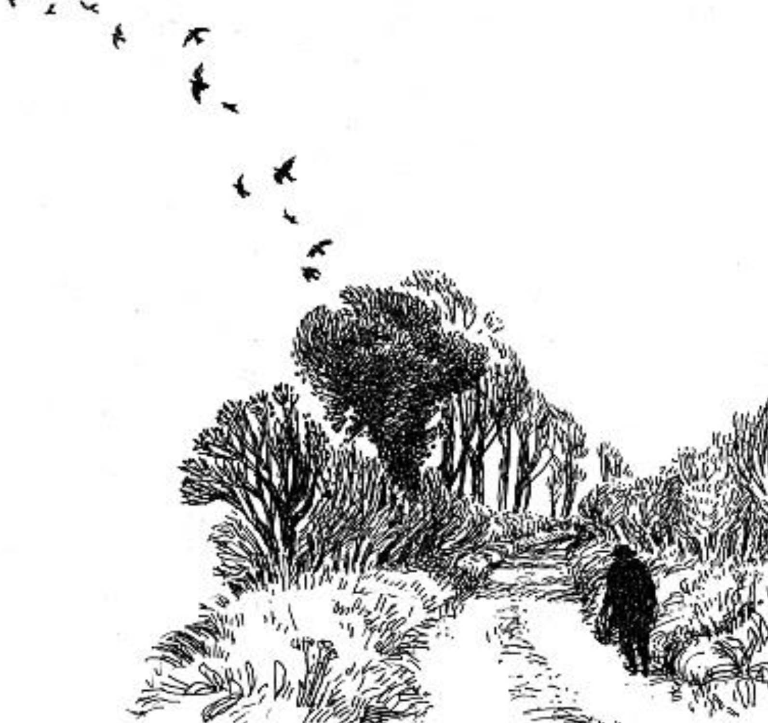
1. What do you notice in the drawing?
2. How does it make you feel?
3. Who or what could that figure be?
4. Where might they be going?
5. Where have they been?

Slide 3
6. What more does the dedication add?
7. What might the story be about?
For the man who walks the road

Slide 4
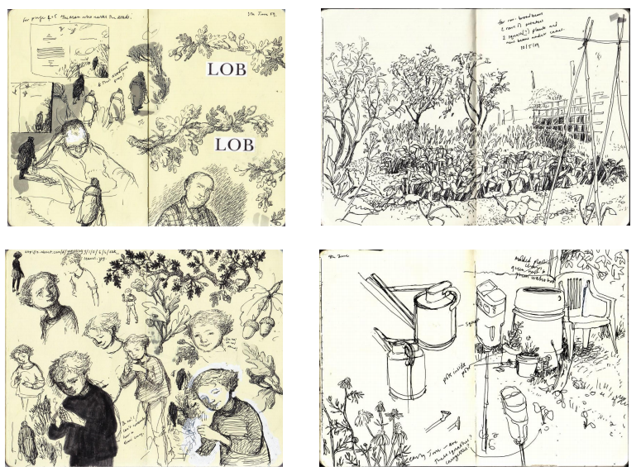
Look at the initial sketches
by the illustrator, Pam Smy.
What ideas do they give
about the story and what
questions do you have?
8. Who could our principal
characters be?
9. What might happen to
them? Why do you think
that?

