Slide 1
Spy Fox
You will need to watch the YouTube short film to complete this weeks literacy tasks.
https://www.youtube.com/watch?v=ghr1YI2nH5w

Slide 2
Monday 29th June
L.O To answer questions about the film.
1. What words would you use to describe Spy Fox?
2. What words would you use to describe Dr. Hammer?
3. Can you explain the relationship between Spy Fox and Dr. Hammer?
4. Why do you think the writer chose sardines as the evil minions?
5. Why did Dr. Hammer kidnap Lily?
6. How did he know it would entice Spy Fox?
7. What do you think happened next?
8. Explain Spy Fox’s job.
9. Did he succeed this time around and how?
Extension: Retell the story using your own words.

Slide 3
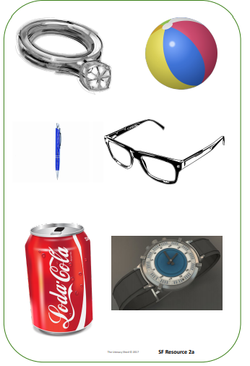
Tuesday 30th June
L.O To write an explanation of a secret weapon.
You are to imagine these objects are actually spy weapons and write a list of features and uses for it.
How could it be used?
What does it do?
Is it as straightforward as it looks, or does it have secret ways to use it?
How could Spy Fox use the object to help him in his missions?

Slide 4
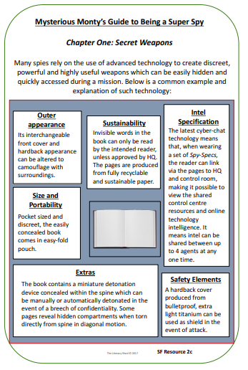
example - book

Slide 5
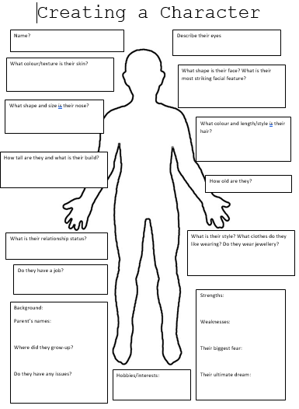
Wednesday 1st July
L.O to write a character description.
Your task is to design your own villain and come up powerful language to describe.
Once you have created your villain, you are going to write a character description.
Remember to use the language you came up with.

Slide 6
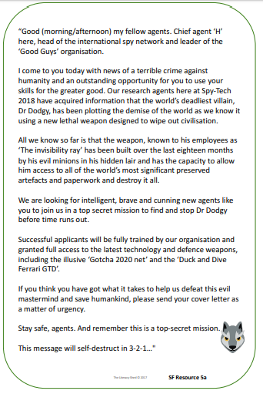

Thursday 2nd July
L.O To write a persuasive letter.
Your task is to write a persuasive letter to Chief Agent H explaining why you are the next top spy and should be given the job.
Can you remember the features of a letter?
Remember to use persuasive language.

Slide 7
Friday 3rd July
L.O write my own alternative ending to the story.
Your task is to write an alternative ending to the story using SpyFox as the hero, your villain and your weapon.
Remember to use your imagination!
Extension: To proof read using CUPS and ARMS.

