Slide 1
Next week, Years 3 and 4 will be participating in a two-week mini topic, The 1960s.
For art, we will look at the works of Andy Warhol and create our own pieces.
In addition, we will see how he influenced Roy Lichtenstein in comic strip cartoons with onomatopoeic words.
On the following slides, you will find some information about Andy Warhol.
After, there are some questions about him.
Which questions can you answer?

Slide 2
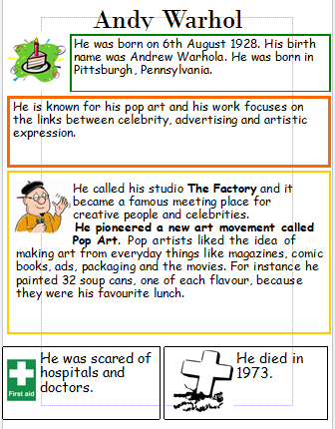

Slide 3
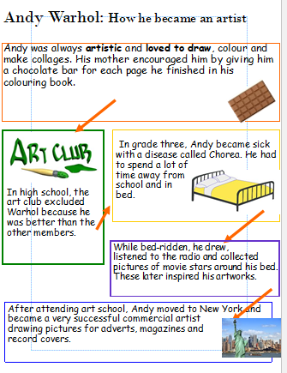

Slide 4
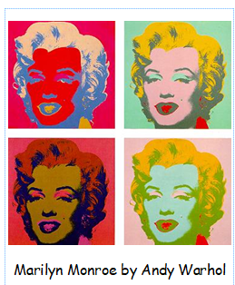

Slide 5
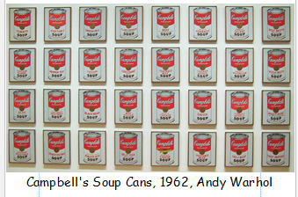
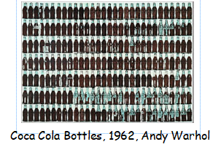

Slide 6
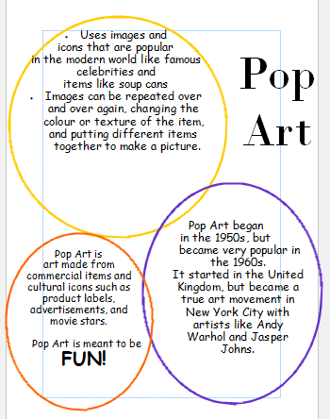


Slide 7
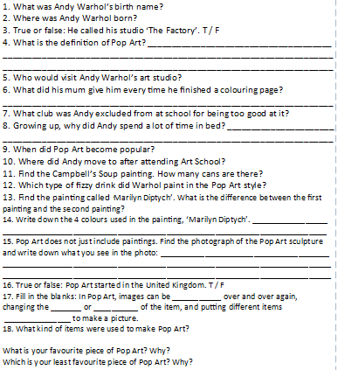

Slide 8


