Slide 1
Pop Art
Andy Warhol

Slide 2
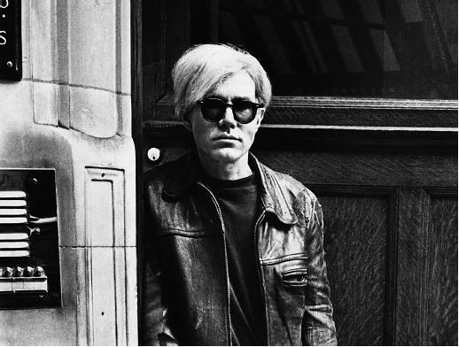
Andy Warhol was a popular American print artist. He helped create a style of art called Pop Art. Warhol printed pictures of ordinary objects. He also printed famous people.
Gr. 5

Slide 3
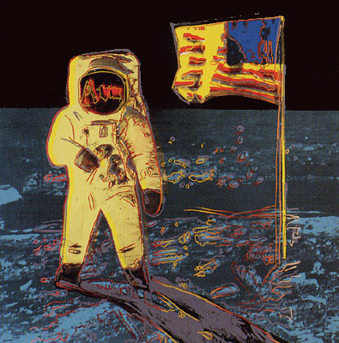
Warhol did most of his painting during the 1960’s. This was an exciting time in popular culture. New kinds of music, art, books, and movies were being created. This inspired Warhol to look at art in a new way.
Warhol’s art showed what was popular in American culture. It was different from anything that had been created before. Many people didn’t take his work seriously.
Gr. 5
Gr. 5

Slide 4
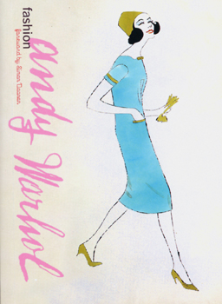
Andy began his career as a commercial artist. His drawings appeared in many fashion magazines.
Warhol made a lot of money, but he still dressed in torn, sloppy clothes. His friends called him, “Raggedy Andy.”
Gr. 5

Slide 5
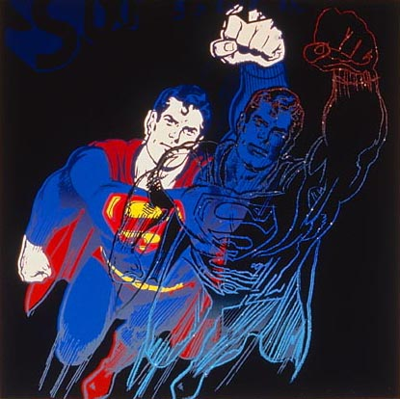
Grade 5
Many commercial artists admired Warhol’s work, but many in the fine arts did not consider him to be a real artist. This upset Warhol. He wanted people to think of him as a real artist and not just a magazine illustrator. So, Warhol began painting ordinary objects and displaying them in museums. Here he painted a character from an old cartoon.
Gr. 5

Slide 6
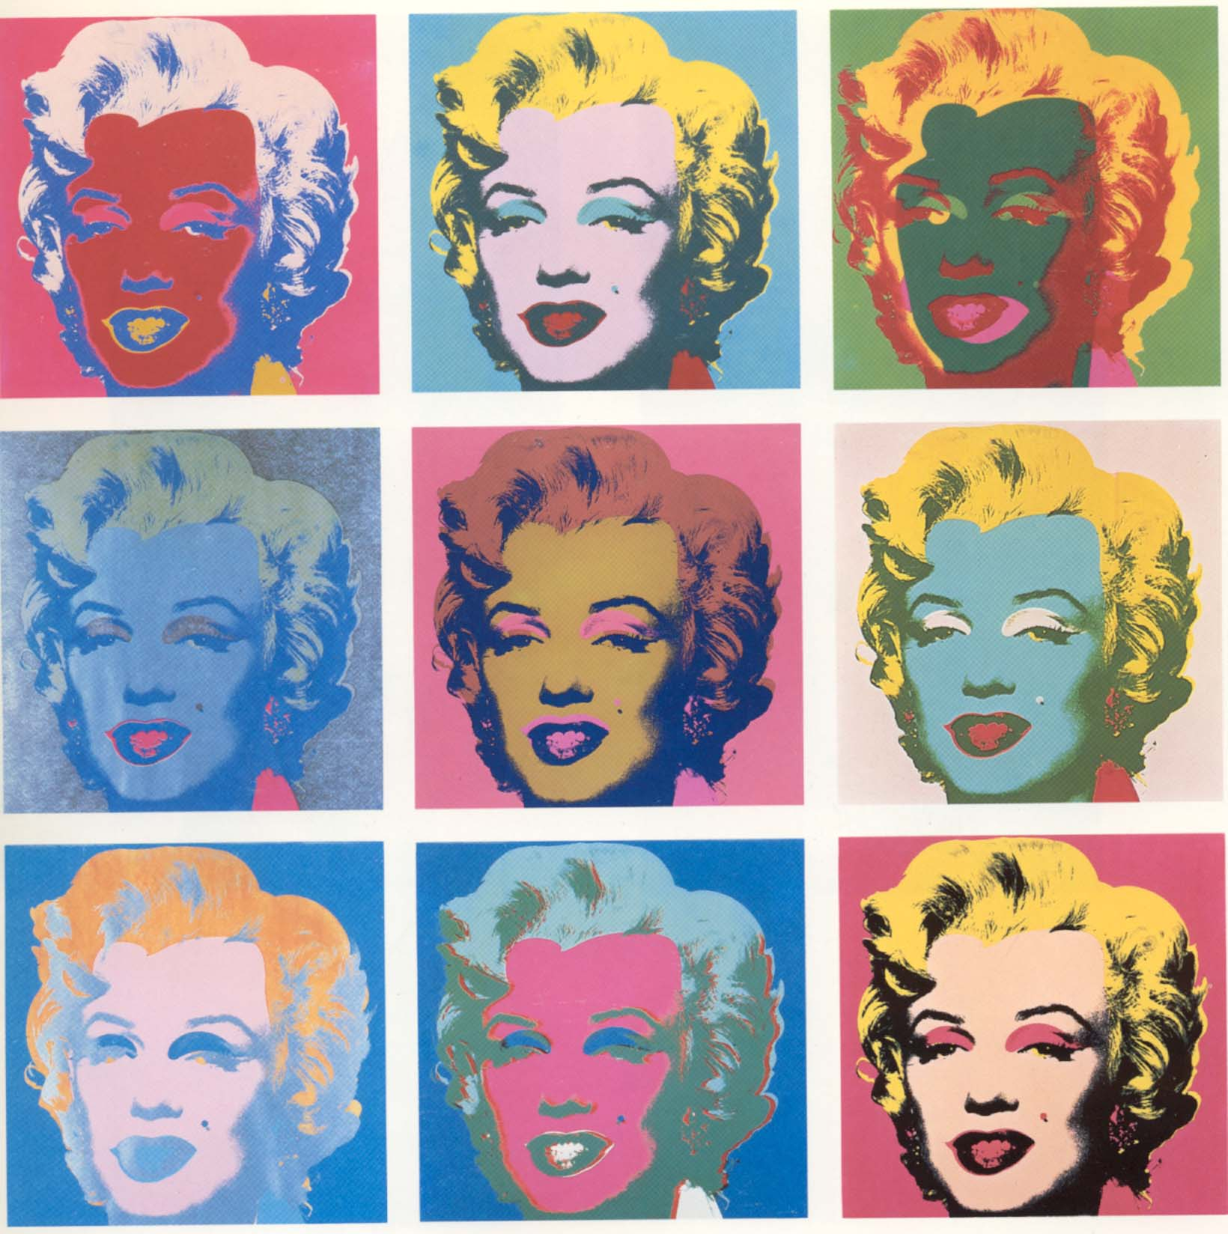
Warhol liked to paint many pictures of the same thing. In 1962 a famous actress named Marilyn Monroe died. That same year he made a series of pictures of her.
Marilyn Monroe by Andy Warhol

Slide 7
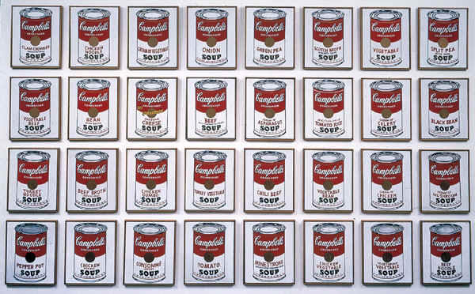
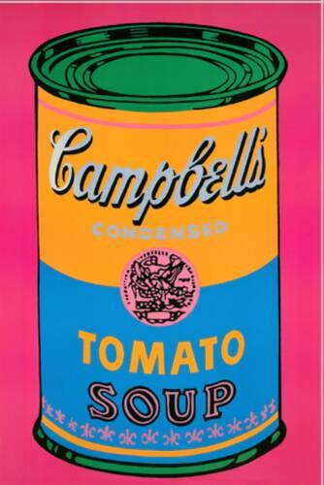
Grade 5
Later that year, a friend suggested Warhol paint something that was so common that people didn’t see it as art. Warhol loved to eat soup, so he decided to paint cans of Campbell’s Soup.
There were many flavours of Campbell’s Soup at that time. Warhol bought all the different kinds, then he spent hours copying the cans onto a white background. He painted the cans 32 times on one canvas! Each can was slightly different from the next.
Gr. 5

Slide 8
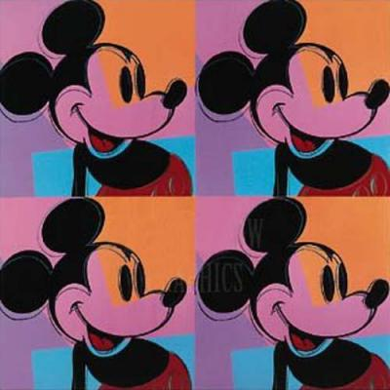
This style of art was called Pop Art because the subjects for his work came from popular culture.
Mickey Mouse by Andy Warhol

Slide 9
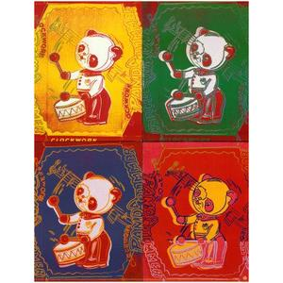
Four pandas by Andy Warhol

Slide 10
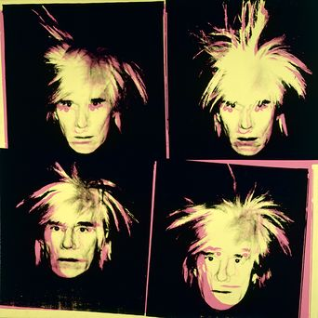
Warhol was fascinated by famous faces and carefully created a celebrity image of his own, wearing a wild white wig to make sure he stood out from other people.
Self Portrait by Andy Warhol

Slide 11
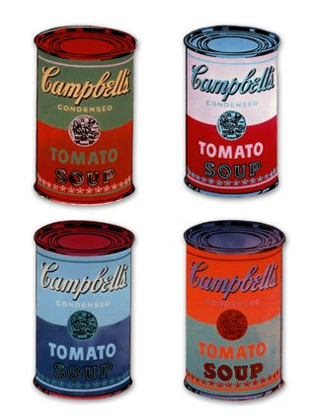
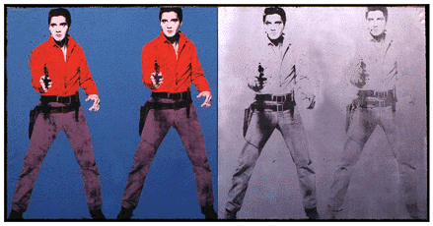
Grade 5
Pop Art Legend
Today, Andy Warhol is remembered as one of the most important American artists. He helped make Pop Art important and popular around the world. For the first time, people realized that cartoons, movie stars, and soup cans could be art.
Gr. 5

Slide 12
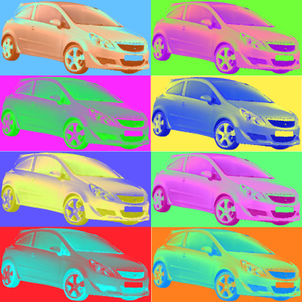
Poster in the style of Andy Warhol

Slide 13
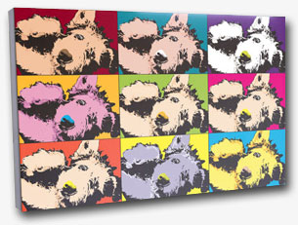
Poster in the style of Andy Warhol

Slide 14
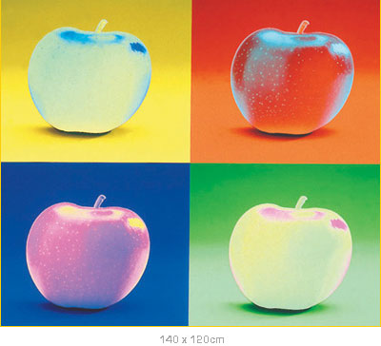
Poster in the style of Andy Warhol

Slide 15
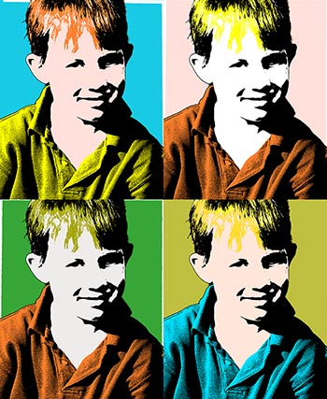
Poster in the style of Andy Warhol

Slide 16
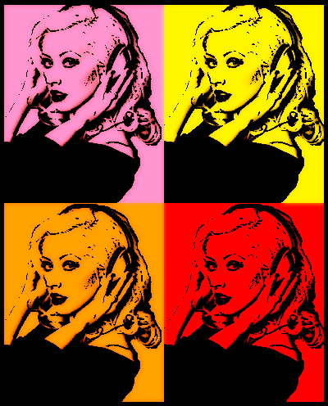
Poster in the style of Andy Warhol

Slide 17
Create your own NHS inspired ‘Pop Art’ …
NHS
NHS
NHS
NHS

