Slide 1
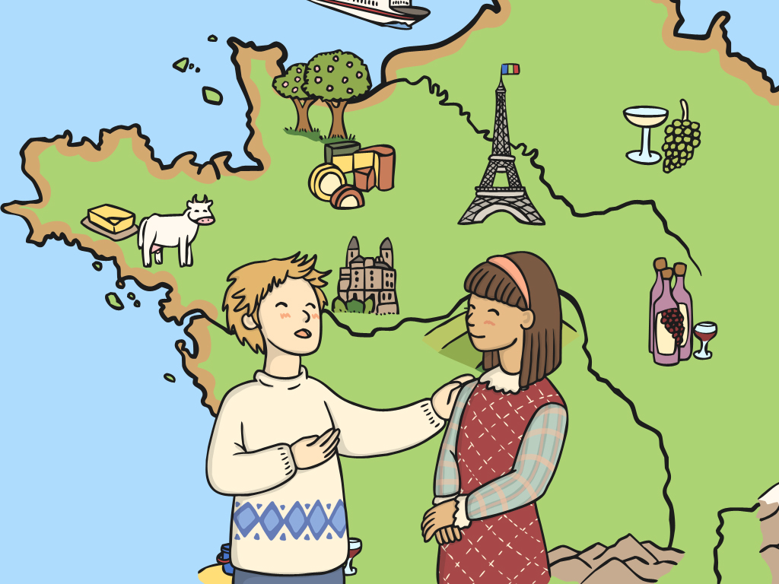

Où habites-tu?
(Where Do You Live?)

Slide 2
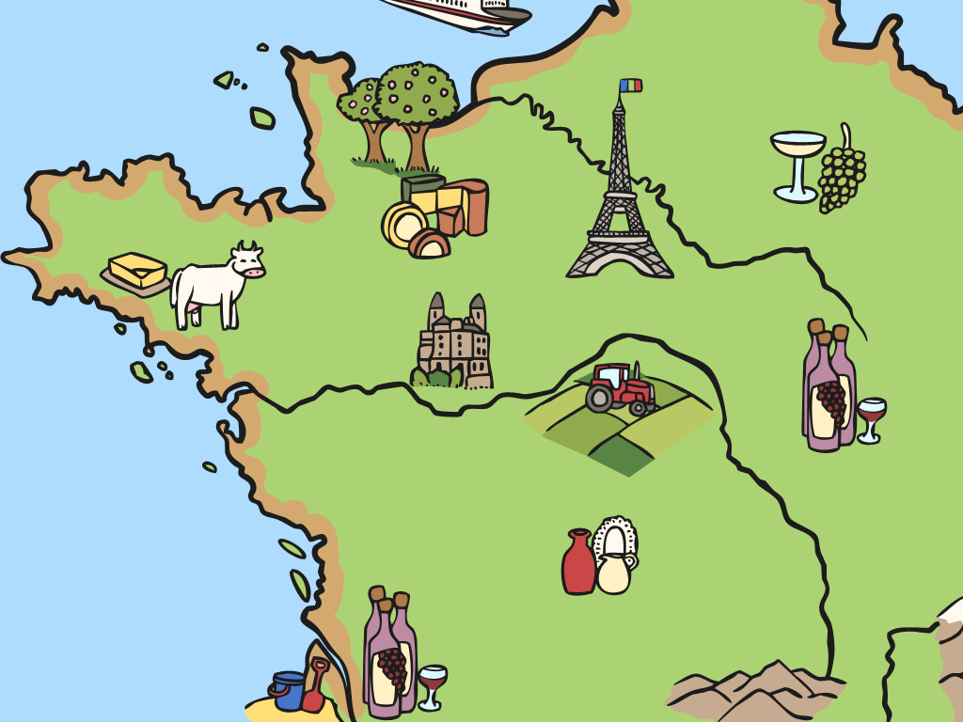
Aim
I can listen carefully and pronounce unfamiliar words with increasing accuracy.
Success Criteria
I can listen to and repeat names of some French towns and cities.
I can compare and contrast French towns with places I know.
I can ask and answer questions to find out where someone lives.

Slide 3


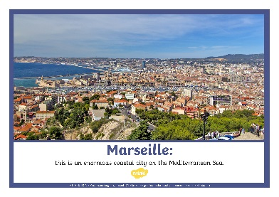
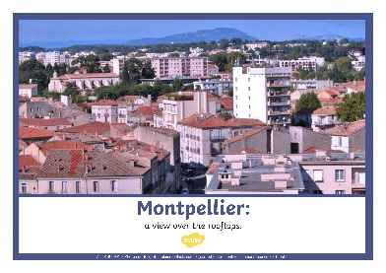
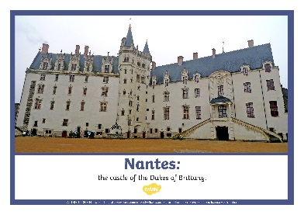
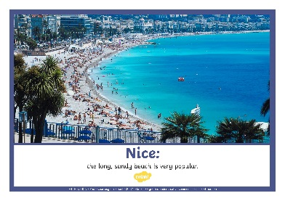
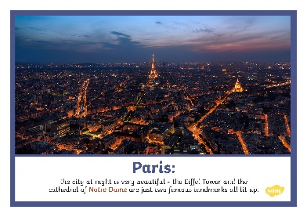

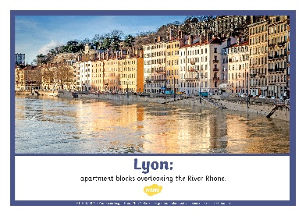
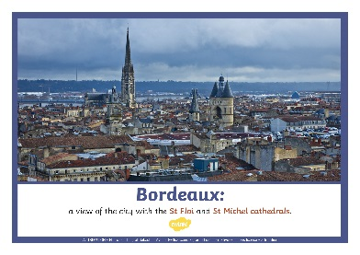
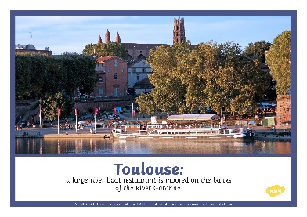
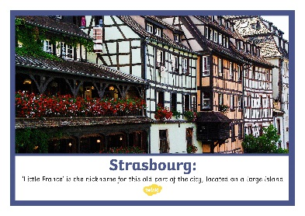
What’s It Like In…?
Click play buttons throughout to hear phrases and words.
Talk to your partner about what you see in the pictures of these French Cities.
Compare and contrast with a town in our country.
Next

Slide 4


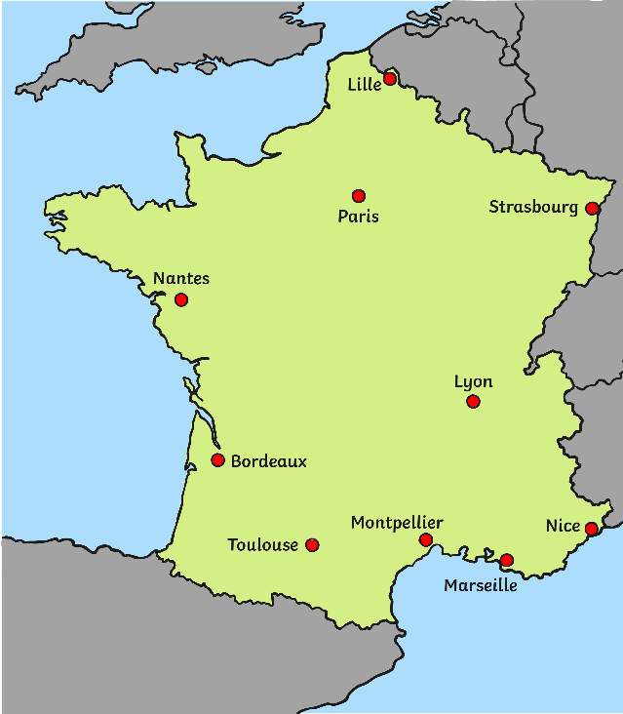

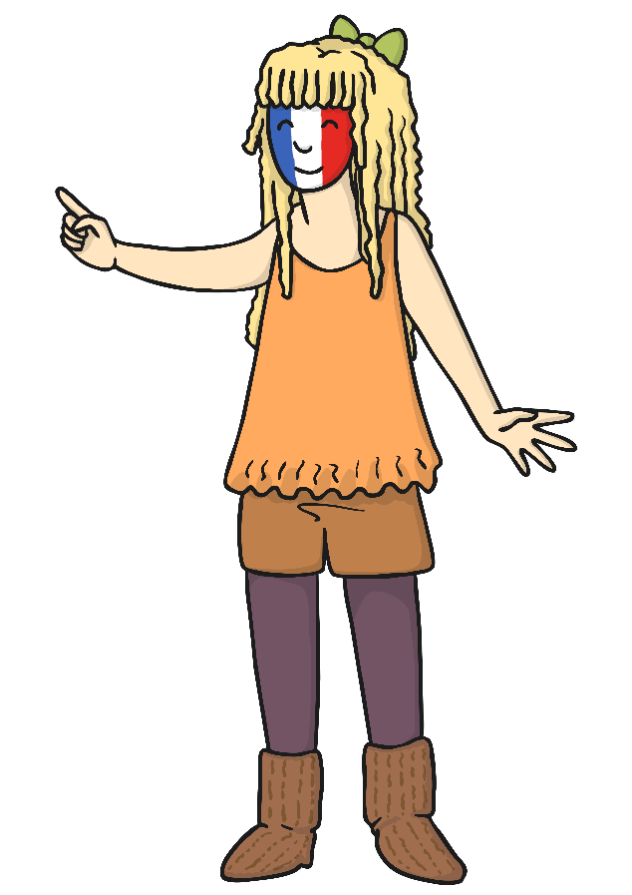
C’est où ça?
(Where’s That?)
Voici Paris!
Back

Slide 5
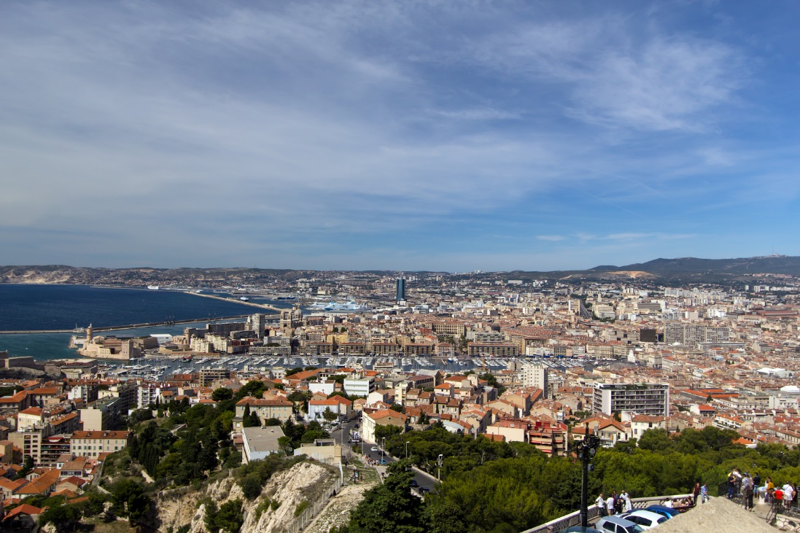
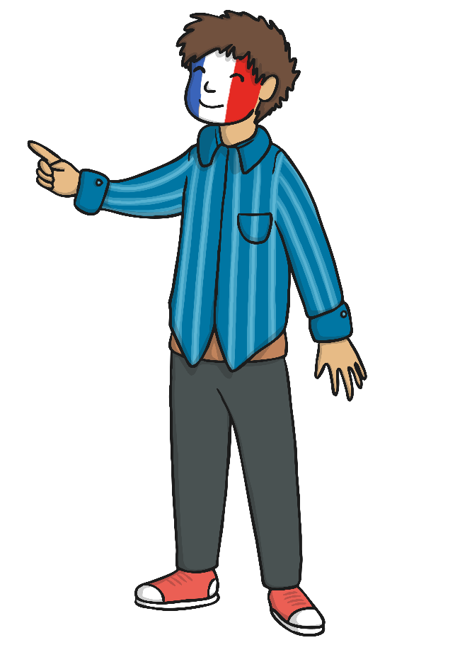
C’est où ça?
(Where’s That?)
Voici Marseille!
Back
ATTRIBUTION - Photo courtesy of gumbeat (@flickr.com) - granted under creative commons licence - attribution

Slide 6
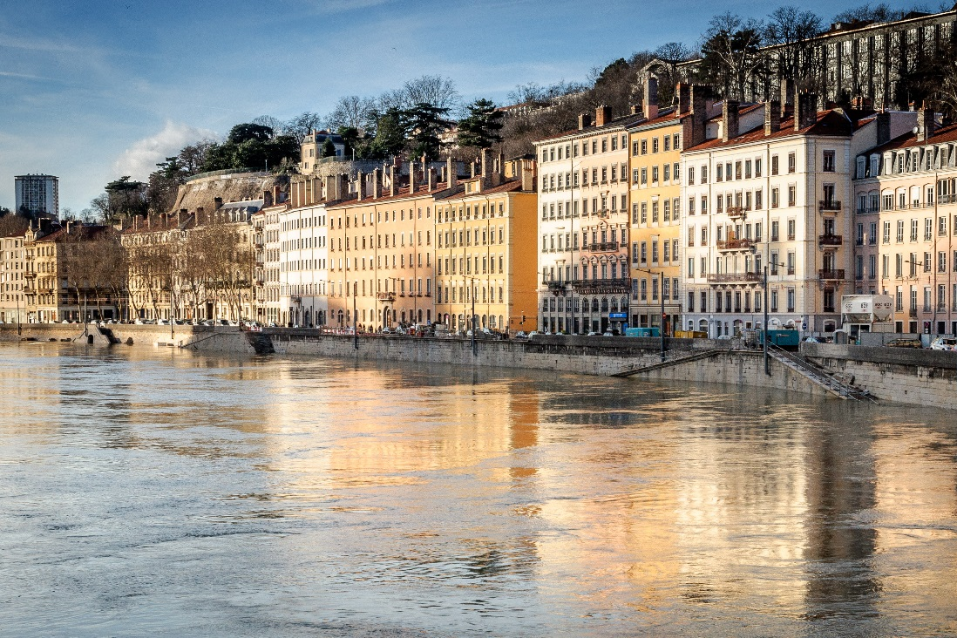
C’est où ça?
(Where’s That?)
Voici Lyon!
Back
ATTRIBUTION - Photo courtesy of Fred_78 (@flickr.com) - granted under creative commons licence - attribution

Slide 7
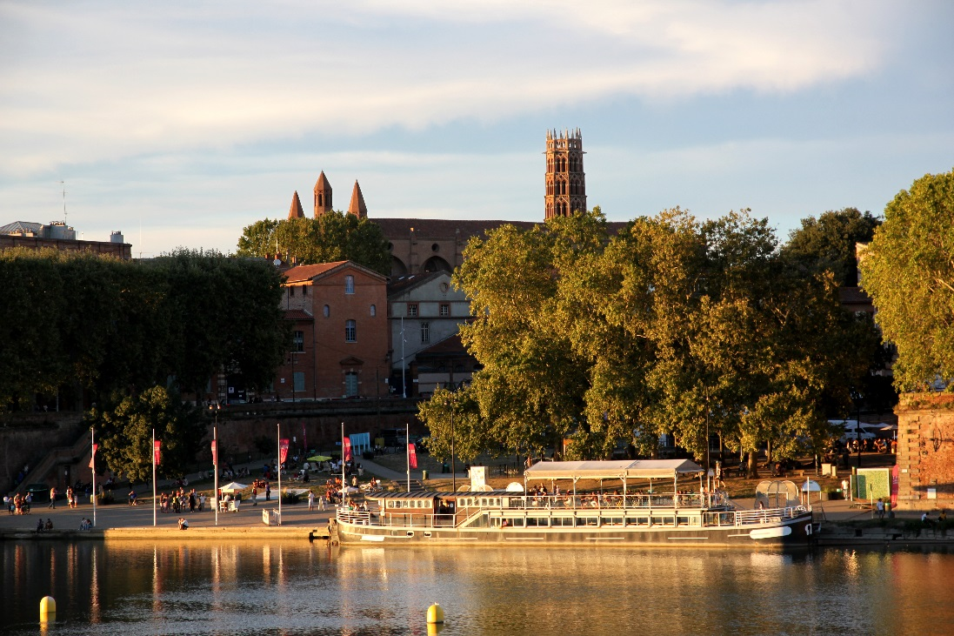
C’est où ça?
(Where’s That?)
Voici Toulouse!
Back
ATTRIBUTION - Photo courtesy of Pistolero31 (@flickr.com) - granted under creative commons licence - attribution

Slide 8
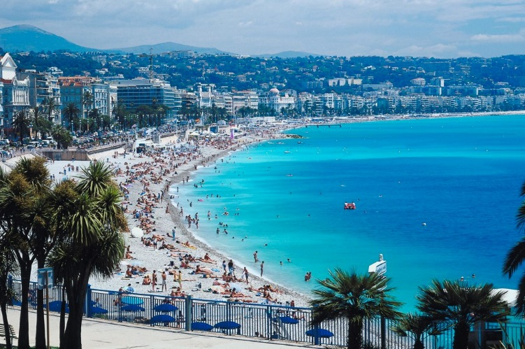
C’est où ça?
(Where’s That?)
Voici Nice!
Back
ATTRIBUTION - Photo courtesy of nathanh100 (@flickr.com) - granted under creative commons licence - attribution

Slide 9
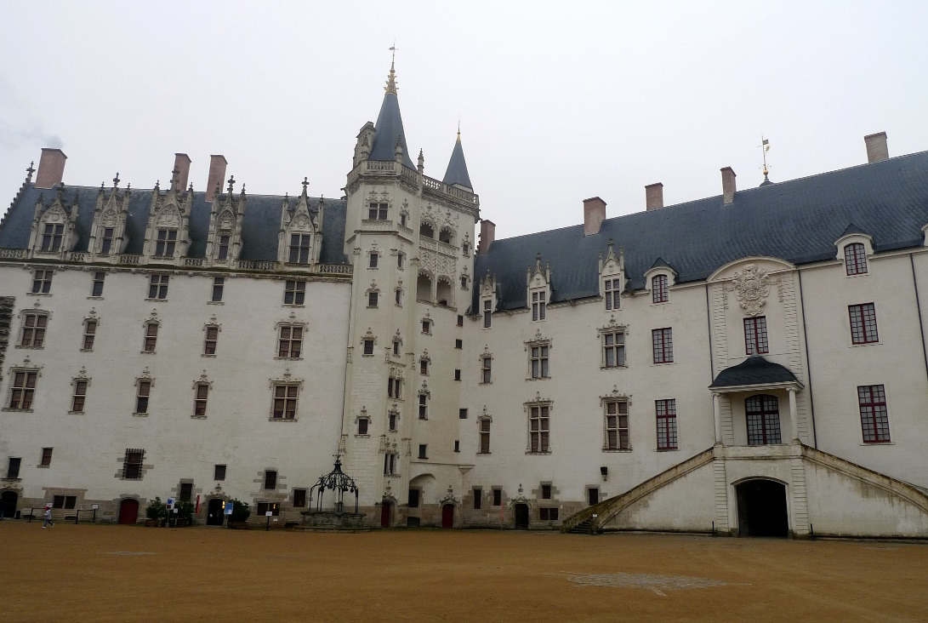
C’est où ça?
(Where’s That?)
Voici Nantes!
Back
ATTRIBUTION - Photo courtesy of jean-louis zimmerman (@flickr.com) - granted under creative commons licence - attribution

Slide 10
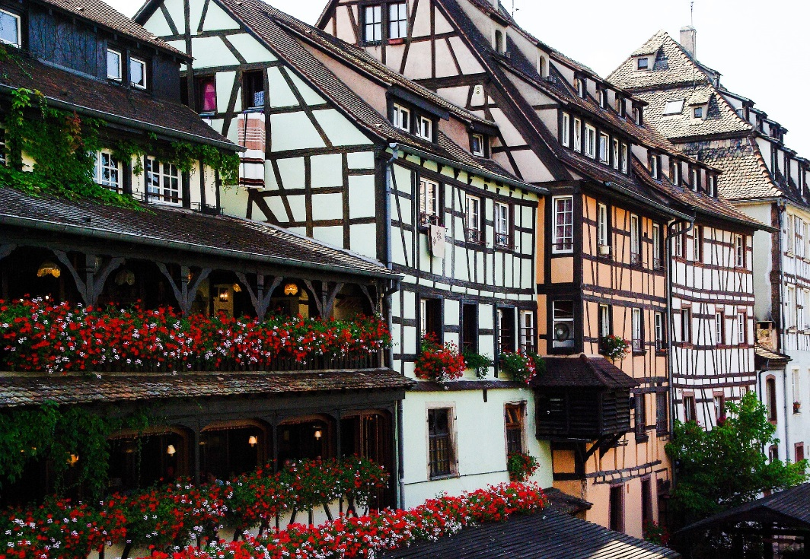
C’est où ça?
(Where’s That?)
Voici Strasbourg!
Back

Slide 11
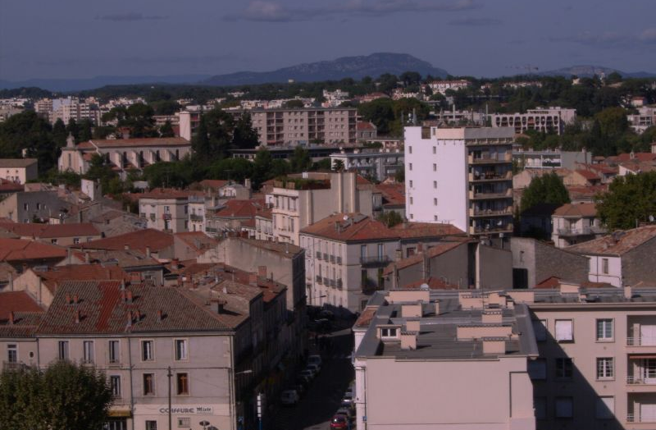
C’est où ça?
(Where’s That?)
Voici Montpellier!
Back
ATTRIBUTION - Photo courtesy of girolame (@flickr.com) - granted under creative commons licence - attribution

Slide 12
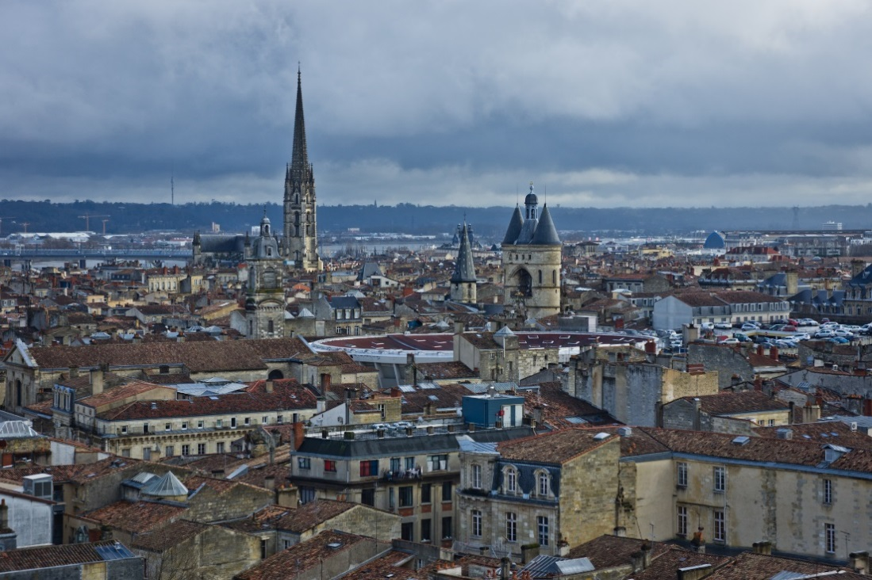
C’est où ça?
(Where’s That?)
Voici Bordeaux!
Back
ATTRIBUTION - Photo courtesy of Sebastien Avenet (@flickr.com) - granted under creative commons licence - attribution

Slide 13
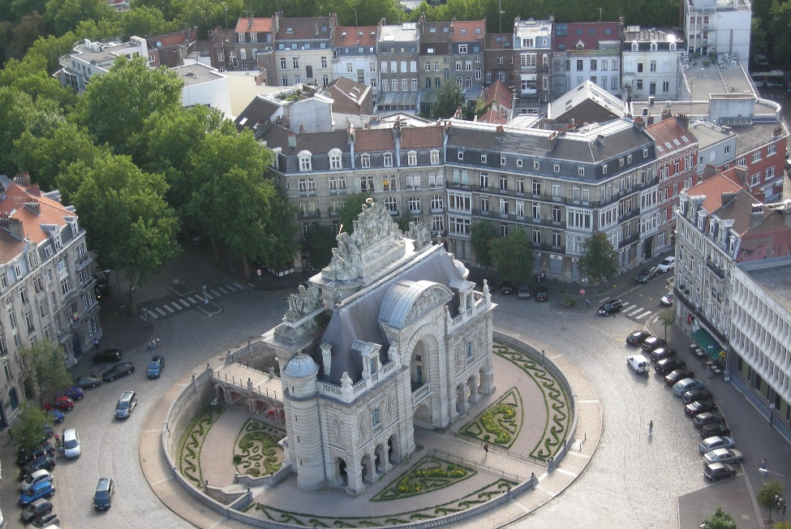
C’est où ça?
(Where’s That?)
Voici Lille!
Back
ATTRIBUTION - Photo courtesy of couscouschocolat (@flickr.com) - granted under creative commons licence - attribution

Slide 14





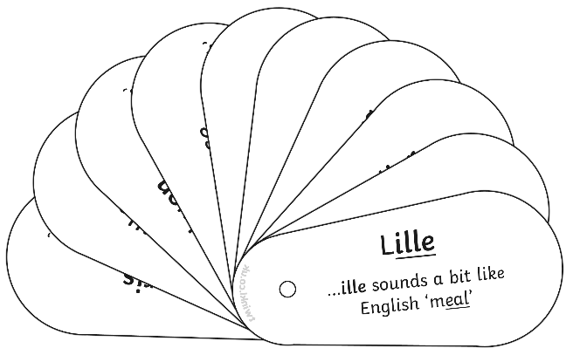
Ecoutez bien!
(Listen up!)
Paris
Marseille
Lyon
Toulouse
Nice
Nantes
Strasbourg
Montpellier
Bordeaux
Lille
Do you hear any familiar sound patterns within the city names?

Slide 15
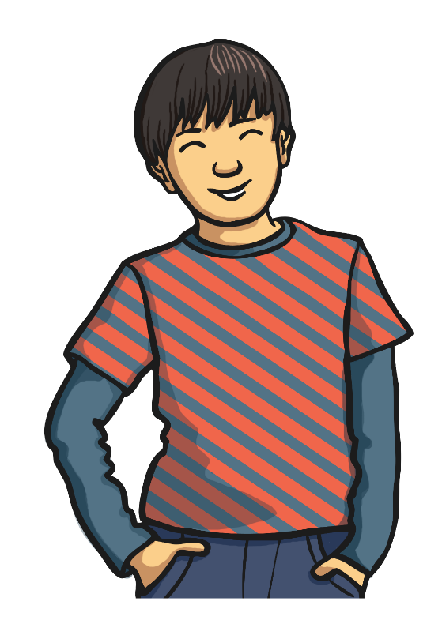
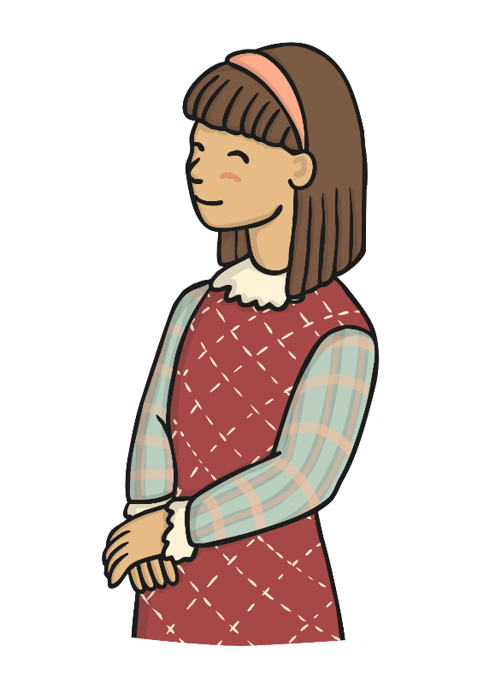
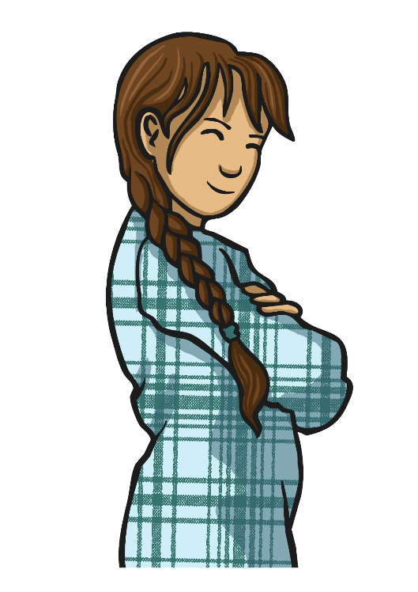
Où habites-tu?
(Where do you live?)
Où habites tu?
Moi j’habite à Toulouse.
J’habite
à Paris.
Et moi, j’habite
à Nantes.
What do you think they are saying?
How do you know?

Slide 16
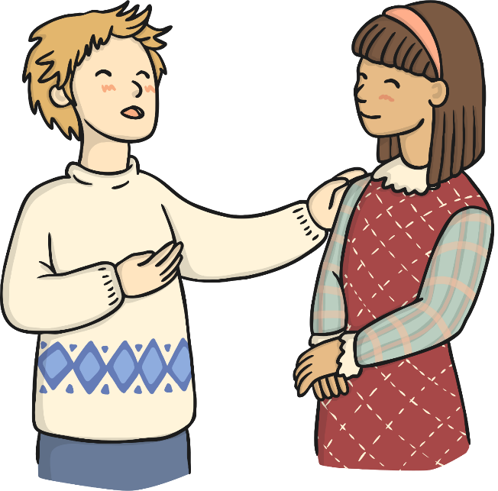

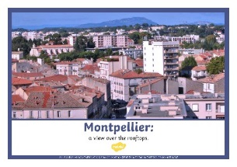
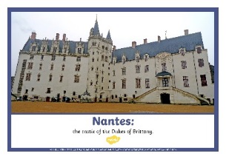


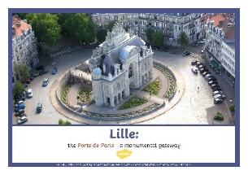
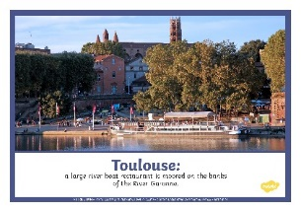
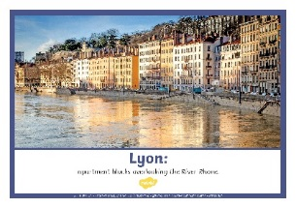
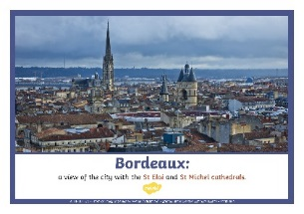
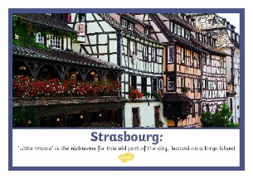
J’habite à …
(I live in…)
J’habite à
____.
Où habites tu?

Slide 17
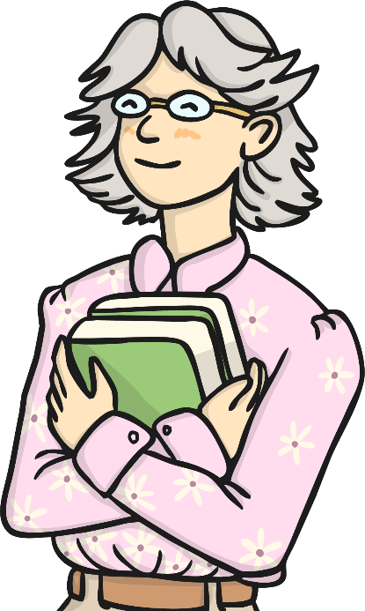
Review
Can you tell the class something about what you’ve noticed in your French city picture?
J’habite à
____.

Slide 18

Aim
I can listen carefully and pronounce unfamiliar words with increasing accuracy.
Success Criteria
I can listen to and repeat names of some French towns and cities.
I can compare and contrast French towns with places I know.
I can ask and answer questions to find out where someone lives.

Slide 19


