Slide 1
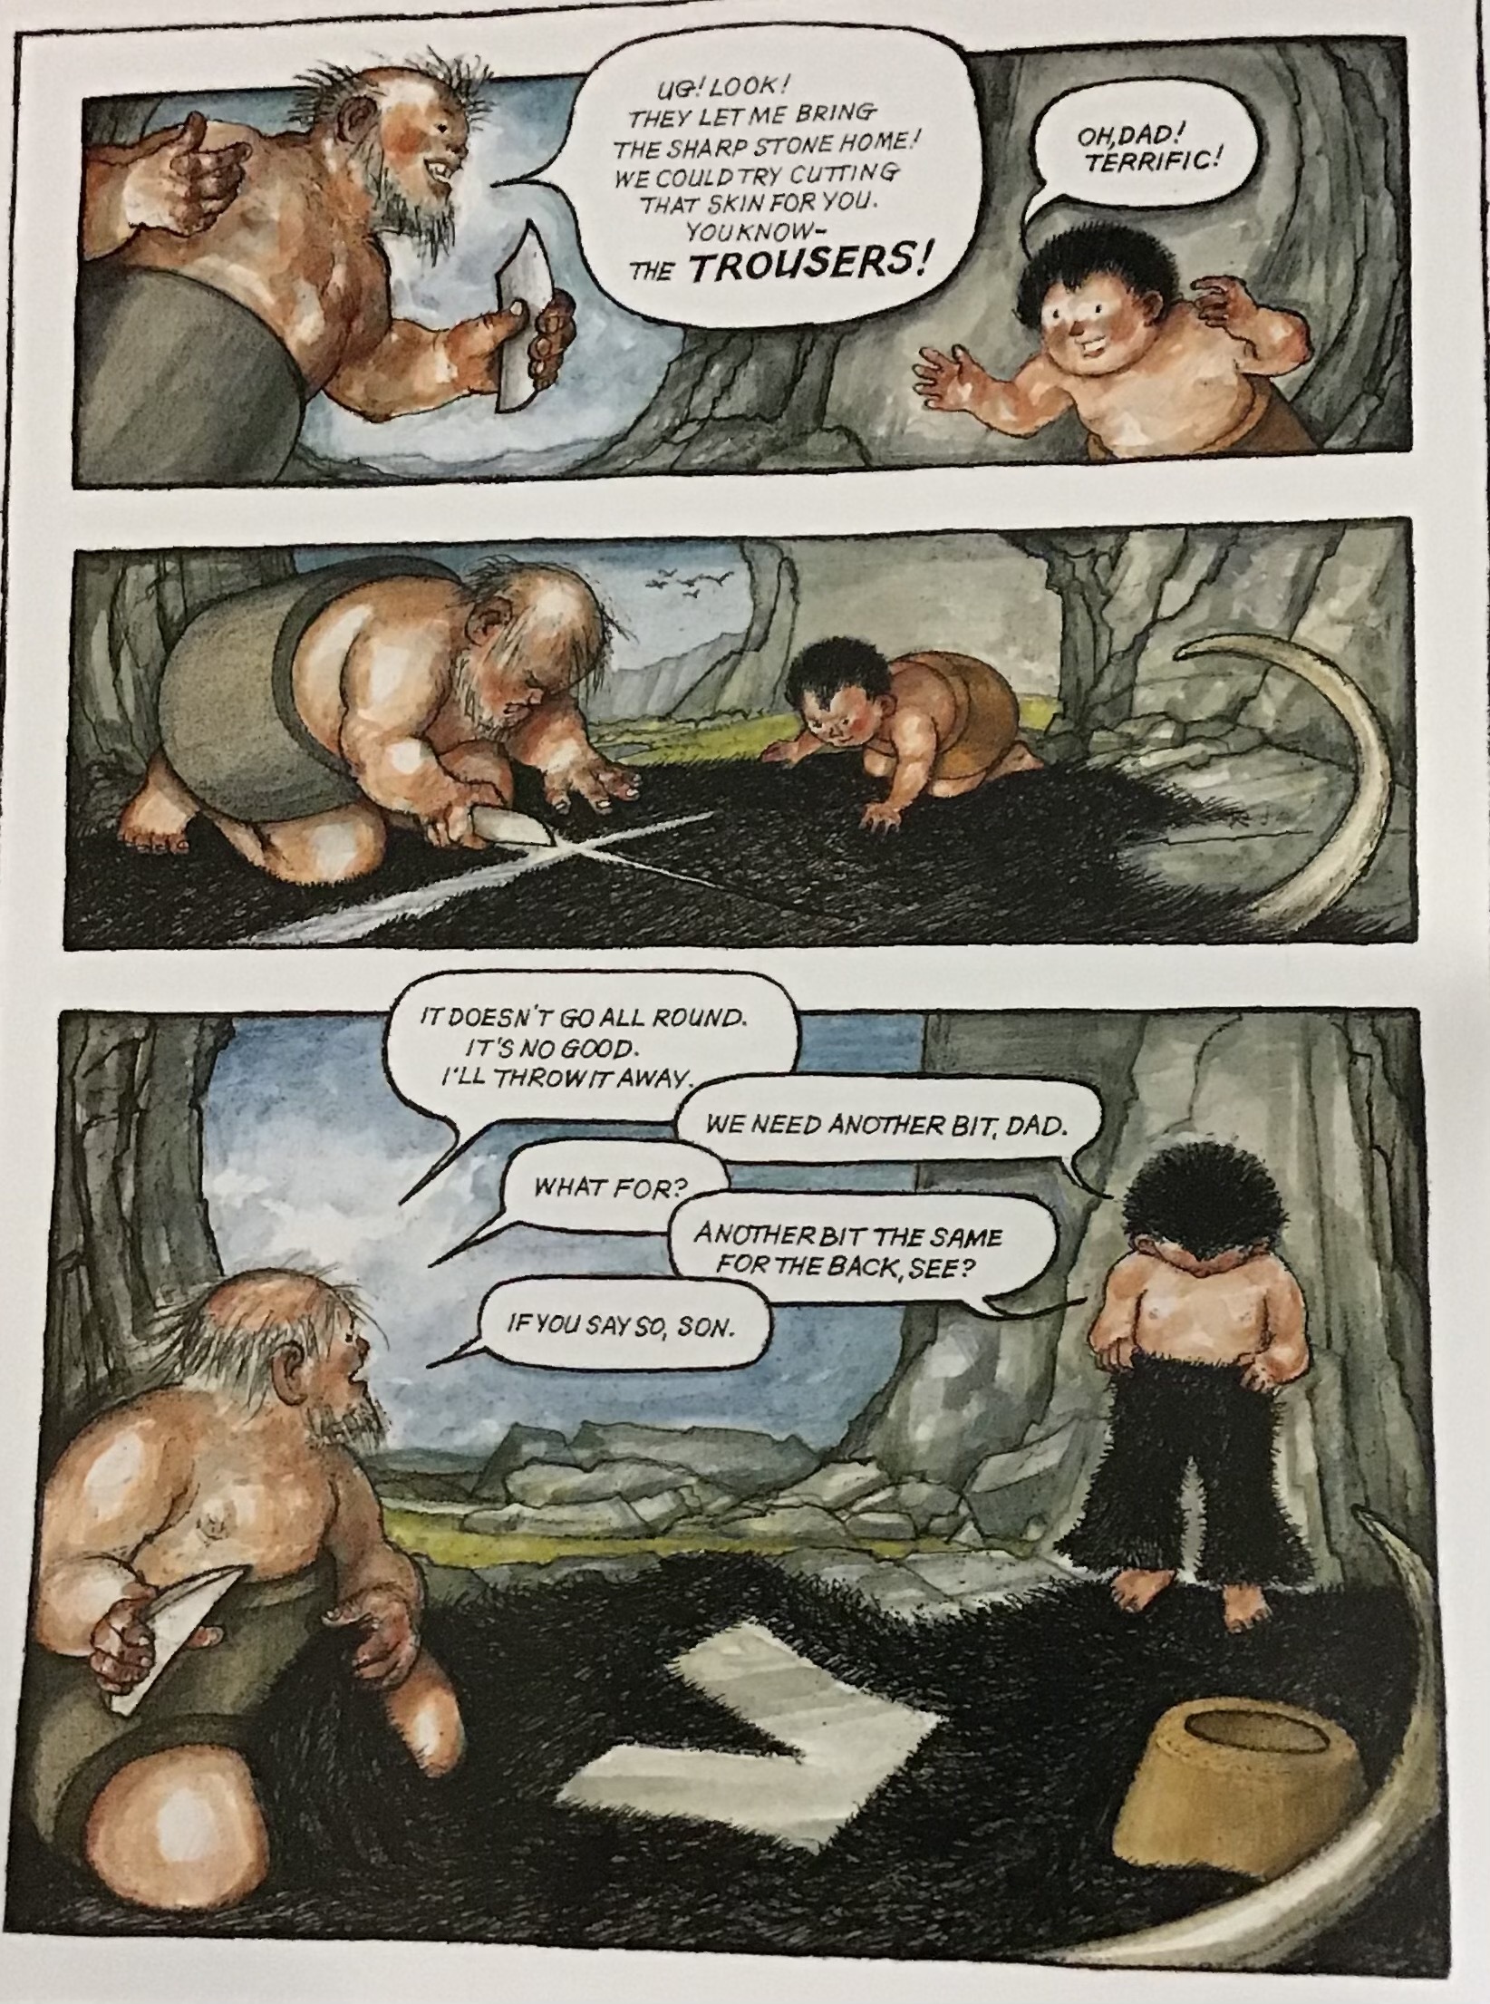

Slide 2
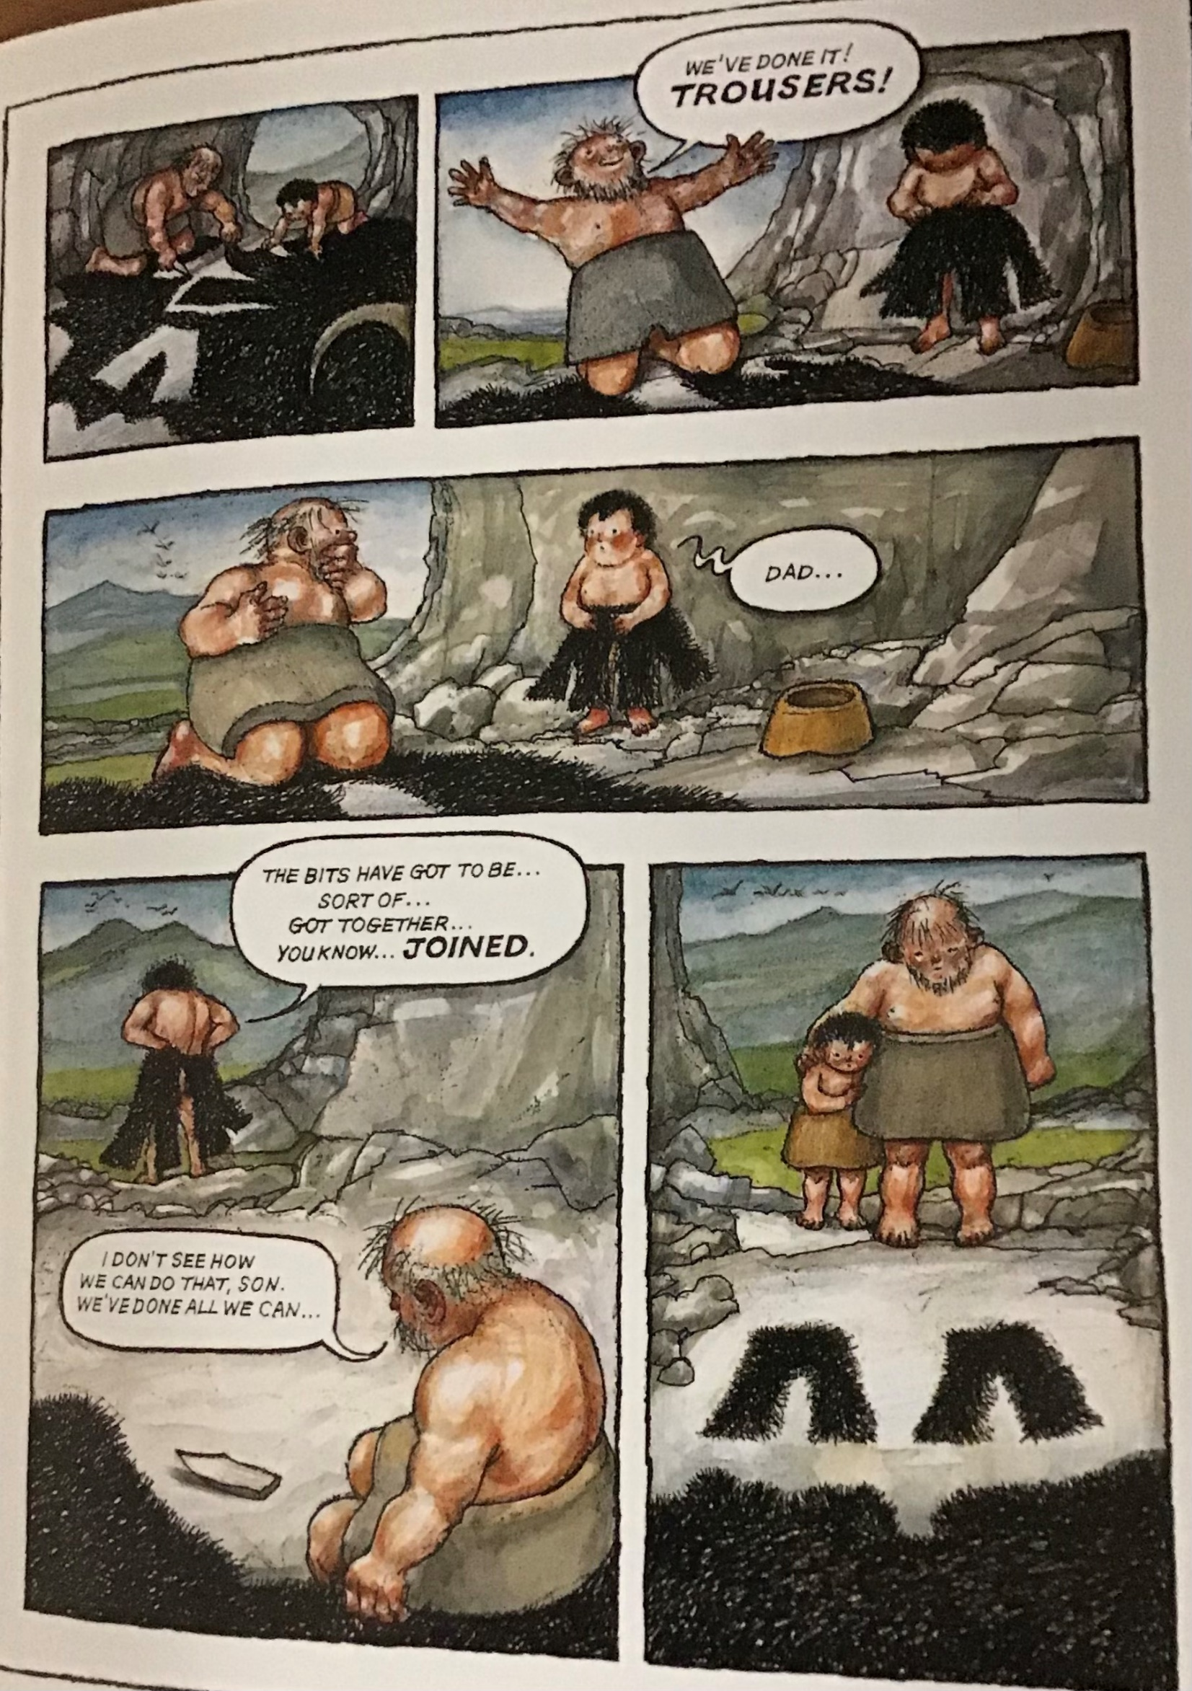

Slide 3
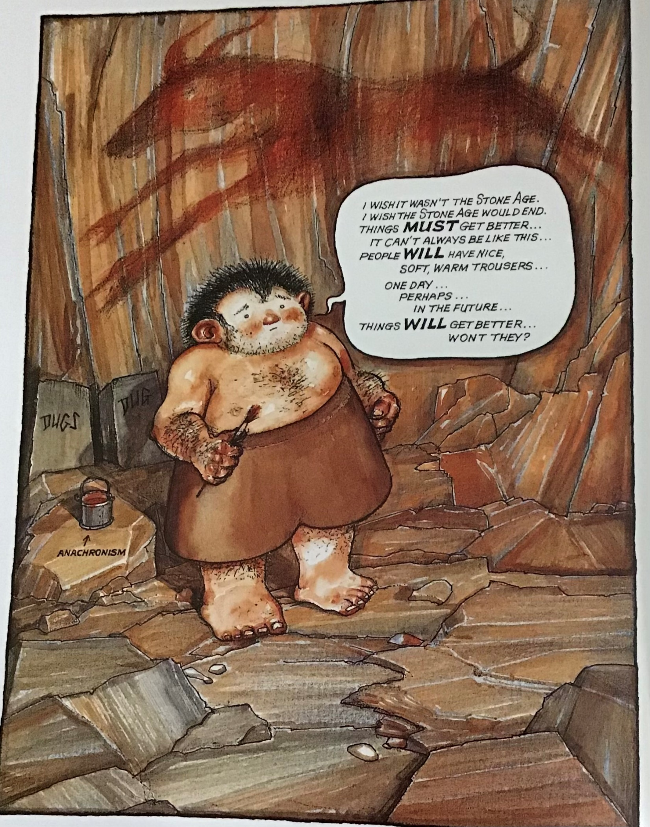

Slide 4
S
T
O
N
E
A
G
E
Acrostic poems
I
N
V
E
N
T
I
O
N
S

Slide 5
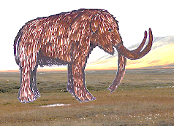
SHAPE POEM
(woolly mammoth)

Slide 6
On the grassy hill
Where the mammoths stay still
And the fishes all go SPLASH!
There’s a cave on a rock
Where the cavemen flock
And firelights flicker and FLASH!
Not last year, but thousands of years ago
Life was not the same, you know
Paintings on the walls of caves
Tell us people were really brave
They hunted meat with spear in hand
They gathered berries from the land
They wore clothes of skin and fur
And now you know just how things were.

Slide 7
Imagine going back in time
Then back a little more
When people gathered forest fruits
And hunters caught wild boar.
This time is marked by artistry
And paintings deep in caves
Of sorcerers and animals
To make the hunters brave.
Perhaps you stalk through woodland
Hunting in the Mesolithic
Bow and arrow in your hand
You’re feeling quite terrific.
You learn your skills from elders
Who teach you to catch deer
Then back to camp for feasting
Full bellies, raise a cheer!

Slide 8
When man was created
It seemed complicated
With our growing brains
And problems hard to explain
We didn’t use pens and whiteboards
We found a different way to record
Our amazing works of art
They’re really worlds apart
Covered in animal hide
From that sabre tooth that just died
I’m more fierce than I appeared
If you knew me I should have been feared
I look so terrific
I am Palaeolithic!

