Slide 1
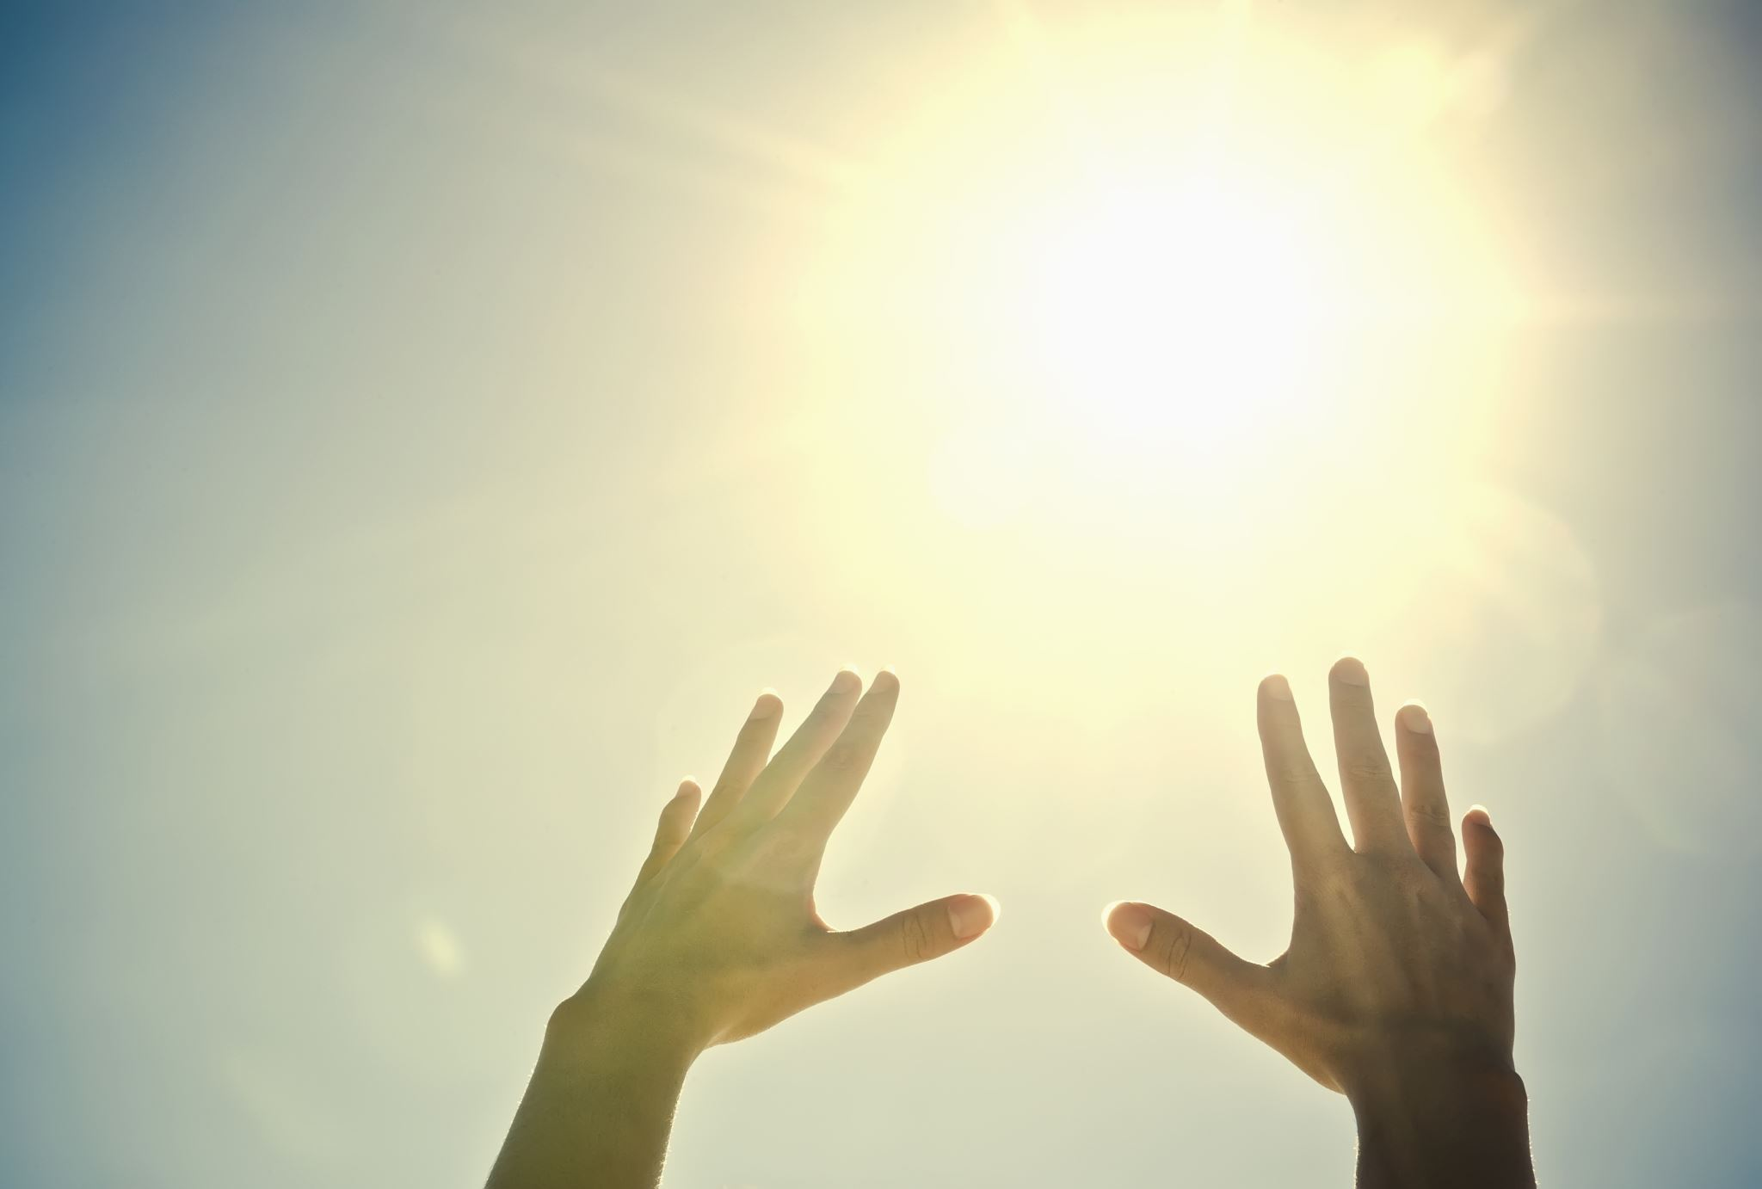

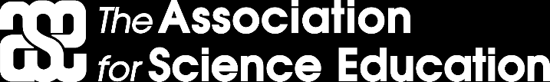
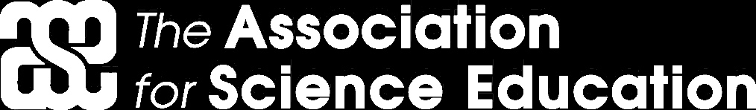
Light
For parents and carers
Thank you for supporting your child’s learning in science.
Before the session:
Please read slide 2 so you know what your child learning and what you need to get ready.
As an alternative to lined paper, slide 5 may be printed for your child to record on.
During the session:
Share the learning intentions on slide 2.
Support your child with the main activities on slides 3 & 4, as needed.
Slide 6 is a further, optional activity.
Slide 7 has a glossary of key terms.
Reviewing with your child:
Slide 8 gives an idea of what your child may produce.
Exploring materials and their properties to make sunglasses
Year 3 / Key Stage 2
Age 7-8

Slide 2


Light
Logo for section to sit inside roundel
Exploring suitable materials for making sunglasses
Key Learning
The light from the sun can damage our eyes and therefore we should not look directly at the sun.
We can protect our eyes by wearing sunglasses or sunhats in bright light.
Activities (pages 3-5): approx. 30-40 mins
Use lined paper, ruler and pencil.
Alternatively, print page 5 as a worksheet.
I can…
explore suitable materials for making sunglasses.
2

Slide 3
Explore, review, think, talk….
Logo for section to sit inside roundel
What do you already know about… sunglasses?
(5 minutes)
Talk or think about why we wear sunglasses?
How do they help us when it’s sunny?
What might happen if we didn’t wear them?
Sunglasses protect our eyes from strong sunlight.
Sunglasses block some of the sunlight from entering our eyes, which makes it easier for us to see.
3

Slide 4
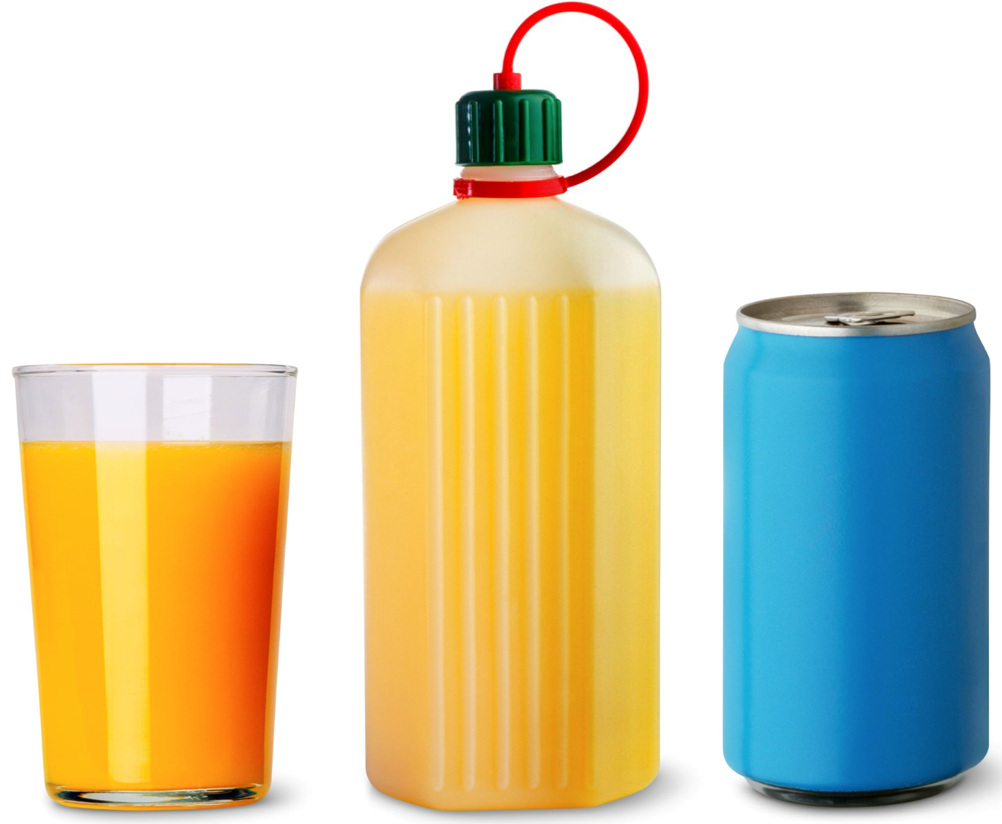
Watch, read, listen…
Logo for section to sit inside roundel
Opaque, translucent, transparent materials
(10 minutes)
Watch this clip about people watching a solar eclipse (England, 1999):
https://www.youtube.com/watch?v=18xY0XygVGc
Why do you think they are wearing special glasses?
Read this article from DK:
https://www.dkfindout.com/uk/science/light/transparent-and-opaque-objects/
4

Slide 5
Instructions for Activity
Give the children a range of materials and ask them to consider which would be most suitable for making a pair of sunglasses.
Use a torch as a light source and record your observations and notes if each material is suitable or not for using as sunglasses.
Learning outcome: I can explore suitable materials for making sunglasses.
Material | Suitability? | Notes
Which of these materials would make good sunglasses? Why?
5

Slide 6
Glossary of terms
bright: If an object is bright it gives out or reflects much light.
dark (scientific): Dark is the absence of light.
dark (everyday): very little amount of light.
dull: If an object is dull it is not shiny or bright.
light: Light is the form of energy that makes it possible for eyes to see.
material: Anything used for building or making something else.
shiny: Reflecting or glowing with light.
surface: The outside limit or top layer of something.
6

Slide 7
Possible learning outcome for reviewing your work: I can explore the need for light to see things
Material | Suitability? | Notes
Tin foil | Not suitable | It is not suitable because we cannot see anything – it is opaque.
Coloured paper | Not suitable | It is not suitable because it’s opaque.
Cling film | Not suitable | Cling film is not suitable because it lets all of the light through. It’s transparent.
Tissue | Suitable | Tissue is suitable because it lets some of the light through and is translucent.
Bubble wrap | Suitable | It is suitable because it’s translucent.
Which of these materials would make good sunglasses? Why? I think the bubble wrap would be the best. You can see more through it. The tissue is hard to see through and might make you bump into things
7

