Slide 1
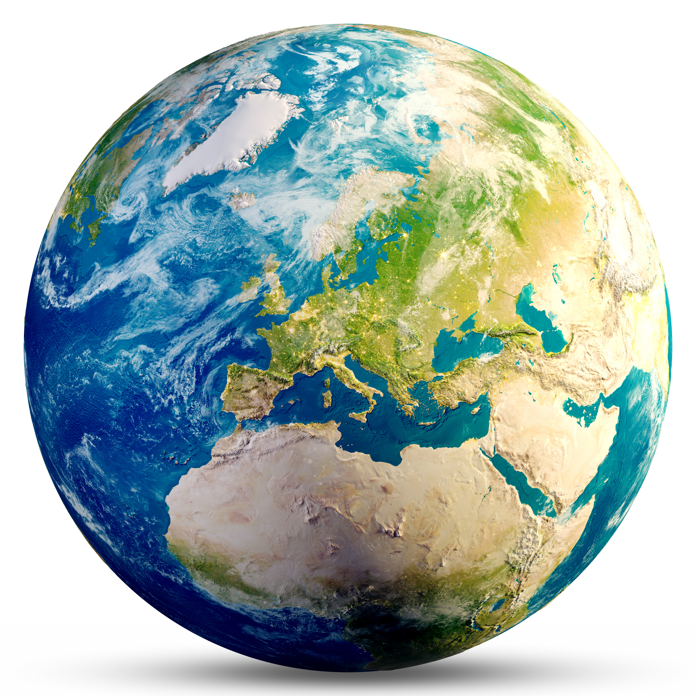
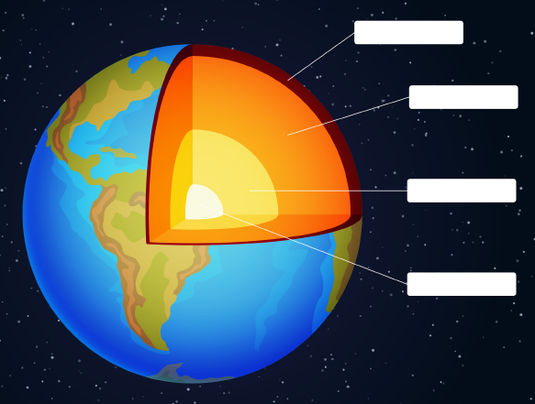
What is the Earth’s crust?
Earth’s crust
Insert text
Fascinating facts
Insert text
Continental crust
Insert text
Insert text
Oceanic crust
Insert text

