Slide 2
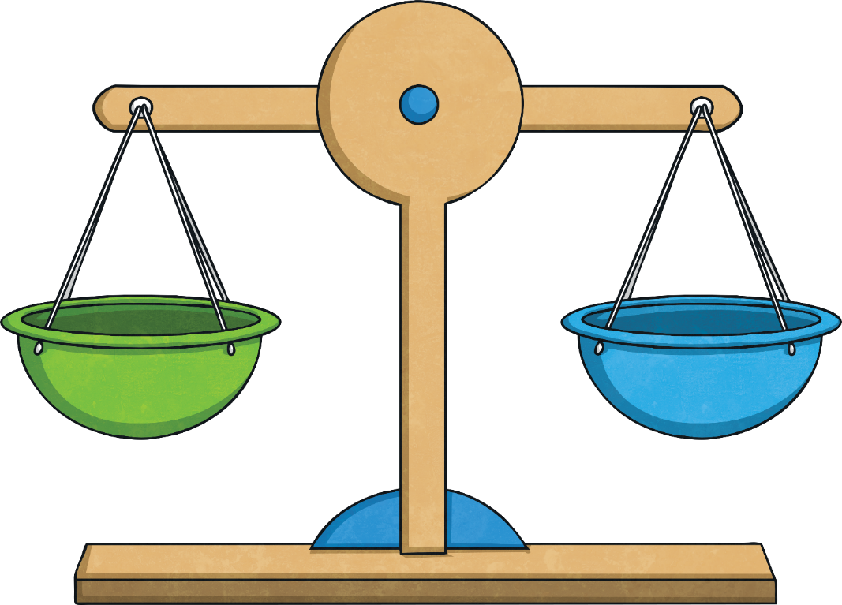
Equations
An equation is a mathematical statement that contains an equal sign, showing that two expressions are equal. For example: 2 + 4 = 6 + 0 is an equation. The group of numbers on the left equals 6, and the group of numbers on the right also equals 6.
6
6

Slide 3
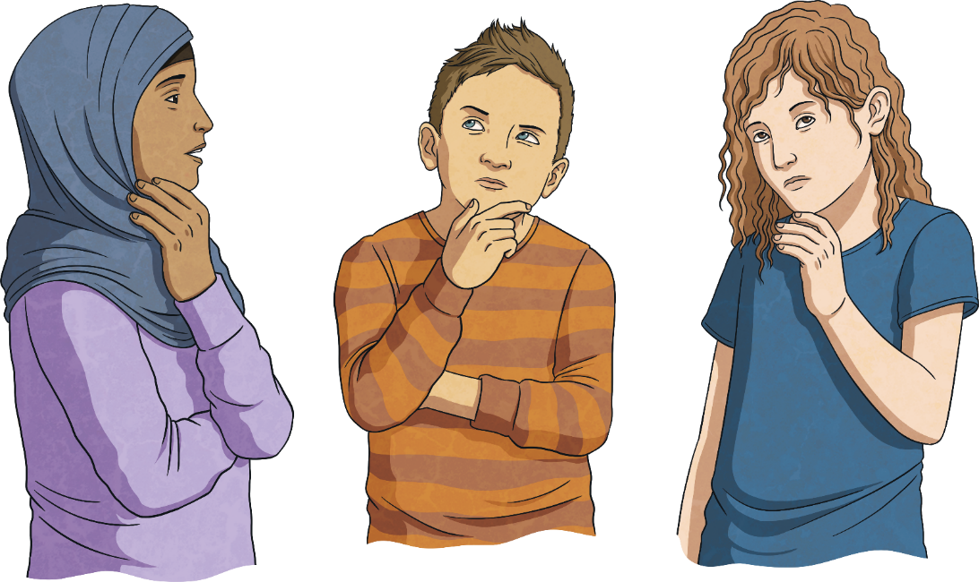
Balancing Equations: Blanks
Sometimes equations include unknown numbers represented by a blank line. For example, 2 + 4 = 9 - includes a blank line. It is your task to figure out what number to place on the line that will make both sides of the equation equal to each other.
Since 2 + 4 = 6, we want 9 - also to equal 6. What can you subtract from 9 to equal 6? 3! So 3 belongs on the blank line. Now your equation is balanced because both sides are equal.

Slide 4

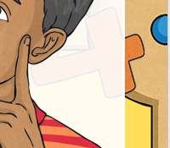
Balancing Equations: Variables
Sometimes equations include unknown numbers represented by a letter or variable. For example, 5 + 6 = 20 - x includes a variable, x. It is your task to figure out what number x represents to make both sides of the equation equal to each other.
Since 5 + 6 = 11, we want 20 - x also to equal 11. What can you subtract from 20 to equal 11? 9! So x = 9. Now your equation is balanced because both sides are equal.

Slide 5
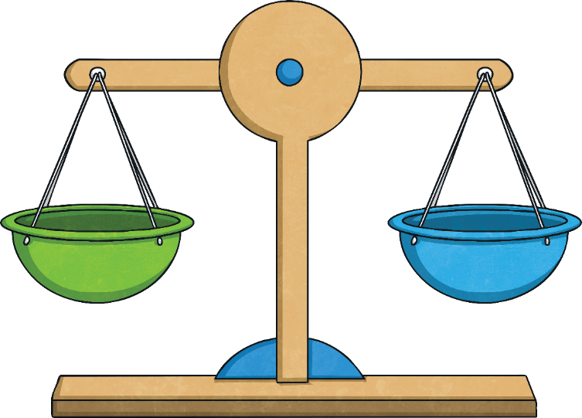
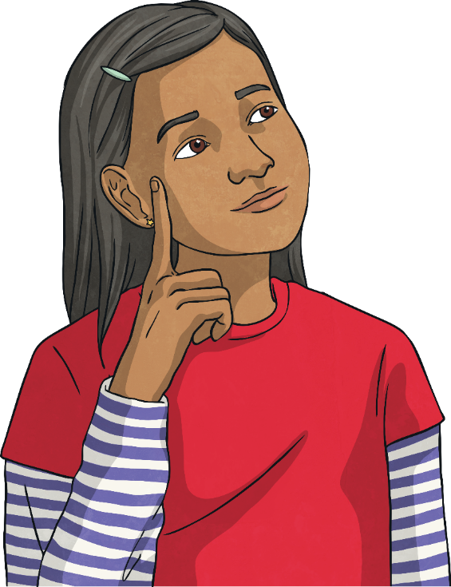
Balancing Equations With All
Four Operations
Balancing equations can be carried out with all four operations: addition, subtraction, multiplication, and division.

Slide 6
Balancing Equations: Addition
Some equations use addition. To balance them, you can use the opposite of addition: subtraction. You can also use addition.
5 + 4 = 7 +
5 + 4 = 9, so 9 - 7 = 2
or
5 + 4 = 9 so 7 + = 9?
2 + 5 = 1 + n
2 + 5 = 7, so 7 - 1 = 6
or
2 + 5 = 7, so 1 + = 7?
what
2
6
what

Slide 7
Balancing Equations: Subtraction
Some equations use subtraction.
15 - 8 = 10 -
15 - 8 = 7,
so 10 - 3 = 7
11 - 6 = 9 – n
11 - 6 = 5,
so 9 - 4 = 5

Slide 8
Balancing Equations: Multiplication
Some equations use multiplication. To balance them, you can use the opposite of multiplication: division. You can also use multiplication.
3 x 4 = 6 x
3 x 4 = 12, so 12 ÷ 6 = 2
or
3 x 4 = 12 so 6 x what = 12? 2
4 x 5 = 10 x n
4 x 5 = 20, so 20 ÷ 10 = 2
or
4 x 5 = 20, so 10 x what = 20? 2

Slide 9
Balancing Equations: Division
÷
Some equations use division.
16 ÷ 4 = 12 ÷
16 ÷ 4 = 4, so what can 12 be divided by to equal 4? 3
20 ÷ 10 = 6 ÷ n
20 ÷ 10 = 2, so what can 6 be divided by to equal 2? 3

Slide 10
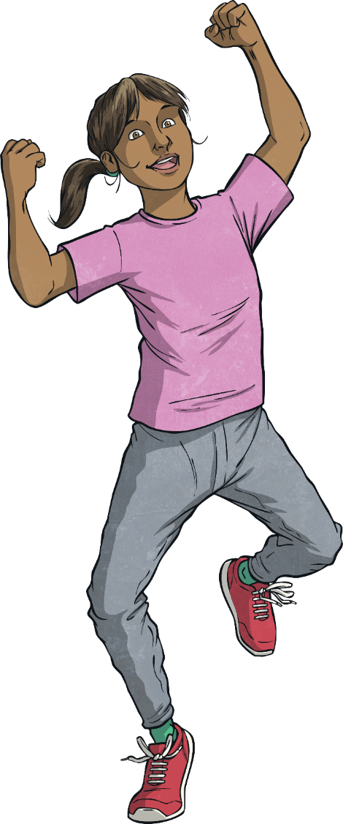
Balancing Equations: Mixed Operations
Some equations use more than one operation. Just remember, your goal when balancing an equation is to make sure both sides are equal.
2 x 3 = 10 - y
2 x 3 = 6, so what can we subtract from 10 to get 6?
4
5 + 7 = 4 x
5 + 7 = 12, so what can multiply 4 by to get 12?
3

Slide 11

Quick Check
Try balancing these equations:
6
5 x 6 = 24 +
14 - 6 = 16 ÷ y
2
5
30 / 3 = 2 x

