Slide 2
Aim
To use the link between addition and subtraction to check answers.
Success Criteria
I can use an inverse operation to check the answer of an addition calculation.
I can use an inverse operation to check the answer of a subtraction calculation.

Slide 3









Remember It
Use this bar model to write 2 addition and 2 subtraction calculations.
Remember! The equals sign (=) means both sides of the calculation are the same.
750
225 | 525
225 + 525 = 750
525 + 225 = 750
750 – 225 = 525
750 – 525 = 225
750 = 225 + 525
750 = 525 + 225
525 = 750 - 225
225 = 750 - 525
225 + 525 = 750
525 + 225 = 750
750 – 225 = 525
750 – 525 = 225
Now use the same calculations, but write the answer at the start.
750 = 225 + 525
750 = 525 + 225
525 = 750 - 225
225 = 750 - 525
We have made 4 addition and 4 subtraction calculations.

Slide 4
Remember It
Use this part-whole model to write 4 addition and 4 subtraction calculations.
423
115
308
115 + 308 = 423
308 + 115 = 423
423 - 115 = 308
423 - 308 = 115
423 = 115 + 308
423 = 308 + 115
308 = 423 - 115
115 = 423 - 308
We have made 4 addition and 4 subtraction calculations.

Slide 5

Checking Answers
We are going to learn how we can check our addition and subtraction answers.
Then, we will use what we have learned to solve some secret codes!

Slide 6
Checking Answers
750
225 | 525
whole
part
part
In this bar model, which of the numbers are the parts?
Which number is the whole?
We can make these addition and subtraction facts using the bar model.
Addition is the inverse of subtraction.
What does inverse mean?
750 = 225 + 525
750 = 525 + 225
525 = 750 - 225
225 = 750 - 525
750 = 225 + 525
750 = 525 + 225
525 = 750 - 225
225 = 750 - 525
Inverse means the opposite or the reverse of. We can use the inverse to check an answer.

Slide 7
Checking Answers
750
225 | 525
whole
part
part
For 225 + 525 = 750, we could do a subtraction check.
Start with the whole and subtract one of the parts to see if the answer is the other part.
750 – 225 = 525
For 750 - 525 = 225, we could do an addition check.
We could add together the two parts to see if they make the whole.
525 + 225 = 750
part + part = whole
check with inverse
whole – part = part
whole - part = part
check with inverse
part + part = whole

Slide 8

Checking Answers
How could we check the answer to this calculation?
This answer is correct.
570 - 280 = 290
The numbers in this calculation are the same as the numbers in the subtraction calculation.
The numbers in this calculation are also the same as the numbers in the subtraction calculation.
We could use the numbers in the calculation to do an inverse addition calculation. What would the addition calculation be?
What is 280 + 290?
What is 290 + 280?
280 + 290 = 570
280 + 290 or 290 + 280
290 + 280 = 570

Slide 9


Checking Answers
Use the inverse to check these subtraction calculations.
The same numbers as in the subtraction calculation. Correct.
25 + 625 = 650
625 + 25 = 650
a) 650 – 25 = 625
Not all the same numbers as in the subtraction calculation. Incorrect.
275 + 520 = 795
520 + 275 = 795
b) 895 - 275 = 520
The same numbers as in the subtraction calculation. Correct.
295 + 190 = 485
190 + 295 = 485
c) 485 - 295 = 190

Slide 10
Checking Answers
How could we check the answer to this calculation?
This answer is correct.
320 + 130 = 450
We could use the numbers in the calculation to do an inverse subtraction calculation. What would the subtraction calculation be?
The numbers in this calculation are the same as the numbers in the addition calculation.
The numbers in this calculation are also the same as the numbers in the addition calculation.
What is 450 - 130?
What is 450 – 320?
450 – 320 = 130
450 – 320 or 450 – 130
450 – 130 = 320

Slide 11
Checking Answers
Use the inverse to check these subtraction calculations.
The same numbers as in the addition calculation. Correct.
240 – 175 = 65
240 – 65 = 175
a) 175 + 65 = 240
Not all the same numbers as in the addition calculation. Incorrect.
656 – 541 = 115
656 – 125 = 531
b) 541 + 125 = 656
Not all the same numbers as in the addition calculation. Incorrect.
475 – 207 = 268
475 – 250 = 225
c) 207 + 250 = 475

Slide 12
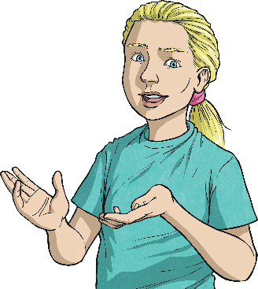

Do You Agree?
I added together 125 + 65.
To check my answer, I can use these numbers in a subtraction calculation: 125 - 65
Do you agree?
Explain why or why not.
?
125 | 65
Drawing a bar model will help us to think about the calculation.
No. First you need to find the answer. Then in the inverse calculation, this becomes the first number to subtract from.
125 + 65 = 190
Inverse check:
190 – 125 = 65 or 190 – 65 = 125

Slide 13
Do You Agree?
My calculation is:
396 – 375 = 21
I can check the answer by using this inverse:
375 + 21 = 396
Do you agree?
Explain why or why not.
396
375 | 21
Drawing a bar model will help us to think about the calculation.
Yes.
We know that 396 is the whole, so it should be the answer in our inverse addition. We add the two parts back together to make the whole.

Slide 14


Do You Agree?
557 – 413 = 134
So I also know:
557 + 134 = 413
Do you agree?
Explain why or why not.
557
413 | 134
Drawing a bar model will help us to think about the calculation.
No.
557 – 413 = 134
557 is the whole, so this would need to be the answer
in an inverse addition calculation.
In year 3, we know that the whole is bigger than the parts.
413 + 134 = 557

Slide 15
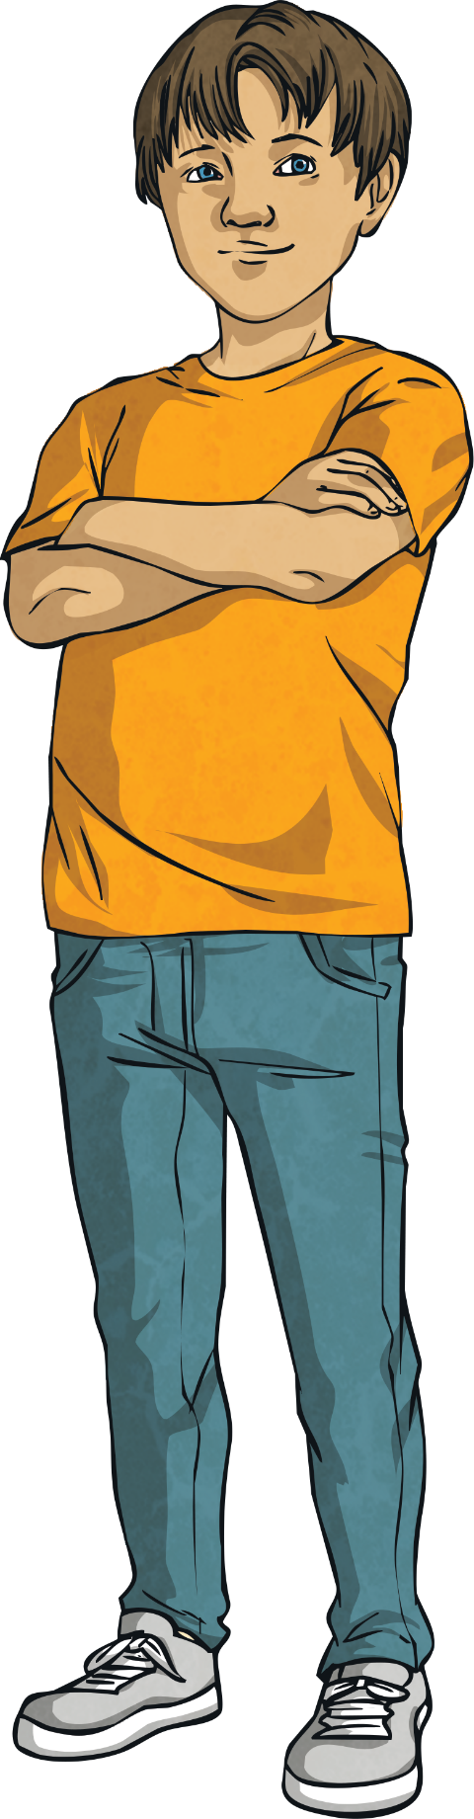
Word Problem
Annie collected 170 shells.
Her friend gave her 43 more.
How many shells did she have altogether?
Do you agree with
Charlie’s answer?
Explain why you think this, using an inverse calculation to check his answer.
The calculation I need to do is
170 + 43.
She has 313 shells.
170 + 43 = 313
Charlie is incorrect.
His answer 170 + 43 = 313 is wrong.
313 – 170 = 143
313 – 43 = 270

