Slide 1


Slide 2
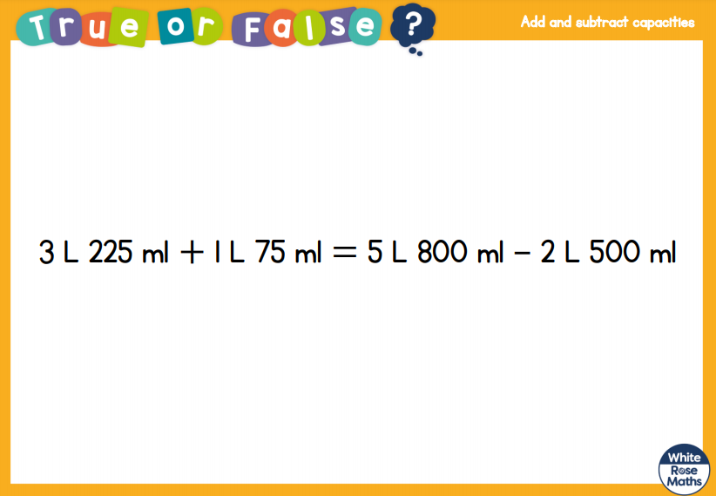

Slide 3
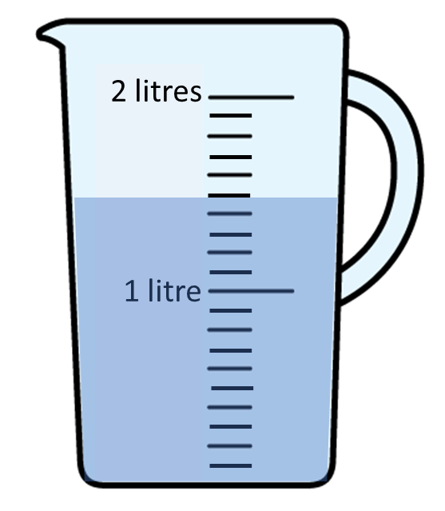
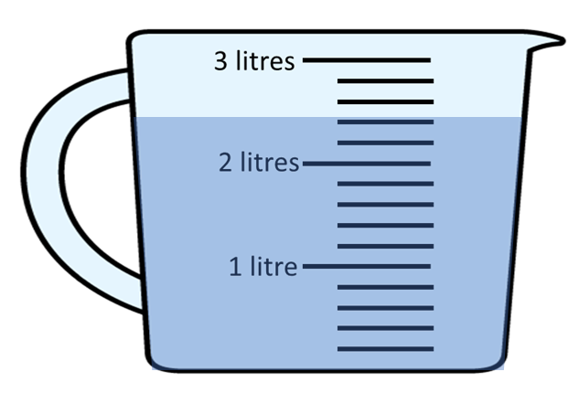
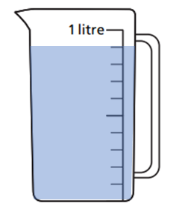

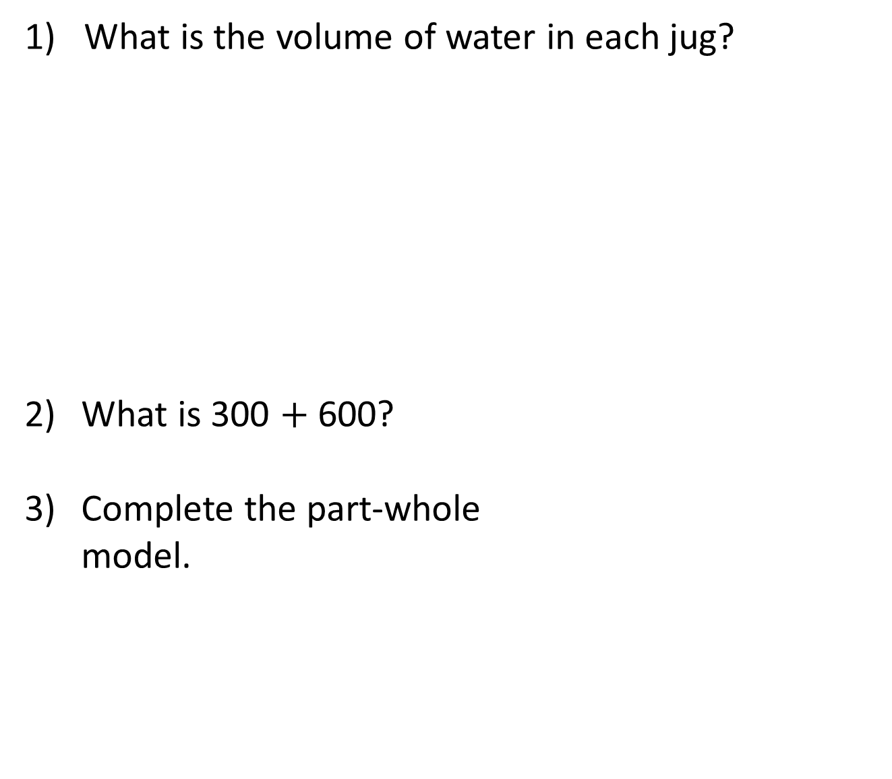
1) What is the volume of water in each jug?
What is 300 $+$ 600?
Complete the part-whole model.
1 litre
750 ml

Slide 4
1) What is the volume of water in each jug?
What is 300 $+$ 600?
Complete the part-whole model.
2 litres 400 ml
1 litre 500 ml
900 ml
1000
ml
900
1 litre
250 ml
750 ml

Slide 5
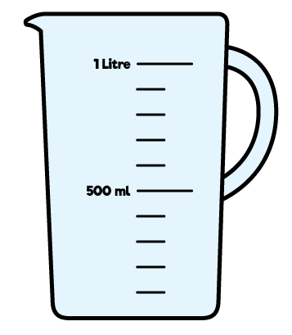

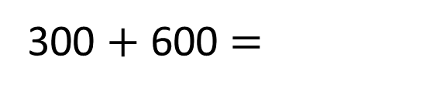
A
B
300 ml
600 ml
The water from jug A is poured into jug B.
How much water will be in jug B?
900 ml
300 $+$ 600 $=$
900 ml
Have a think

Slide 6
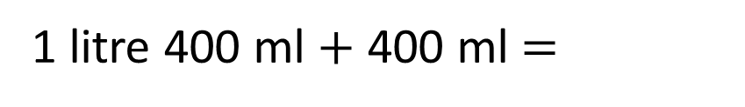
Have a think
A
2 litres
1 litre
B
1 litre 400 ml
400 ml
The water from jug B is poured into jug A.
How much water will be in jug A?
1 litre 400 ml $+$ 400 ml $=$
1 litre 800 ml

Slide 7
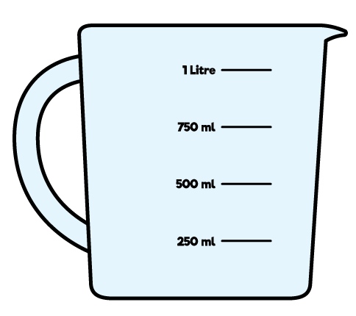
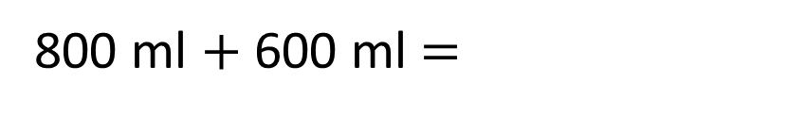
3 litres
3 litres
2 litres
2 litres
1 litre
1 litre
800 ml
600 ml
1,400
ml
800 ml $+$ 600 ml $=$
1,400 ml
1 litre 400 ml
Have a think
1
litre
1,000
ml
400
ml
What is the total volume of water?

Slide 8
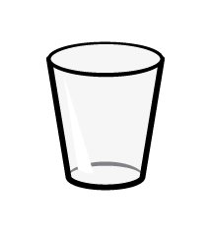
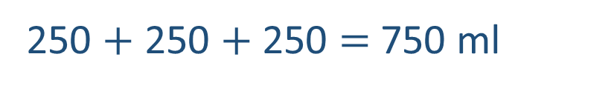
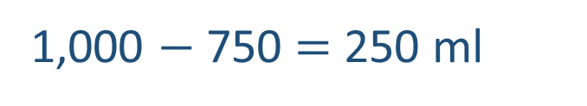
Have a think
Mo fills each glass using the water in the jug.
Each glass has a capacity of 250 ml.
How much water will be left in the jug?
250 $+$ 250 $+$ 250 $=$ 750 ml
1,000 $−$ 750 $=$ 250 ml

Slide 9
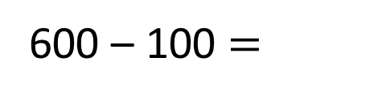
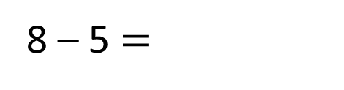
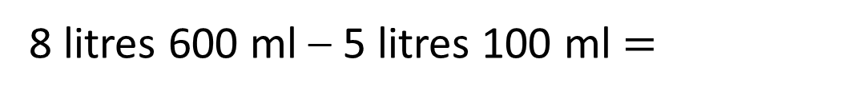
The capacity of a fish tank is 8 litres and 600 ml
The tank contains 5 litres and 100 ml of water.
How much more water needs to be poured in to fill the tank?
8 litres 600 ml
?
5 litres 100 ml
Have a think
8 litres 600 ml – 5 litres 100 ml $=$
3 litres 500 ml
8 – 5 $=$
3 litres
600 – 100 $=$
500 ml

Slide 10
A paddling pool has a capacity of 10 litres 700 ml
There is some water in the pool.
Rosie adds 3 litres 500 ml of water to fill the pool.
How much water was in the pool at the start?
10 litres 700 ml
3 litres 500 ml
?
Have a think
200 ml
7 litres
10 litres 700 ml – 3 litres 500 ml =

