Slide 1


Slide 2
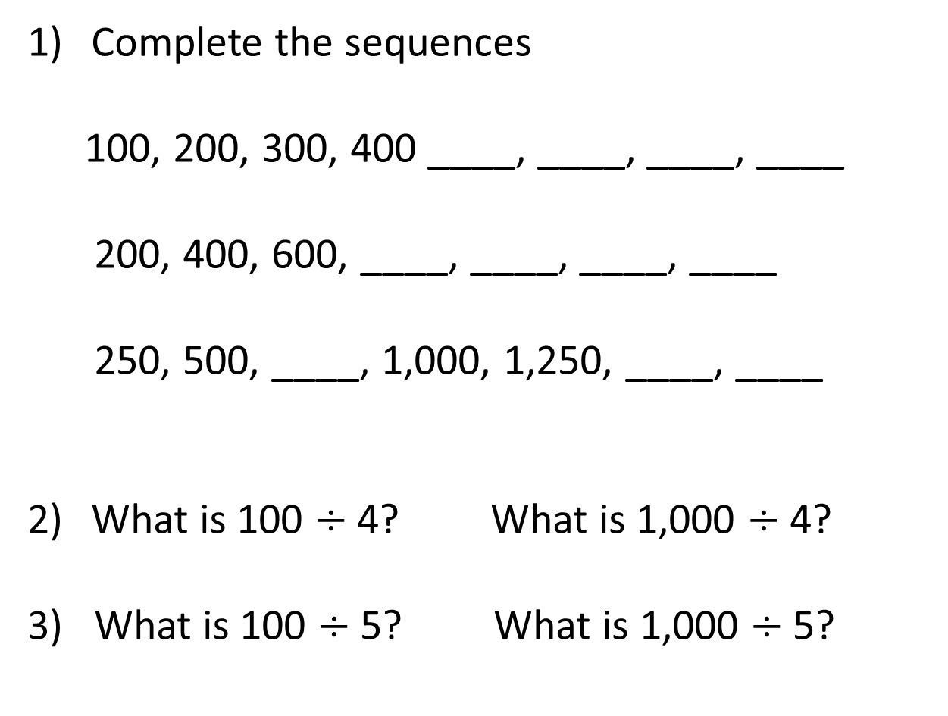
Complete the sequences
100, 200, 300, 400 ____, ____, ____, ____
200, 400, 600, ____, ____, ____, ____
250, 500, ____, 1,000, 1,250, ____, ____
What is 100 $÷$ 4? What is 1,000 $÷$ 4?
3) What is 100 $÷$ 5? What is 1,000 $÷$ 5?

Slide 3
Complete the sequences
100, 200, 300, 400 ____, ____, ____, ____
200, 400, 600, ____, ____, ____, ____
250, 500, ____, 1,000, 1,250, ____, ____
What is 100 $÷$ 4? What is 1,000 $÷$ 4?
3) What is 100 $÷$ 5? What is 1,000 $÷$ 5?
500
600
700
800
800
1,000
1,200
1,400
750
1,500
1,750
25
250
20
200

Slide 4
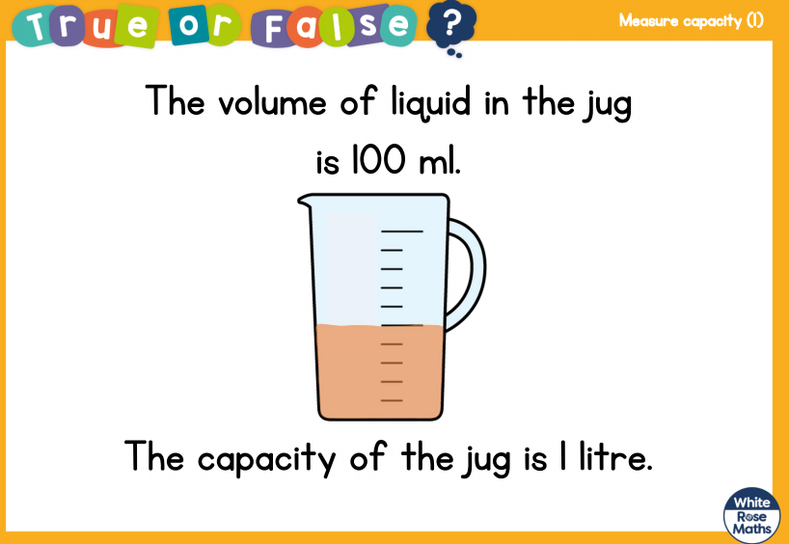

Slide 5
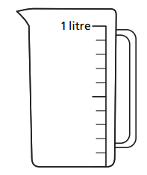

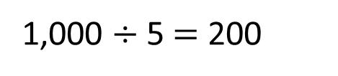
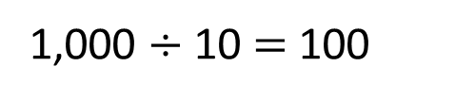
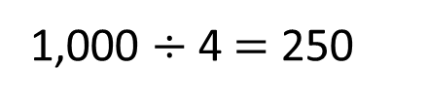
What’s the same? What’s different?
A) B) C)
900
800
800
750
700
600
600
500
500
400
400
300
250
200
200
100
1,000 $÷$ 10 $=$ 100
1,000 $÷$ 5 $=$ 200
1,000 $÷$ 4 $=$ 250
Have a think

Slide 6
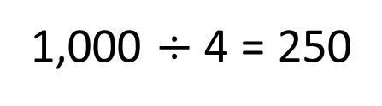
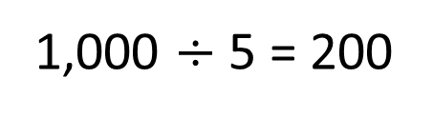
What is the volume of water in each jug?
A) B)
800
750
600
500
400
250
200
1,000 $÷$ 5 = 200
1,000 $÷$ 4 = 250
Jug A has 800 ml
Jug B has 750 ml
Have a think

Slide 7
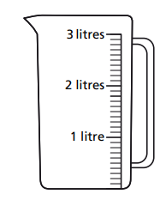
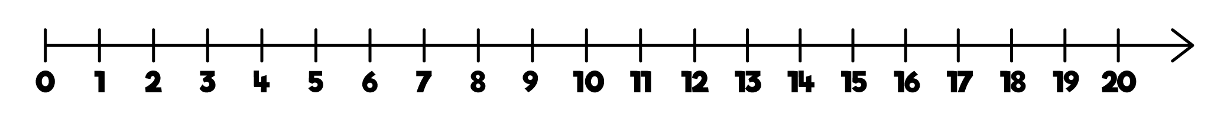
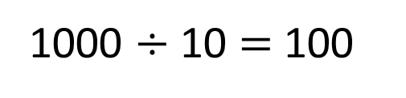

What is the volume of water in this jug?
1 litre and 300 ml
Have a think
1000 $÷$ 10 $=$ 100
1 litre $=$ 1,000 ml
1 litre
100
200
300
400
500
600
700
800
900
2 litres

Slide 8
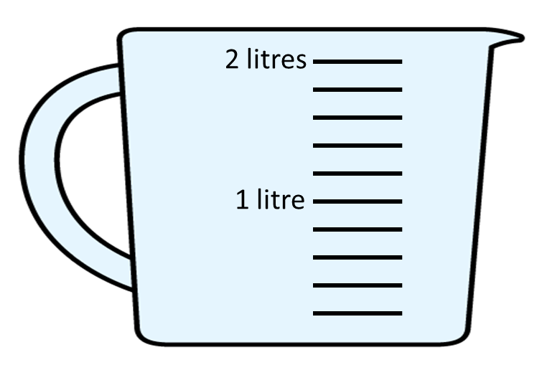
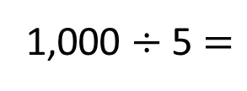
What is the volume of water in this jug?
1 litre and 600 ml
1 litre and 300 ml?
Have a think
1,000 ÷ 5 $=$
200 ml
1 litre
200 ml
400 ml
600 ml
800 ml
2 litres
1 litre = 1,000 ml

Slide 9
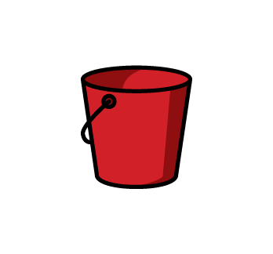
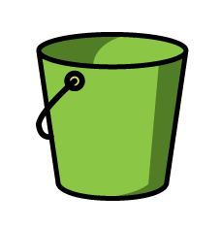
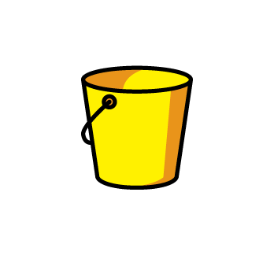

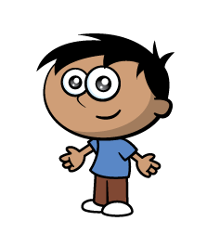


One green bucket will fill 2 red buckets.
One red bucket will fill 2 yellow buckets.
Who will collect the most water?
$$=$$
$$=$$
Have a think

Slide 10
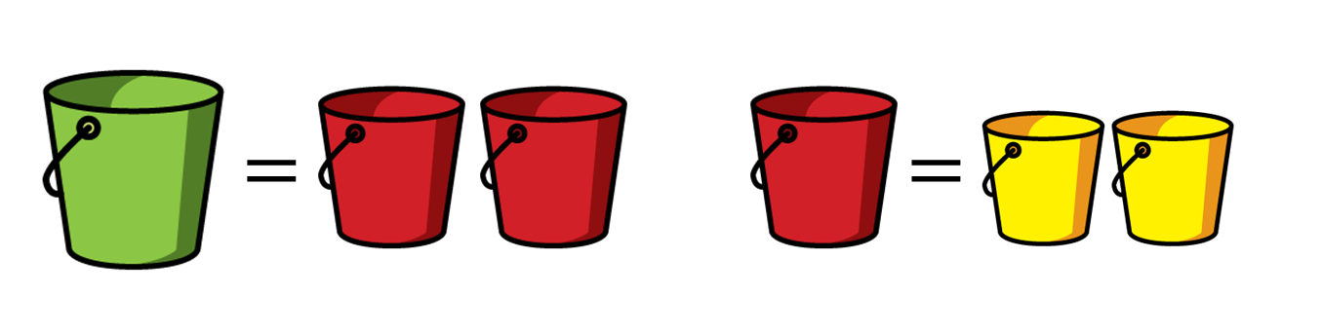


Who will collect the most water?
$$=$$
$$<$$
Amir will collect the most water.

