Slide 1


Slide 2
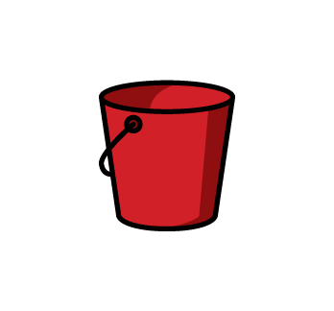
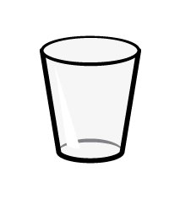
What language is used to describe volume?
2) Which item would you expect to have a greater capacity?
or
Which units are used to measure the volume of liquids?
Long and short
Full and empty
Heavy and light
Kilograms and grams
Litres and millilitres
Metres and centimetres

Slide 3
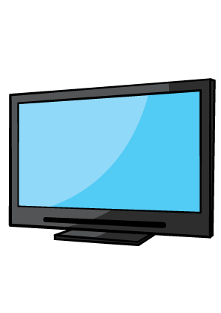
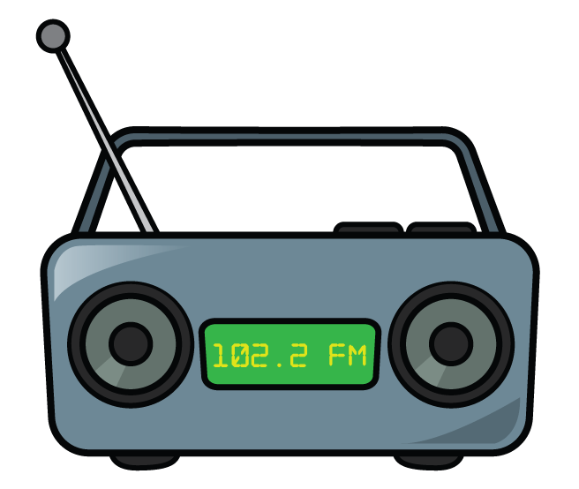
What do we mean by volume?
TURN THE VOLUME DOWN!
Volume can also mean the amount of space that is filled by something.

Slide 4
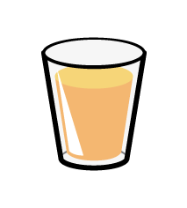
empty
half-full
almost full
These glasses all have the same capacity.
But they don’t have the same volume of orange juice.

Slide 5
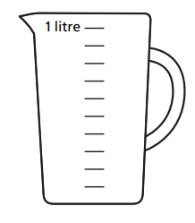
These jugs all have the same capacity.
But they don’t have the same volume of water.

Slide 6

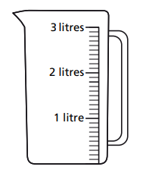
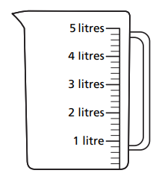
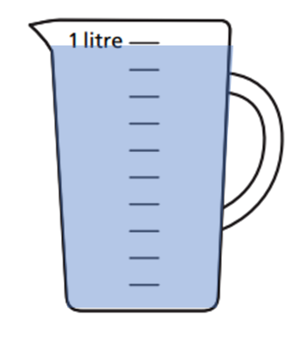
Have a think
What do you notice about these jugs?
The jugs all have a different capacity.
The jugs all contain the same volume of water.

Slide 7


Slide 8
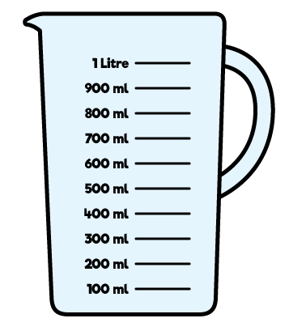
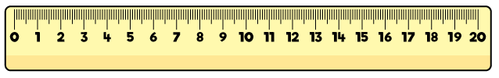
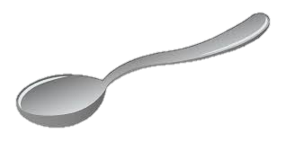
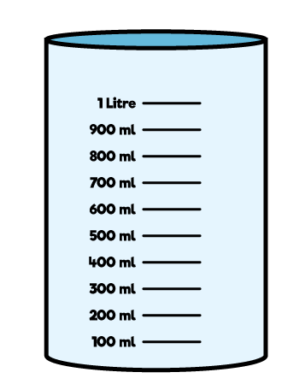
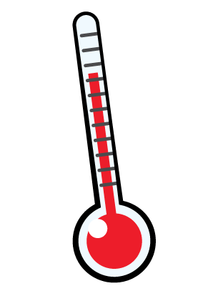
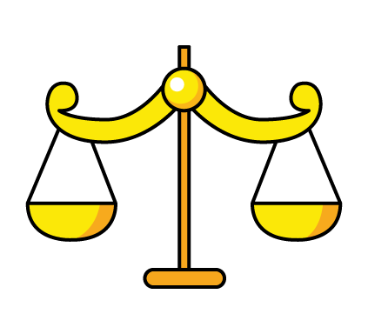
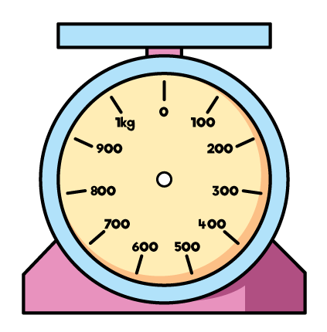
Which equipment do we use to measure capacity?
Have a think

Slide 9
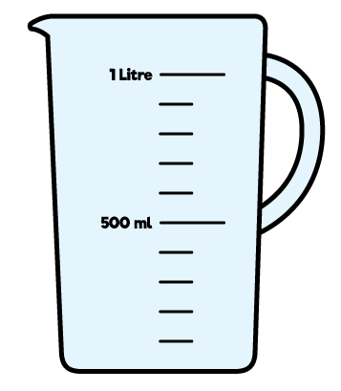
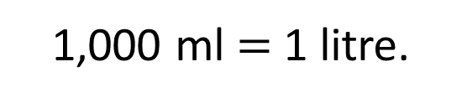
We measure liquid in litres and millilitres.
Milli means thousandth.
There are 1,000 millimetres in 1 metre.
There are 1,000 millilitres in 1 litre.
1,000 ml $=$ 1 litre.

Slide 10
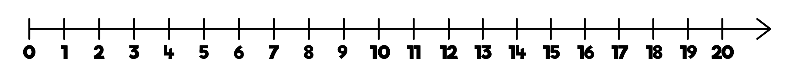
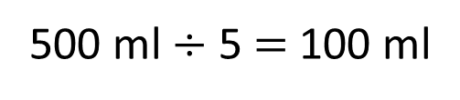
What is the volume of water in the jug?
400 ml
500 ml $÷$ 5 $=$ 100 ml
500 ml
0 ml
100
200
300
400
500 ml
600
700
800
900
1 litre

Slide 11
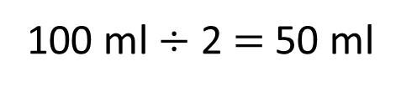
What is the volume of water in the jug?
650 ml
Have a think
100 ml $÷$ 2 $=$ 50 ml
0 ml
100
200
300
400
500 ml
600
700
800
900
1 litre

Slide 12
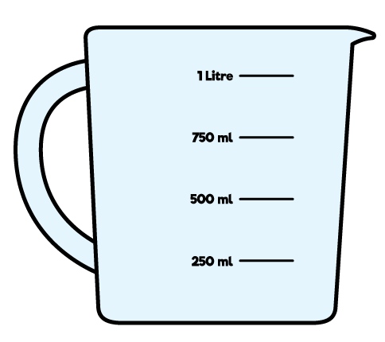
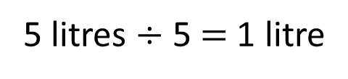
What is the volume of water in the jug?
5 litres
4 litres
5 litres $÷$ 5 $=$ 1 litre
0
1 l
2 l
3 l
4 l
5 l

Slide 13

Teddy has 1 litre of water in a jug.

Slide 14
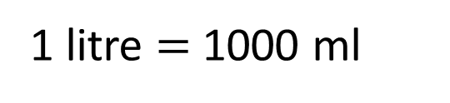

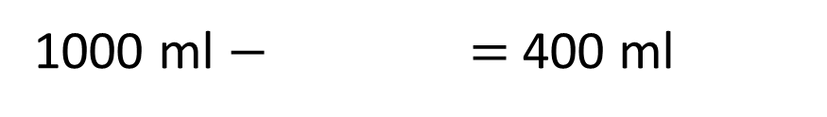
Teddy has 1 litre of water in a jug.
He uses the water to fill 2 glasses.
What is the capacity of one glass?
1 litre $=$1000 ml
400 ml
600 ml
1000 ml $−$ $=$ 400 ml
600 ml $÷$2 $=$ 300 ml
Have a think

