Slide 1
Monet’s Bridge Challenge!
Oh dear!
Monet’s bridge over his waterlily pond has collapsed! Can you design and build him a new one?

Slide 2
There are lots of bridge types to choose from.
^{Beam bridges}
^{Arch bridges}
^{Truss bridges}
^{Suspension bridges}

Slide 3
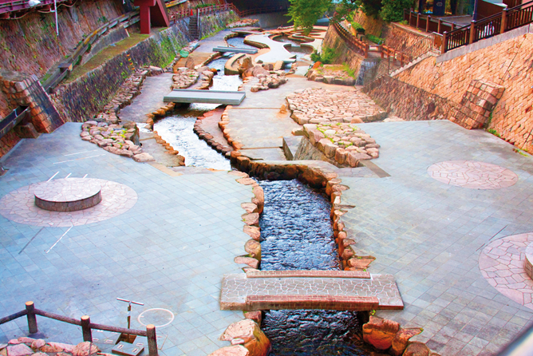
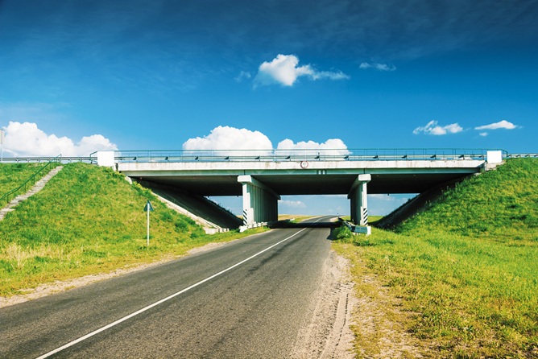
Beam Bridge
A beam bridge is the simplest and oldest kind of bridge
The further apart a beam bridge’s supports, the weaker it becomes.

Slide 4
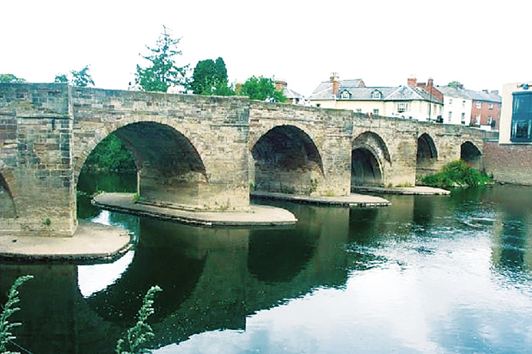
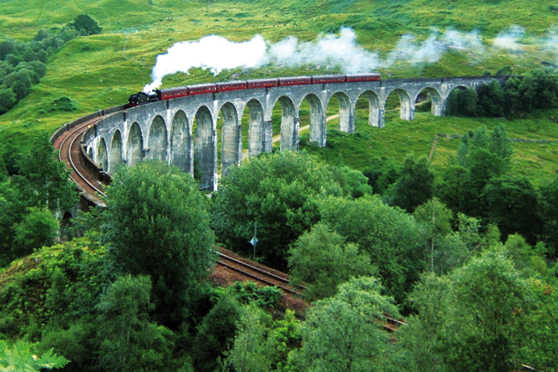
Arch Bridge
Very strong if well
designed and can be beautiful.

Slide 5
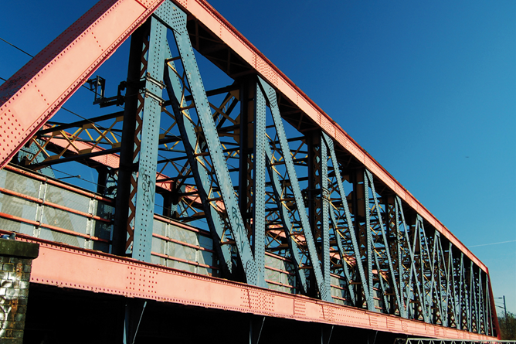
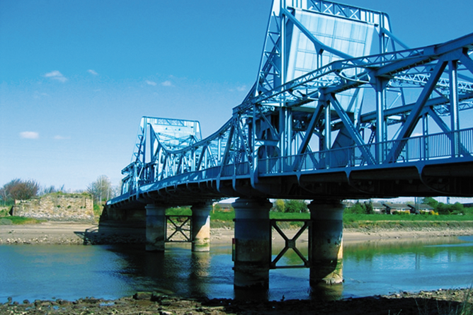
Truss Bridge
Very good strength to weight performance and if well
designed can be beautiful and made into any design.

Slide 6
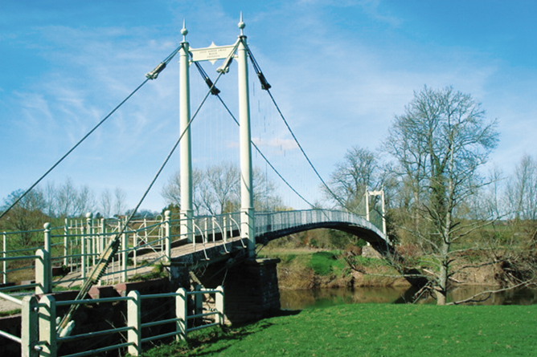
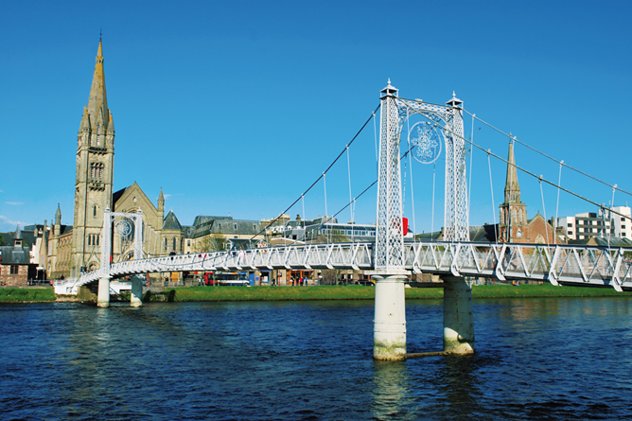
Suspension Bridge
Aesthetically pleasing, light, strong and can span longer distances than other bridges.

Slide 7
Your Team Challenge
1) Each group should think of a company name for themselves.
2) Each group is given a budget of £100, which they can use to build the bridge.
Paper costs £10 per A4 sheet
Sellotape costs £10 for 10cm strip
Paper clips cost £3 each.
Scissors, rulers and pencils are free.
Scrap paper to practice construction techniques is free.
You should therefore think about what materials you will need before you buy them (No Refunds can be given!).
4) You MUST work as a team, planning ahead, deciding what to buy and working out the best way to solve the problem.
5) You will be given a specific time to plan/design and then build your bridge.
6) At the end points will be awarded for design, teamwork, fitness for purpose and use of materials. The winning team will be awarded merits/house points.

Slide 8
PROJECT TIMETABLE team consultation – 10 mins designing and planning until break constructing 10:45-11:45 testing 1:25-2:15 discussion and questions 2:15-2:30 tidying up 2:30-2:45

