Slide 1


Slide 2
Complete these scales
0 2 4 6 8 10 12 14
0 10 20 30 40 50 60 70
Place these numbers on this number line
0 10 20 30 40
25
35
15

Slide 3
Complete these scales
0 2 4 6 8 10 12 14
0 10 20 30 40 50 60 70
Place these numbers on this number line
0 10 20 30 40
25
35
15

Slide 4






What language do we use to describe
temperature?
?
cold
?
hot
?
boiling
warm
?
freezing
Celsius
?
Temperature is measured in degrees Celsius °C

Slide 5

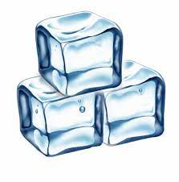
Temperature is measured in degrees Celsius °C
Water boils at 100 °C
Water freezes at 0 °C
Your body temperature should be around 37 °C

Slide 6
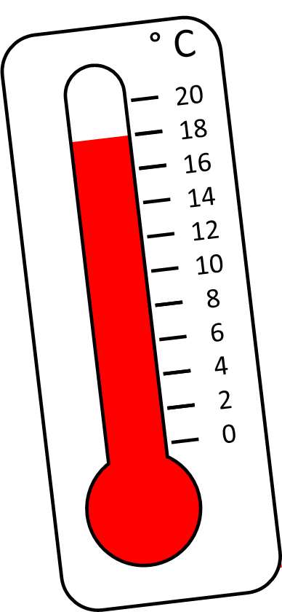
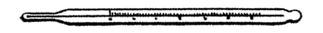
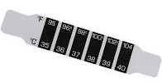
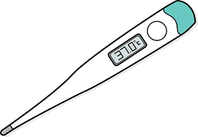
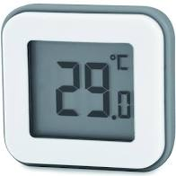
Which equipment do we use to measure temperature?

Slide 7

° C
10
9
8
7
6
5
4
3
2
1
0
9° C
Notes:
Has he filed to 400 ml?

Slide 8


° C
20
18
16
14
12
10
8
6
4
2
0
Have a think
9° C
Notes:
Has he filed to 400 ml?

Slide 9

20
10
0
Both are showing the same temperature
18° C
° C
10
5
0
Have a think
9° C
° C
Notes:
Has he filed to 400 ml?

Slide 10
20
10
0
12° C
° C
20
10
0
Have a think
14 °C
° C
Notes:
Has he filed to 400 ml?

Slide 11
° C
° C
° C
100
90
80
70
60
50
40
30
20
10
0
100
90
80
70
60
50
40
30
20
10
0
100
90
80
70
60
50
40
30
20
10
0
70° C
90° C
Have a think
55° C
Notes:
What are the temps.
These were recorded as some soup was cooling

Slide 12
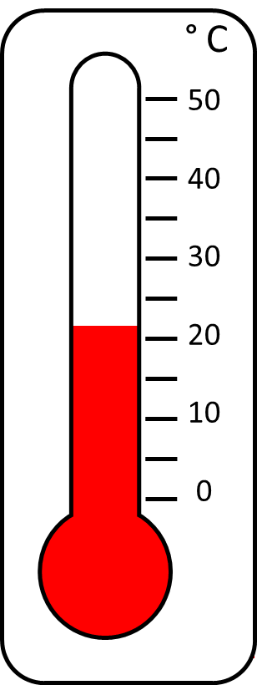
This thermometer shows the temperature in Tiny’s house.
What temperature is shown on the thermometer?
Have a think
It is just over 20 °C
21 or 22 °C
I wonder what the temperature is inside the fridge.

Slide 13
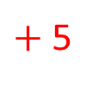
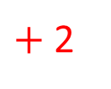
Eighteen degrees
During the afternoon the temperature rises to 25 °C.
By how many degrees did the temperature rise?
° C
100
90
80
70
60
50
40
30
20
10
0
Have a think
$+$ 2
$+$ 5
18
20
25
The temperature rose by 7 °C
Notes:
The temp today is 18 d c which of these

Slide 14


Mon | Tues | Wed | Thurs | Fri
19 °C | 17 °C | 19 °C | 21 °C | 22 °C
Mon | Tues | Wed | Thurs | Fri
20 °C | 22 °C | 24 °C | 21 °C | 23 °C
What do you notice?
Wednesday of week 2 was the hottest day.
Tuesday of week 1 was the coldest day.
The difference in temperature between the coldest and hottest day is 7 °C.
Both Thursdays had the same temperature.
Have a think

Slide 15
Mon | Tues | Wed | Thurs | Fri
19 °C | 17 °C | 19 °C | 21 °C | 22 °C
Mon | Tues | Wed | Thurs | Fri
20 °C | 22 °C | 24 °C | 21 °C | 23 °C
Which week do you think had most sunshine?
Why?
How many days was the temperature above 20 °C?
Week 2 because the temperature was warmer.
Have a think
6 days

Slide 16
Mon | Tues | Wed | Thurs | Fri
19 °C | 17 °C | 19 °C | 21 °C | 22 °C
Mon | Tues | Wed | Thurs | Fri
20 °C | 22 °C | 24 °C | 21 °C | 23 °C
What was the difference in temperature between Thursday and Friday of week 2?
2 °C
19 | 20 | 21 | 22 | 23 | 24 | 25 | 26 | 27 | 28
Have a think

Slide 17
In week 3, the temperature on Monday was 23 °C.
The difference between the temperature on Monday and Tuesday was 4 °C.
What could the temperature on Tuesday have been?
Is there more than one answer?
The temperature could have been 19 °C or 27 °C.
19 | 20 | 21 | 22 | 23 | 24 | 25 | 26 | 27 | 28
Have a think

