Slide 1
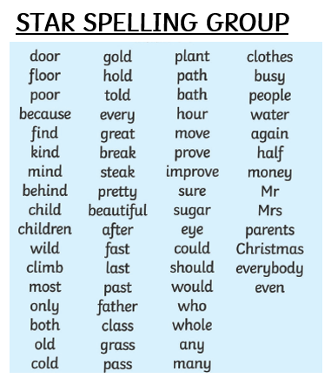
LIST 12 le to ly suffix
muscle
wriggle
wrinkly
cuddle
wriggly
giggle
prickle
bubble
bubbly
prickly
cuddly
wrinkle
giggly
muscly
crumbly

