Slide 1
Aim
To estimate the location of 3-digit numbers on number lines.
Success Criteria
I can use my understanding of dividing 100 into equal parts to help with estimating.
I can estimate where to place 3-digit numbers on number lines.
I can estimate the values of 3-digit numbers indicated on number lines.

Slide 2







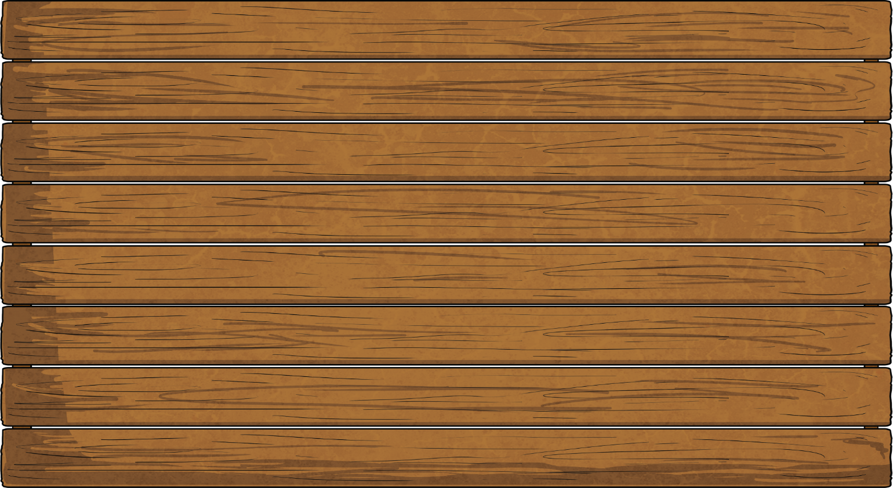

Remember It
Write the next five numbers in these counting sequences.
195, 196, 197…
198, 199, 200, 201, 202
764, 774, 784…
794, 804, 814, 824, 834
305, 304, 303…
302, 301, 300, 299, 298
954, 944, 934…
924, 914, 904, 894, 884

Slide 3


Placing Numbers
on a Number Line
230
200
210
220
235
250
260
270
280
290
300
The number line is marked with the values of 200 and 300. This is a range of 100.
What place value skills can we use to estimate the position of 235 on this number line?
240
The number line is divided into 10 equal parts.
Each increment on the number line represents 10.
235 is the midpoint between 230 and 240.

Slide 4

Placing Numbers
on a Number Line
520
540
560
580
500
570
600
The number line is marked with the values of 500 and 600. This is a range of 100.
What place value skills can we use to estimate the position of 570 on this number line?
The number line is divided into 5 equal parts.
570 is the midpoint between 560 and 580.
Each increment on the number line represents 20.

Slide 5
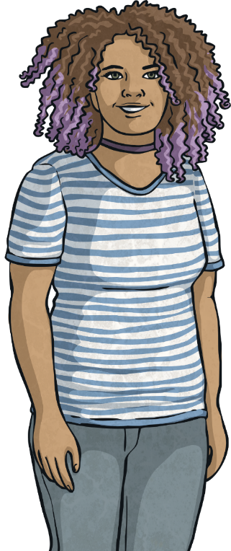
Placing Numbers
on a Number Line
650
600
640
700
The number line is marked with the values of 600 and 700. This is a range of 100.
What place value skills can we use to estimate the position of 640 on this number line?
The number line is divided into 2 equal parts.
640 is closer to 650 than 600.
The greater the value between increments, the less accurate we can be in our estimation.
Each increment on the number line represents 50.

Slide 6

Identifying Numbers
on a Number Line
525
550
575
500
?
600
580
The number line is marked with the values of 500 and 600. This is a range of 100.
What place value skills can we use to estimate the value of the number indicated on the number line?
The number line is divided into 4 equal parts.
The arrow is closer to 575 than 600. A sensible estimate would be 580.
The greater the value between increments, the less accurate we can be in our estimation.
Each increment on the number line represents 25.

Slide 7
Identifying Numbers
on a Number Line
525
550
575
500
580
600
Estimation (or estimating) is the process of finding an estimate, or approximation, which is a value that is close enough to the actual answer to be useable.
Should I expect to be spot on with my estimate? Why not?

Slide 8
Identifying Numbers
on a Number Line
525
550
575
500
580
600
To estimate the value of a 3-digit number on a unmarked number line, think about the hundreds digit first and then the tens digit. Accuracy of estimation decreases as you try to estimate the digits in smaller place value positions.
Why do you think I gave an estimation that was a multiple of ten? Why did I not estimate 582?

Slide 9
Identifying Numbers
on a Number Line
Estimate the values of the numbers indicated on the number lines. The answers given are estimations. Are your estimations similar?
?
675
600
700
?
745
700
800
?
220
200
300

Slide 10

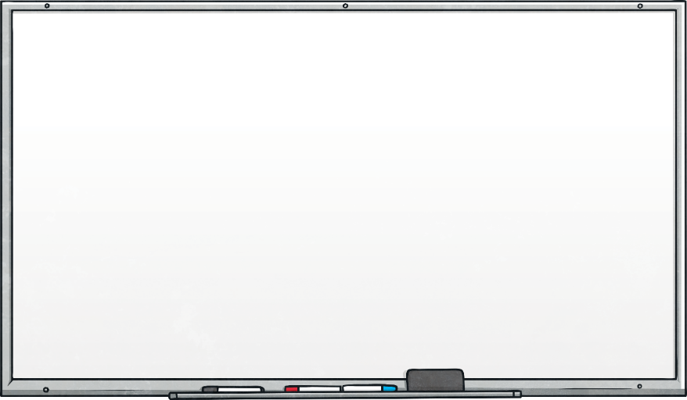

Compare It
Which number line shows the biggest number? Explain your reasoning.
?
70
0
100
?
60
0
200

