Slide 1


Slide 2



Which flag has horizontal stripes?
a) b) c)
2) Which flag has vertical stripes?
a) b) c)
3) Which flag has diagonal stripes?
a) b) c)

Slide 3
Which flag has horizontal stripes?
a) b) c)
2) Which flag has vertical stripes?
a) b) c)
3) Which flag has diagonal stripes?
a) b) c)

Slide 4

Parallel lines are always the same distance apart. They will never meet.

Slide 5
These lines are not parallel.

Slide 6


parallel
Train tracks are parallel.

Slide 7
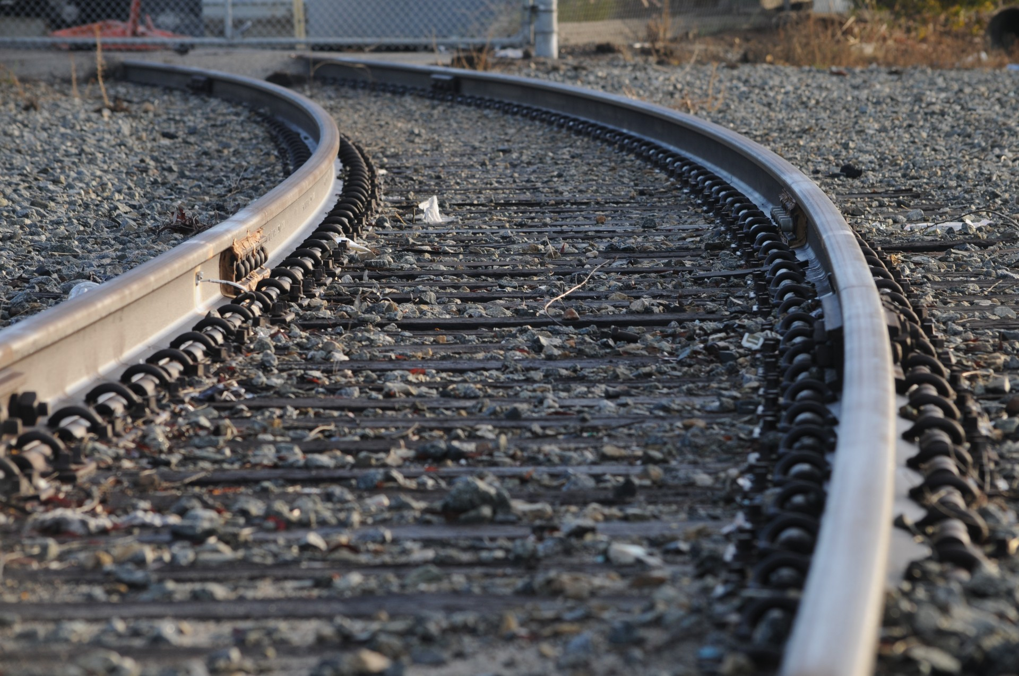
parallel
parallel

Slide 8

Which pairs of lines are parallel?
Have a think
a)
b)
no
yes
c)
d)
yes
no

Slide 9


Perpendicular – lines which meet (or would meet) at a right angle.

Slide 10
Have a think
Perpendicular

Slide 11



The sides of a triangle can never be perpendicular.
Is Amir correct?
Have a think
I can draw a triangle with perpendicular sides.
Could the sides of a triangle ever be parallel?

