Slide 1


Slide 2
Draw another line to make
one right angle.
Draw another line to make
one right angle.
3) Circle the acute angles

Slide 3
Draw another line to make
one right angle.
Draw another line to make
one right angle.
3) Circle the acute angles

Slide 4
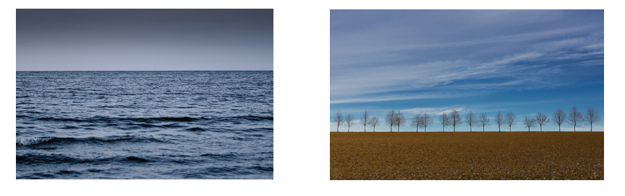
Horizontal
Horizon
Horizon – the line where the earth’s surface and the sky appear to meet.

Slide 5

Which lines are horizontal?
Have a think
a)
no
b)
yes
c)
yes
d)
no

Slide 6

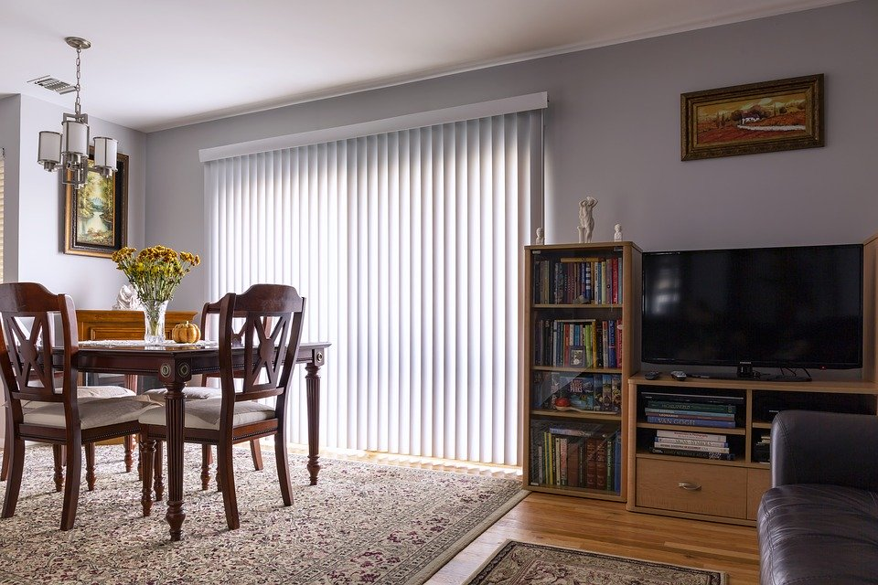
Vertical
Vertical – a straight line where the top is directly above the bottom.

Slide 7


Slide 8
Is each line horizontal, vertical or neither?
Have a think
a)
b)
c)
d)
e)
horizontal | vertical | neither
b)
c)
d)
a)
e)

Slide 9
Does each shape have vertical lines, horizontal lines, both, or neither?
Have a think
a)
neither
b)
both
c)
d)
horizontal
vertical

Slide 10
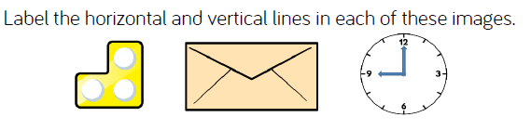

Slide 11
Line of symmetry – a mirror line which divides a shape into 2 identical halves.
This shape has a vertical line of symmetry.

Slide 12
This shape has a horizontal line of symmetry.

Slide 13
This shape has a line of symmetry but it is neither horizontal or vertical.

Slide 14
This shape has 2 lines of symmetry.
It has a horizontal and a vertical line of symmetry.

Slide 15


