Slide 1


Slide 2

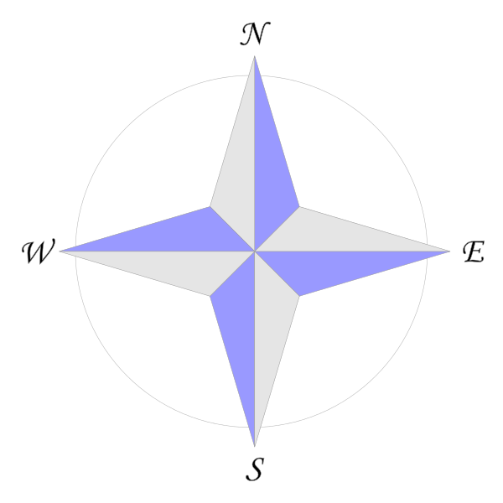
Annie is facing East.
She makes a quarter turn.
Which direction could she be facing now?
2) If Annie faced West and made a half turn, which direction would she be facing?

Slide 3
Annie is facing East.
She makes a quarter turn.
Which direction could she be facing now?
2) If Annie faced West and made a half turn, which direction would she be facing?
South
or North
East

Slide 4
What is an angle?
We see angles where 2 straight lines meet at a point.
An angle is a measure of the amount of turn between two lines

Slide 5
A quarter turn is called a right angle.

Slide 6



Which pairs of lines make right angles?
Which do not make right angles?
Have a think

Slide 7
Which shapes have right angles?
Have a think

Slide 8
There is 1 right angle in a quarter turn.
There are 2 right angles in a half turn.

Slide 9
There is 1 right angle in a quarter turn.
There are 2 right angles in a half turn.
There are 3 right angles in a 3 quarter turn.

Slide 10
There is 1 right angle in a quarter turn.
There are 2 right angles in a half turn.
There are 3 right angles in a 3 quarter turn.
There are 4 right angles in a full turn.

Slide 11
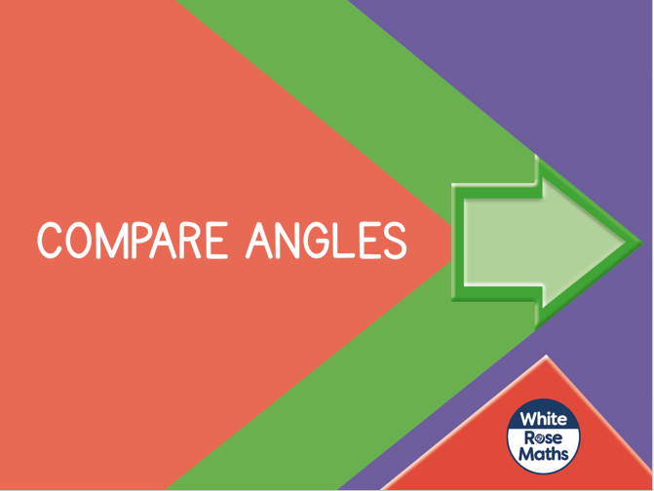


Slide 12

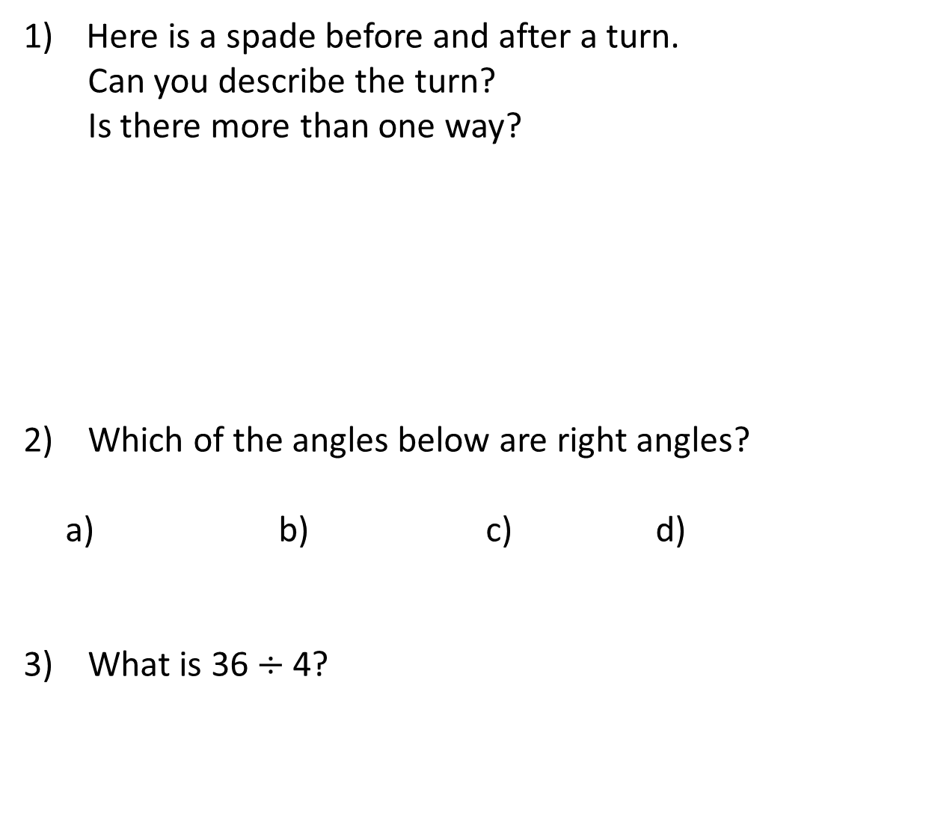
Here is a spade before and after a turn.
Can you describe the turn?
Is there more than one way?
2) Which of the angles below are right angles?
a) b) c) d)
3) What is 36 $÷$ 4?
before
after

Slide 13

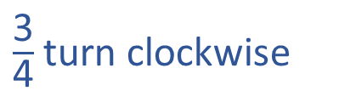

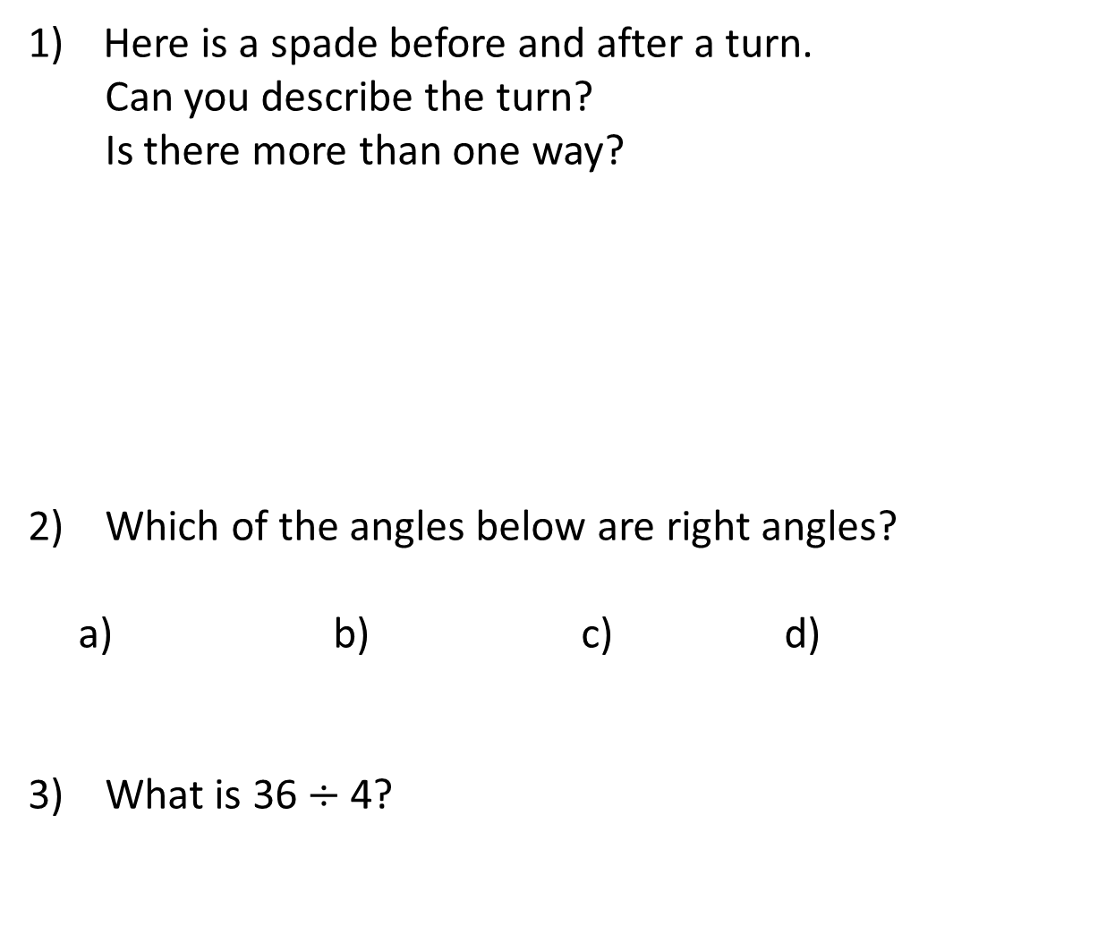
Here is a spade before and after a turn.
Can you describe the turn?
Is there more than one way?
2) Which of the angles below are right angles?
a) b) c) d)
3) What is 36 $÷$ 4?
$\frac{\text{1}}{\text{4}}$turn anti-clockwise
$\frac{\text{3}}{\text{4}}$turn clockwise
before
after
b and c
9

Slide 14
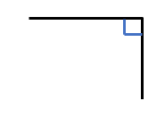
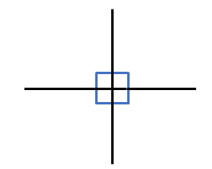
Have a think
right angle
A right angle is a quarter of a full turn.
There are 4 right angles in a full turn.
Angles are measured in degrees.
There are 360 degrees in a full turn.
How many degrees are in one right angle?

Slide 15


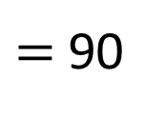
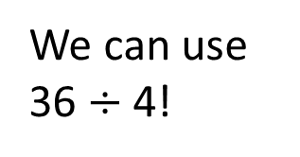
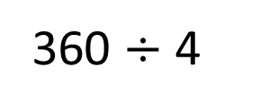
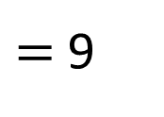
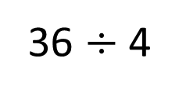
How many degrees are in a right angle?
There are 4 right angles in a full turn.
We can use 36 $÷$ 4!
There are 360 degrees in a full turn.
360 $÷$ 4
$=$ 90
36 $÷$ 4
$=$ 9
There are 90 degrees in a right angle.

Slide 16
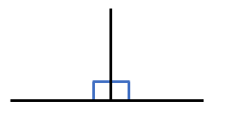
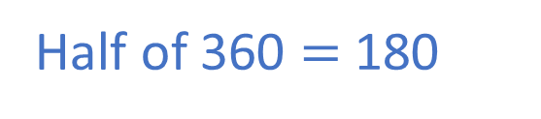
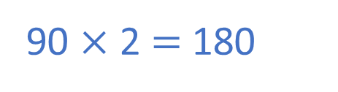
How many degrees are there in half of a full turn?
Two right angles are equal to half of a full turn.
A right angle is 90 degrees.
Have a think
90 × 2 $=$ 180
Half of 360 $=$ 180
There are 180 degrees in half of a full turn.

Slide 17
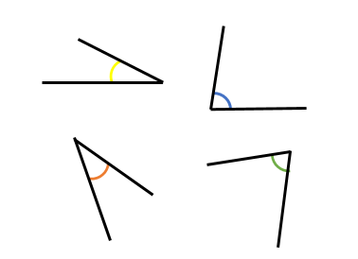
Here are 4 angles.
Have a think
smaller than
All of the angles are ___________ a right angle.
less than
All of the angles are ________ 90 degrees.
Angles less than 90 degrees are called acute angles.

Slide 18
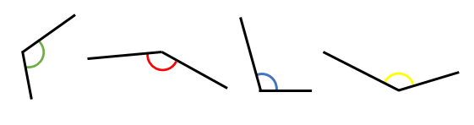
Here are 4 more angles.
Have a think
greater than
All of the angles are ___________ a right angle.
greater than
All of the angles are ___________ 90 degrees.
Angles more than 90 degrees and less than 180 degrees are called obtuse angles.

Slide 19
Put these angles in order from smallest to largest.
a)
b)
c)
d)
right
angle
acute
obtuse
Have a think

Slide 20

I think these are both right angles.
The angle on the left is smaller.
Is Tiny correct?
Have a think
Both angles are equal.
They both measure 90 degrees.

Slide 21
I can see some obtuse angles
I can see some acute angles.
obtuse
obtuse
acute
acute
What types of angles do you see?
Have a think

