Slide 1


Slide 2

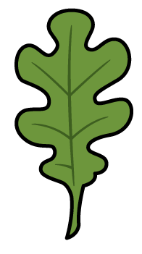
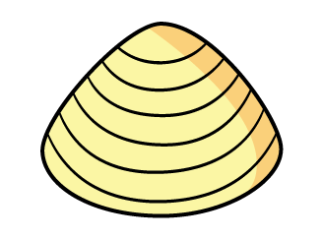
What patterns do you notice?

Slide 3
What is an angle?
We see angles where 2 straight lines meet at a point.
An angle is a measure of the amount of turn between two lines

Slide 4

How do we describe turns?
We can describe the direction of turn.
clockwise
anti-clockwise

Slide 5
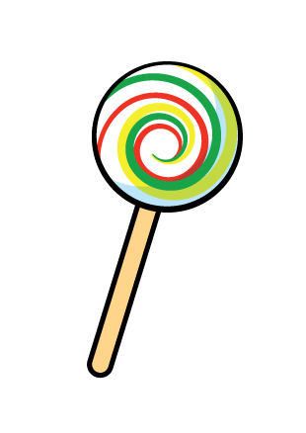
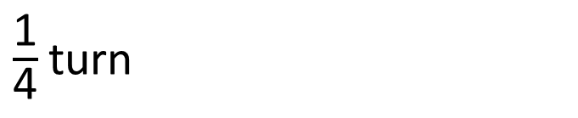
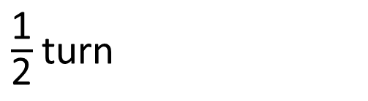
How do we describe turns?
We can describe the size of turn.
$\frac{\text{1}}{\text{4}}$turn
$\frac{\text{1}}{\text{2}}$turn
full turn

Slide 6
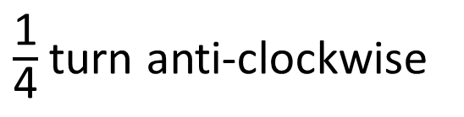
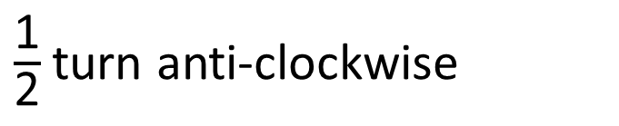
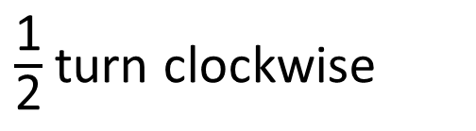
How would you describe these turns?
$\frac{\text{1}}{\text{2}}$turn clockwise
$\frac{\text{1}}{\text{2}}$turn anti-clockwise
$\frac{\text{1}}{\text{4}}$turn anti-clockwise
full turn clockwise

Slide 7
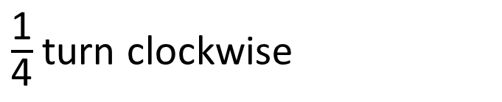
How would you describe these turns?
$\frac{\text{1}}{\text{2}}$turn clockwise
$\frac{\text{1}}{\text{4}}$turn clockwise
$\frac{\text{1}}{\text{4}}$turn anti-clockwise
full turn clockwise

Slide 8
listen to/follow instructions
give instructions
use the correct mathematical language in different contexts
practice making ½ , ¼ , ¾ and whole turns from different starting points in both clockwise and anti-clockwise directions

Slide 9
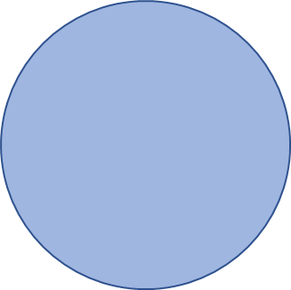

What time will show on each clock after half an hour?
quarter past 3
5 minutes to 4
Have a think

Slide 10
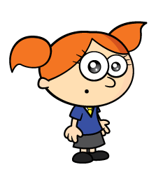

Here is a leaf before and after a turn.
before
after
The leaf made a quarter turn anti-clockwise.
The leaf made a quarter turn clockwise.
Have a think

Slide 11
Here is a leaf before and after a turn.
before
after
The leaf made a half turn anti-clockwise.
The leaf made a half turn clockwise.
Have a think

Slide 12
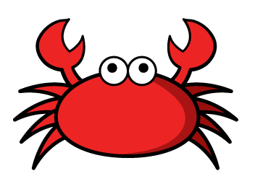
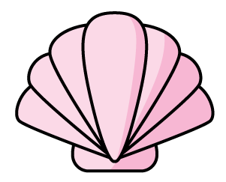
The crab turns to face the pink shell?
How could we describe the turn?
Have a think
The crab could make a quarter turn anti-clockwise.
The crab could make a three-quarter turn clockwise.

Slide 13


