Slide 1


Slide 2

1) What comes next?
Count in halves to 5

Slide 3
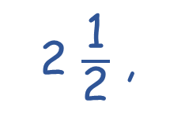
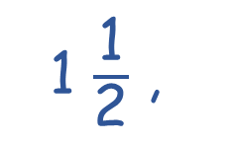
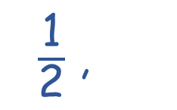
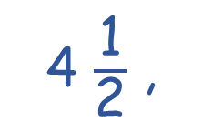
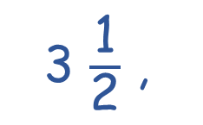
1) What comes next?
Count in halves to 5
$\frac{\text{1}}{\text{2}}$ ,
1 $\frac{\text{1}}{\text{2}}$ ,
2 $\frac{\text{1}}{\text{2}}$ ,
3 $\frac{\text{1}}{\text{2}}$ ,
4 $\frac{\text{1}}{\text{2}}$ ,
1,
2,
3,
4,
5

Slide 4

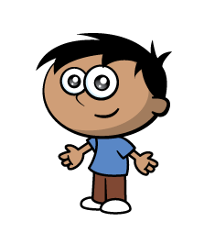
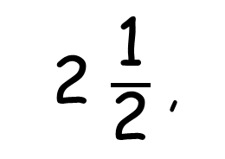
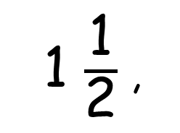
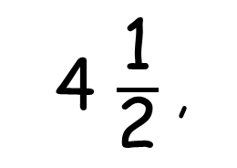
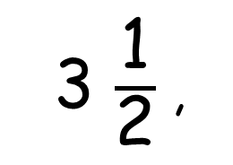
I can count in halves
1 $\frac{\text{1}}{\text{2}}$ ,
2 $\frac{\text{1}}{\text{2}}$ ,
3 $\frac{\text{1}}{\text{2}}$ ,
4 $\frac{\text{1}}{\text{2}}$ ,
1,
2,
3,
4,
I can count in half hours
1 o’clock,
half past 1,
2 o’clock,
half past 2,
3 o’clock,
half past 3,
4 o’clock,
half past 4,

Slide 5
I can count in halves
1 $\frac{\text{1}}{\text{2}}$ ,
2 $\frac{\text{1}}{\text{2}}$ ,
3 $\frac{\text{1}}{\text{2}}$ ,
4 $\frac{\text{1}}{\text{2}}$ ,
1,
2,
3,
4,
I can count in half hours
1 o’clock,
half past 1,
2 o’clock,
half past 2,
3 o’clock,
half past 3,
4 o’clock,
half past 4,

Slide 6


What do you notice?
1 o’clock,
half past 1,
2 o’clock,
half past 2,
Have a think
3 o’clock,
half past 3,

Slide 7
1 o’clock,
At o’clock times, the minute hand points to the 12.
2 o’clock,
3 o’clock,

Slide 8
half past 1,
At half past the hour, the minute hand points to the 6
half past 2,
half past 3,

Slide 9

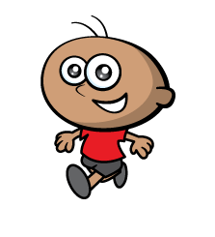
It’s 12 o’clock
10 o’clock

Slide 10
It’s 12 o’clock
11 o’clock

Slide 14
Have a think
p
a
s
t
half past 4

Slide 15
Have a think
p
a
s
t
half past 5

Slide 16
half past __
half past 7

Slide 17
Which clock shows half past 1?
half past 1
Have a think

