Slide 1


Slide 2
How many does each tally represent?
a) b)
What comes next in each sequence?
a) 2, 4, 6, 8, 10, ___, ___, ___, ___, ___
b) 5, 10, 15, 20, 25, ___, ___, ___, ___, ___
c) 10, 20, 30, 40, 50, ___, ___, ___, ___, ___
What is the difference between
a) 8 and 12
b) 25 and 40

Slide 3
How many does each tally represent?
a) b)
What comes next in each sequence?
a) 2, 4, 6, 8, 10, ___, ___, ___, ___, ___
b) 5, 10, 15, 20, 25, ___, ___, ___, ___, ___
c) 10, 20, 30, 40, 50, ___, ___, ___, ___, ___
What is the difference between
a) 8 and 12
b) 25 and 40
13
26
12 14 16 18 20
30 35 40 45 50
60 70 80 90 100
4
15

Slide 5
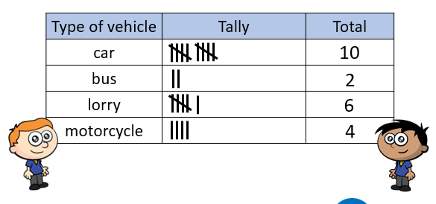
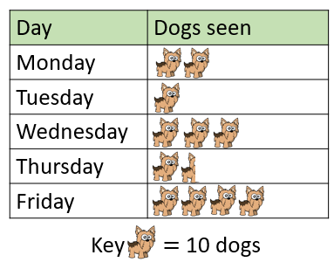
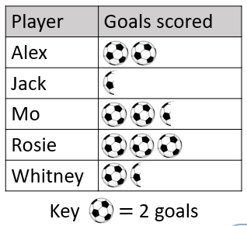

Slide 6
What do you notice?
Children’s Favourite Lessons
English
Maths
Music
PE
Lesson
The most popular lesson is PE.
Music is the least popular lesson.
More children voted for maths than English.

Slide 7
What other information would be useful?
Children’s Favourite Lessons
6
5
4
3
2
1
0
English
Maths
Music
PE
Lesson
5 children chose PE.
2 children chose music.
3 more children chose PE than music.

Slide 8

Children’s Favourite Lessons
12
6
10
5
8
4
3
6
4
2
1
2
0
0
English
Maths
Music
PE
Lesson
Have a think
10
How many children chose PE?
4
How many children chose music?
How many more children chose PE than music?
6

Slide 9
Points Scored in a Game
6
60
12
Player | Points
Annie | 8
Dora | 3
Ron | 11
Teddy | 6
5
50
10
4
40
8
3
30
6
2
20
4
1
10
2
0
Annie
Dora
Ron
Teddy

Slide 10
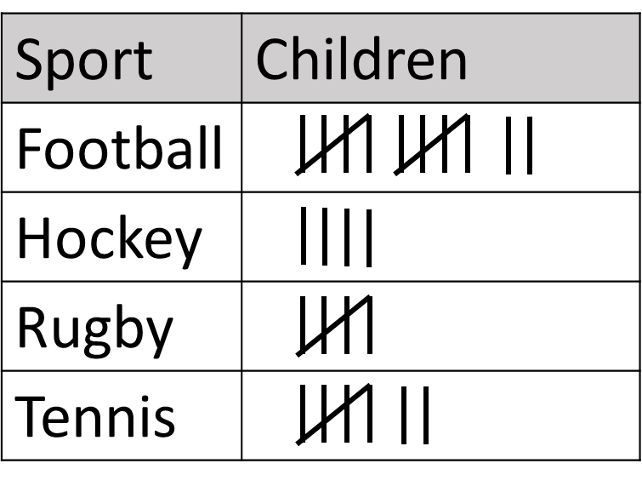
Draw a bar chart for this data.
Children’s Favourite Sports
_____________________
12
10
8
6
Have a think
4
2
0
Football
Hockey
Rugby
Tennis

Slide 11
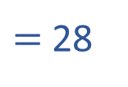

Children’s Favourite Sports
Have a think
12
10
8
6
4
2
$=$ 28
12 $+$ 4 $+$ 5 $+$ 7
0
Football
Hockey
Rugby
Tennis
1) Which sports were preferred by an odd number of children? ______ and ______
rugby
tennis
8
2) How many fewer children chose hockey than football? __
3) How many children were asked for their favourite sport? _____
28

Slide 12
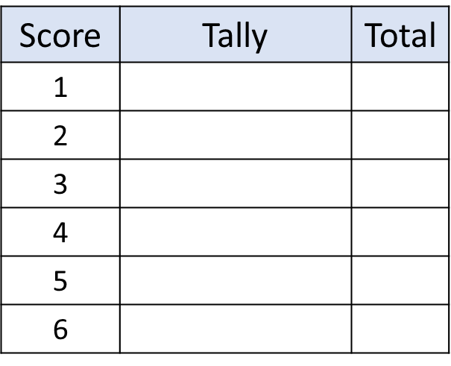

If I roll a dice 30 times, how many times is each number rolled?
First create a tally chart.
Then roll the dice and tally each score.
After 30 rolls, total how many times each number was rolled.
Now present your data on a bar chart.
Can you think of your own question to investigate?

