Slide 1
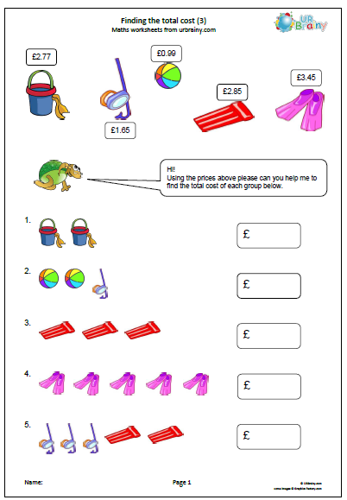
4/2/21 Show your workings out and methods

Slide 2


