Slide 1
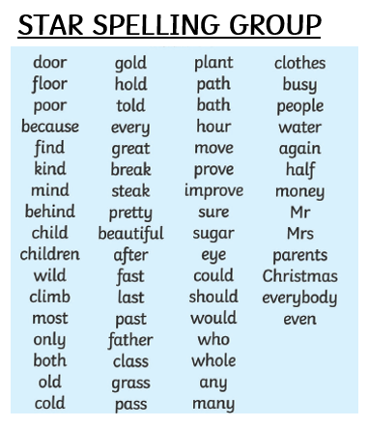
LIST 11 ily suffix
steady
happy
heavily
greedily
happily
crazy
easy
sleepy
sleepily
easily
lily
heavy
crazily
steadily
greedy

