Slide 1
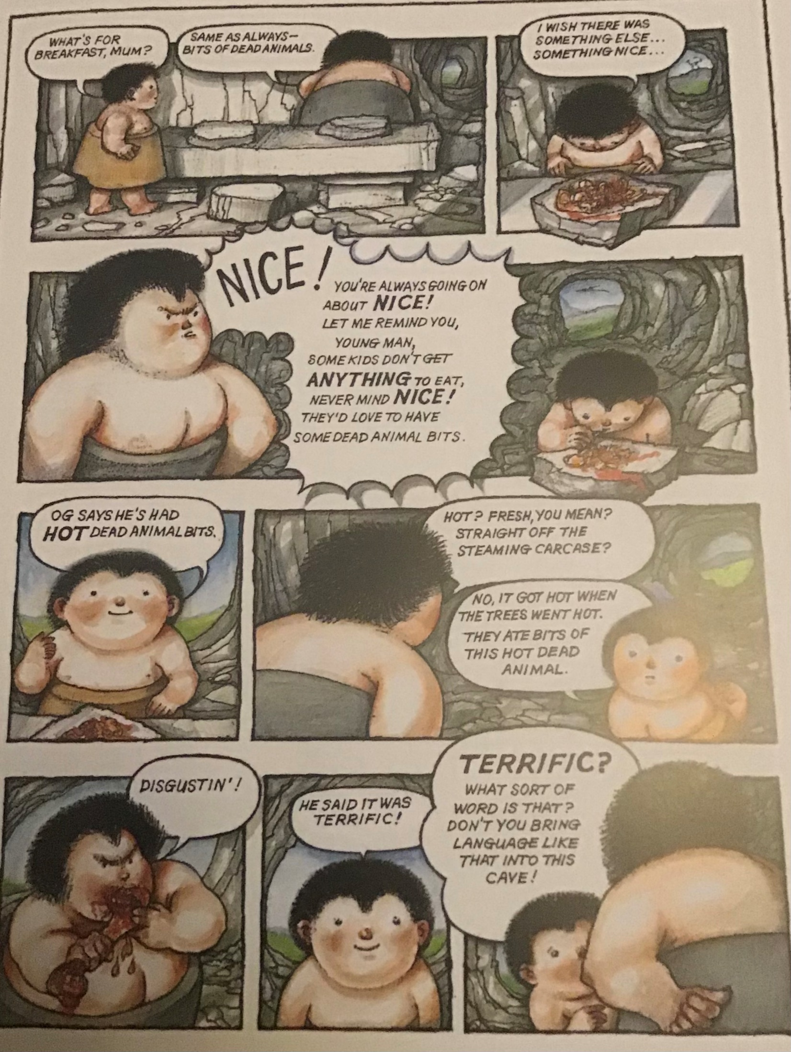
READ PAGE 3

Slide 2
What have you noticed?
What more have we learnt about Ug, his family and his community through the text and illustrations?
Where is the humour in this page?
How is it created?
What do we know so far about the family?
What words would you use to describe each family member and what behaviour, action or speech have you seen in the story that has led you to that perception?
Friday 8th January 2021
Write a character description
describe the character’s external characteristics, e.g. words that might be used to describe their appearance, phrases to describe interests, or talents, things that they do or the clothing they wear (they could also write down the type of things that they say or how they say them)
describe internal characteristics – words to describe the personality as well as thoughts and feelings

