Slide 1
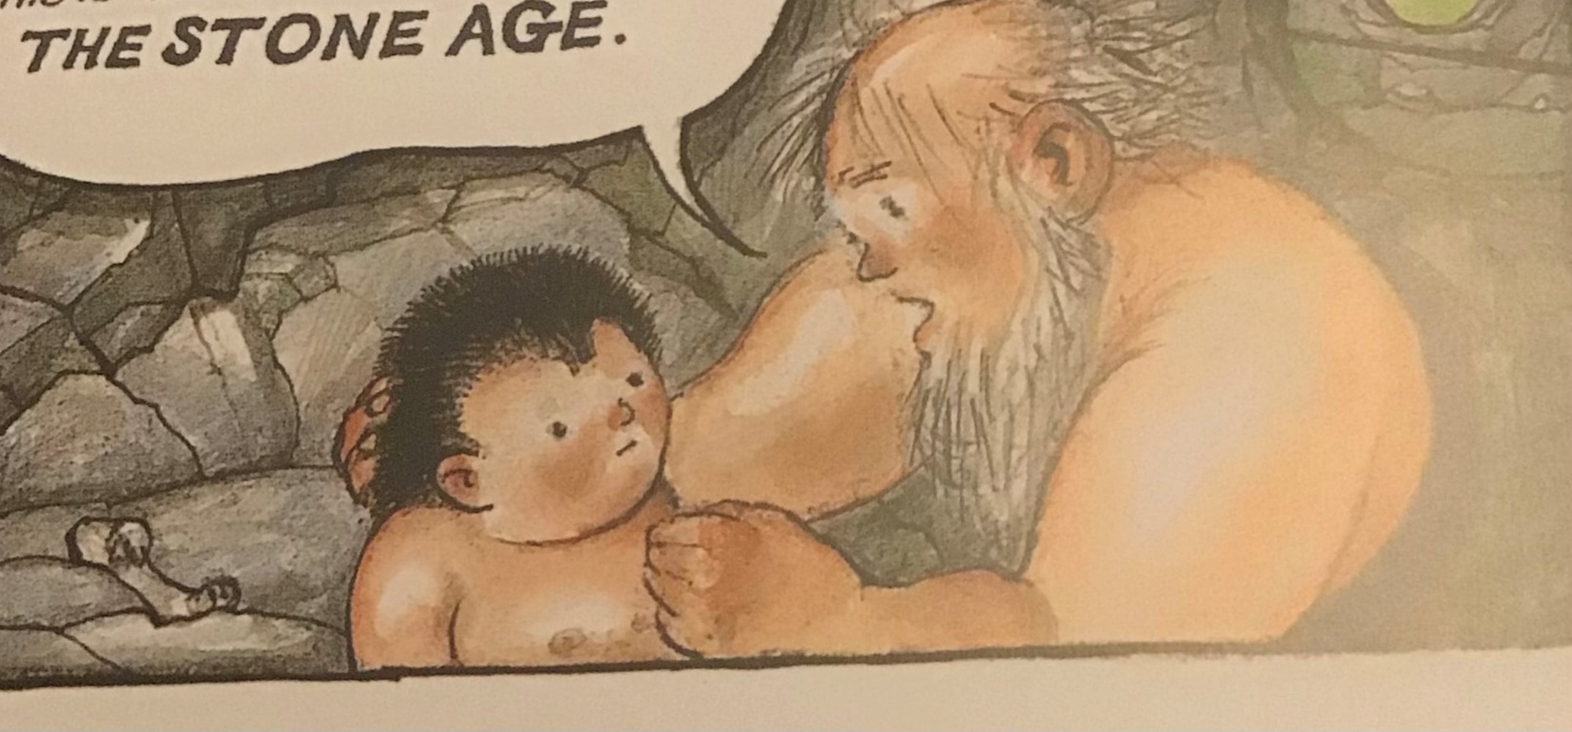
Thursday 7th January 2021
Learning from pictures
What do you know from this illustration?
What would you like to know?

Slide 2
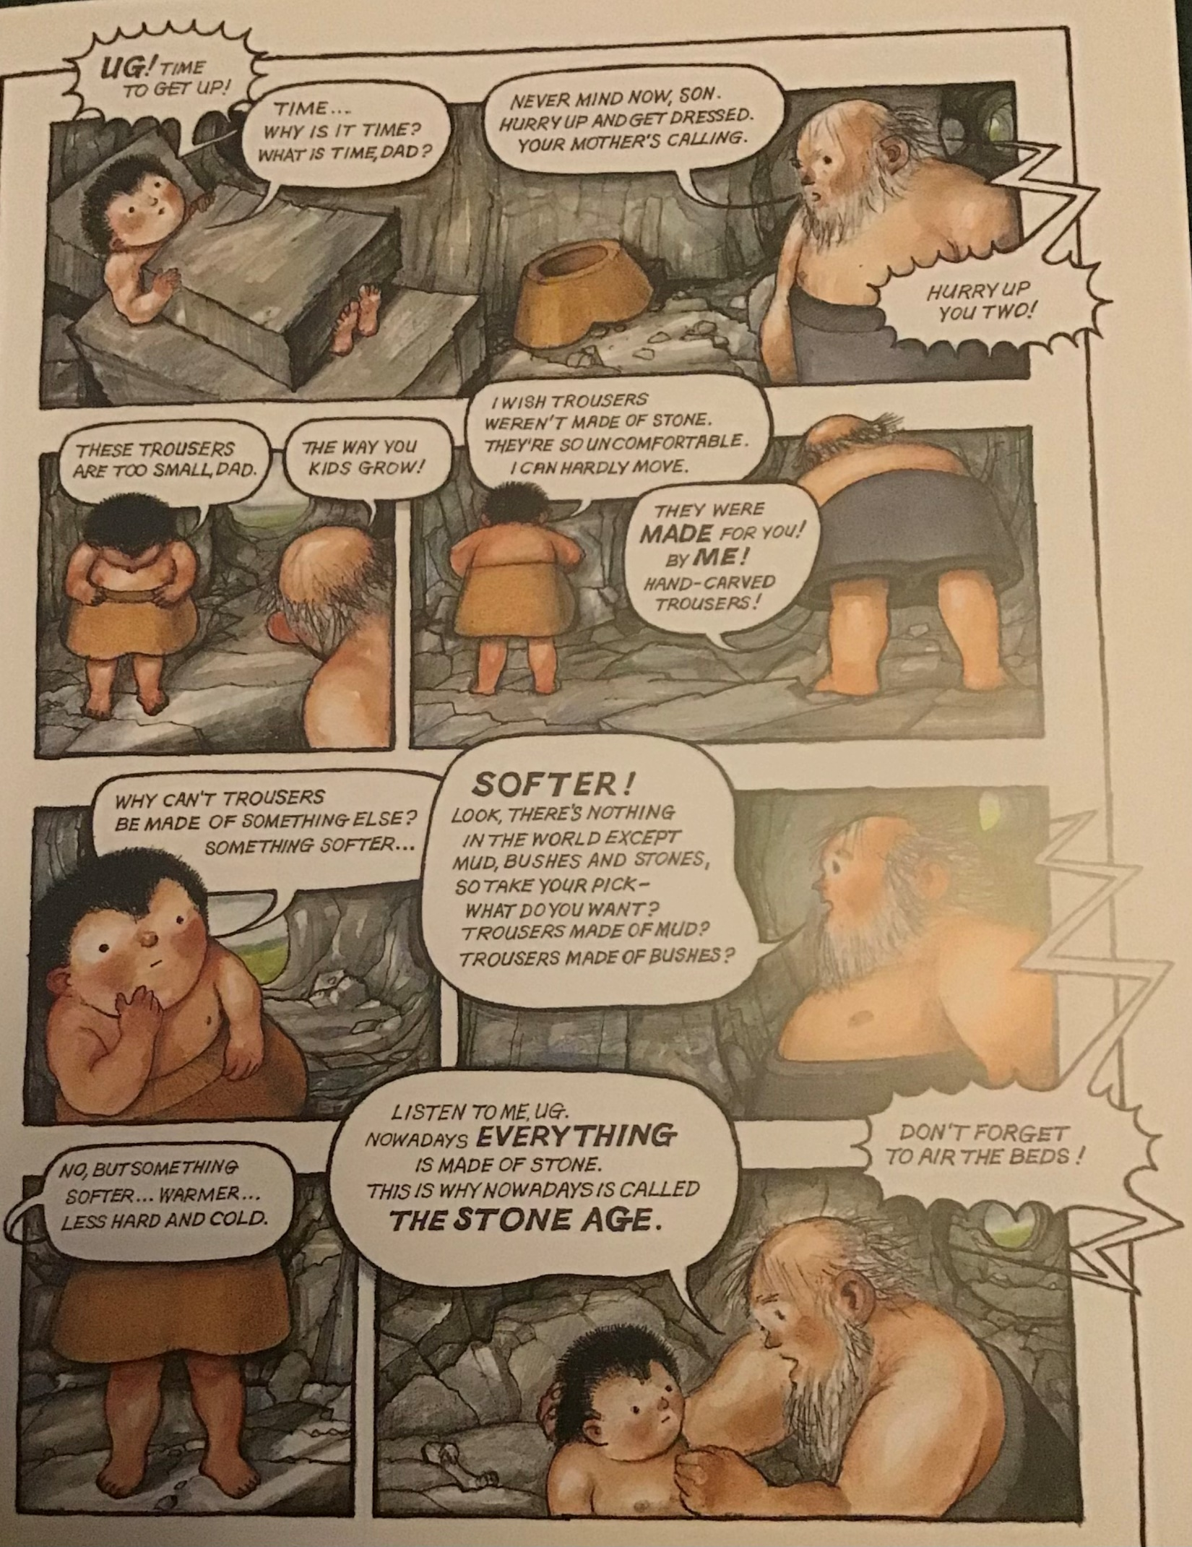
READ PAGE 1 OF THE COMIC BOOK

Slide 3
Ug’s dad says “Nowadays everything is made of stone. This is why nowadays is called the Stone Age.”
3. Is this true? Was everything made of stone in the Stone Age? Add reasons for your answer.
Look at how Raymond Briggs uses exaggeration in order to create humour for the book.
Would Stone Age humans have worn stone trousers, lain on stone beds under stone blankets and with stone pillows?
Do you think the book will be a factually accurate representation of the era? Why/why not?

Slide 4
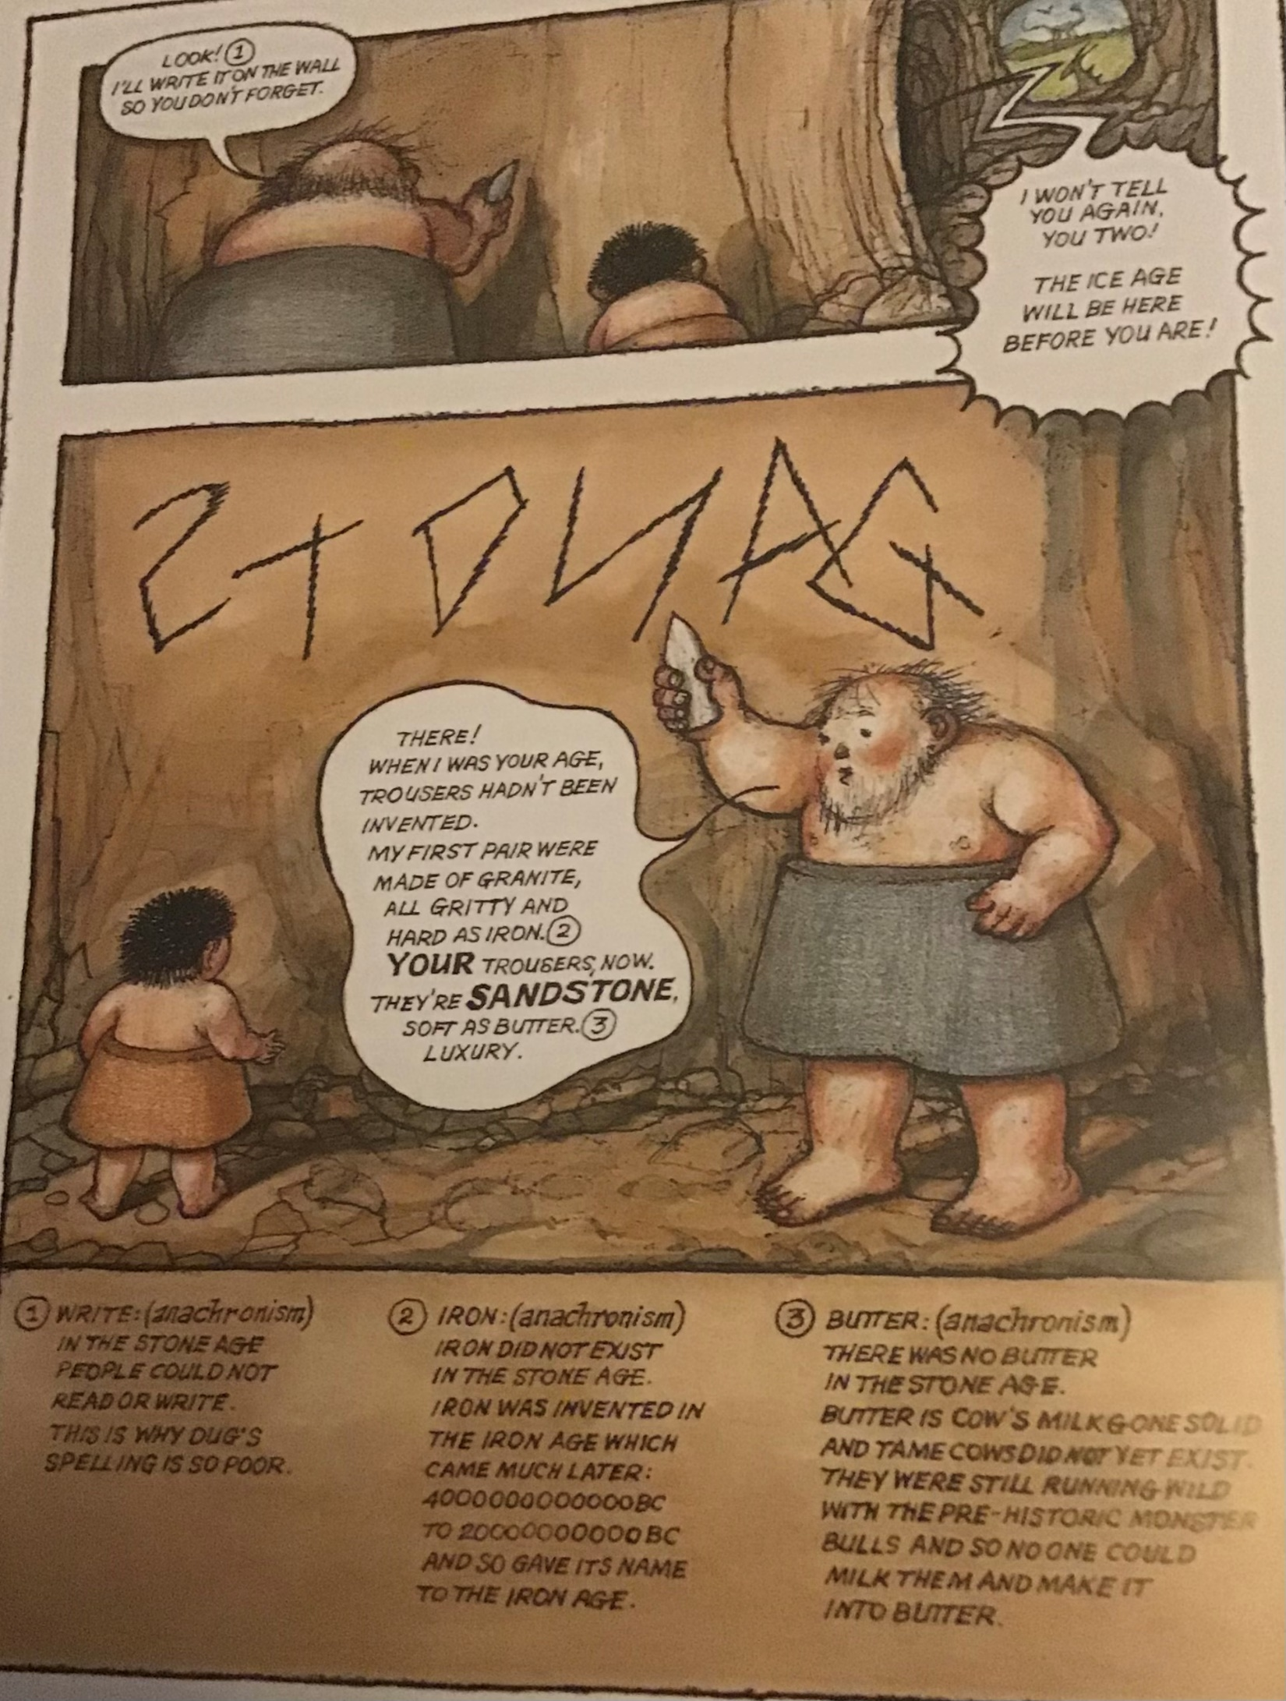
READ PAGE 2

Slide 5
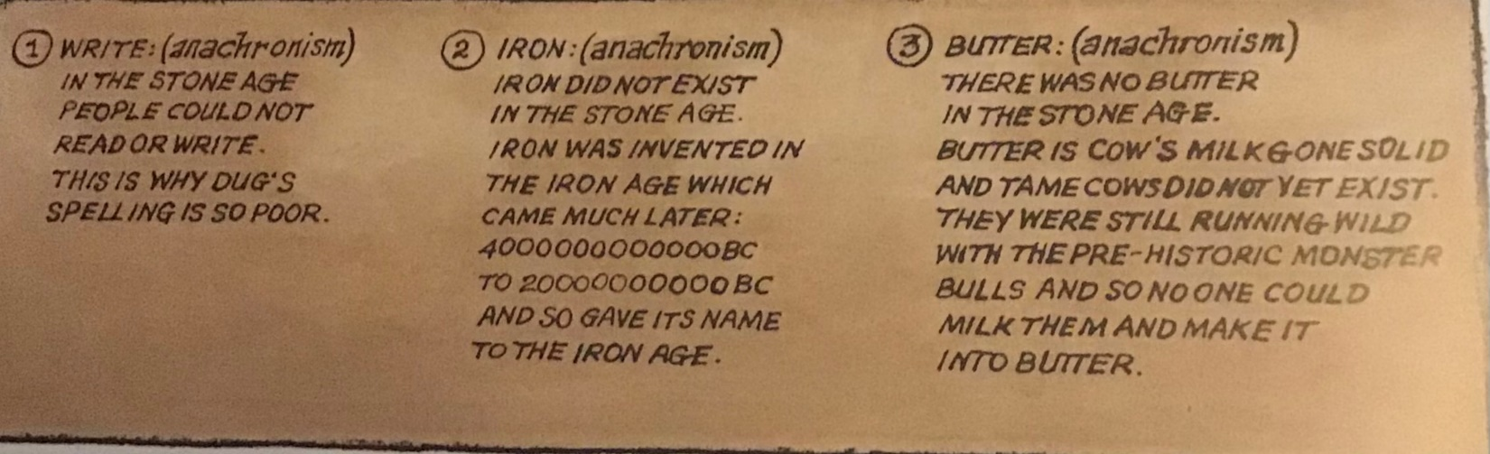
4. Why have footnotes been added to the book?

