Slide 1
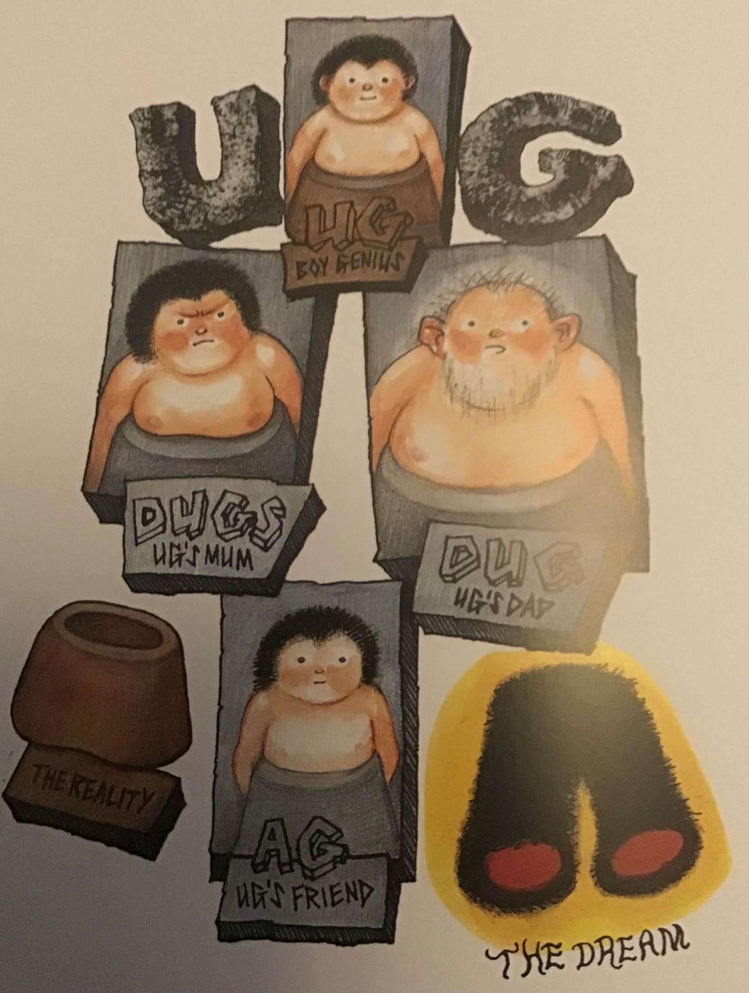

Slide 2
What is the first thing you notice about the illustration? What can you tell about these characters?
What assumptions might we make about them based on their appearance, their dress, their facial expressions, etc.
WRITE ABOUT THE CHARACTERS
What clues are there that might allow us to starting predicting what this story might be about?
Who is the main character?
Where might it be set?
What could happen?
What position might the character be in at the start of the story and how might this have changed by the end?
WRITE NOTES TO THESE PREDICTING QUESTIONS

Slide 3
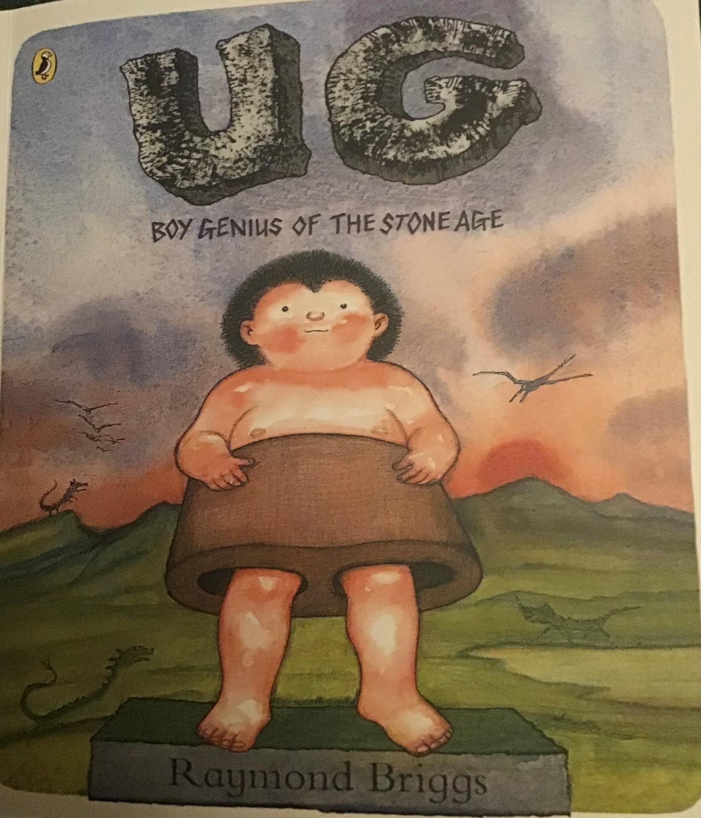
What do you notice?
What more can we tell from the cover of the book?
Does it confirm our original thoughts about the story or provide new possibilities?
What questions or puzzles do we have about the story?
What do we want to find out?
Do our early impressions of this story remind us of anything else that we’ve read/seen/experienced?

