Slide 1
Aim
To calculate complements to 100.
Success Criteria
I can use number facts to 10 to calculate multiple of 10 complements to 100.
I can use a 100 grid to represent complements to 100.
I can use a part-whole model to calculate complements to 100.
I can calculate tens and ones complements to 100.

Slide 2











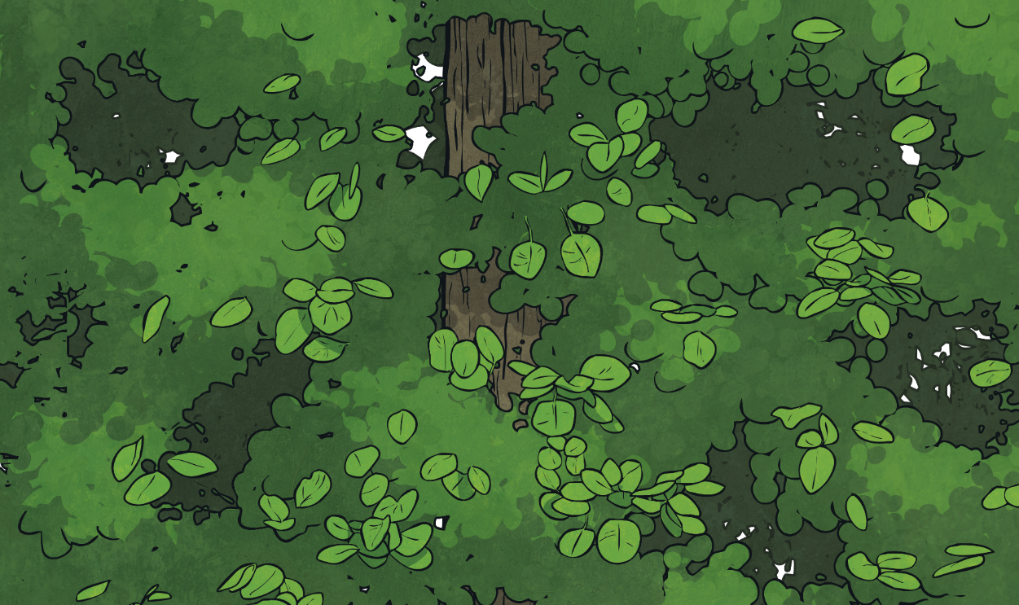

Remember It
Make each ladybird have 10 spots.
Write down the number fact to 10 calculation.
1 + 9 = 10
2 + 8 = 10
3 + 7 = 10
4 + 6 = 10
5 + 5 = 10
6 + 4 = 10

Slide 3
Remember It
Make each ladybird have 10 spots.
Write down the number fact to 10 calculation.
7 + 3 = 10
8 + 2 = 10
9 + 1 = 10
10 + 0 = 10

Slide 4

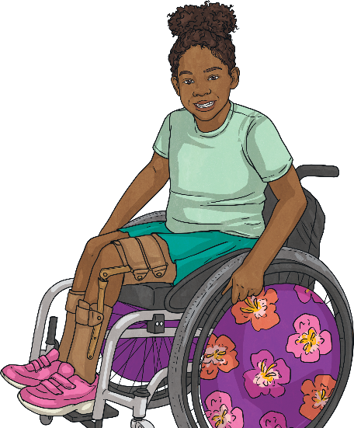
Make 100 - Multiples of 10
10
10 tens equal 100.
How many tens make 100?
20
30
40
50
60
70
80
90
100

Slide 5
Make 100 - Multiples of 10
10
1 + 9 = 10
10 + 90 = 100
90
Explain how we can use our number facts to 10 to help calculate number facts to 100.

Slide 6
Make 100 - Multiples of 10
20
2 + 8 = 10
20 + 80 = 100
80
Explain how we can use our number facts to 10 to help calculate number facts to 100.

Slide 7
Make 100 - Multiples of 10
3 + 7 = 10
30 + 70 = 100
30
70
Explain how we can use our number facts to 10 to help calculate number facts to 100.

Slide 8
Make 100 - Multiples of 10
4 + 6 = 10
40 + 60 = 100
40
60
Explain how we can use our number facts to 10 to help calculate number facts to 100.

Slide 9
Make 100 - Multiples of 10
5 + 5 = 10
50 + 50 = 100
50
50
Explain how we can use our number facts to 10 to help calculate number facts to 100.

Slide 10



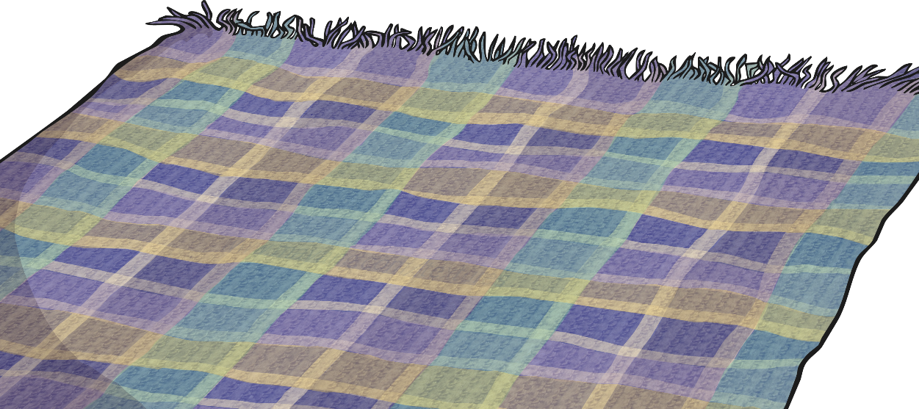
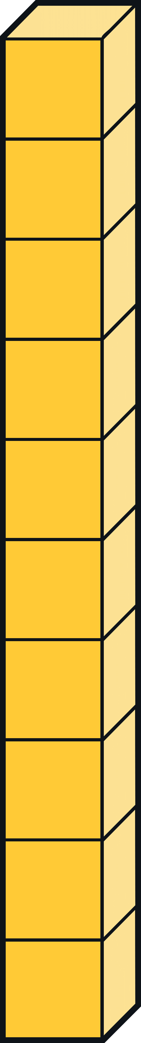
Multiples of 10 Practise
Make 100 with base ten sticks or place value counters.
On your turn, hide any number of tens. Can your partner tell you how many you are hiding as a number fact to 100?
Explain your reasoning.
4 + 6 = 10
40 + 60 = 100
I know you are hiding 6 tens!

Slide 11
Make 100 - Tens and Ones
53 + 47 = 100
50
10
40
Here we have a number fact to 100 using tens and ones.

Slide 12

Make 100 - Tens and Ones
53 + 47 = 100
First, we make 10 ones. 3 and 7 add up to 1 ten, so we need 9 more tens.
50
100
10
53
47
40
53
+
47
50
3
7
40
When we calculate number facts to 100 using tens and ones, the ones must total 10 and the tens must total 90.
10
90

Slide 13
Make 100 - Tens and Ones
First we make 10 ones. 5 and 5 add up to 1 ten, so we need 9 more tens.
20
25 + 75 = 100
10
100
25
75
70
25
+
75
20
5
5
70
When we calculate number facts to 100 using tens and ones, the ones must total 10 and the tens must total 90.
10
90

Slide 14
Make 100 - Tens and Ones
61 + 39 = 100
First we make 10 ones. 1 and 9 adds up to 1 ten, so we need 9 more tens.
60
100
61
39
10
61
+
39
30
60
1
9
30
When we calculate number facts to 100 using tens and ones, the ones must total 10 and the tens must total 90.
10
90

Slide 15
Tens and Ones Practise
Make 100 using 9 base ten sticks and 10 ones cubes.
On your turn hide any number of tens and any number of ones. Can your partner tell you how many you are hiding as a number fact to 100?
Explain your reasoning.
66 + 34 = 100
I know you are hiding 3 tens
and 4 ones!
66
+
34
60
6
4
30
10
90

Slide 16
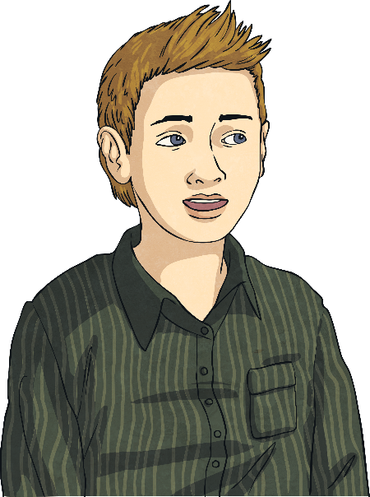
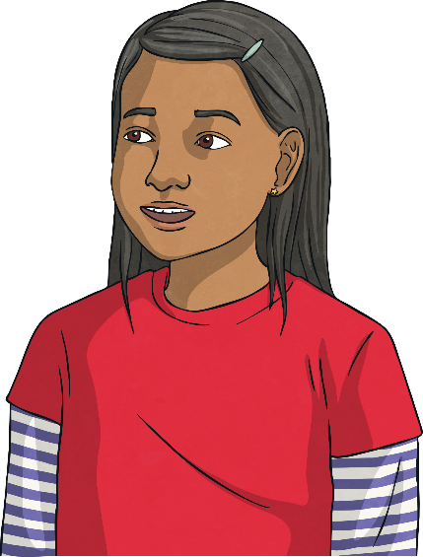

Make 100 - Reasoning
Sam and Ameena are trying to work out the missing number. Who do you agree with? Explain why.
34 + = 100
Sam
Ameena
The missing number
is 76.
The missing number
is 66.

