Slide 1
Aim
To compose and partition three-digit numbers using non-standard partitioning.
Success Criteria
I can partition three-digit numbers in non-standard ways and write the related addition calculation.
I can combine non-standard units of ones, tens and hundreds to compose three-digit numbers and write the related addition calculation.
I can solve problems relating to non-standard partitioning.

Slide 2
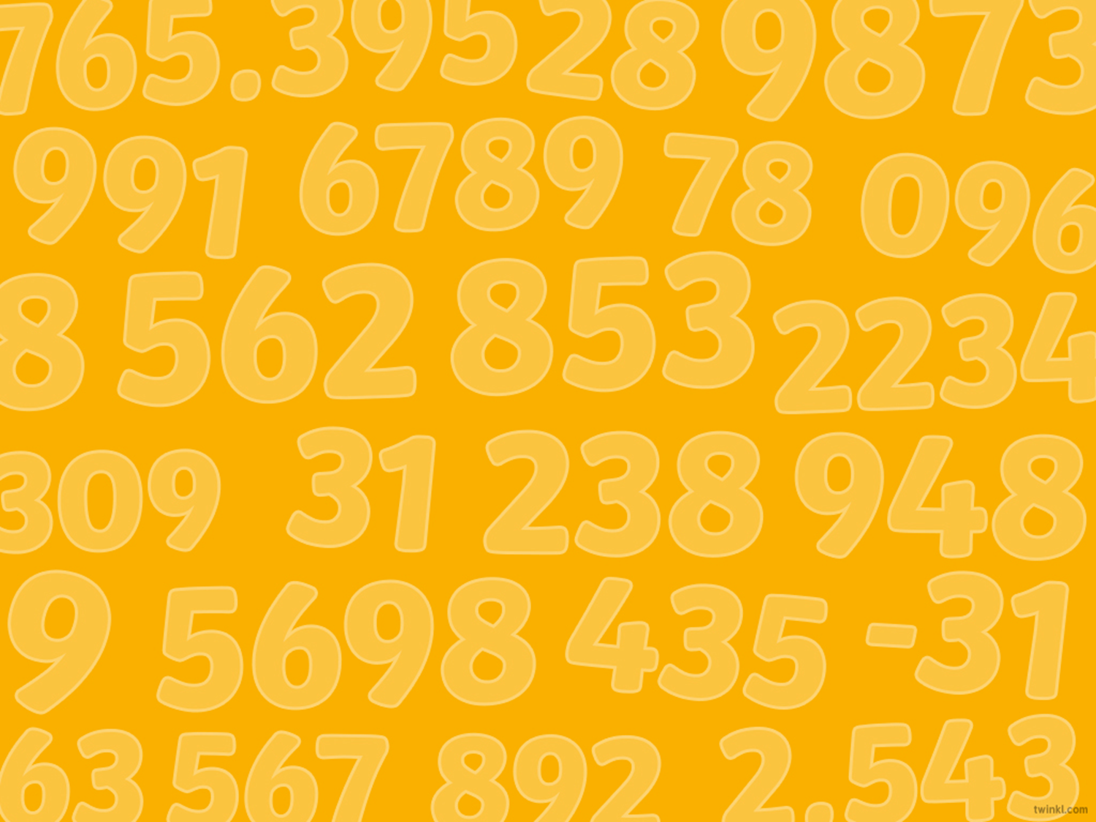







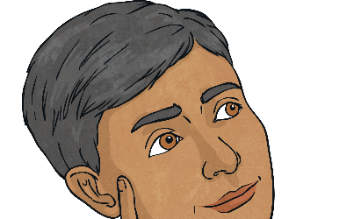

Remember It
Compose the 3-digit numbers.
394
213
475
642
300
90
4
400
70
5
100
1
100
10
10
1
10
100
100
100
100
1
1
10
10
1
100
100
Write the missing parts in these partitioned 3-digit numbers.

Slide 3
Non-Standard Partitioning
When we partition a 3-digit number, we are separating the number into hundreds, tens and ones.
standard partitioning
non-standard partitioning
We can do this using standard partitioning or non-standard partitioning. The value of the 3-digit number stays the same.
345
345
300
40
5
200
140
5

Slide 4
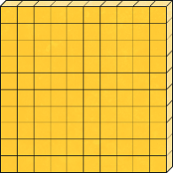

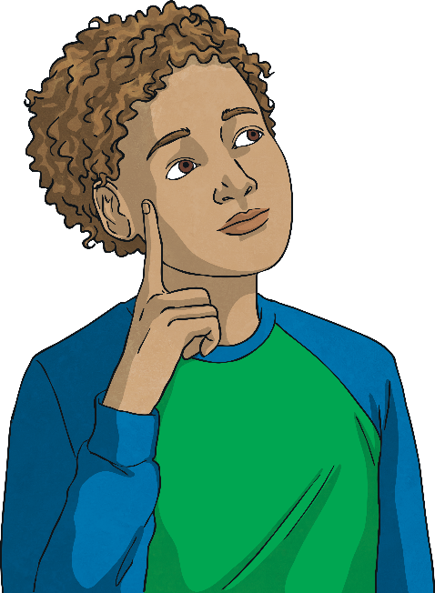

Non-Standard Partitioning
Let’s represent 345 with base ten equipment using standard partitioning:
345 with base ten equipment using non-standard partitioning:
+
+
300
200
40
140
5
Let’s compare this with a non-standard way of partitioning 345:

Slide 5

Non-Standard Partitioning
+
+
300
40
5
How is the non-standard partitioning of 345 different?
+
+
200
140
5

Slide 6

Non-Standard Partitioning
+
+
200
140
5
Can you think of another way to partition 345 using non-standard partitioning?

Slide 7
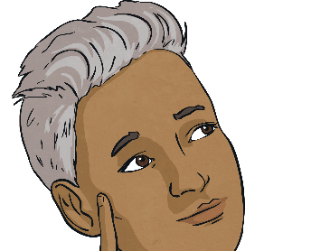

Non-Standard Partitioning
+
+
+
+
230
200
100
90
130
230
220
25
15
25
Did you find any more ways?

Slide 8
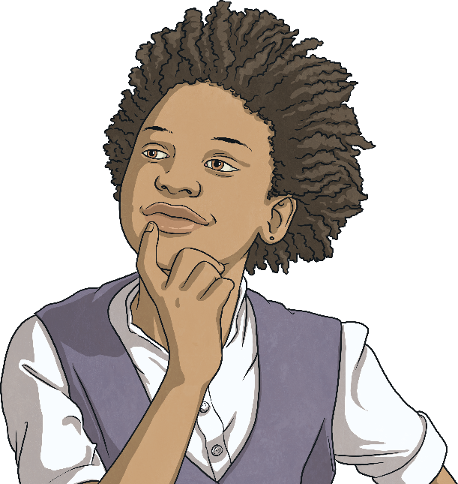
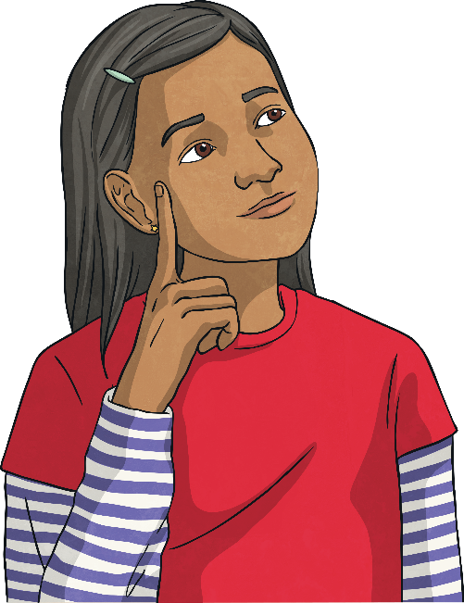
Non-Standard Partitioning
Find three different ways to partition 436 using non-standard partitioning.
+
+
400
30
6
Try exchanging 100 for 10 tens and making different groups of the base ten.
One possible way is
350 + 80 + 6.
What other ways did you find?

Slide 9

Non-Standard Composing
What 3-digit number is shown here using non-standard unit parts?
+
+
110
100
50
70
14
4
174

Slide 10

Non-Standard Composing
What 3-digit number is shown here using non-standard unit parts?
Were you able to compose the
3-digit number without the base ten representations?
What methods did you use?
375
200
60
15

Slide 11
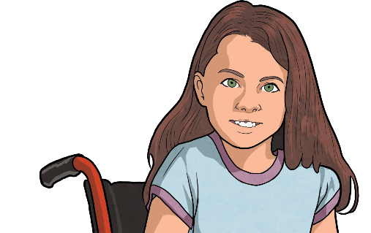
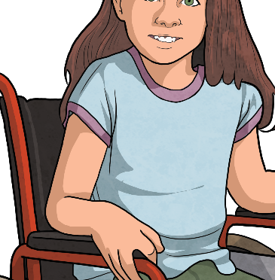
Three-Digit Number Reasoning
Look carefully at how Meera has combined the non-standard unit parts to compose the 3-digit number. Is she correct? Explain your reasoning.
200 + 50 + 7 = 257
257
37
210
10
Meera is correct. The order of the non-standard unit parts doesn’t matter. When the hundreds, tens and ones are regrouped into standard unit parts there are 2 hundreds, 5 tens and 7 ones.

Slide 12
Three-Digit Number Reasoning
Look carefully at how Meera has used the part-whole model to solve this word problem. Is she correct? Explain your reasoning.
A cinema can hold 235 people.
So far, 20 tickets have been
sold for a film.
How many tickets are left?
235 - 20 = 215 There are 215 tickets left.
235
Meera is correct.
Using the part-whole model to subtract a non-standard unit part is a good method.
200
X
20
15

Slide 13
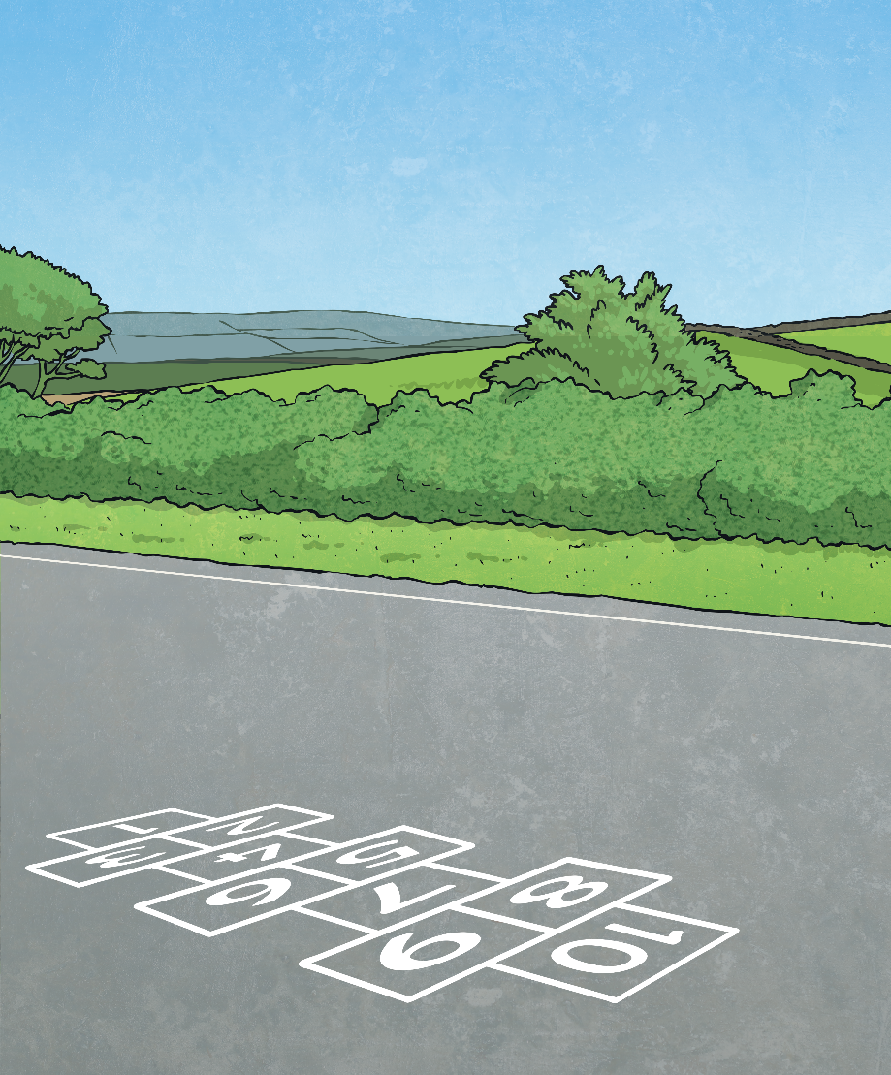
Alice and Gary are playing a game of hopscotch to practise their learning about non-standard partitioning.
Hopscotch
839
600 + 220 + 19
600 + 230 + 29
800 + 30
+ 9
Find a path they can follow.
From the start grid, they are only allowed to hop to non-standard partitioning representations of the 3-digit number at the end of the hopscotch.
83 tens and
9 ones
1 hundred and 739 ones
2 hundreds, 63 tens and
9 ones
939 - 100
849 - 20
Start

