Slide 1


Slide 2
How many degrees are there in a right angle?
2) Can you draw a right angle?
3) How many mm are equal to 3 cm?
4) What is the perimeter of this rectangle?
3 cm
7 cm

Slide 3
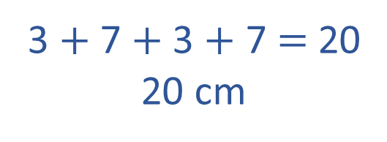

How many degrees are there in a right angle?
2) Can you draw a right angle?
3) How many mm are equal to 3 cm?
4) What is the perimeter of this rectangle?
90
3 cm $=$ 30 mm
7 cm
3 cm
3 cm
3 $+$ 7 $+$ 3 $+$ 7 $=$ 20
20 cm
7 cm

Slide 4

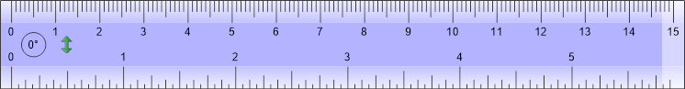

Tommy is trying to measure the brick.
He is struggling.
Have a think

Slide 5
Our Top Tips for Tommy
1. Make sure you’re using the cm side of the ruler
2. Line up the edge of your item with 0 on the ruler
3. Look to see where the other edge of your item lines up with the ruler.
The brick is 5 cm long.

Slide 6
Tommy wants to measure the height of the brick.
The brick is 2 cm tall.

Slide 7



Dora is drawing a line 7 cm long.

Slide 8
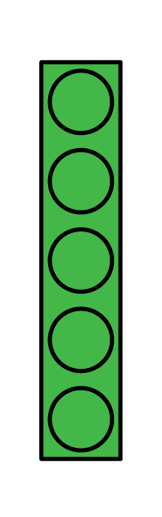
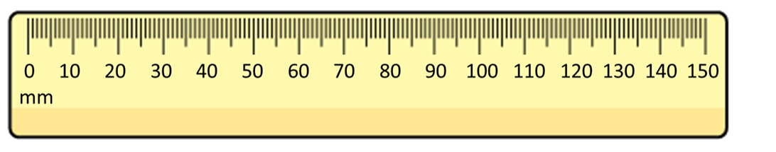
Tommy wants to measure the length of this brick.
The brick is 60 mm
The brick is 58 mm long.

Slide 9
Dora is drawing a 65 mm by 65 mm square.

Slide 10

Dora wants to find the length of the diagonal.
The diagonal is 90 mm long.
That’s the same as 9 cm

Slide 11
Sort the measurements into the table below.
Shorter than 1 m | Longer than 1 m
140 cm
850 mm
1 m 11 cm
1050 mm
97 cm
Have a think

Slide 12



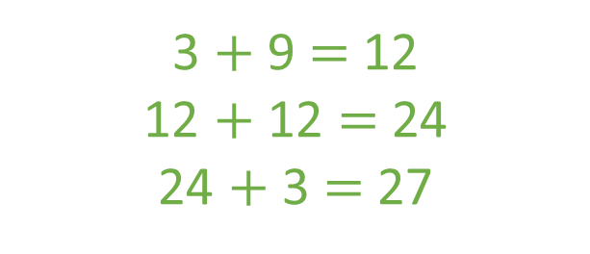

A paperclip is 30 mm long.
A crayon is 9 cm long.
Dexter arranges some paperclips
and crayons like this:
Does his pattern fit onto a 30 cm long piece of paper?
Have a think
Yes
3 cm
30 mm
3 cm
9 cm
30 mm
3 cm
30 mm
9 cm
3 $+$ 9 $+$ 3 $+$ 3 $+$9 $=$ 27
3 $+$ 9 $=$ 12
12 $+$ 12 $=$ 24
24 $+$ 3 $=$ 27
3 $×$ 9 $=$ 27

Slide 13
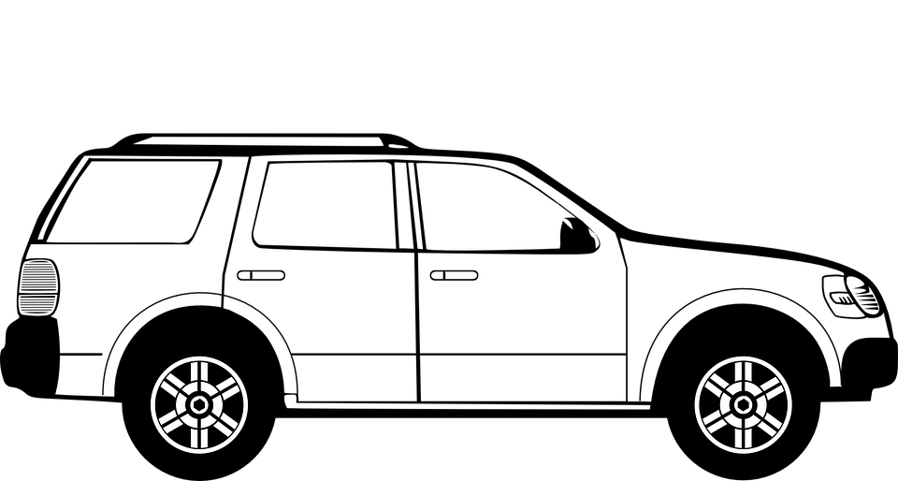
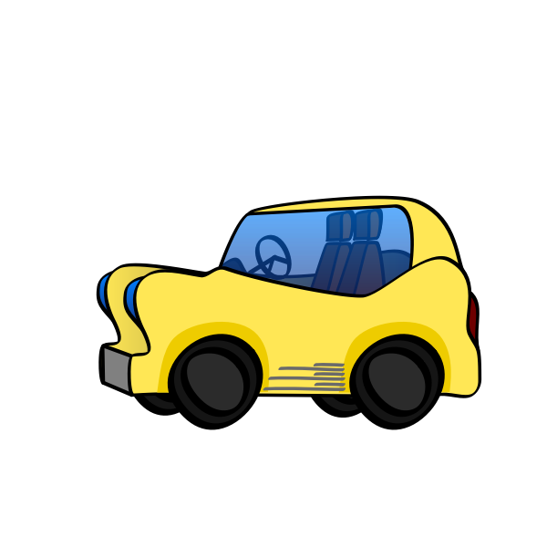


The large car is 145 cm longer than the small car.
The large car is 4 m 50 cm long.
How long is the small car?
____ m ___ cm
3
5
H | T | O
4 | 5 | 0
1 | 4 | 5
4 m 50 cm
Large
450 cm
4
1
145 cm
$$−$$
?
Small
305 cm $=$ 3 m 5 cm
3
0
5

