Slide 1


Slide 2
What’s the same? What’s different?

Slide 3
What’s the same? What’s different?
Same:
They both have 4 straight sides and 4 vertices.
They both have 4 right angles.
Adjacent sides are perpendicular.
Opposite sides are equal.
Opposite sides are parallel.

Slide 4
What’s the same? What’s different?
Different:
One shape has 2 long sides and 2 short sides and the other has 4 equal sides.
They are both types of rectangle but one is an oblong and one is a square.
The square has a shorter perimeter.

Slide 5
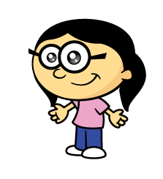

Annie is drawing 2D shapes.
Can I draw a 2D shape with two straight lines?
Have a think

Slide 6
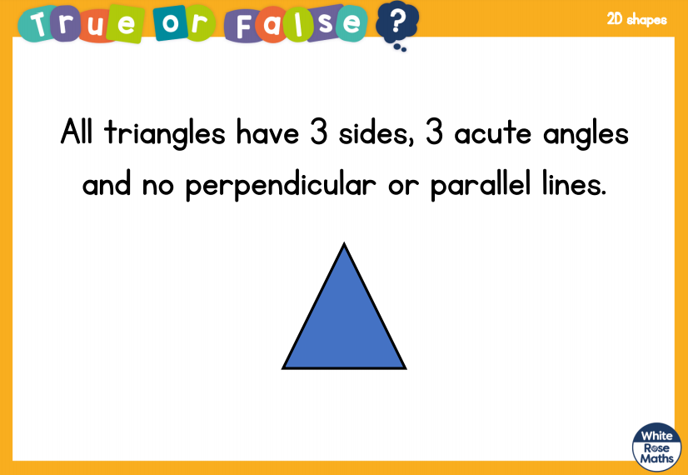

Slide 7
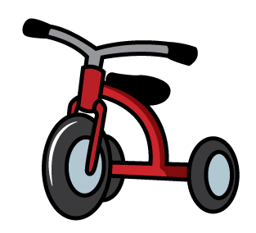
What about 3 straight lines?
Shapes with 3 straight sides and 3 vertices are called triangles.
I can draw lots of different triangles.
tricycle
triathlon

Slide 8
What about 4 straight lines?
Shapes with 4 straight sides and 4 vertices are called quadrilaterals.
rectangle
kite
trapezium
rhombus
There are lots of different shapes with 4 straight sides

Slide 9

Are these shapes both squares?
5 cm
5 cm
5 cm
5 cm
5 cm
5 cm
5 cm
5 cm
square
rhombus
They both have 4 equal sides.

Slide 10
Do shapes with 5 and 6 sides have a special name?
Shapes with 5 straight sides are called pentagons.
Shapes with 6 straight sides are called hexagons.

Slide 11

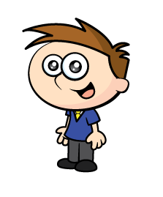
Pentagon Hexagon Neither
Pentagon!
??????
Quadrilateral!
Hexagon!
??????
Pentagon!
Hexagon!
Hexagon!

Slide 12
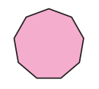

Shapes with 7 straight sides are called heptagons.
Shapes with 8 straight sides are called octagons.
Shapes with 9 straight sides are called nonagons.
Like an octopus!
Shapes with 10 straight sides are called decagons.

