Slide 1


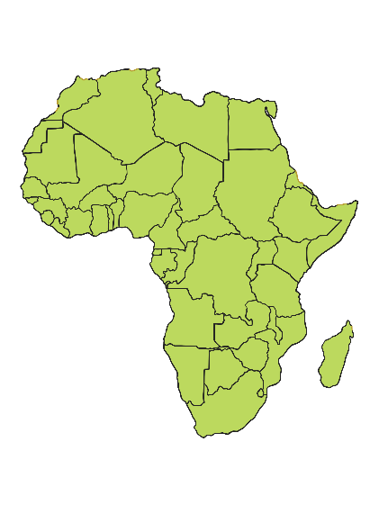
Where Does Chocolate Come From?
Chocolate comes from cacao pods that grow on a cacao tree.
These trees usually grow near the equator because they need a very warm climate to survive.
About 70% of the world’s cacao pods are grown in Africa.

Slide 2
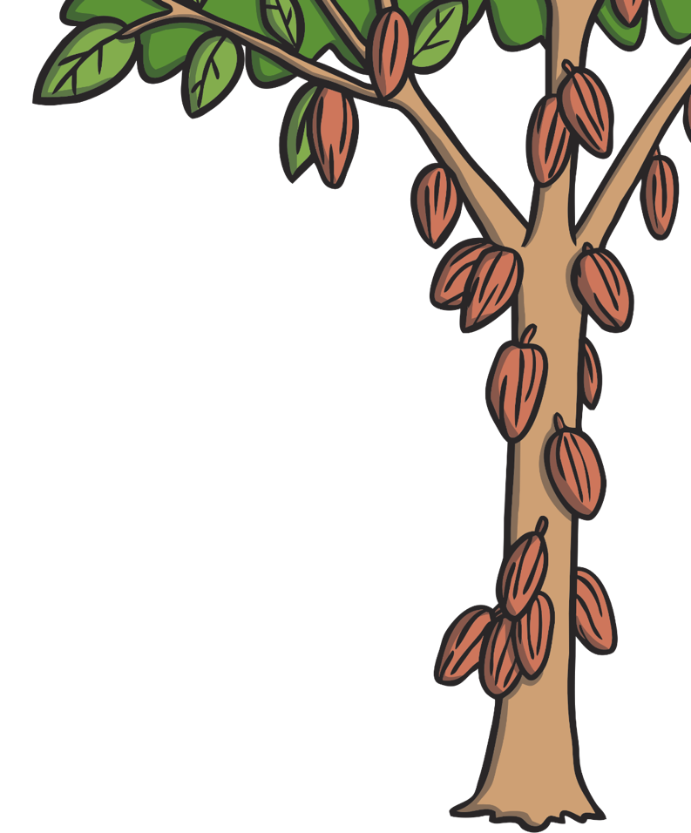




Cacao Pods
Cacao pods grow from trees. When they are ready, they are removed with a machete.
They grow in the shape of a rugby ball.

Slide 3

Cacao Beans
The pods have seeds inside them called cacao beans.
The pods are opened carefully by the workers.
If you were to eat these beans at this point, they would taste very bitter.

Slide 4


Fermenting the Beans
The beans are set aside and left to ferment.
The heat takes the bitter taste away and makes it sweeter.
This process can take around a week.

Slide 5

Drying
After the beans have fermented, they must be dried out.
They are laid out on a flat surface in the sun for up to a week to make sure they are completely dry.

Slide 6
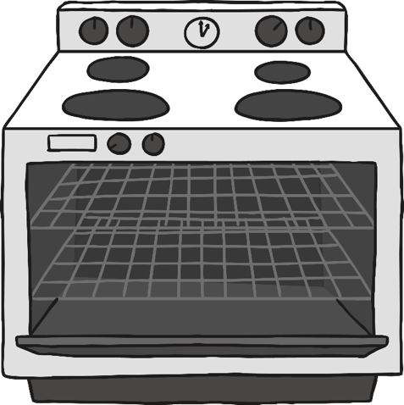
Roasting
Once the beans are dry, they must be roasted.
This can be done in many ways.
In a factory, this takes place in a huge oven and can take from 30 minutes to a few hours.

Slide 7
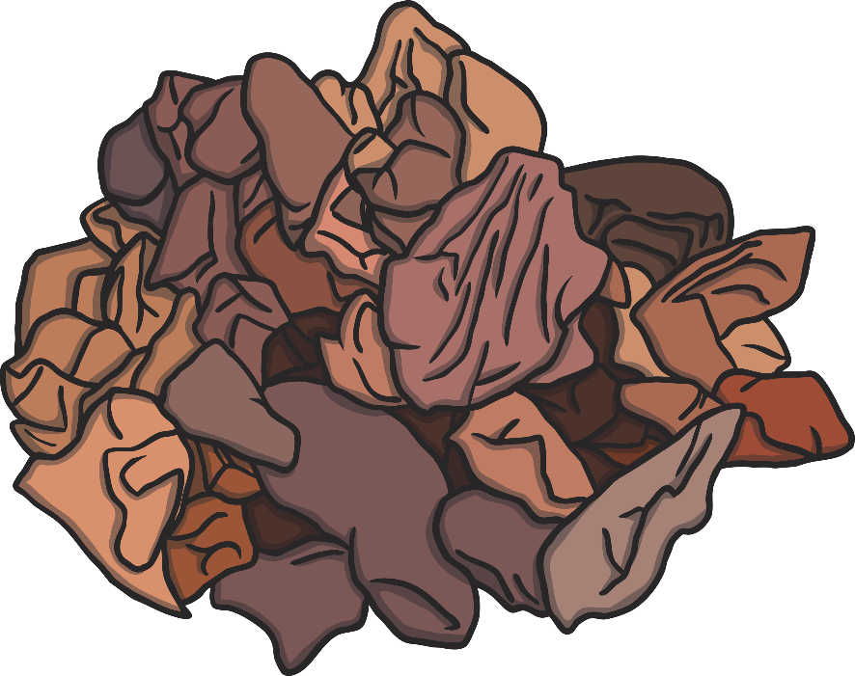
Finding the Nibs!
Once the beans are completely dry and roasted, the chocolatey nibs must be taken from inside.
This is done by crushing the beans. The outer shell cracks and inside are the nibs.

Slide 8
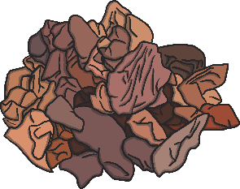
Making a Paste
The cocoa nibs must now
be ground up.
As they are ground, the cocoa butter inside them is released, making the mixture into a paste.
This can take a long time.

Slide 9

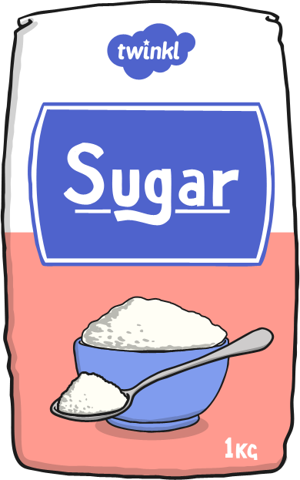
Sweetening
Once the mixture is made, it still tastes very bitter and grainy.
Factories will add ingredients such as sugar and milk to make it taste sweeter and creamier.

Slide 10
No Bits Please!
The mixture would still be very grainy and wouldn’t taste like the chocolate bars that you know at this point.
It must be pressed many times to mix down all of the grains.

Slide 11
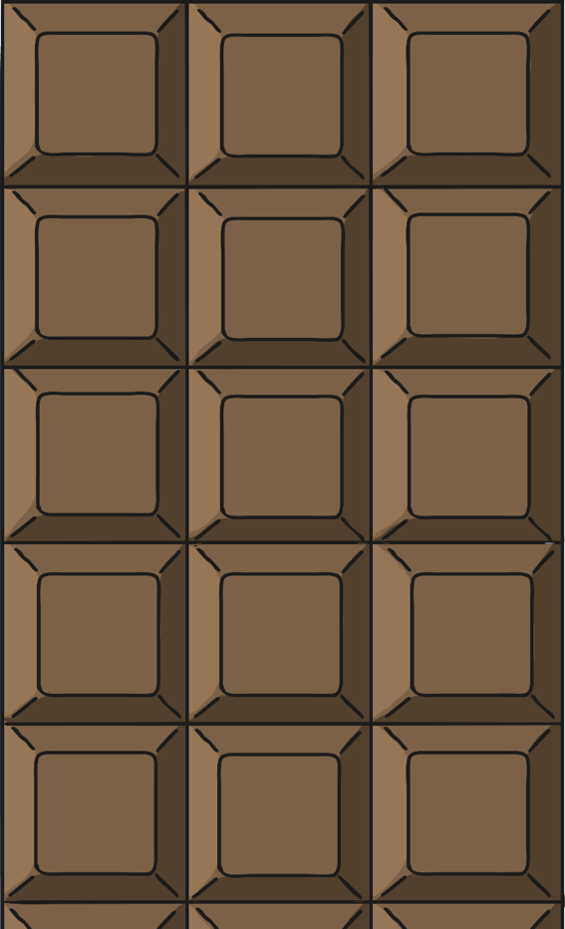
Moulding
Once the chocolate has been processed and melted down, it can be placed into a mould.
This is then wrapped up and sent out to shops for us to buy!

