Slide 2
Aim
To add 3-digit numbers using the formal method of column addition with regrouping.
Success Criteria
I can add 1-digit numbers using mental recall.
I add the digits in the smallest place value column first.
I can regroup into the next place value column if the total is 10 or over.
I write a single digit in the answer box of each place value column.

Slide 3















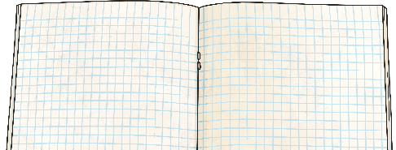


Remember It
Can you write 5 more addition facts involving adding three 1-digit numbers?
Add three 1-digit numbers to solve these addition calculations.
+
+
=
+
+
=
7 + 6 + 4 = 17
5 + 8 + 3 = 16

Slide 4

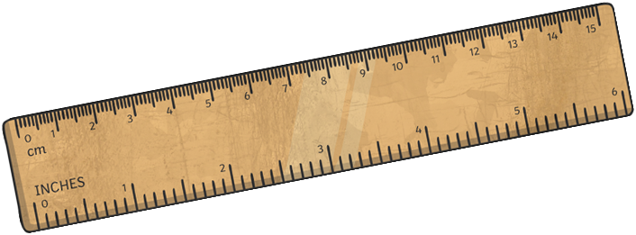


Column Addition
When we use the written method of column addition, we use our understanding of place value to line up the hundreds, tens and ones into columns.
100s | 10s | 1s
245 + 339
 | H | T | O
+
100
100
10
10
1
1
1
2
4
5
10
10
1
1
3
3
9
100
100
100
10
10
10
1
1
1
1
1
1
1
1
1

Slide 5
Column Addition
Now that we have lined up the numbers, we find the total of each column. We always start with the place value column of the smallest value, which is the ones. 5 ones add 9 ones equals 14 ones. We need to regroup 10 ones for 1 ten. We put the regrouped ten into the tens column. This leaves us with 4 ones in the ones column. We write the total of the ones column in the answer box.
100s | 10s | 1s
245 + 339
 | H | T | O
+
100
100
10
10
1
1
1
2
4
5
10
10
1
1
3
3
9
10
10
10
1
1
1
4
100
100
100
1
1
1
1
10
1
1
1

Slide 6
Column Addition
Next, we add the tens. We must remember to add the ten we just regrouped. 4 tens add 3 tens add 1 ten equals 8 tens. We do not need to regroup. We write the total of the tens column in the answer box.
100s | 10s | 1s
245 + 339
 | H | T | O
+
100
100
10
10
1
1
1
2
4
5
10
10
1
1
3
3
9
8
4
100
100
100
10
10
10
1
1
1
10
1
1
1
1
1
1
1

Slide 7
Column Addition
Finally, we add the hundreds. 2 hundreds add 3 hundreds equals 5 hundreds. We do not need to regroup. We write the total of the hundreds column in the answer box.
We have calculated that 245 + 339 = 584.
100s | 10s | 1s
245 + 339
 | H | T | O
+
100
100
10
10
1
1
1
2
4
5
10
10
1
1
3
3
9
5
8
4
100
100
100
10
10
10
1
1
1
10
1
1
1
1
1
1
1

Slide 8
Column Addition
Next, let’s try a column addition where we need to regroup from the tens into the hundreds. First, we need to line up the hundreds, tens and ones into columns.
100s | 10s | 1s
153 + 475
 | H | T | O
+
100
10
10
10
1
1
1
1
5
3
10
10
4
7
5
100
100
100
10
10
10
1
1
1
100
10
10
10
1
1
10

Slide 9
Column Addition
Now that we have lined up the numbers, we find the total of each column. We always start with the place value column of the smallest value, which is the ones. 3 ones add 5 ones equals 8 ones. We do not need to regroup. We write the total of the ones column in the answer box.
100s | 10s | 1s
153 + 475
 | H | T | O
+
100
10
10
10
1
1
1
1
5
3
10
10
4
7
5
10
10
10
1
1
1
8
100
100
100
100
10
10
10
1
1
10

Slide 10
Column Addition
Next, we add the tens. 5 tens add 7 tens equals 12 tens. We need to regroup 10 tens for 1 hundred. We put the regrouped hundred into the hundreds column. This leaves us with 2 tens in the tens column. We write the total of the tens column in the answer box.
100s | 10s | 1s
153 + 475
 | H | T | O
+
100
10
10
10
1
1
1
1
5
3
10
10
4
7
5
10
10
10
1
1
1
2
8
100
100
100
100
10
10
10
1
1
1
10
100

Slide 11
Column Addition
Finally, we add the hundreds. We must remember to add the hundred we just regrouped. 1 hundred add 4 hundreds add 1 hundred equals 6 hundreds. We do not need to regroup. We write the total of the hundreds column in the answer box.
We have calculated that 153 + 475 = 628.
100s | 10s | 1s
153 + 475
 | H | T | O
+
100
10
10
10
1
1
1
1
5
3
10
10
4
7
5
10
10
10
1
1
1
6
2
8
100
100
100
100
100
10
10
10
1
1
1
10

Slide 12
Column Addition
Next, let’s try a column addition where we need to regroup from the ones into the tens and from the tens into the hundreds. Remember, we need to first line up the hundreds, tens and ones in columns.
100s | 10s | 1s
268 + 382
 | H | T | O
+
100
100
10
10
10
1
1
1
2
6
8
10
10
10
1
1
1
3
8
2
1
1
100
100
100
10
10
10
1
1
10
10
10
10
10

Slide 13
Column Addition
Now that we have lined up the numbers, we find the total of each column. We always start with the place value column of the smallest value, which is the ones. 8 ones add 2 ones equals 10 ones. We need to regroup 10 ones for 1 ten. We put the regrouped ten into the tens column. This leaves us with 0 ones in the ones column. We write the total of the ones column in the answer box.
100s | 10s | 1s
268 + 382
 | H | T | O
+
100
100
10
10
10
1
1
1
2
6
8
10
10
10
1
1
1
3
8
2
1
1
10
10
10
1
1
10
0
100
100
100
10
10
10
1
10
10

Slide 14
Column Addition
Next, we add the tens. We must remember to add the ten we just regrouped. 6 tens add 8 tens add 1 ten equals 15 tens. We need to regroup 10 tens for 1 hundred. We put the regrouped hundred into the hundreds column. This leaves us with 5 tens in the tens column. We write the total of the tens column in the answer box.
100s | 10s | 1s
268 + 382
 | H | T | O
+
100
100
10
10
10
1
1
1
2
6
8
10
10
10
1
1
1
3
8
2
1
1
10
10
10
1
1
5
0
100
100
100
10
100
1
1
10
10
10
10
10

Slide 15
Column Addition
Finally, we add the hundreds. We must remember to add the hundred we just regrouped. 2 hundreds add 3 hundreds add 1 hundred equals 6 hundreds. We do not need to regroup. We write the total of the hundreds column in the answer box.
We have calculated that 268 + 382 = 650.
100s | 10s | 1s
268 + 382
 | H | T | O
+
100
100
10
10
10
1
1
1
2
6
8
10
10
10
1
1
1
3
8
2
1
1
10
10
10
1
1
6
5
0
100
100
100
100
10
10
10
1
1
10
10
10

Slide 16







Column Addition Practice
483 | 375 | 269 | 358 | 486
 | H | T | O
+
+
=
841
4
8
3
3
5
8
8
4
1
Practise your column addition skills by finding the total of the
moji pairing.
1
1

Slide 17


Column Addition Practice
483 | 375 | 269 | 358 | 486
 | H | T | O
+
+
=
861
3
7
5
4
8
6
8
6
1
Practise your column addition skills by finding the total of the
moji pairing.
1
1

Slide 18

Column Addition Practice
483 | 375 | 269 | 358 | 486
 | H | T | O
+
+
=
755
2
6
9
4
8
6
7
5
5
Practise your column addition skills by finding the total of the
moji pairing.
1
1

Slide 19

Missing Digits
 | H | T | O
 |  | 8 | 5
+ | 5 |  | 7
 | 8 | 3 | 2
 | 1 | 1
Use your understanding of column addition to work out the missing digits in each calculation.
2
4
 | H | T | O
 | 3 |  | 8
+ | 2 | 6
 | 6 | 2 | 3
 | 1 | 1
 | H | T | O
 | 2 |  | 9
+ |  | 6 | 6
 | 4 | 3 | 5
 | 1 | 1
5
6
5
1

Slide 20
Aim
To add 3-digit numbers using the formal method of column addition with regrouping.
Success Criteria
I can add 1-digit numbers using mental recall.
I add the digits in the smallest place value column first.
I can regroup into the next place value column if the total is 10 or over.
I write a single digit in the answer box of each place value column.

