Slide 1
Lesson Objective
At the end of this lesson we will have looked at how people spoke in Tudor England, and understand it better.

Slide 2
The Inventor
Shakespeare invented over 1700 words.
Do you recognise any of the following? If you do, what do they mean?
Tranquil
Label
Compromise
Accused
Champion
Varied
Lonely
Rant
Outbreak

Slide 3

Keep thy peace!!

Slide 4
Starter
Keep thy peace!!
Now hark...

Slide 5
Starter
Keep thy peace!!
Now hark...
Even now about it!

Slide 6
Starter
Keep thy peace!!
Now hark...
Even now about it!
‘Tis a pretty piece of work!

Slide 7
Starter
Keep thy peace!!
Now hark...
Even now about it!
‘Tis a pretty piece of work!
Why thou false knave!

Slide 8
Starter
Keep thy peace!!
Now hark...
Even now about it!
‘Tis a pretty piece of work!
Why thou false knave!
I thank thee.

Slide 9
Starter
Keep thy peace!!
Now hark...
Even now about it!
‘Tis a pretty piece of work!
Why thou false knave!
I thank thee.
Thou art worthy to be hanged!

Slide 10
Starter
Keep thy peace!!
Now hark...
Even now about it!
‘Tis a pretty piece of work!
Why thou false knave!
I thank thee.
Thou art worthy to be hanged!
Get thee gone!

Slide 11
Starter
Keep thy peace!!
Now hark...
Even now about it!
‘Tis a pretty piece of work!
Why thou false knave!
I thank thee.
Thou art worthy to be hanged!
Get thee gone!
Hence! Follow me not!

Slide 12
Starter
Keep thy peace!!
Now hark...
Even now about it!
‘Tis a pretty piece of work!
Why thou false knave!
I thank thee.
Thou art worthy to be hanged!
Get thee gone!
Hence! Follow me not!
Did I not bid thee hold thy peace?

Slide 13
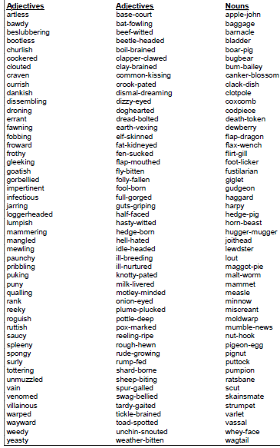
Shakespearean Insults

Slide 14
Shakespeare’s Language
Translate the following phrases from Shakespearian English into modern English:
Canst = Hath = _____________________
Doth = Ist =
Durst = Wilt = ________________
Look to see if the next set appear familiar:
Betwixt = Quoth = _____________
Thou = Thine =
Thee = Yonder =
The following are very common in Shakespeare’s work; have a guess at their translations into modern English:
Avaunt! = Drab =
Forsooth = Ifaith =
Lest = Methinks =
Naught = O’er =
Prithee = Quaff =
Repair = Varlet =
Wench = Zounds! =

