Slide 1
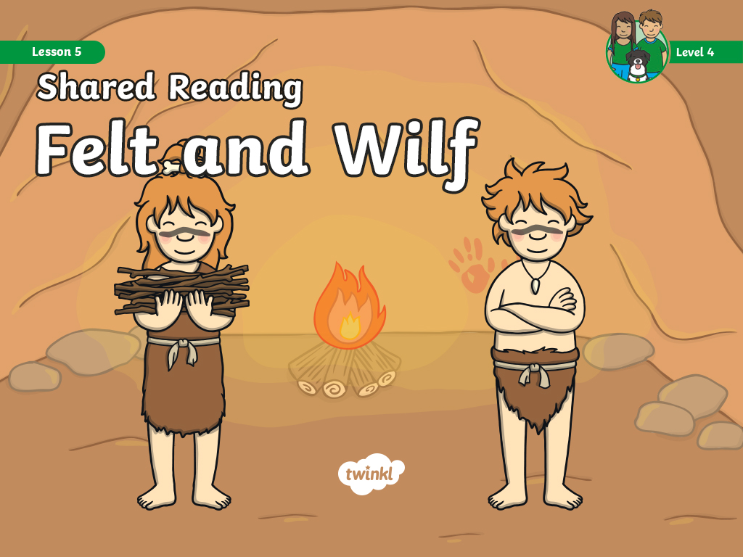

Slide 2

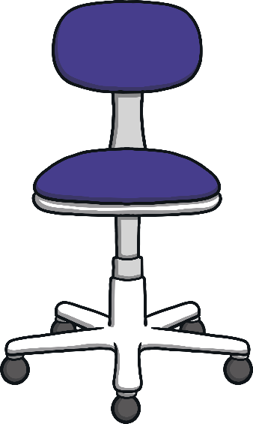

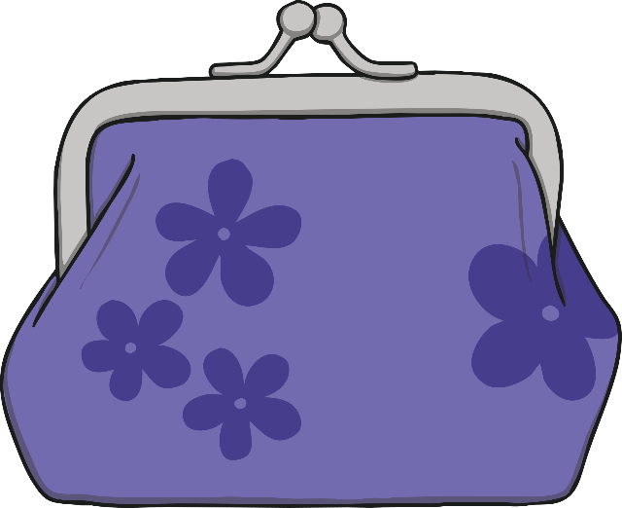

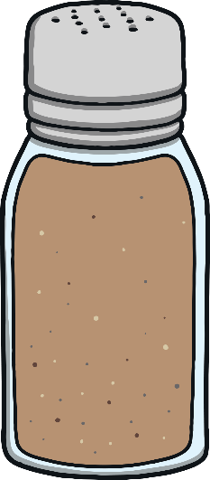

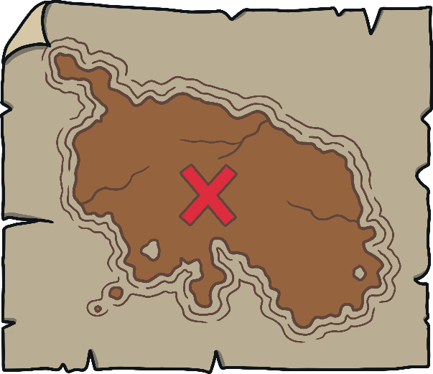
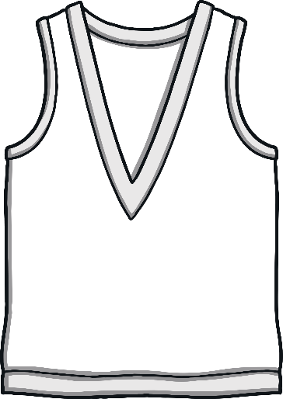

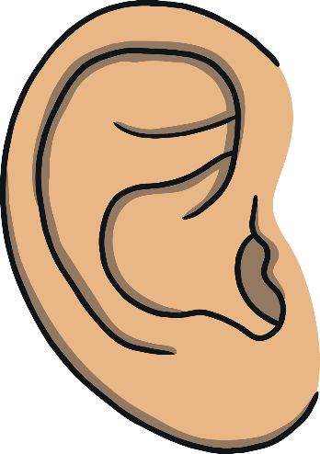
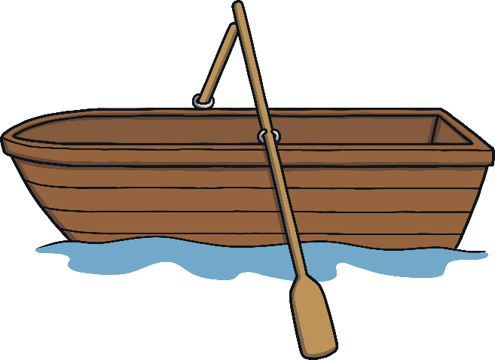



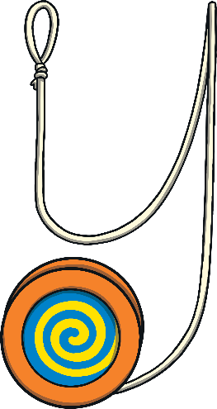
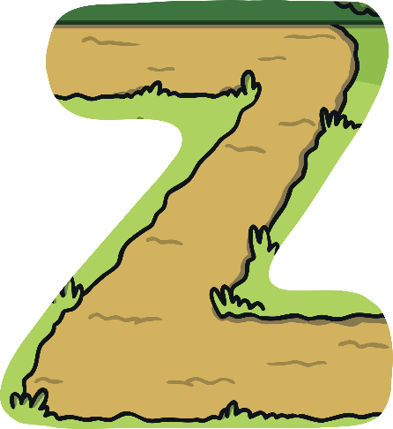



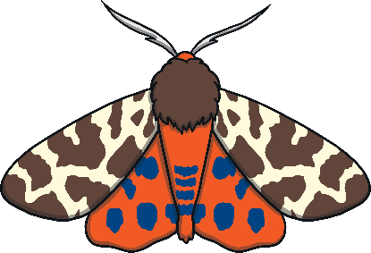


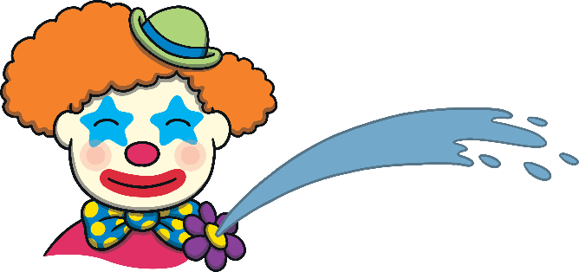
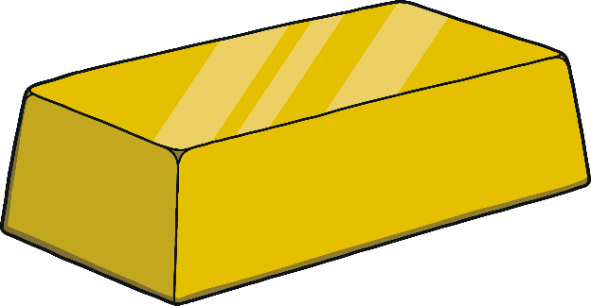

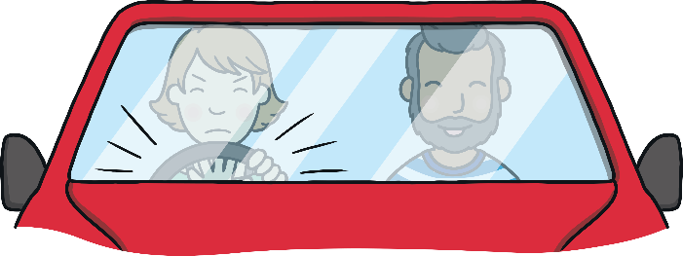


Revisit and Review
Let’s practise Sam’s Sounds and Tricky Words!
air
ure
ai
ear
ng
ow
oi
oa
er
qu
ch
th
ur
ee
oo
w
z
y
x
v
j
ar
igh
sh
or
zz
th
oo
be
my
you
here
are
she
they
me
all
we
was
he
said
so

Slide 3
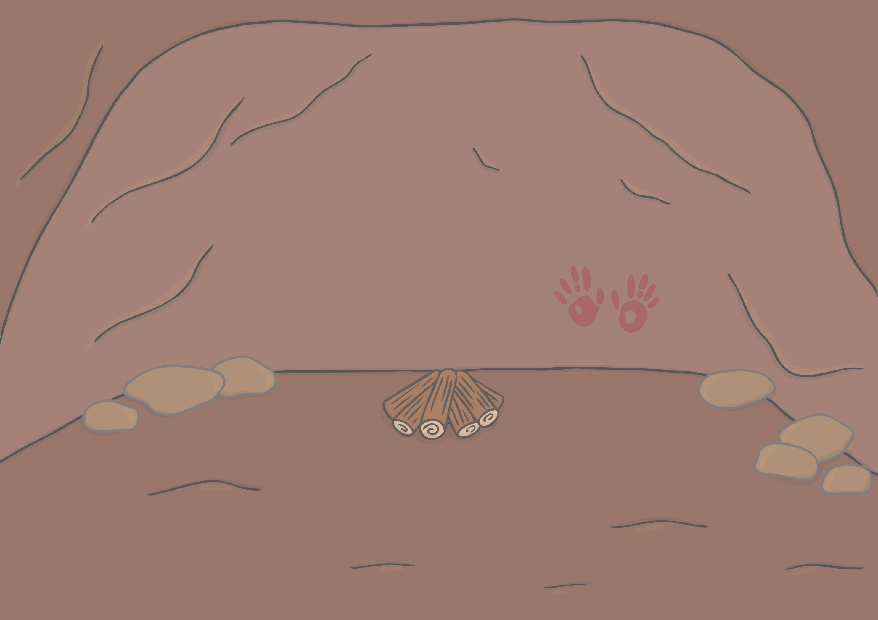
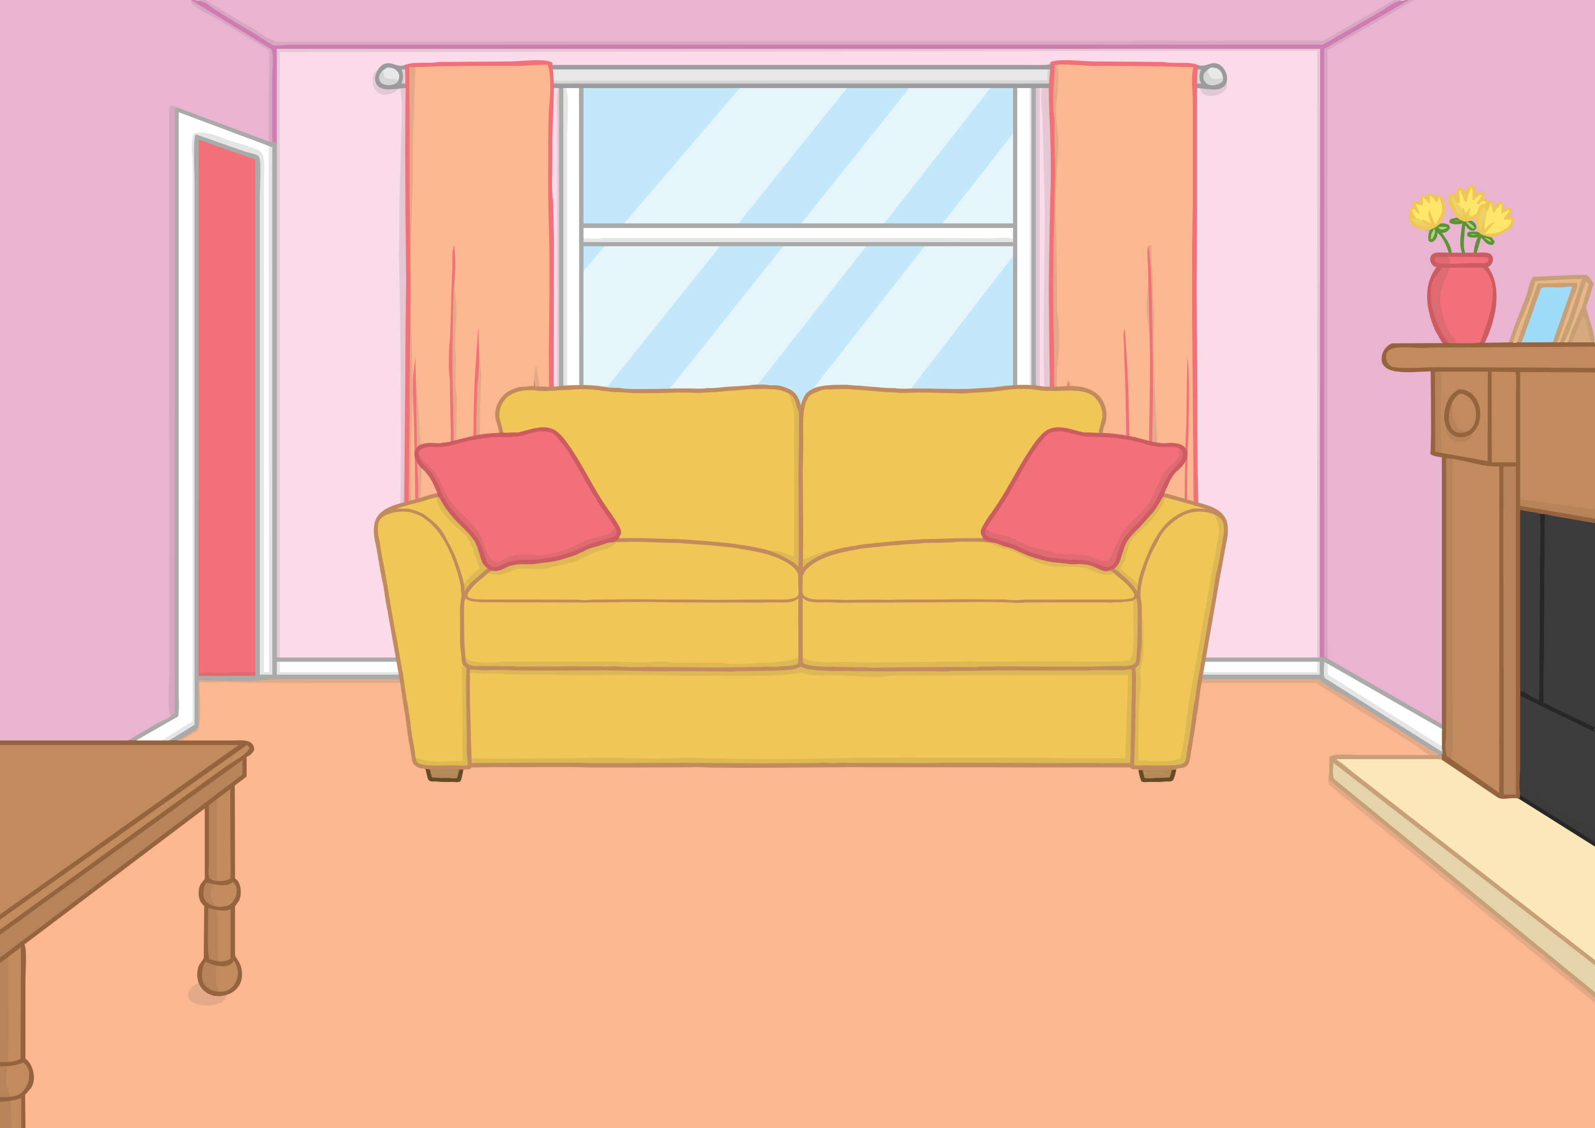


Teach
Kit and Sam were back at Gran and Grandad’s house after their Stone Age adventure. They decided to look at the book once more.

Slide 4

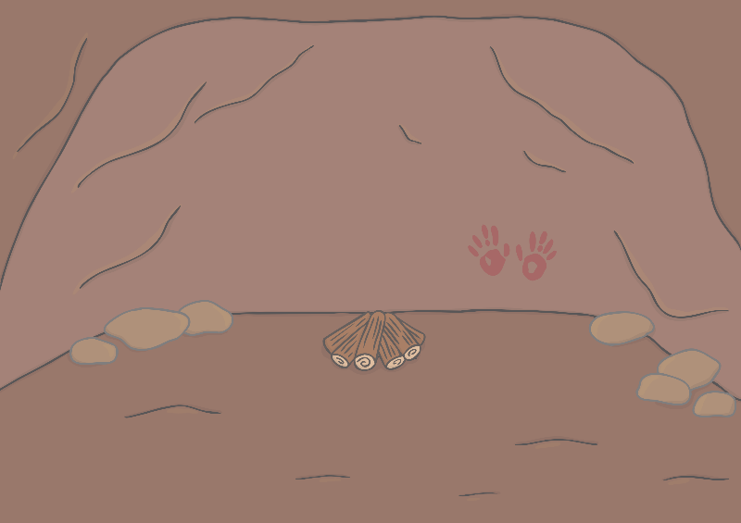
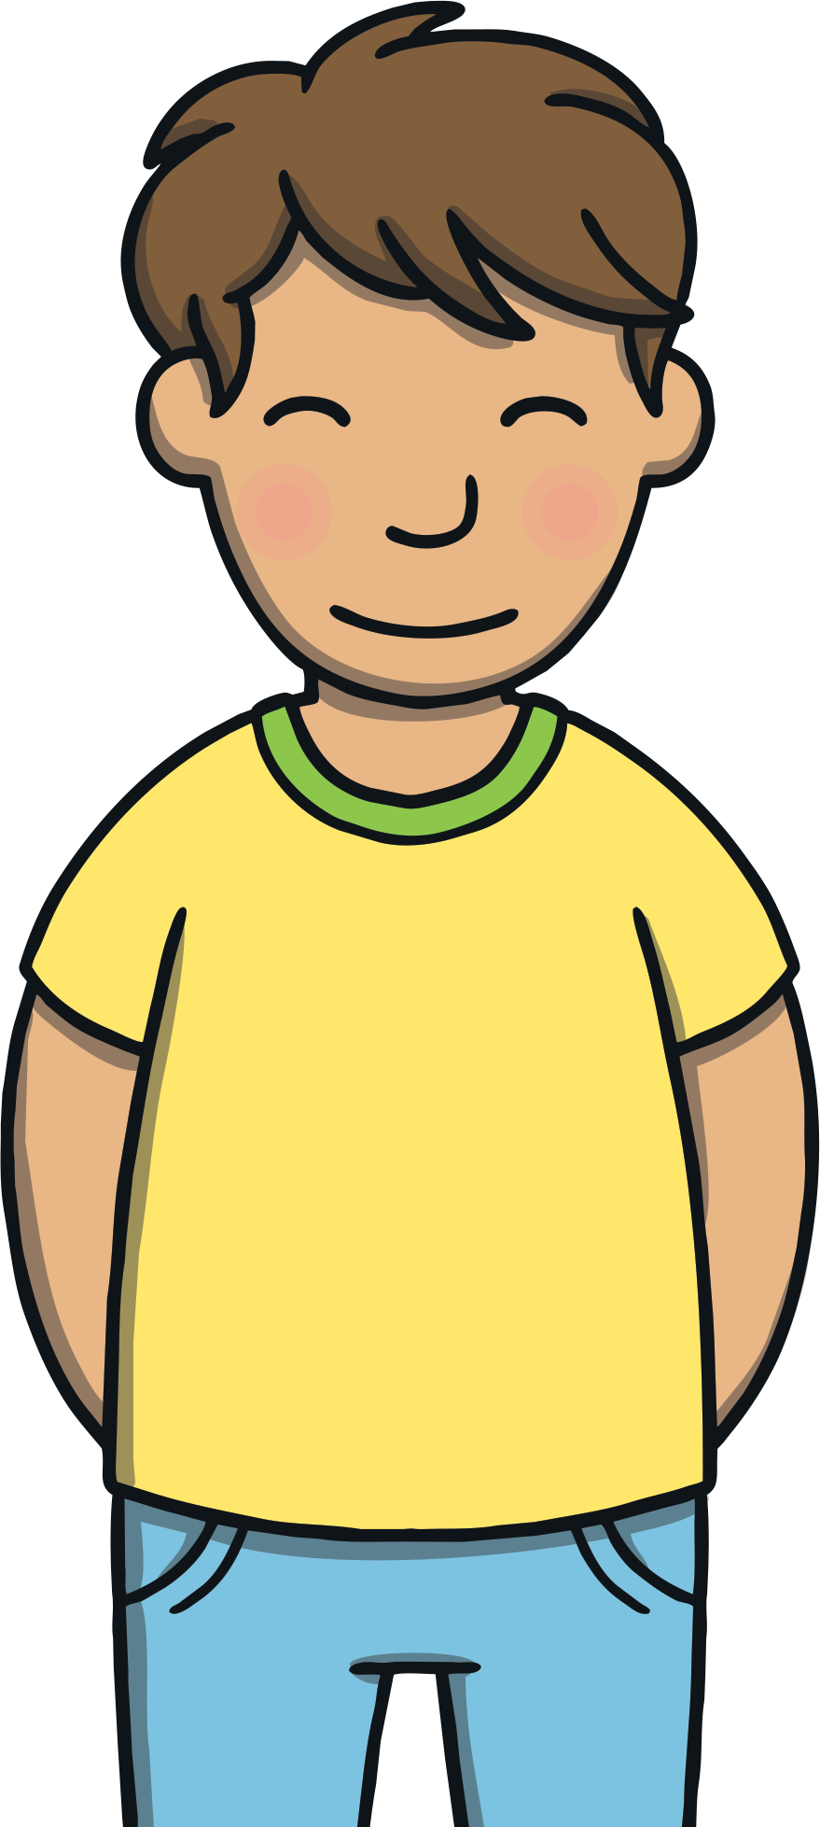
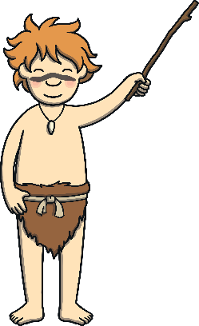
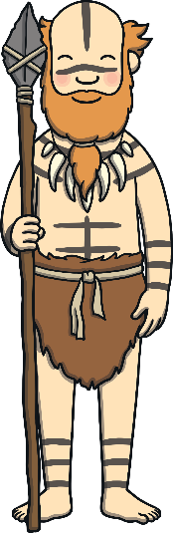
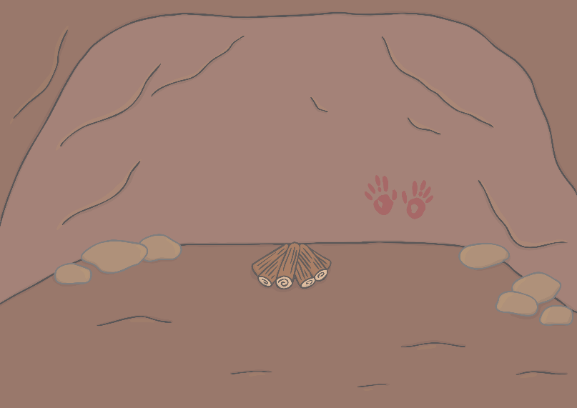
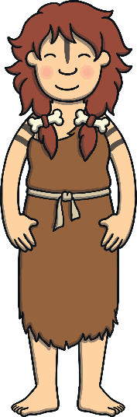
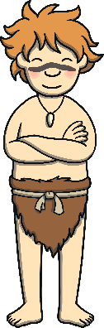
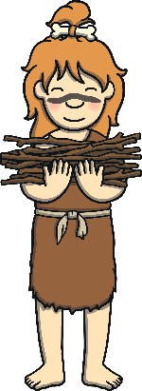
Teach
lf
lp
nk
“Wow!” said Kit. “Did you realise it was Felt and Wilf and their family in this book?”
“No,” said Sam. “I can’t believe we got to meet them!”

Slide 5
Teach
lf
lp
nk
“Look at their speech bubbles,” said Sam. “Do you think we can read them, now that we understand caveman sounds?”
“Let’s give it a go!” said Kit.

Slide 6


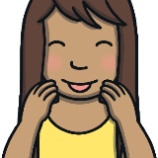
Practise
belt
Check

Slide 7
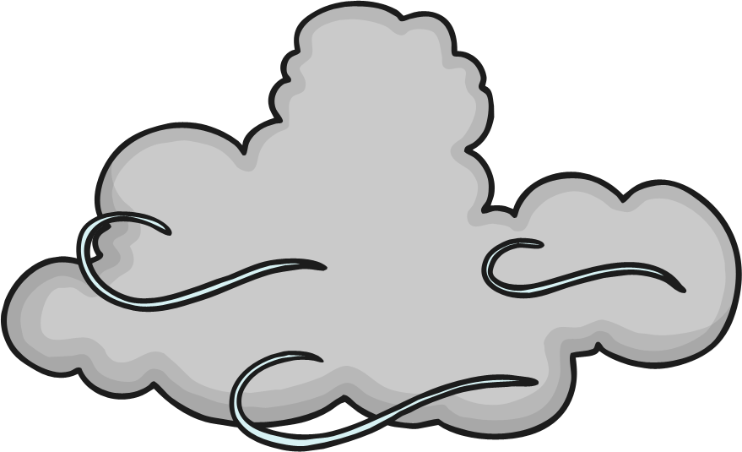
Practise
wind
Check

Slide 8
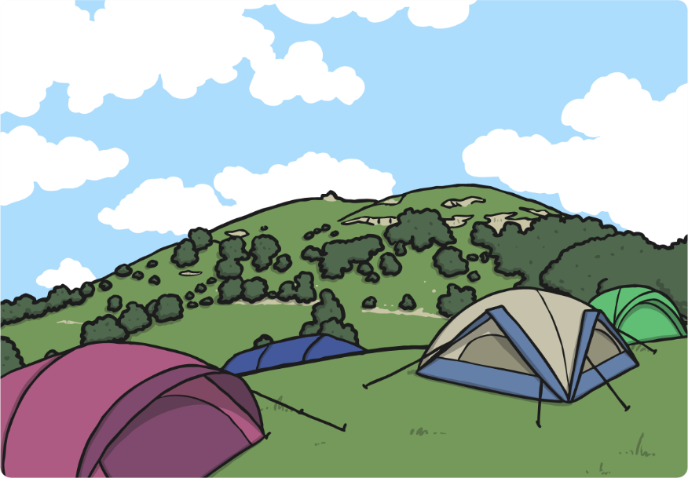
Practise
camp
Check

Slide 9
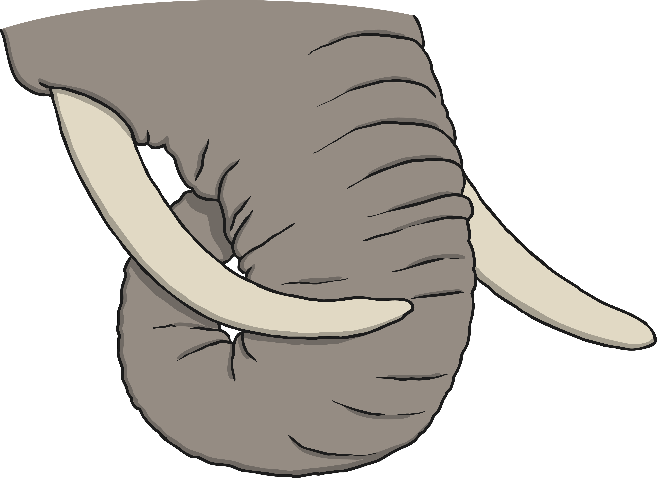
Practise
tusk
Check

Slide 10
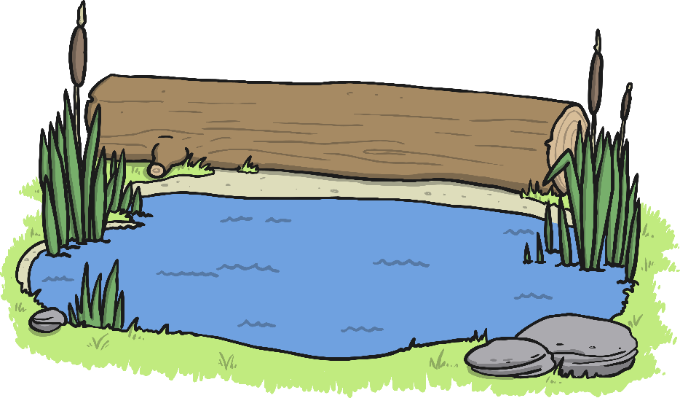
Practise
pond
Check

Slide 11

Practise
chimp
Check

Slide 12
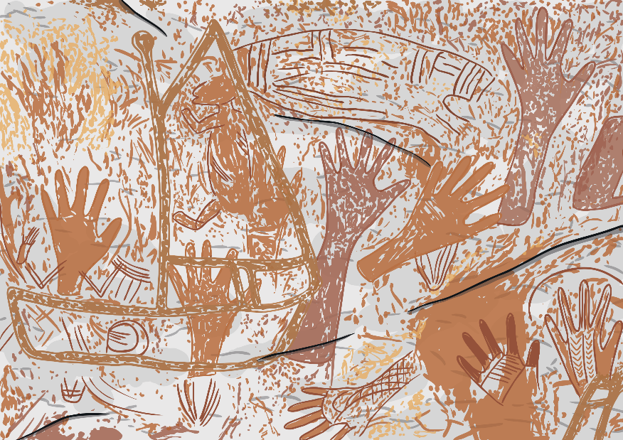
Practise
paint
Check

Slide 13
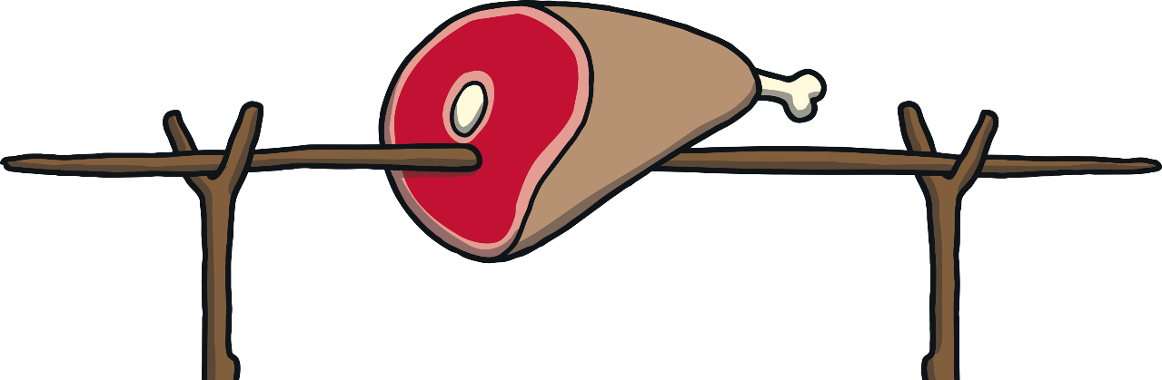
Practise
roast
Check

Slide 14
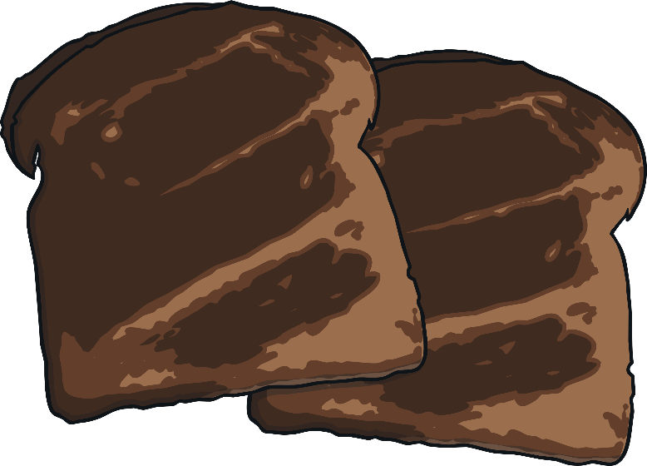
Practise
burnt
Check

Slide 15

Apply
“Let’s make our own Stone Age book all about our adventure with Felt and Wilf,” said Kit.
“Great idea!” said Sam.

Slide 16
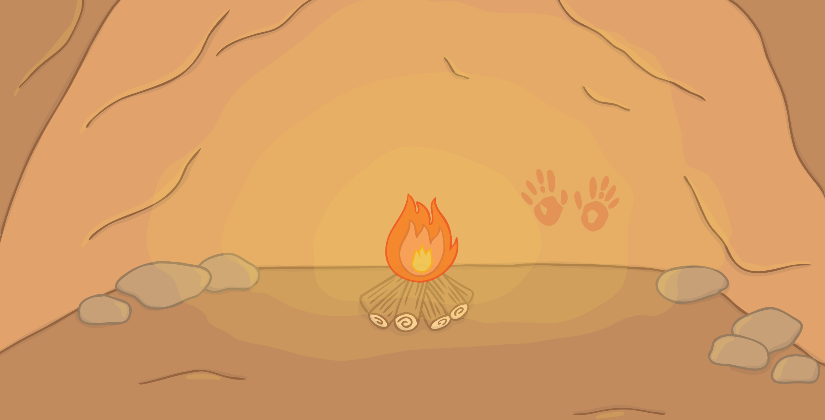



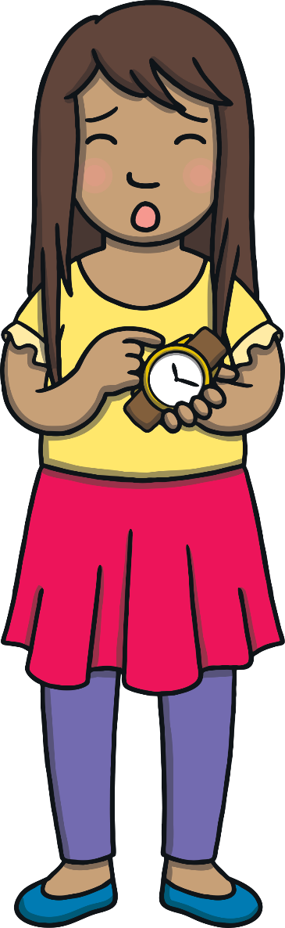
Felt and Wilf
Apply
Write your own story about Felt and Wilf in the booklet.

Slide 17
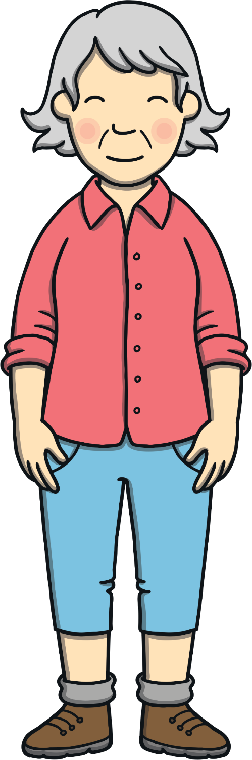
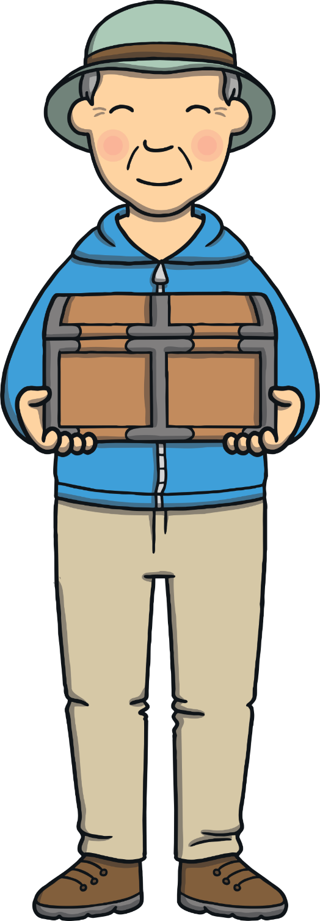




Apply
“So, did you enjoy wearing my old watch?” asked Grandad.
“Yes!” said Sam.

Slide 18
Apply
“Hmm... I wonder what will happen if you open that
map?” said Gran.

