Slide 2
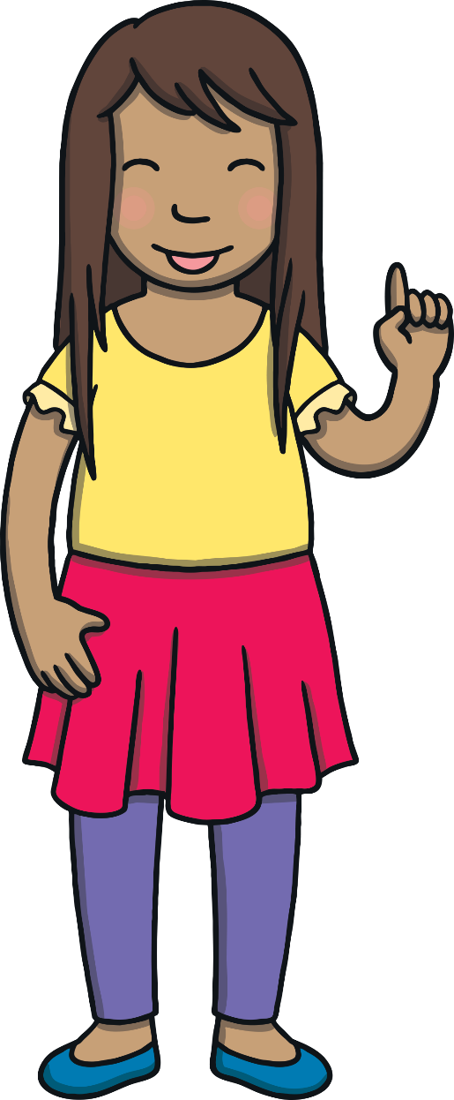




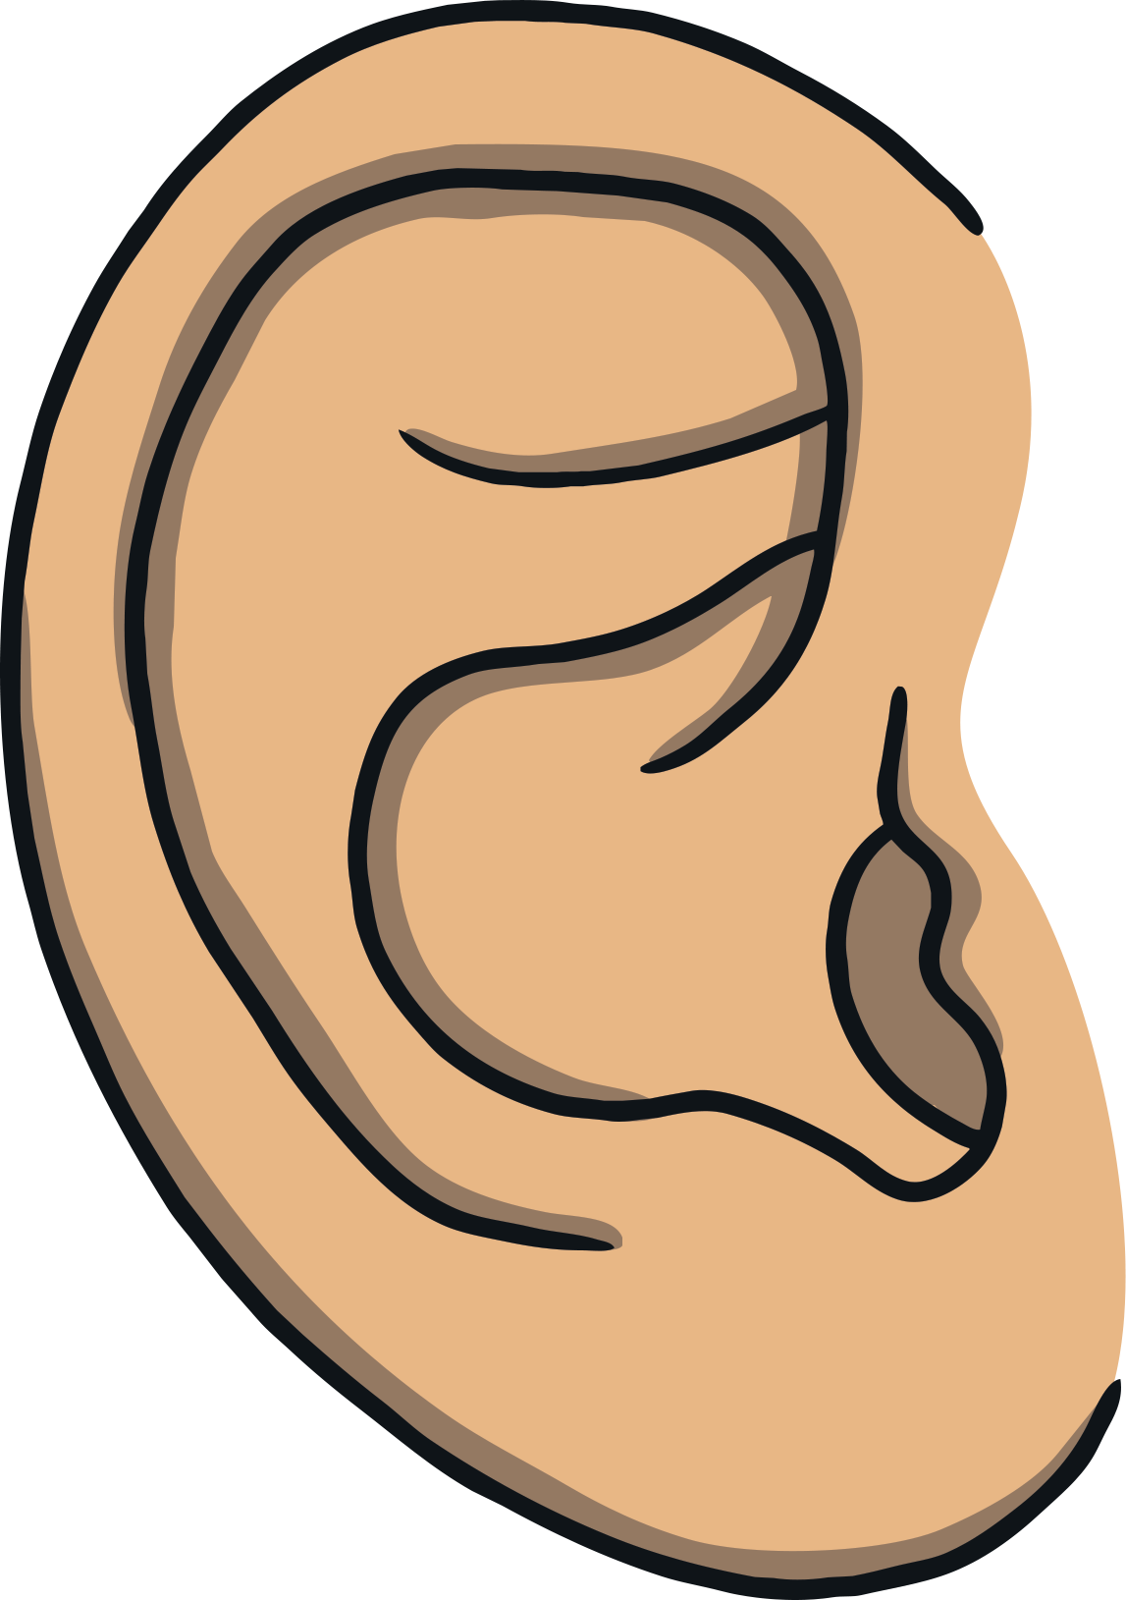




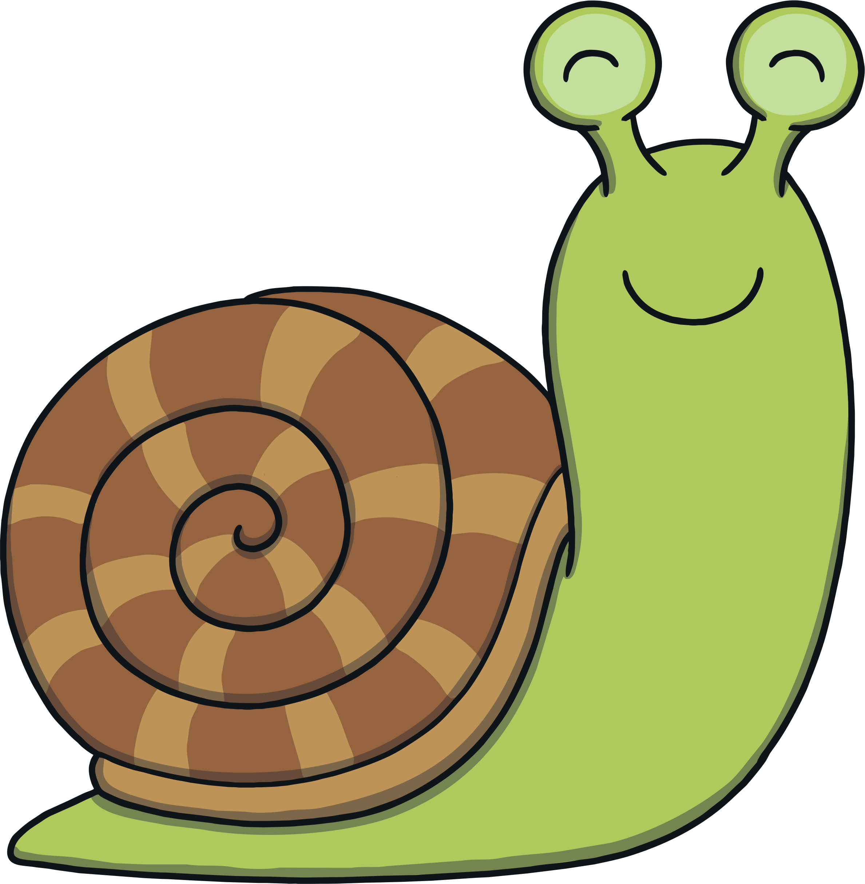

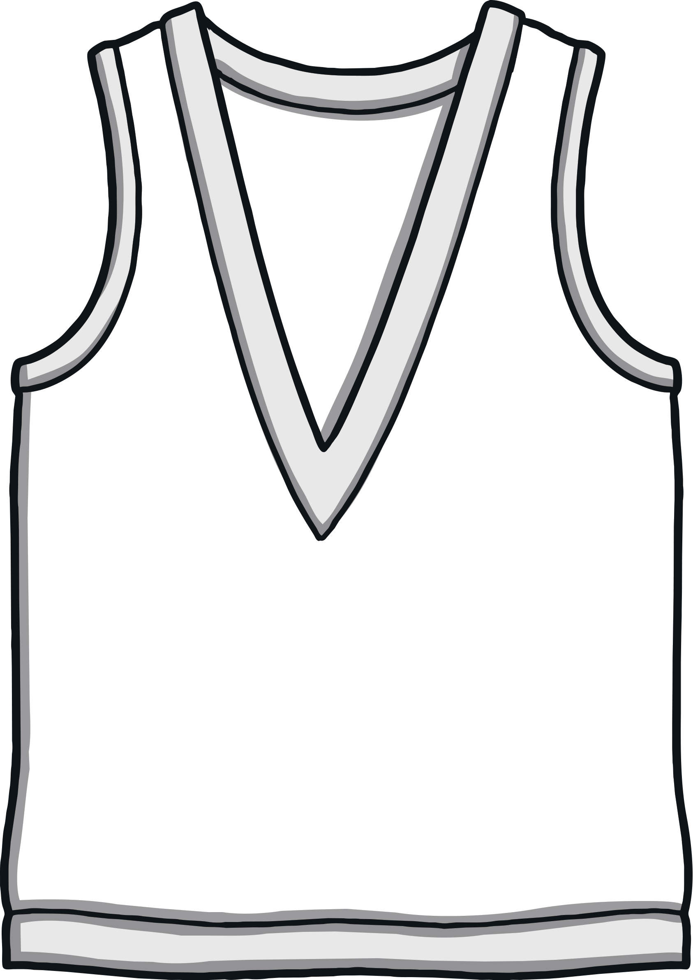


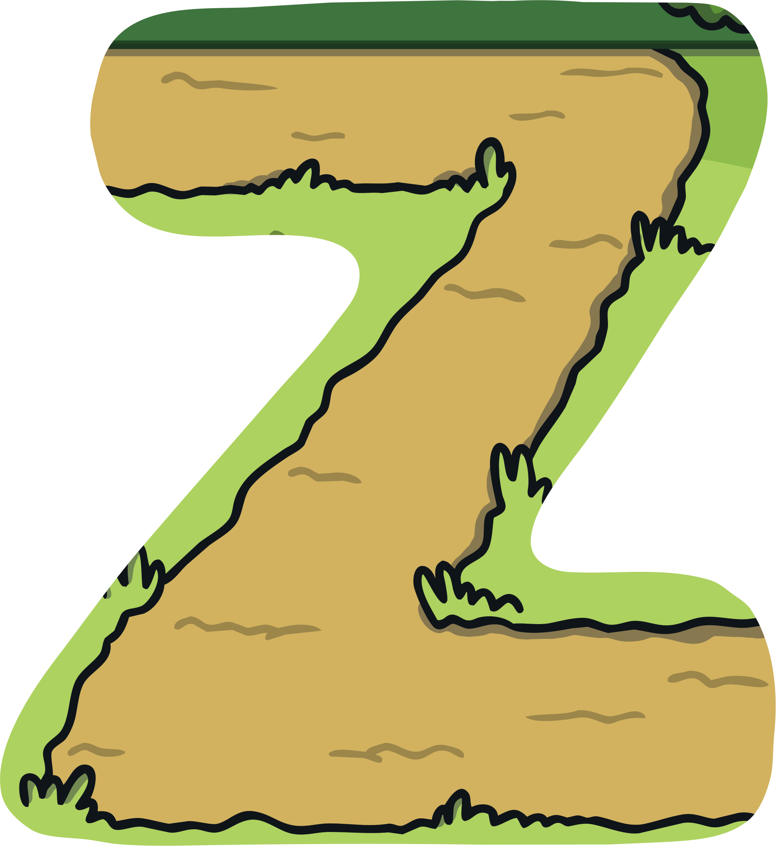

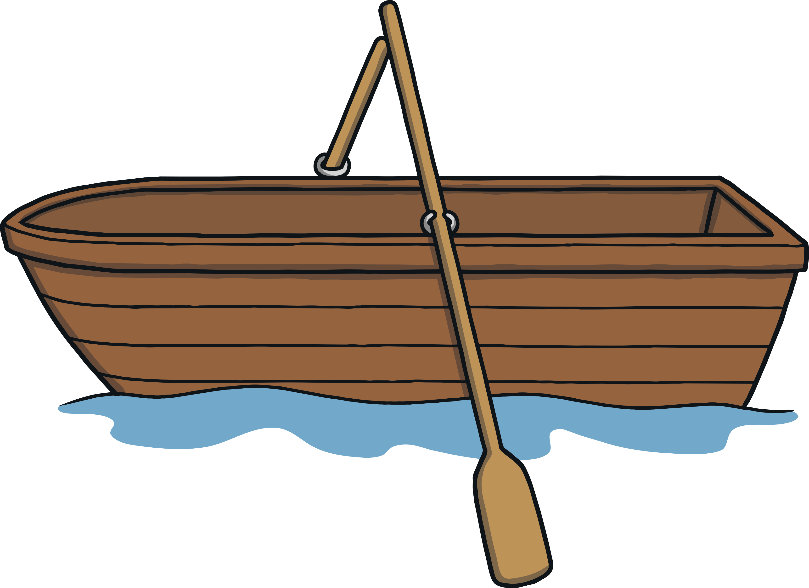
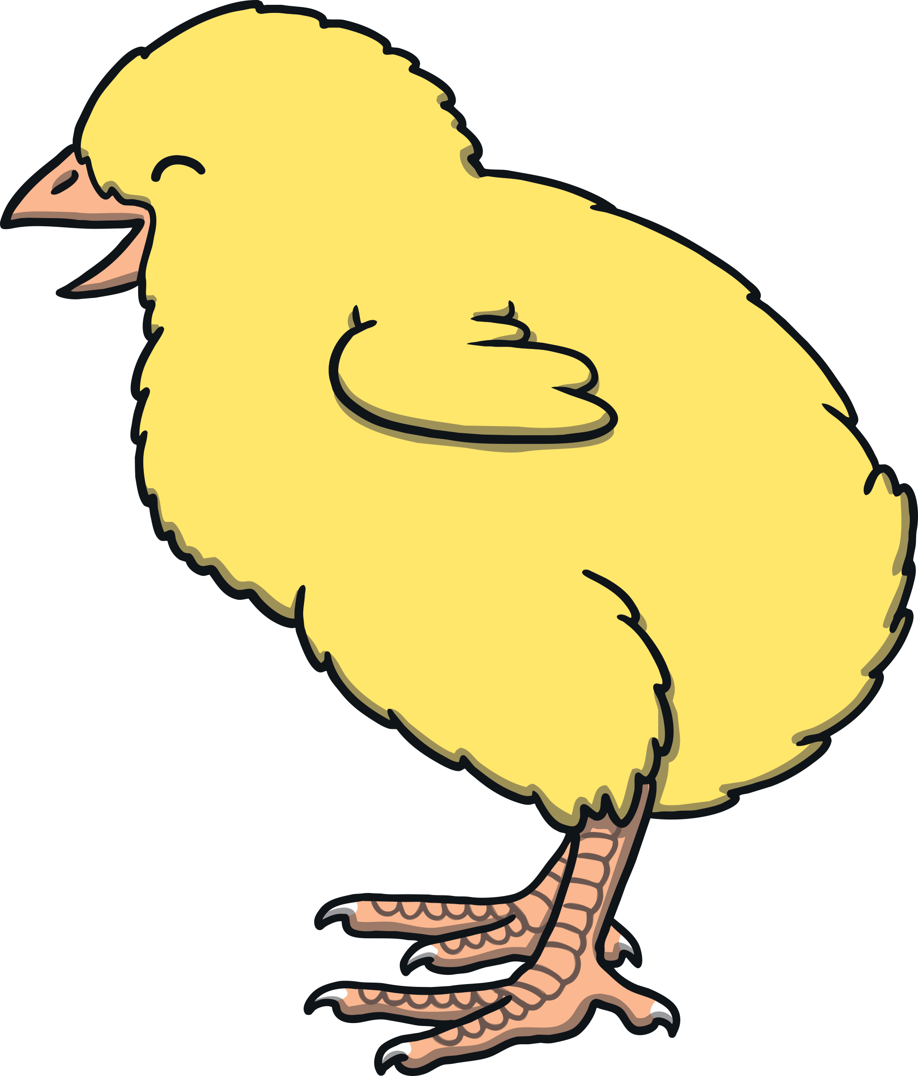


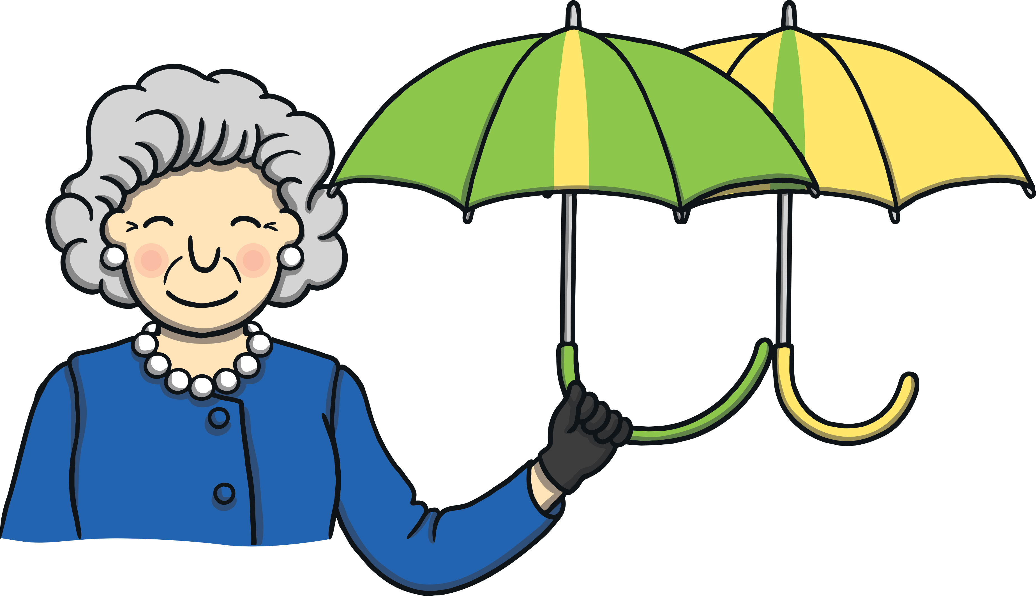
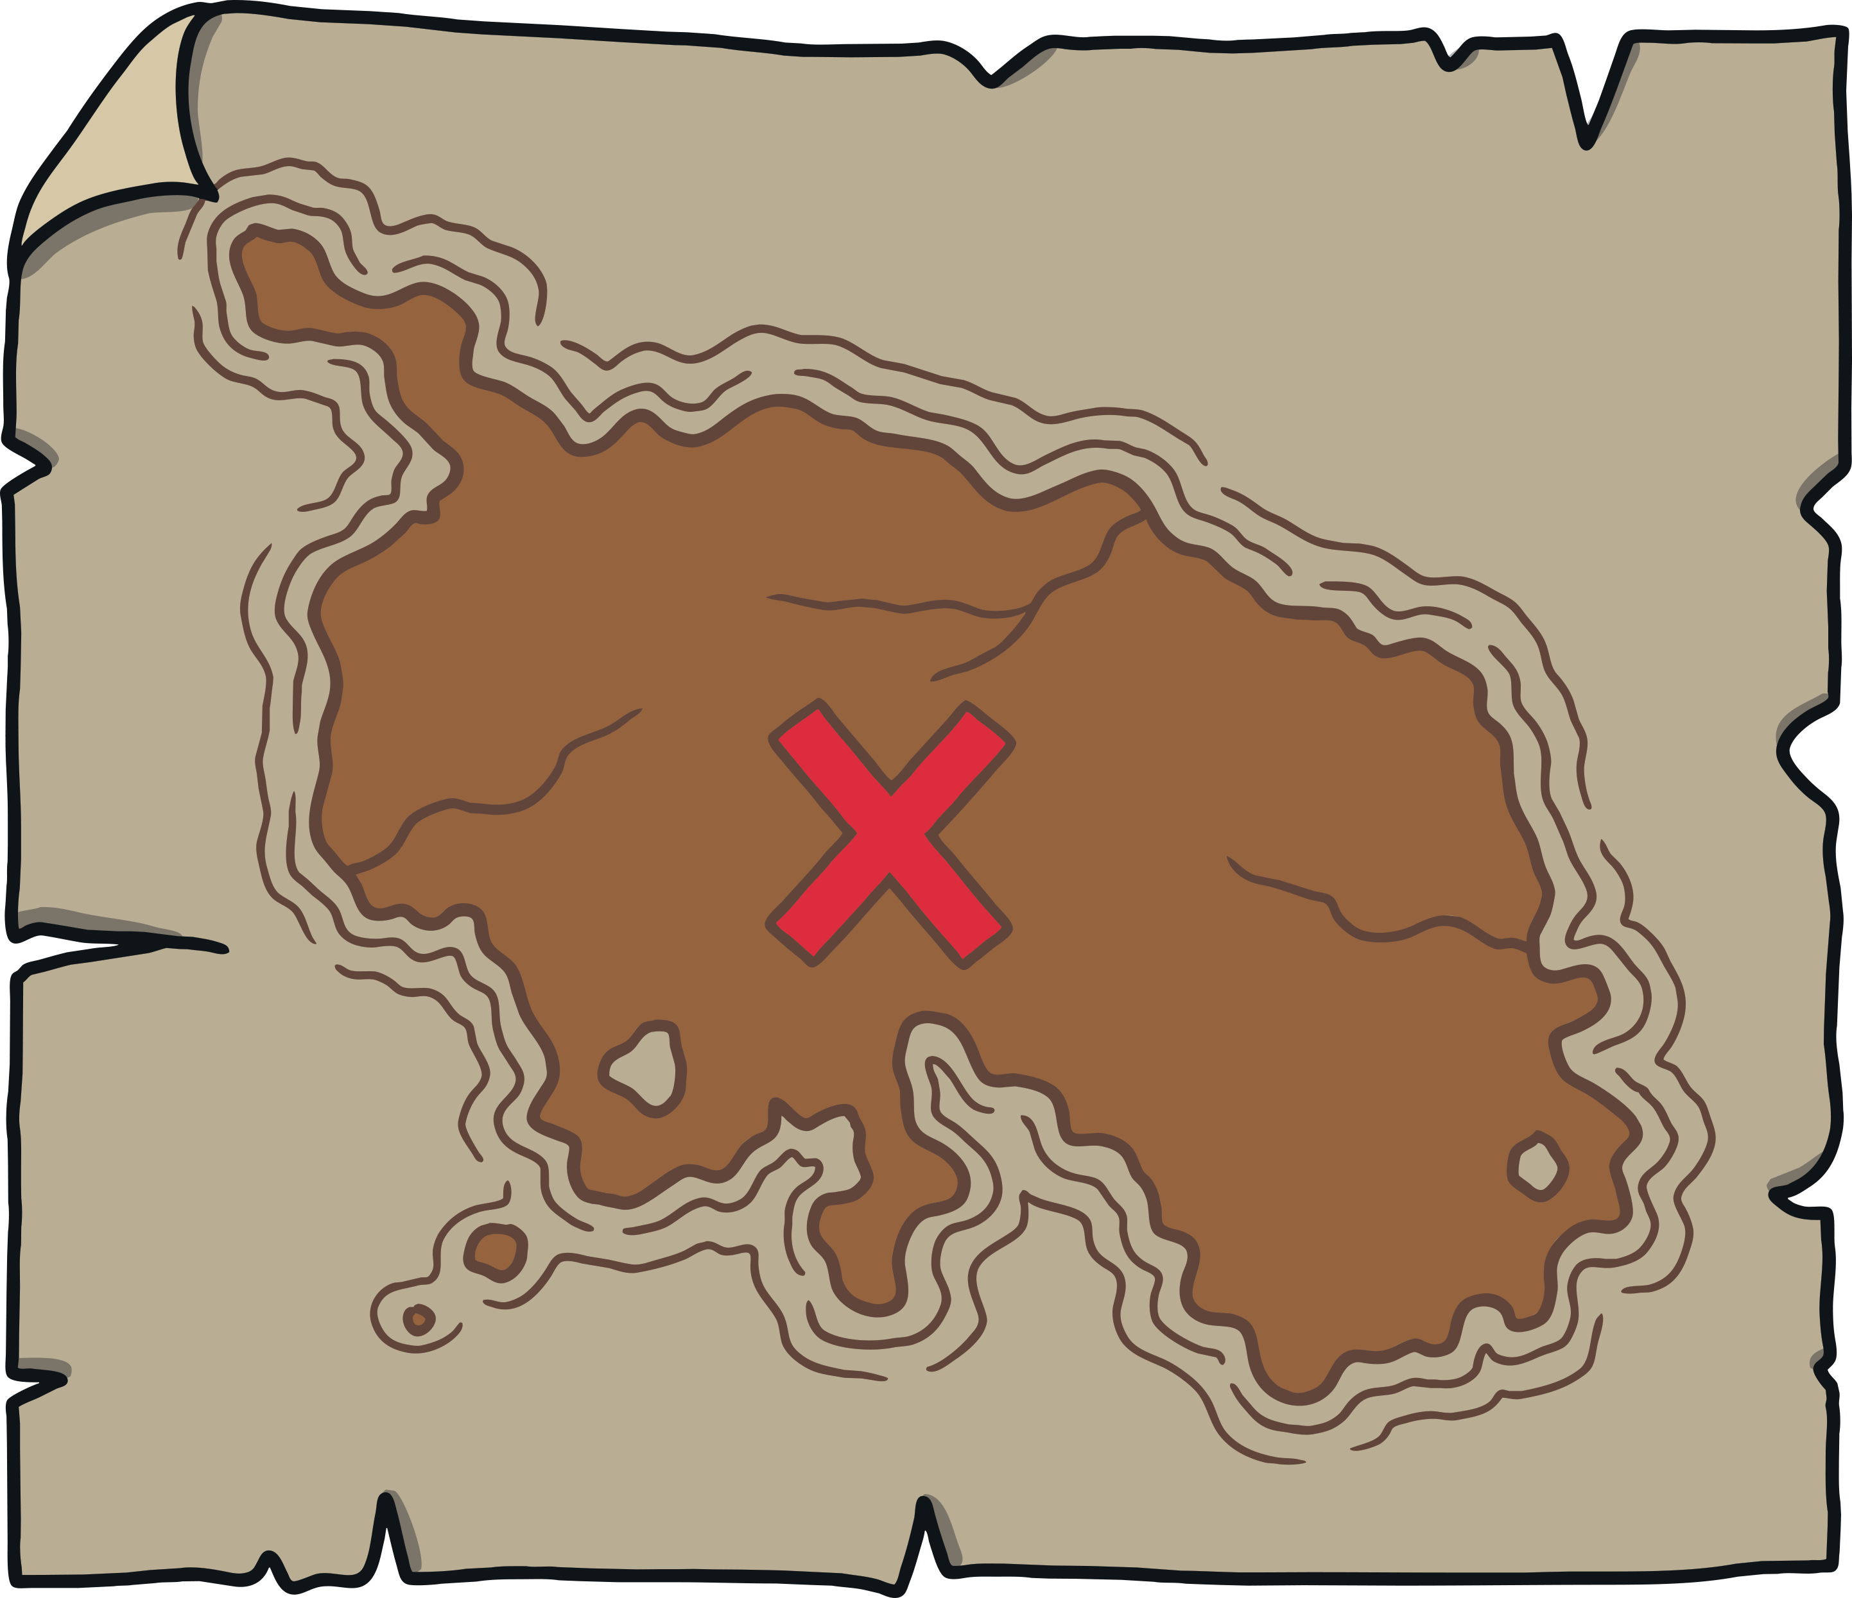
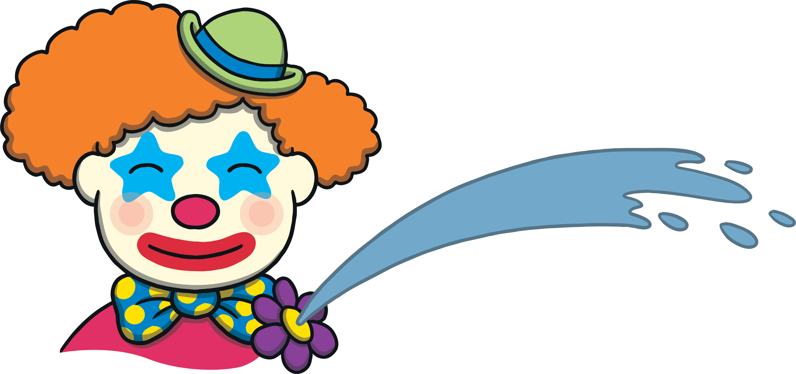

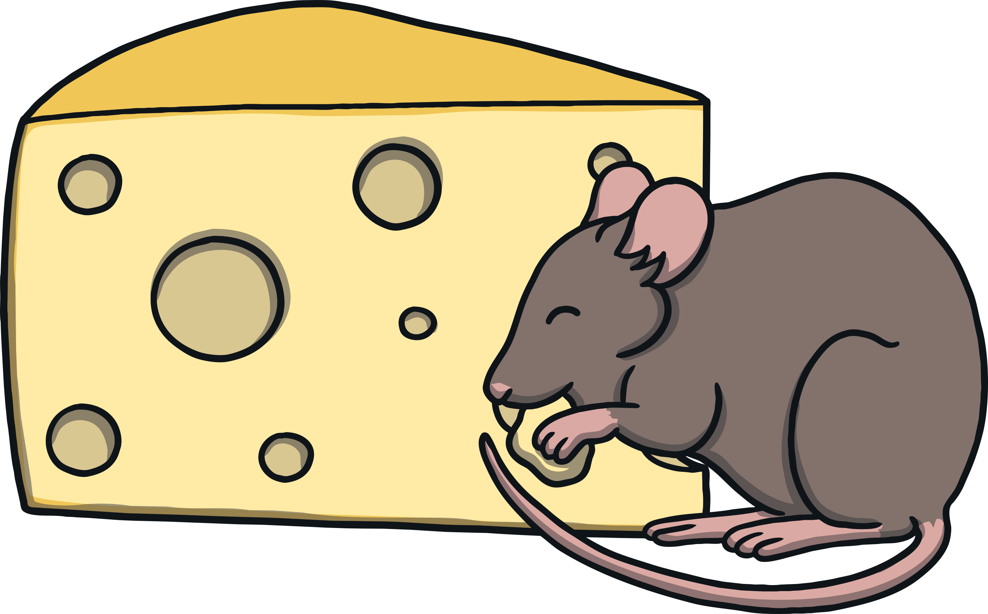
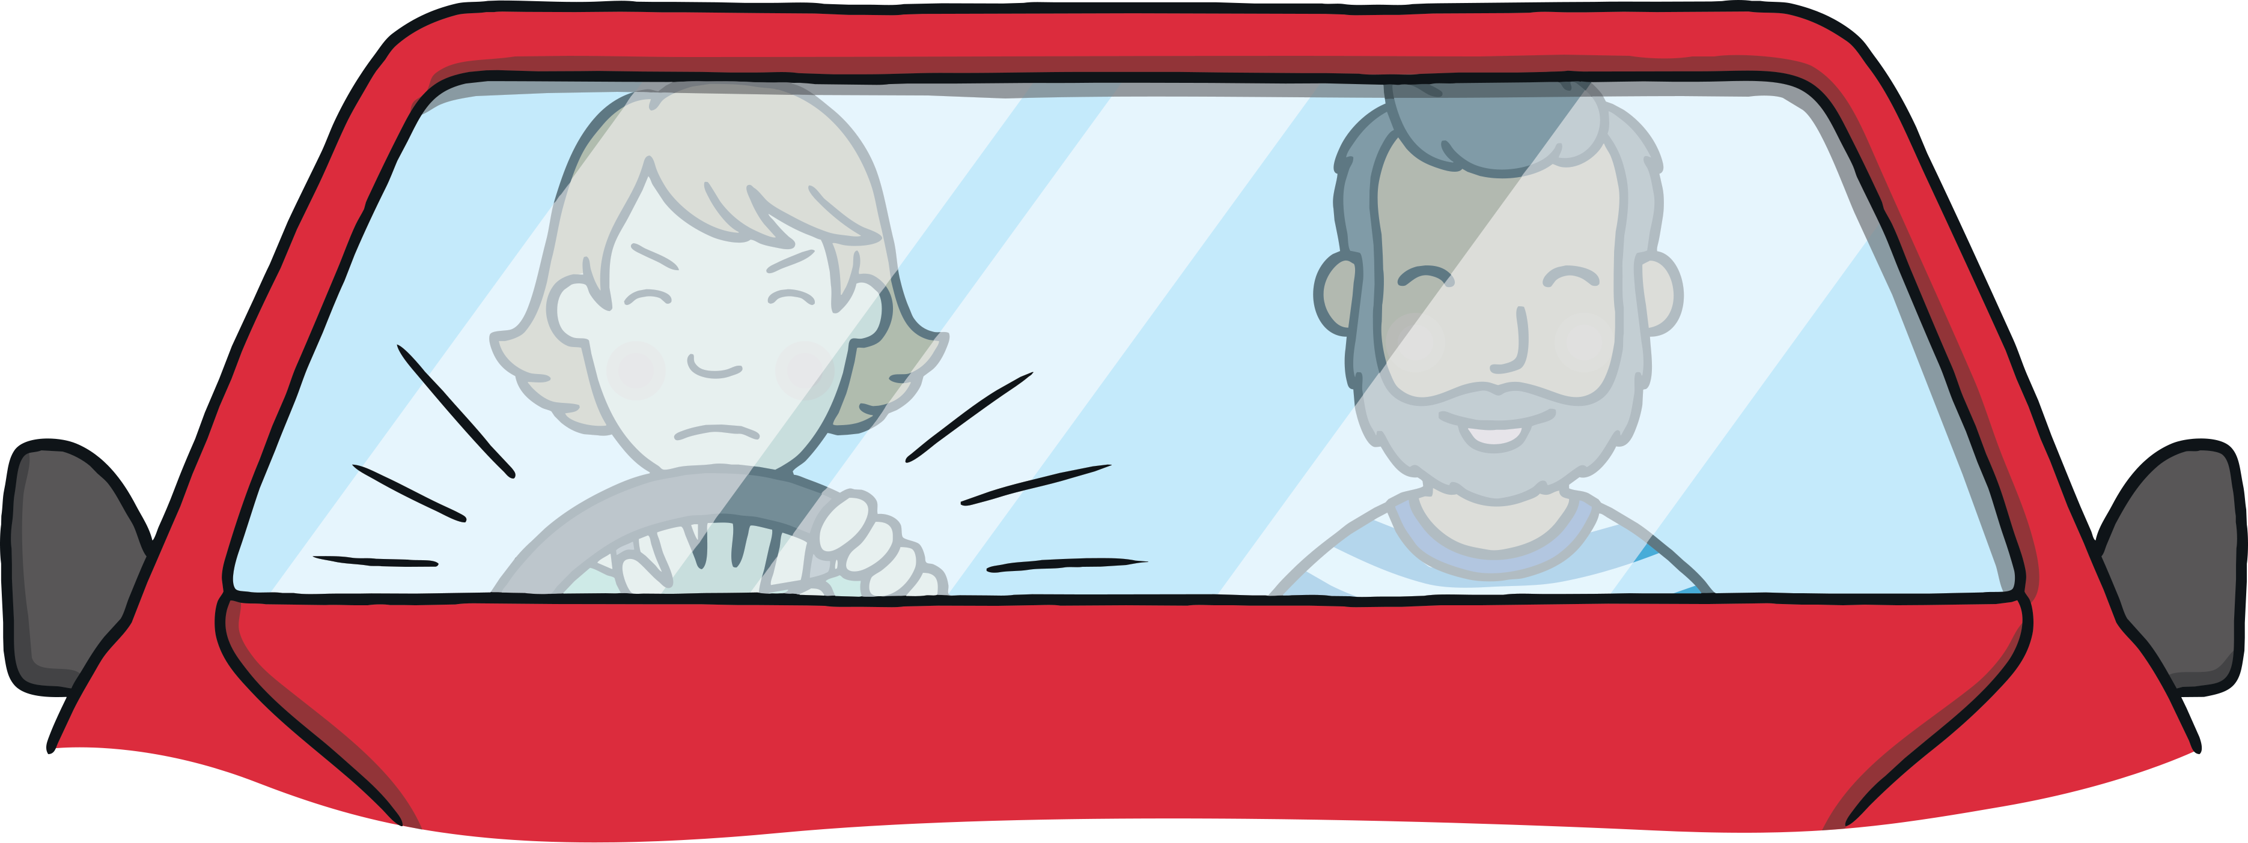


Revisit and Review
Let’s practise Sam’s Sounds and Tricky Words!
igh
j
air
er
y
ng
ear
ai
ar
z
oo
oo
v
ee
th
ure
oi
oa
qu
ur
ow
oo
ch
x
th
w
sh
or
so
have
come
said
like
some

Slide 3
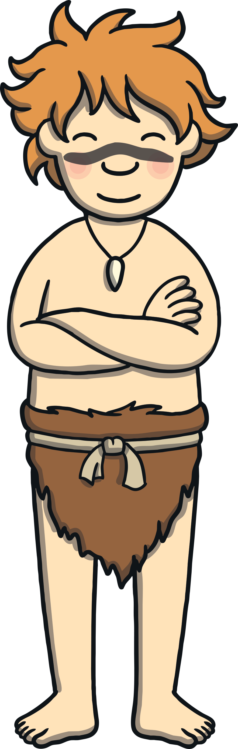
Teach
Today, we are learning to read words that contain final consonant blends.

Slide 4


Teach
This week, we are learning to spell the tricky words me, we and be.
Can you write the words on a whiteboard or piece of paper?
X
It can help to spell out tricky words using the letter names to remind children that tricky words can’t be sounded out.
Click me for Kit’s teaching tips!

Slide 5
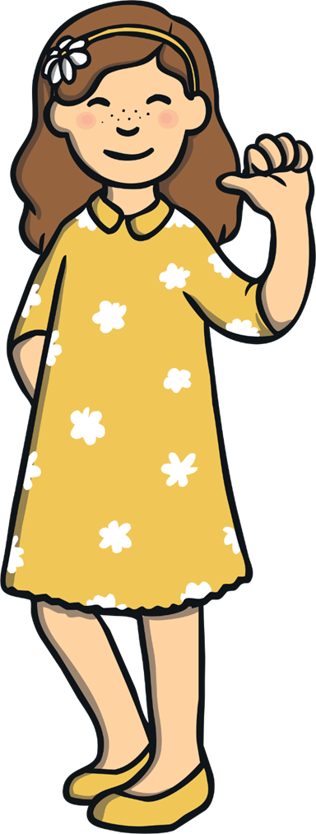
Teach
me

Slide 6
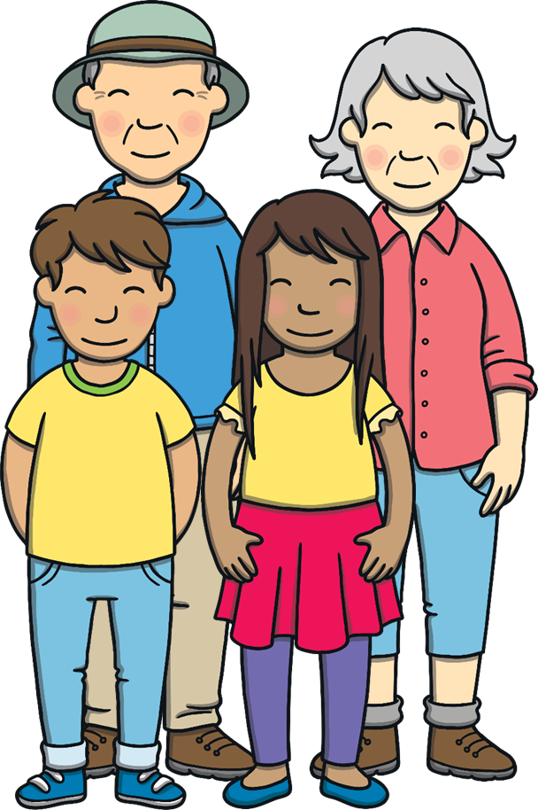
Teach
we

Slide 7
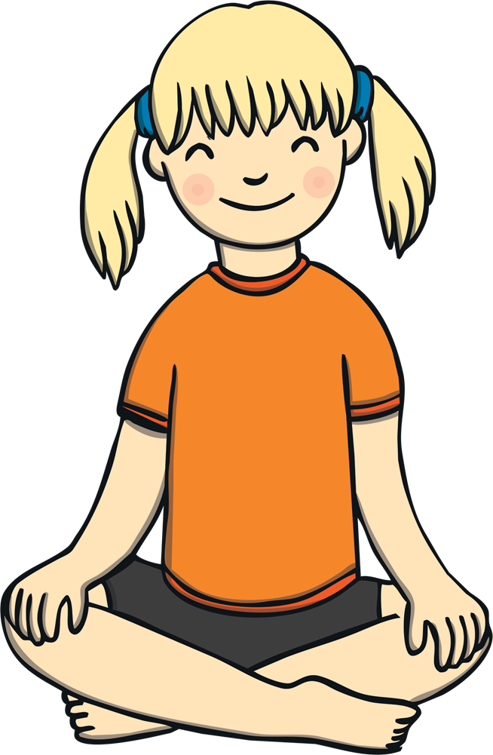
Teach
be

Slide 8
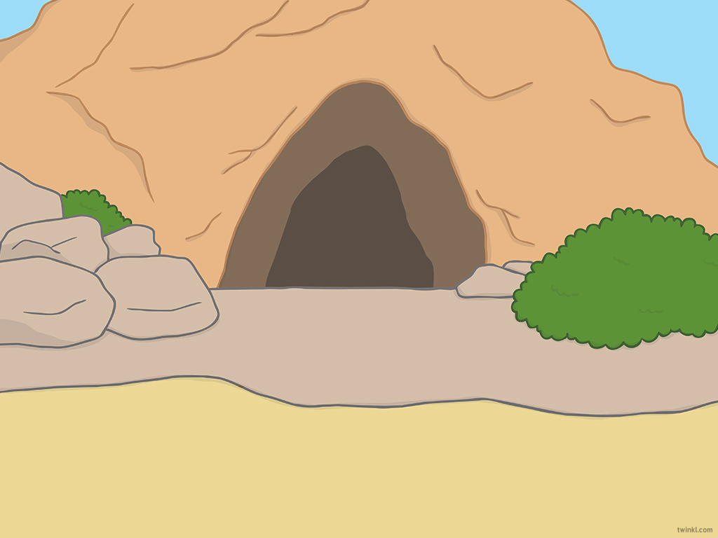
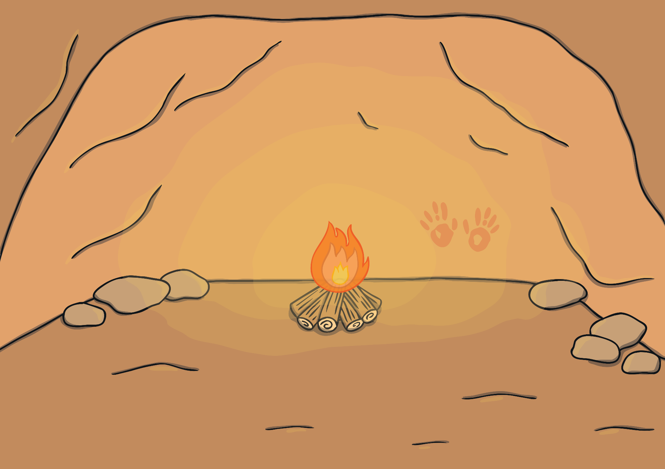
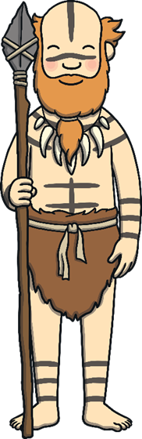
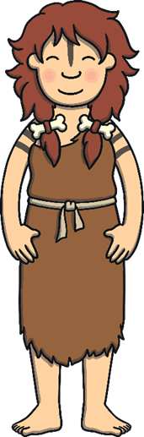



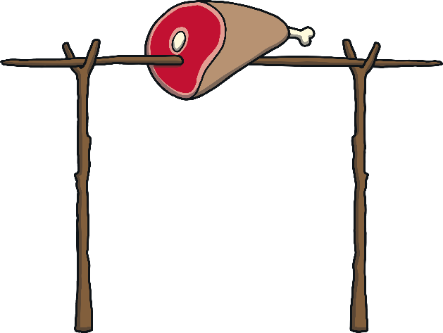
Teach
Kit and Sam explained to Felt and Wilf’s mum and dad how Grandad’s old watch had taken them back in time to visit the Stone Age.

Slide 9

Teach
“We read a book about cave people,” said Kit. “We tried to imagine what it would be like to live in the Stone Age.”
“Now, we are here!” said Sam.

Slide 10
Teach
“After you have eaten, why don’t you all go outside? Felt and Wilf can show you some games that cave children play,” said Dad.

Slide 11
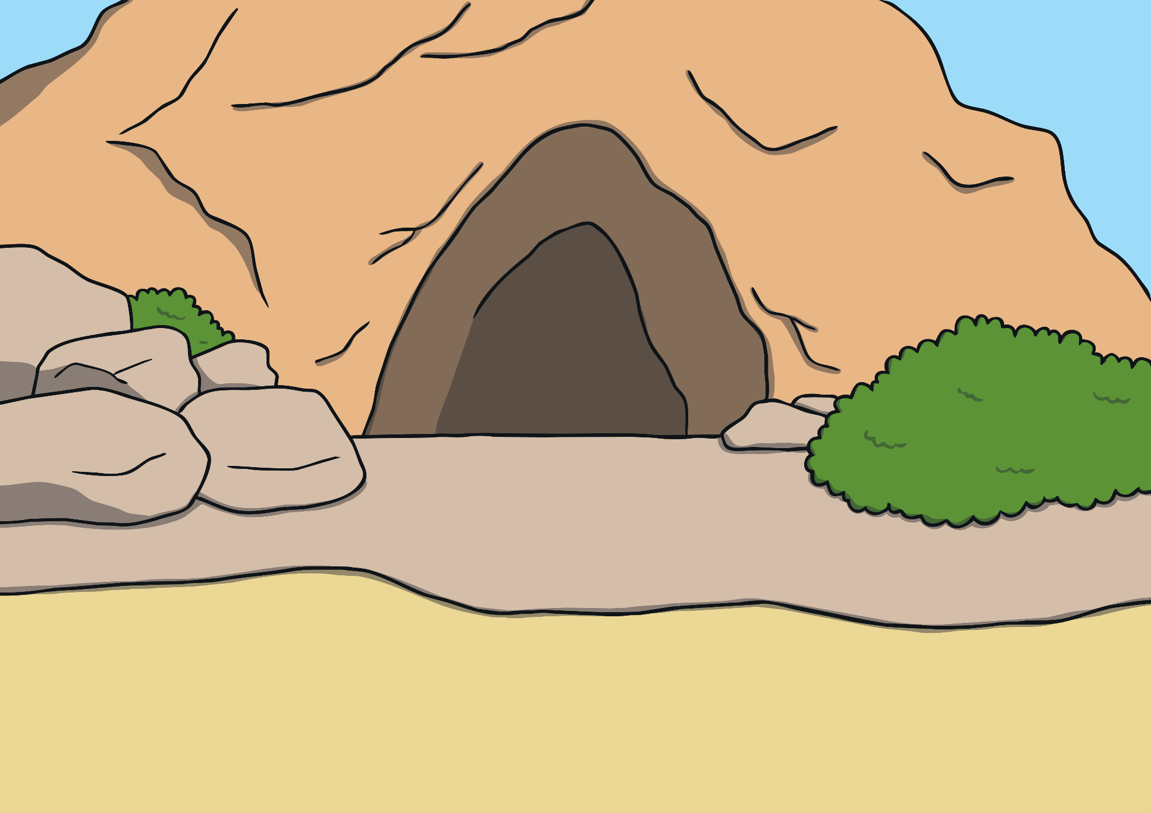
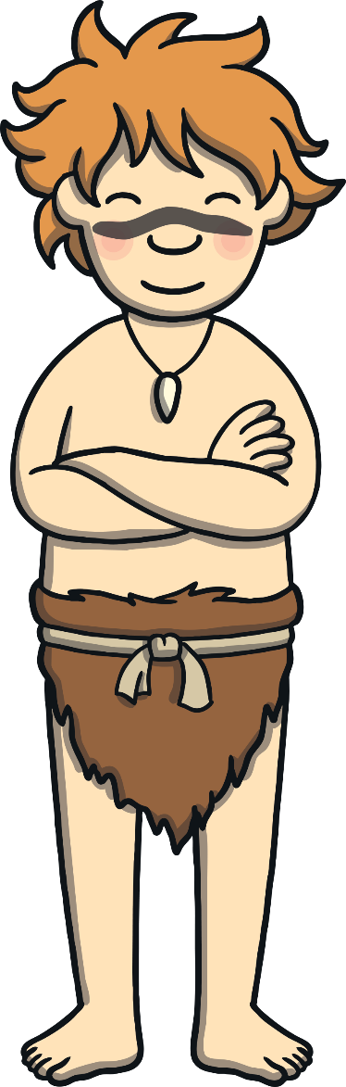
Practise
Wilf has written some caveman sounds outside the cave.
Write them down as you spot them.
sk
st
lt
lm
nk
nt
mp
ct
xt
pt
ft
lf
lb
nd
lk
lp
ld

Slide 12
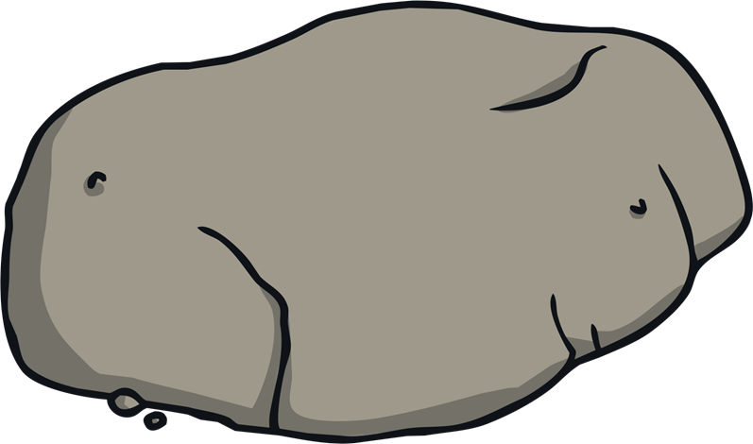
Rock and Roll!
Practise
Roll the rock to reveal a final consonant blend. How many words can you write down that end with that blend before the time runs out?
X
Your children could do this activity on whiteboards, independently or in pairs.
Click me for Kit’s teaching tips!

Slide 13


Practise
Start 1 Minute Timer
nk
Click on the rock to roll it!

Slide 14
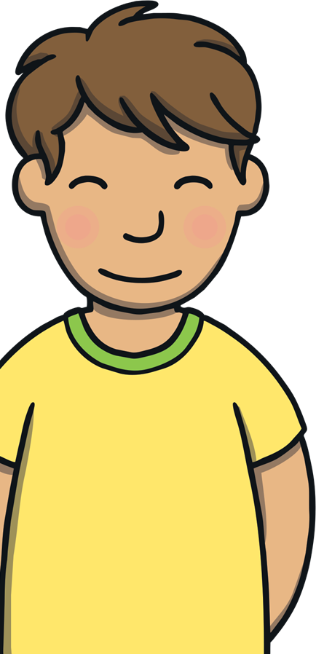
Practise
Start 1 Minute Timer
mp
Click on the rock to roll it!

Slide 15
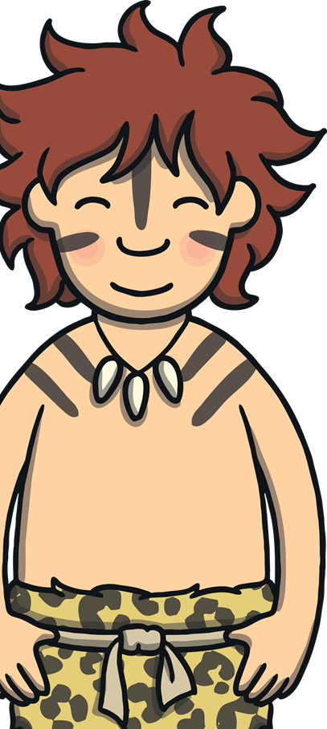
Practise
Start 1 Minute Timer
nt
Click on the rock to roll it!

Slide 16

Practise
Start 1 Minute Timer
lf
Click on the rock to roll it!

Slide 17

Practise
Start 1 Minute Timer
lk
Click on the rock to roll it!

Slide 18
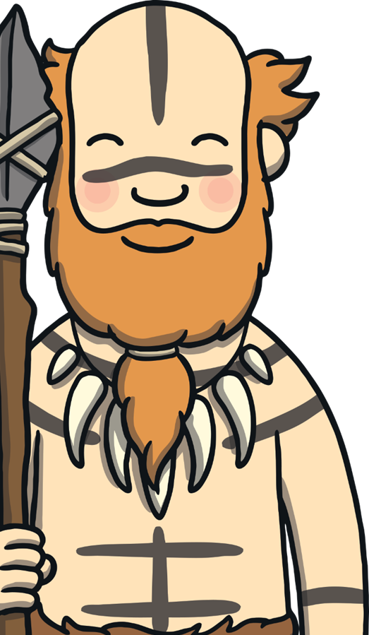
Practise
Start 1 Minute Timer
lp
Click on the rock to roll it!

Slide 19

Practise
Start 1 Minute Timer
st
Click on the rock to roll it!

Slide 20


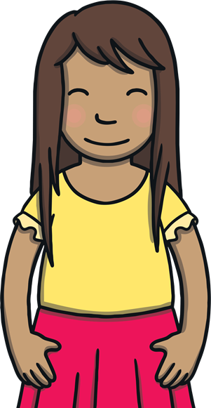
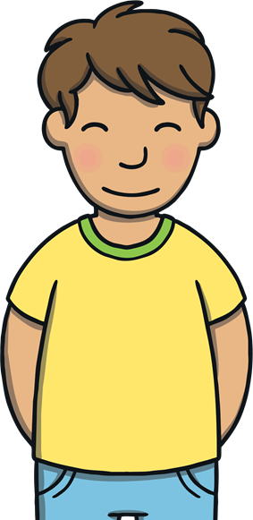
Apply
“Cool games,” said Sam. “Thanks, I’ve really loved getting to see what Stone Age life is really like.”
“Me, too,” said Kit, “but I think it’s time to go.”

Slide 21
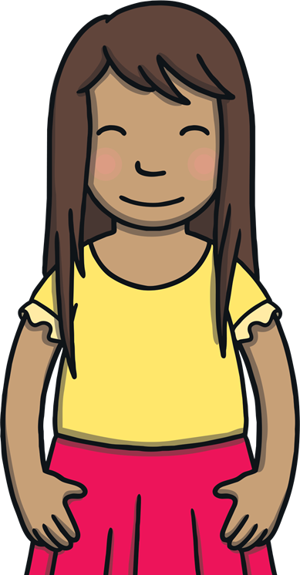


Apply
Kit and Sam said goodbye to Felt and Wilf. Sam gave the watch a wind and the cave began to fade.
They heard Felt call goodbye to them.

Slide 22





Sentence Time
Apply
What did Kit and Sam shout back to Felt?
Look at the picture and write a sentence to match.
X
Click ‘Show Suggestion’ on the next slide to see a suggested sentence for the picture.
Click me for Kit’s teaching tips!

Slide 23

Apply
We will be jumping back again soon.
Show

Slide 24
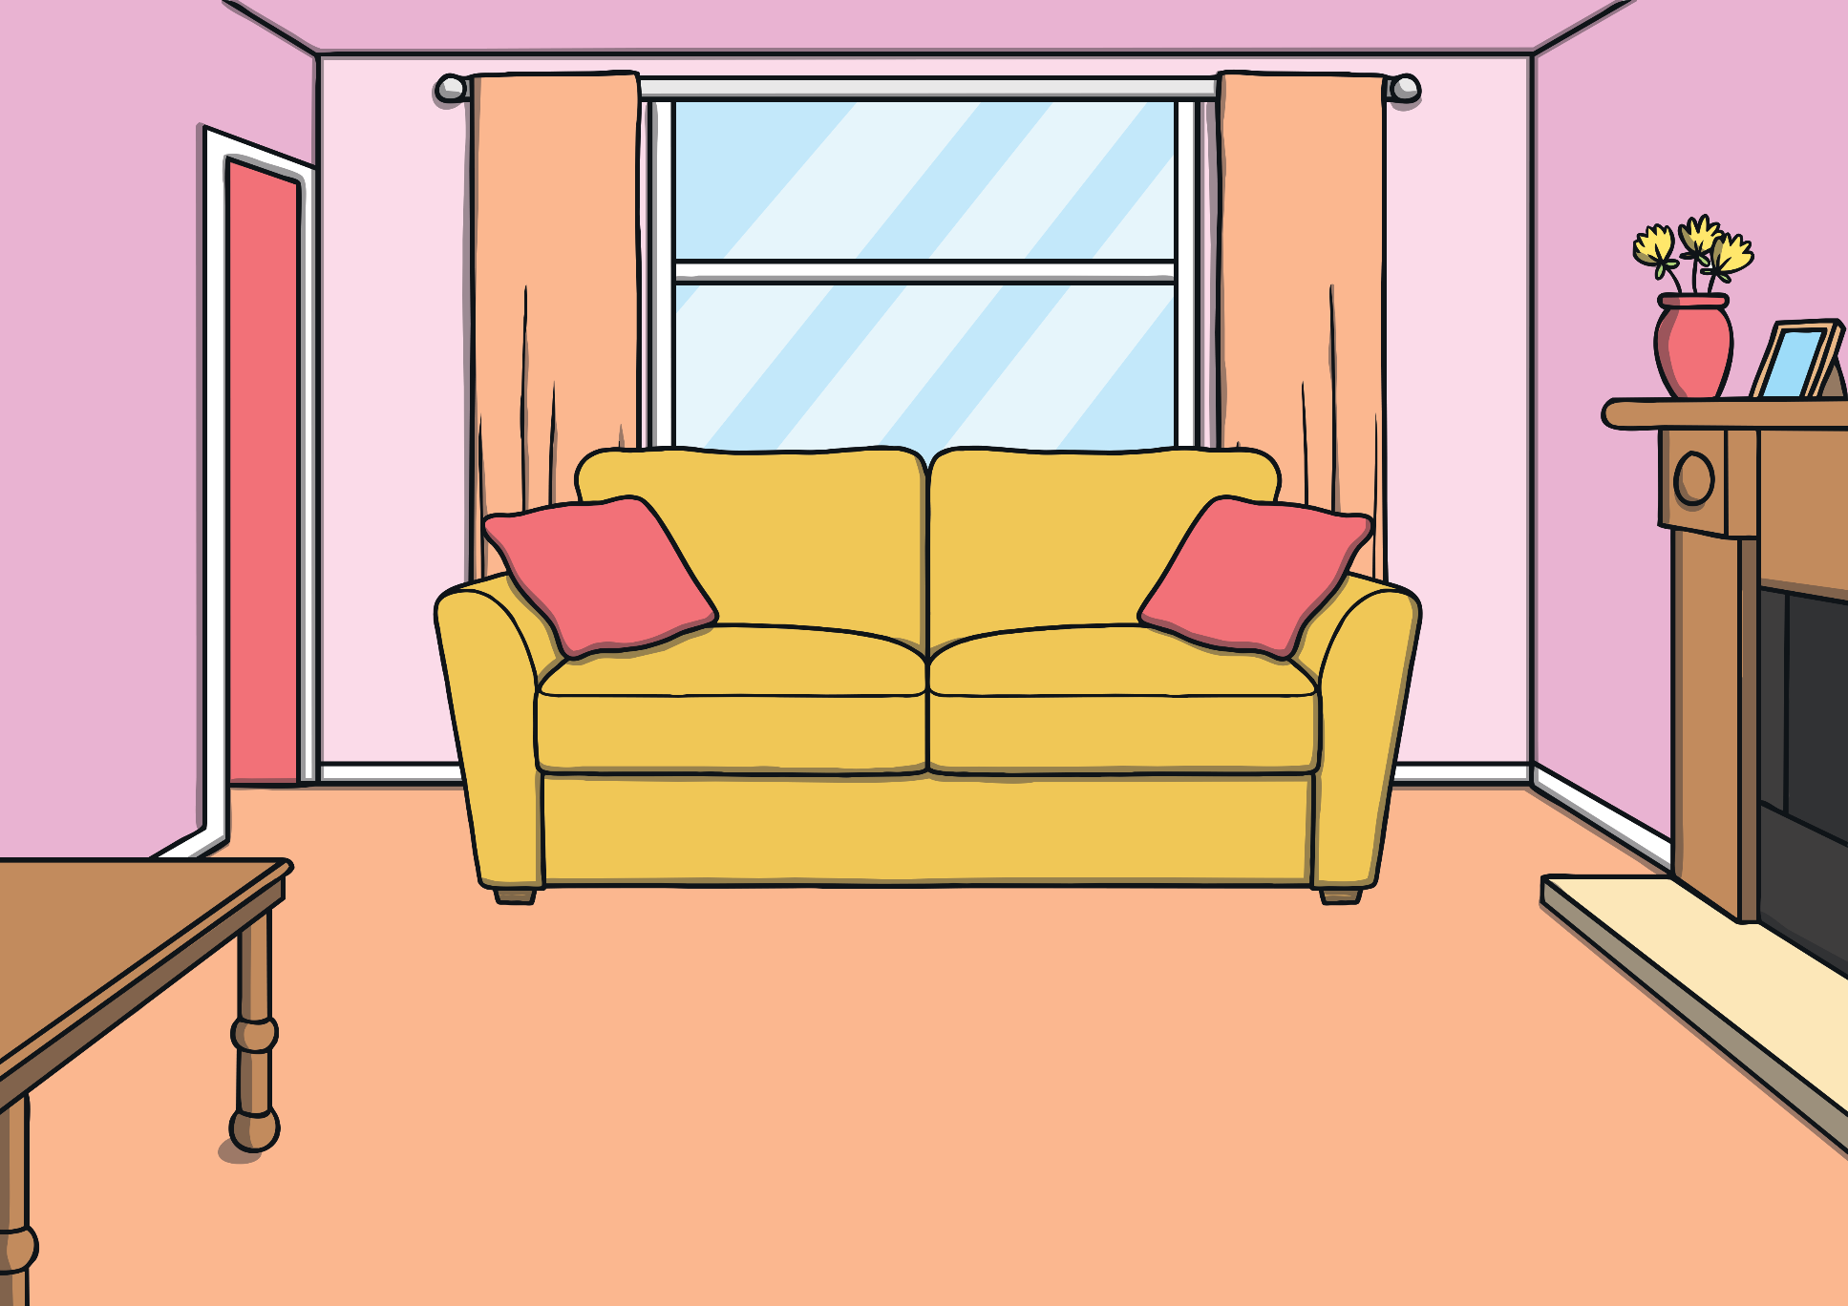
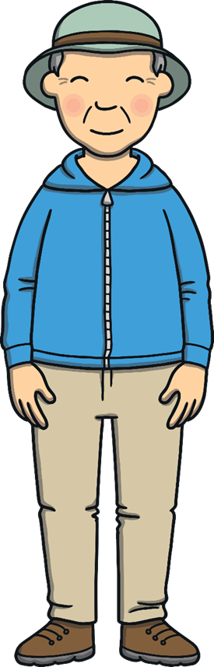
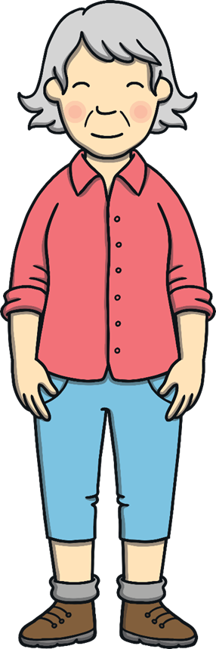
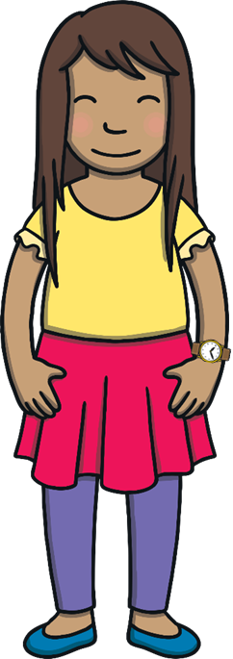

Apply
Kit and Sam found themselves back in Gran and Grandad’s house. “Ah, you are wearing my old watch,” said Grandad, winking mysteriously.

Slide 25


Today, we have learnt…
Final Consonant Blends
The adventure continues next lesson!

