Slide 2







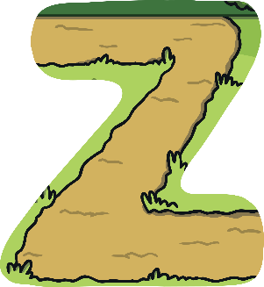




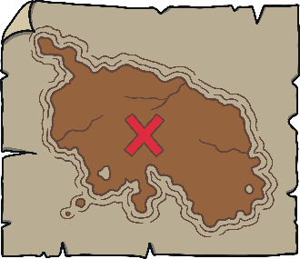

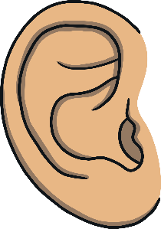





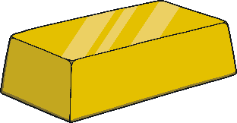





Revisit and Review
Let’s practise Sam’s Sounds and Tricky Words!
w
er
v
ure
air
qu
ng
j
ch
z
ar
x
ee
ow
ur
ai
sh
igh
th
y
or
oo
oa
ear
oi
here
they
was
you
she
are
my
me
we
all
he
be

Slide 3

Teach
This week, we meet our next tricky words:
said
so
Remember, tricky words are words that can’t be sounded out. We just have to learn them off by heart!

Slide 4

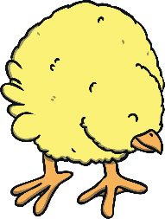
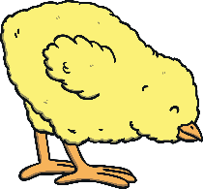
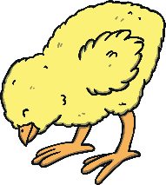
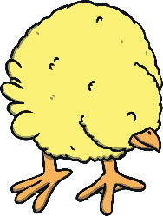
Teach
Hidden Chicks
Click on the eggs to reveal the tricky words and chicks.
said
so
so
said
said
so

Slide 5

Teach
Today, we are learning to read words that contain
final consonant blends.

Slide 6
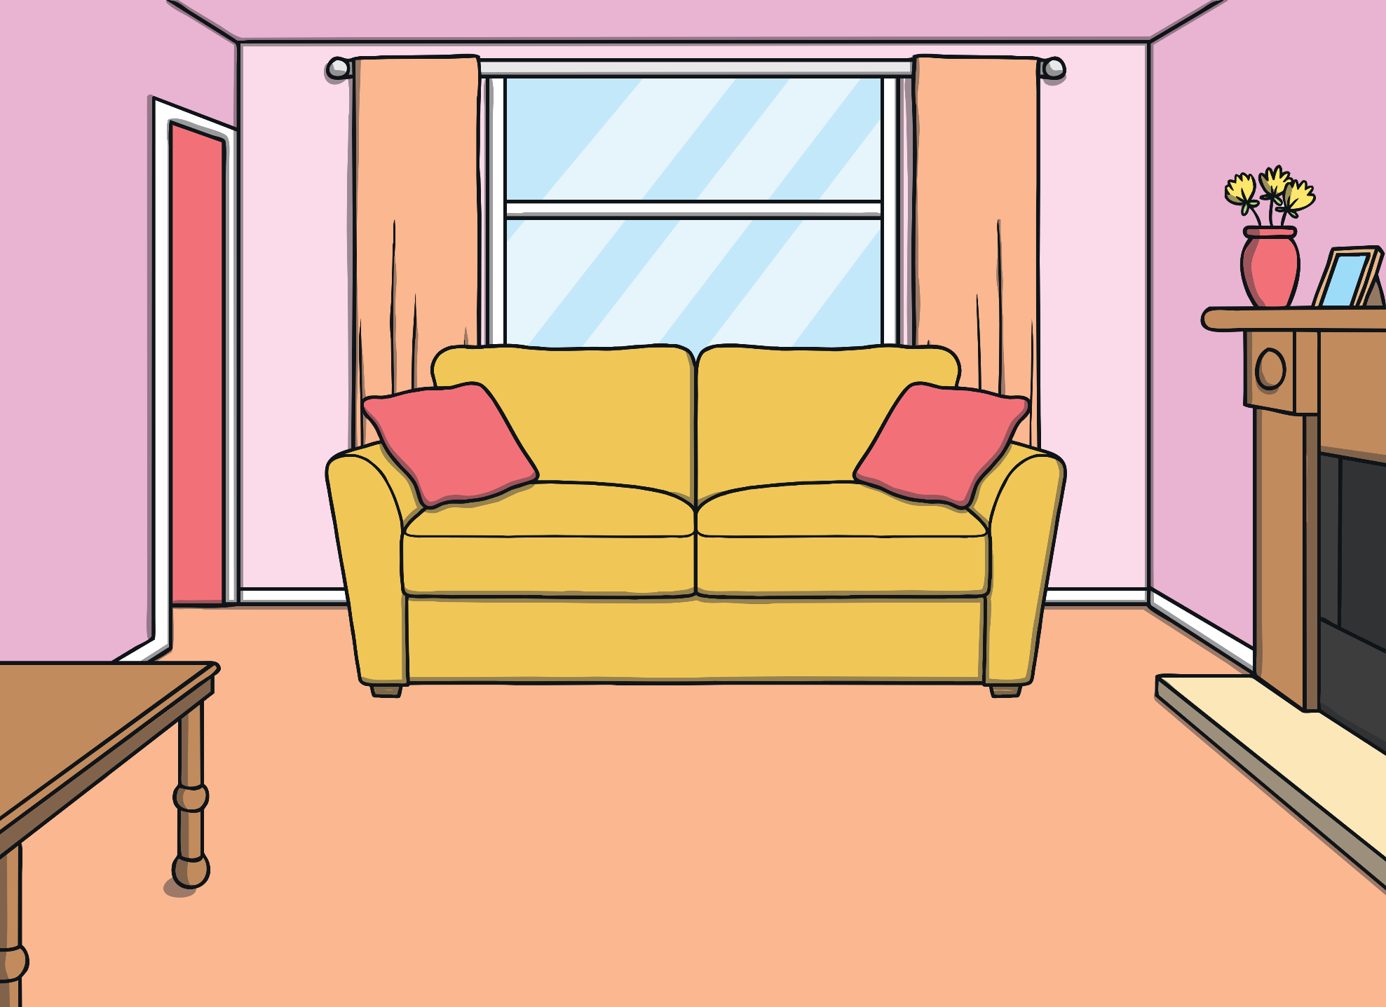
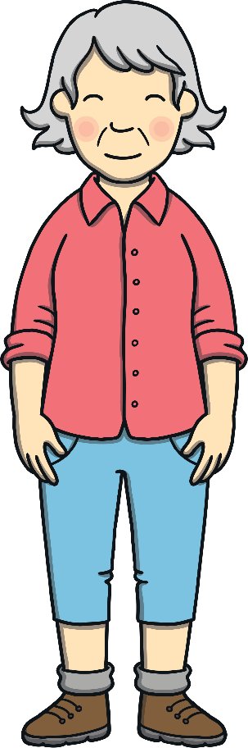
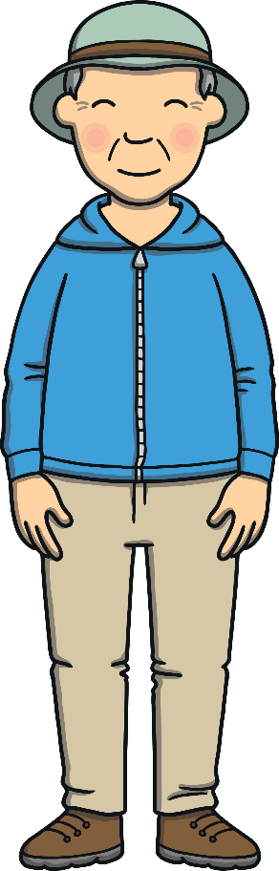

Teach
Kit and Sam were visiting Gran and Grandad. They had all been out for a walk and were reading Sam’s library book about the Stone Age.

Slide 7

Teach
“Look,” said Kit. “Stone Age people lived in caves and wore animal skins for clothes!”
“I can’t imagine what that would be like,” shivered Sam.

Slide 8
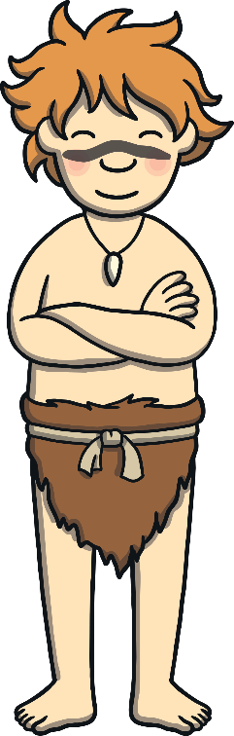
Teach
nk
mp
They looked at the picture of a cave boy in the book. “What is he saying?” asked Sam. “They are some sort of caveman sounds,” laughed Kit.

Slide 9
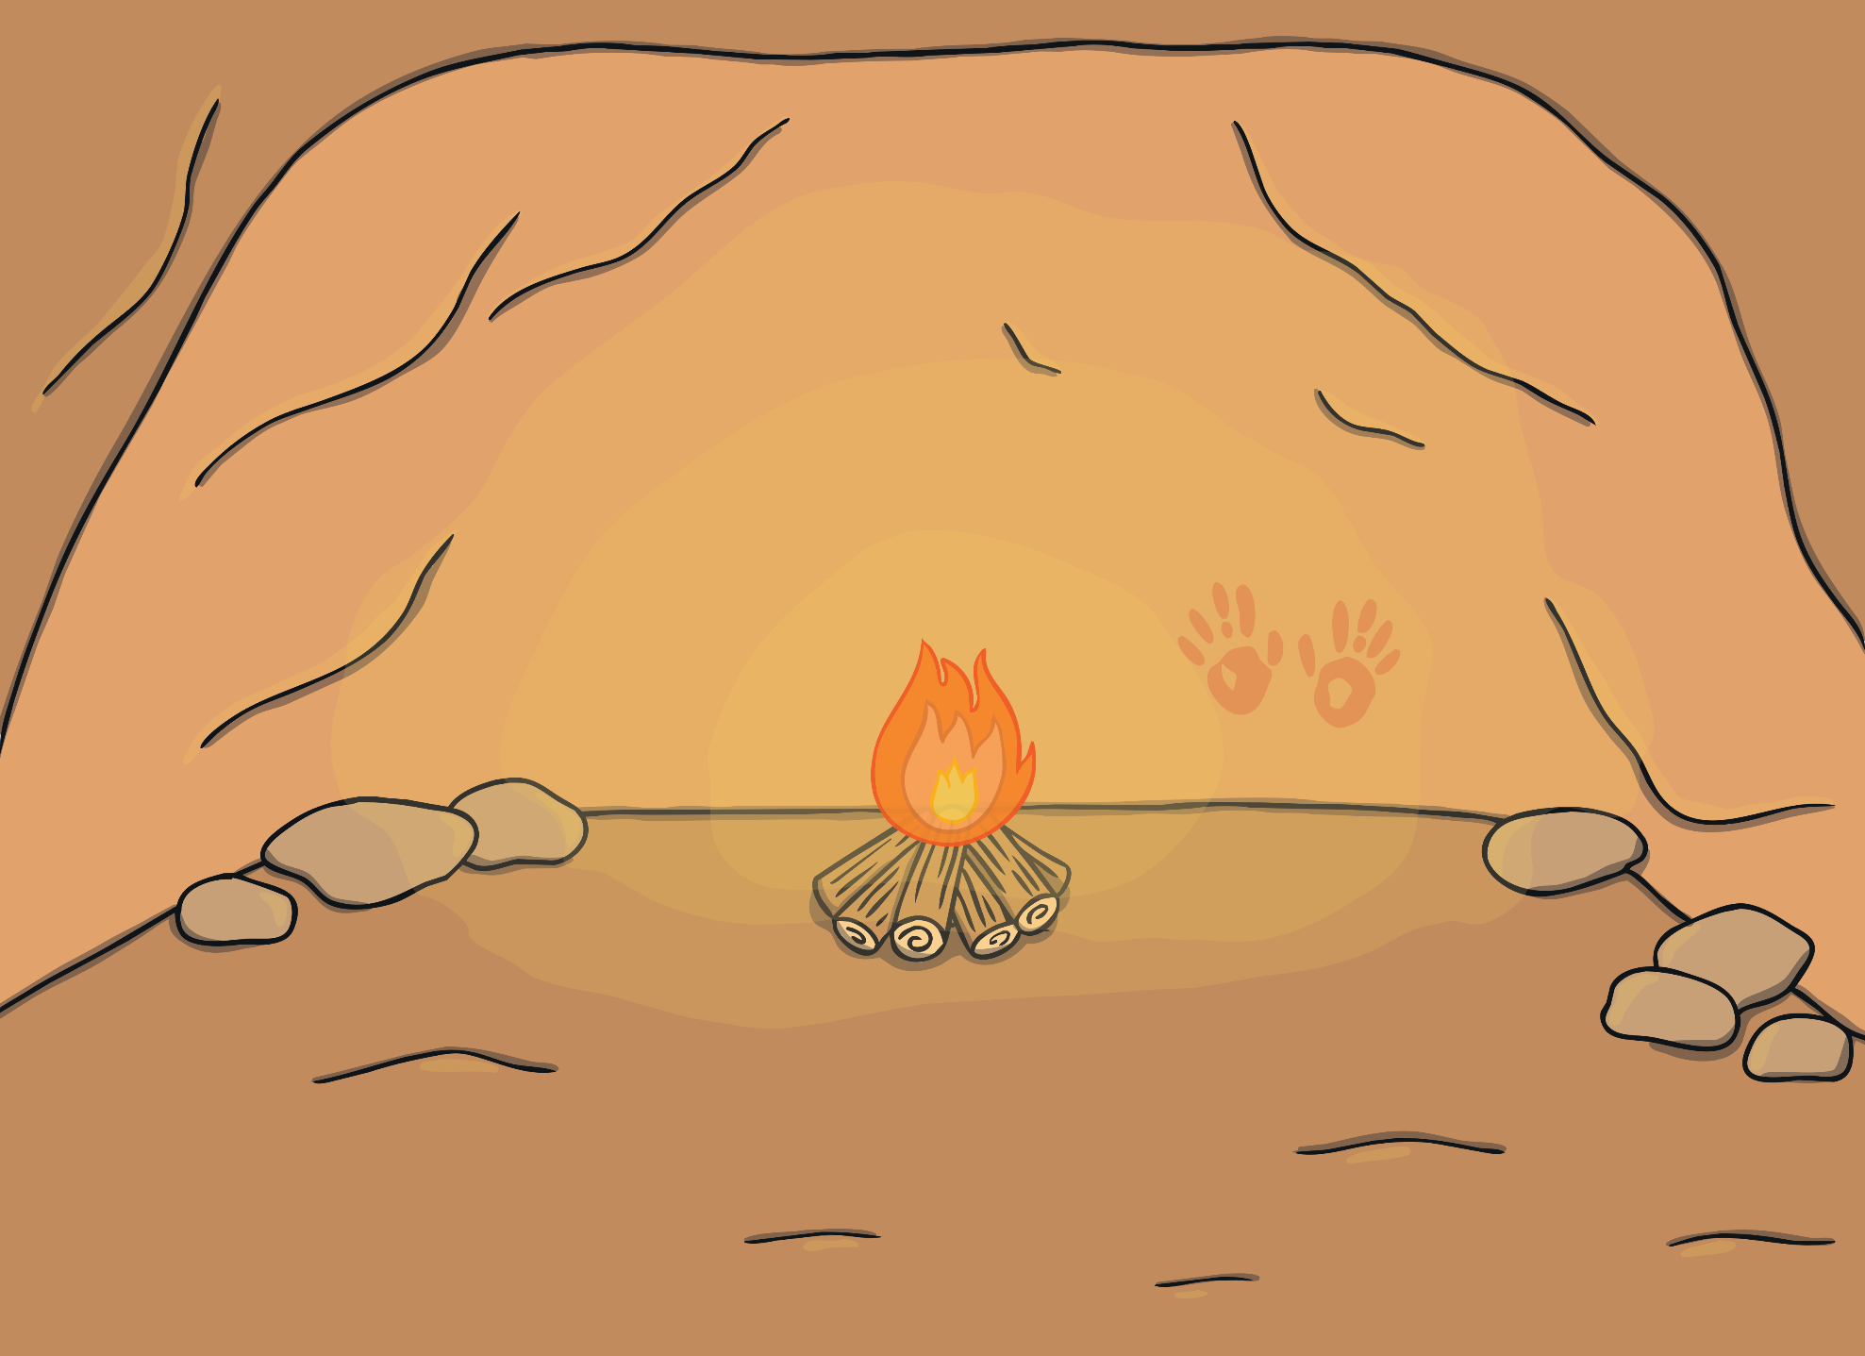

Practise
The cave boy in the book can only make caveman sounds! Say the caveman sounds as they appear on the cave wall.
nd
nk
sk
mp
nt
X
The guttural sounds made by final consonant blends can be taught as ‘caveman sounds’!
Click me for Kit’s teaching tips!

Slide 10
Practise
Caveman Sounds
What word is the cave boy saying? Click the boy to hear the word and then click on the picture that matches.

Slide 11





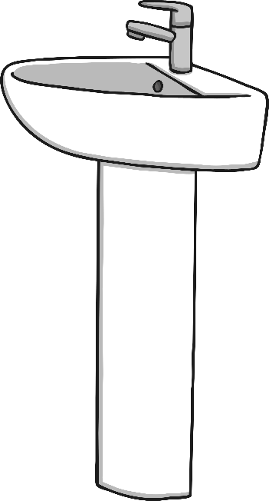

Practise

Slide 12
Practise

Slide 13
Practise

Slide 14
Practise

Slide 15
Practise
Well done.

Slide 16

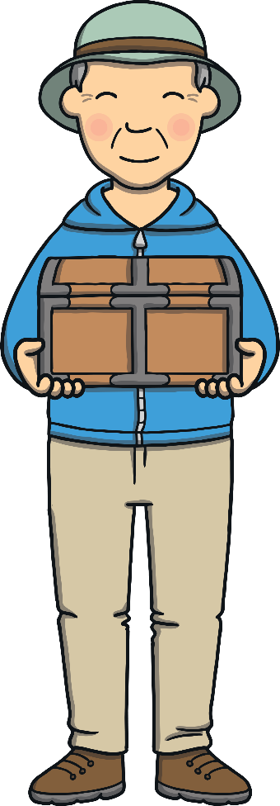
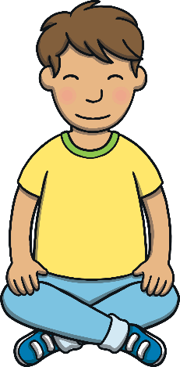
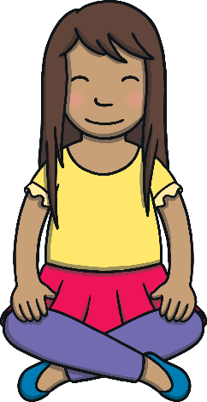
Apply
Gran and Grandad came back in carrying a box. “Here are some very special presents for you both,” they said.

Slide 17



Apply
Kit and Sam opened the box. Inside were some old objects – a watch, a map and a book. “What do we do with these?” Kit sounded disappointed.

Slide 18
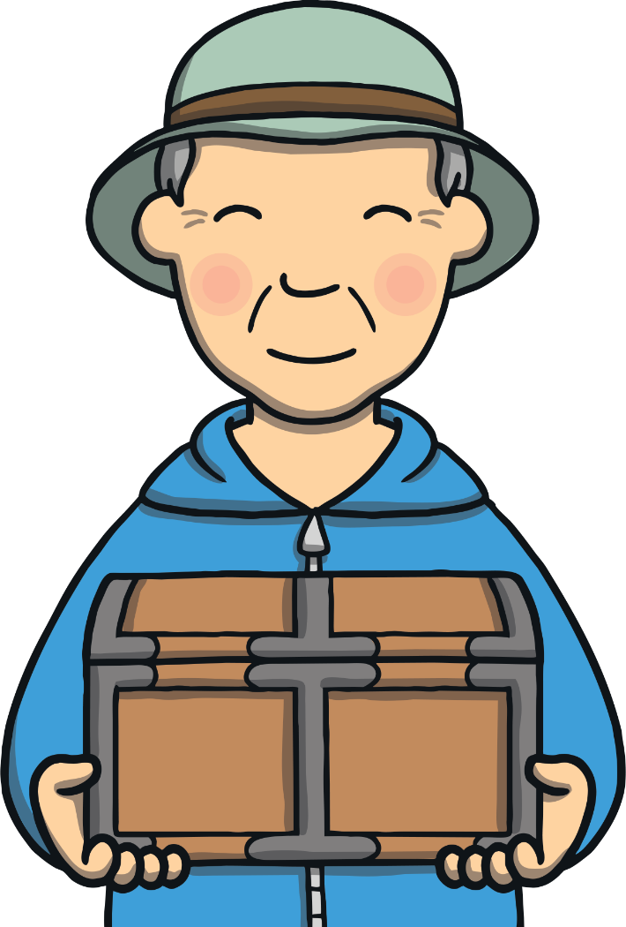
Apply
Sentence Time
What is special about the objects in the box? Read the sentence then click ‘Show’ to reveal the answer!
X
Click ‘Sound Buttons On/Off’ to select whether you want show sound buttons under the sentence.
Click me for Kit’s teaching tips!

Slide 19
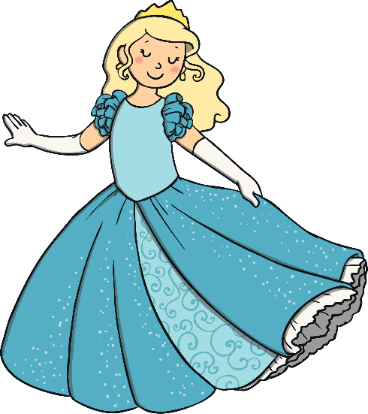


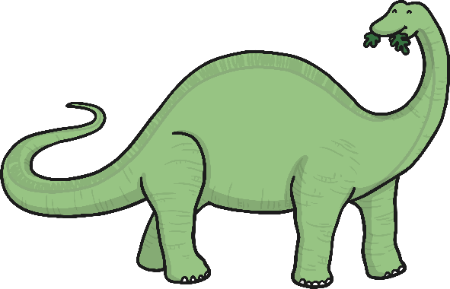

Apply
You can think of a land or a person to go and see.
Sound Buttons On/Off
Show

Slide 20

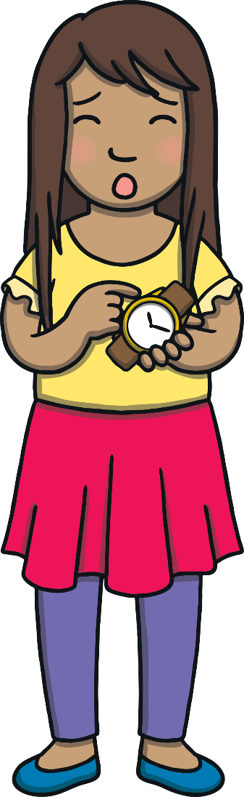
Apply
“I’m not sure,” said Sam, giving the watch a wind. “I don’t think this even works!”
It looks old enough to be from the Stone Age!” laughed Kit.

Slide 21
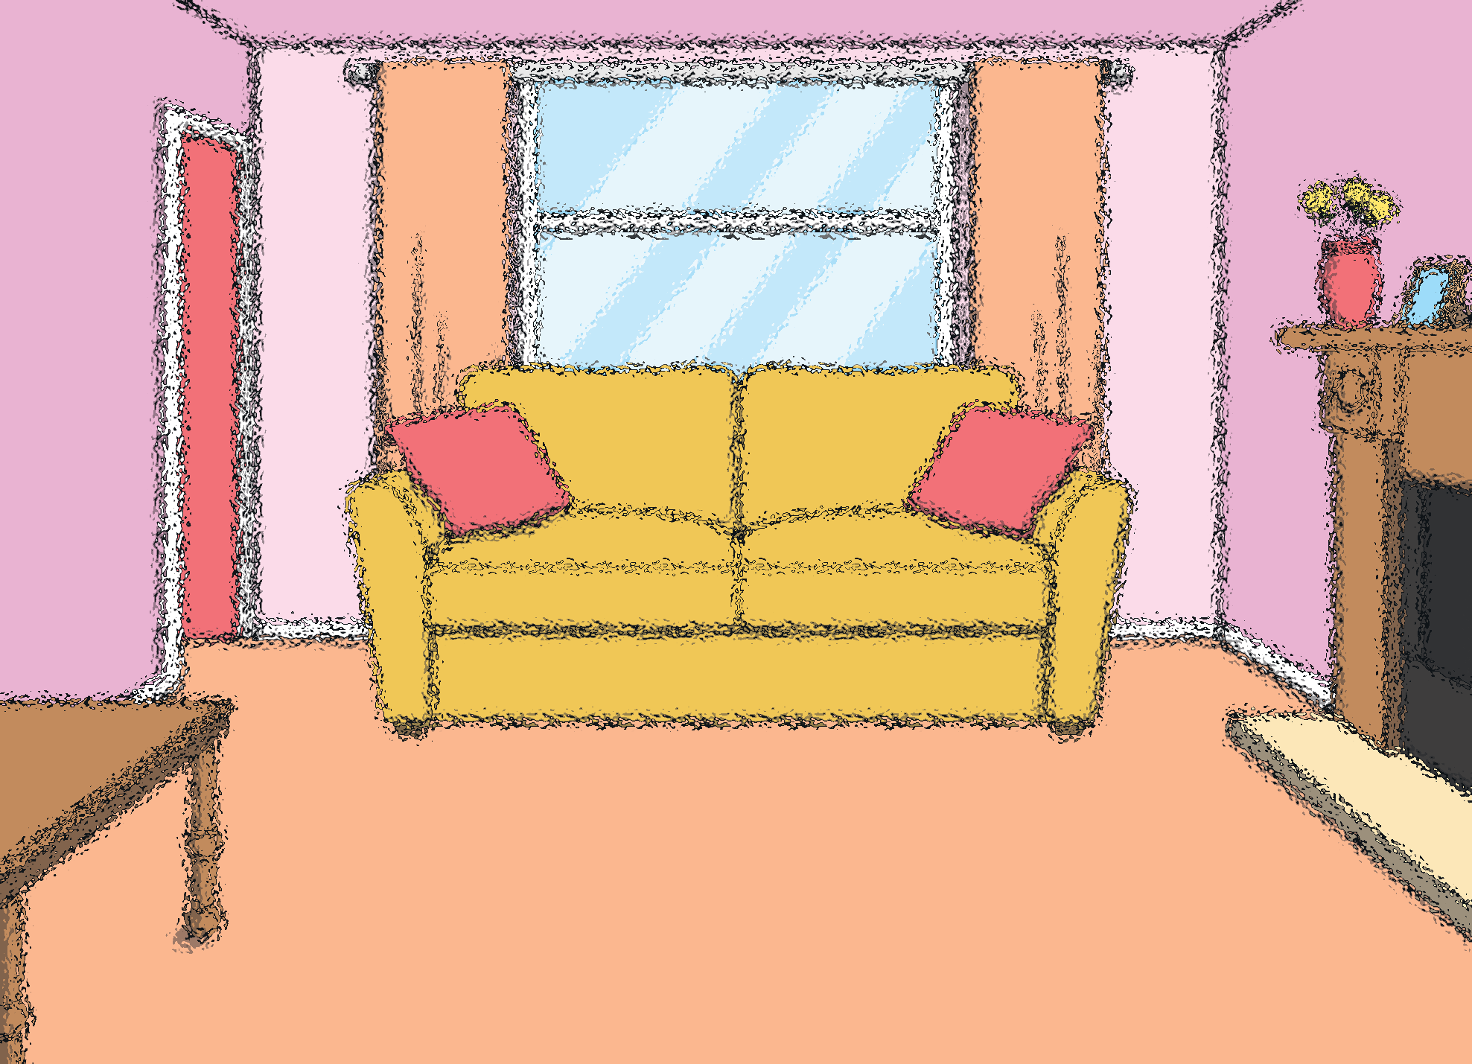

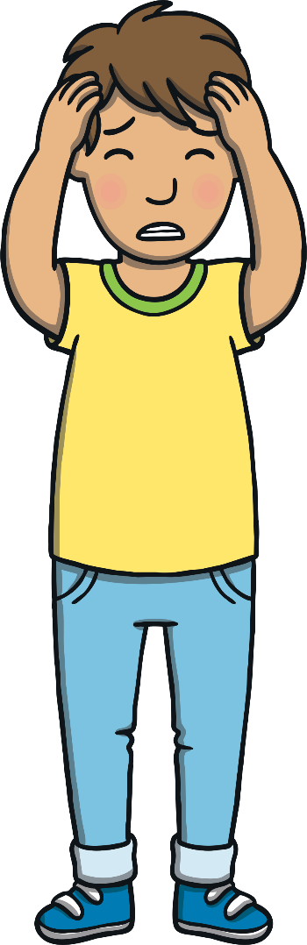
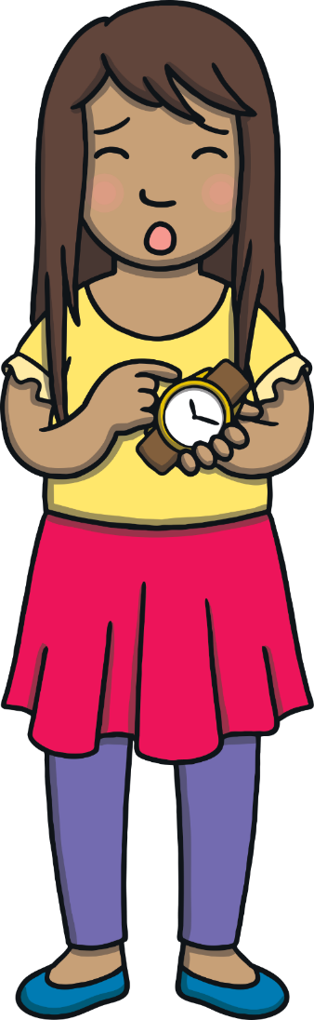
Apply
“Woah! What’s happening?” said Kit, as the room began to fade.
“I don’t know!” said Sam. “Did you say… the Stone Age?”

Slide 22

Today, we have learnt…
Final Consonant Blends
nk, mp, nd, sk, nt
The adventure continues next lesson!

