Slide 1
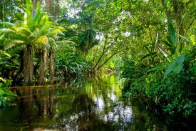
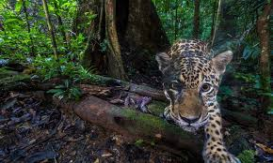
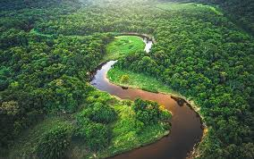
Wednesday 20th January 2021
LO: To write a performance poem from the viewpoint of a rainforest animal.

Slide 3

What is Poetry?
Poetry is a style of reading and writing.
It is imaginative writing, written by anybody.
People choose to write poetry about many different
things. It is a way to express thoughts and feelings
about something in a creative way.

Slide 4
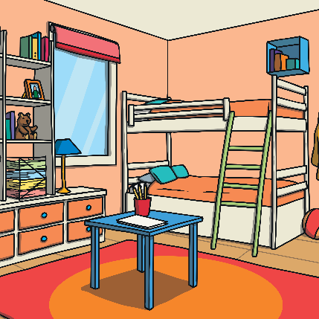
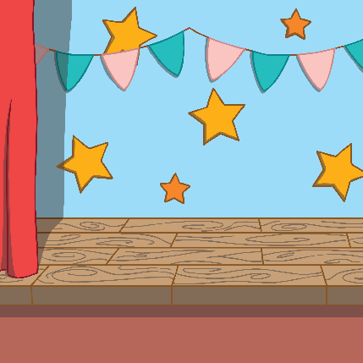
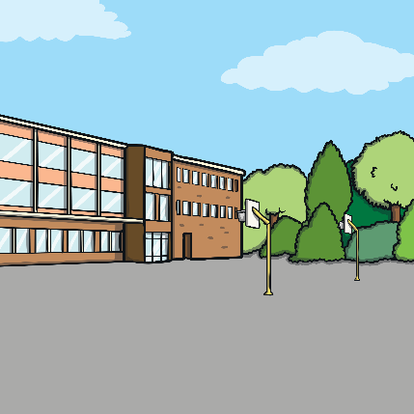
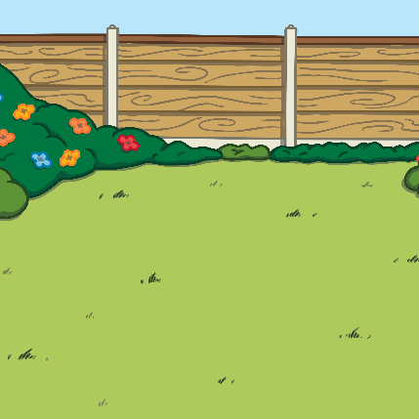
What is Performance Poetry?
Performance Poetry brings the poetry words to life through actions.
Poetry can be performed anywhere. Can you think of any places?
a bedroom
a stage
a playground
a garden

Slide 5

How Can You Perform Poetry?
When performing poetry, the reader will play with the words. It’s fun to experiment with the different words and make the poem come to life:
You may read some words loudly in a booming voice.
You could read some words quietly, whispering softly.
You may read a poem quickly, racing through
the words.
You could read the poem slowly, taking your
time with every word.
What about mixing it up? The poet might
perform using all of these styles.

Slide 6
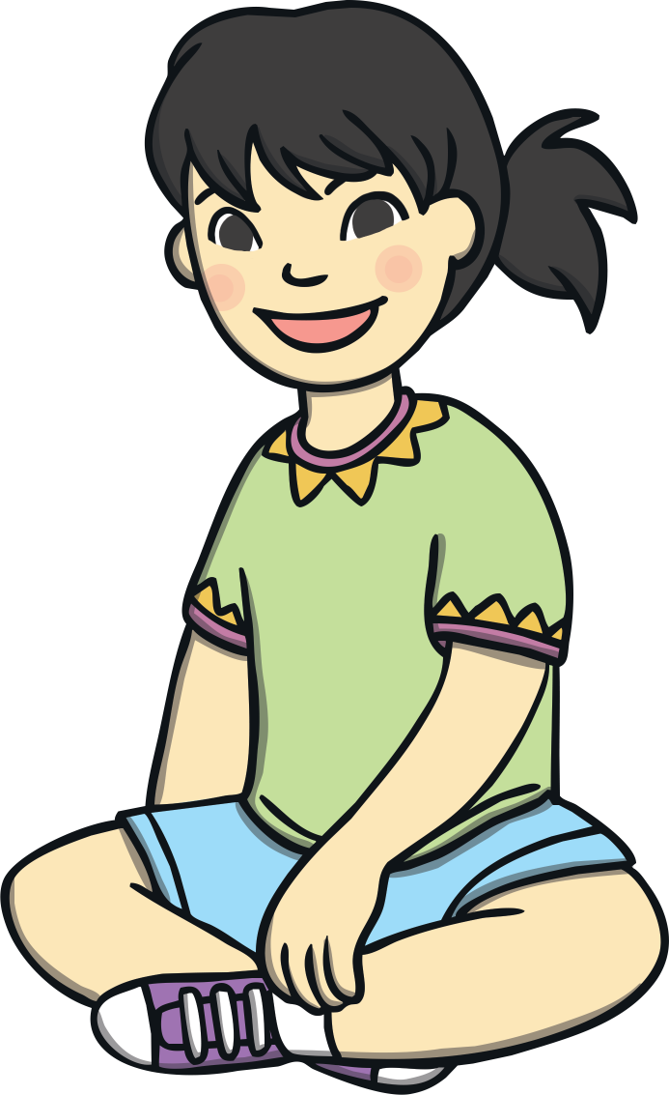
Actions
You can even use your body to perform poems:
standing – How might your chosen animal stand?
sitting – How might your chosen animal sit?
laying down – How might your chosen animal lie down?

Slide 7
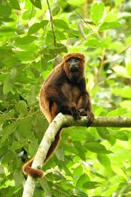
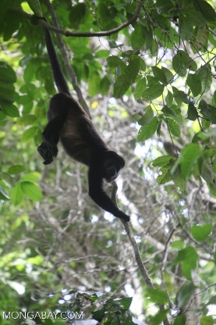
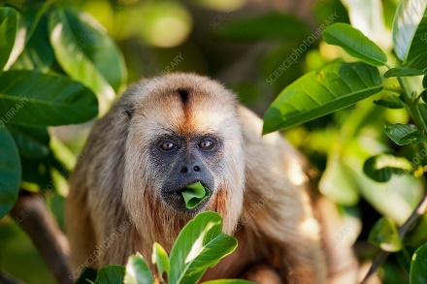
Actions
Actions can be as simple as small gestures. This could be pointing to objects, gentle flicks of the wrist or miming with your hands.
Imagine acting out some of these actions as part of your Poetry Performance.
Swinging through the trees.
Sitting in a tree.
Eating a green leaf.

Slide 8
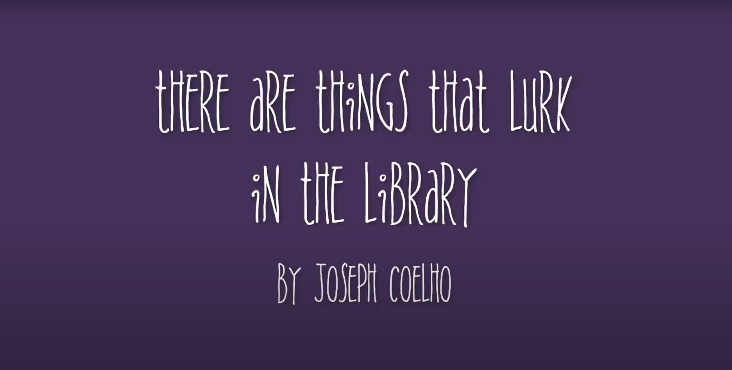
Performance Poetry
Watch this poem by Joseph Coelho and see if you can recognise any of the features you have learnt.
click here

Slide 9
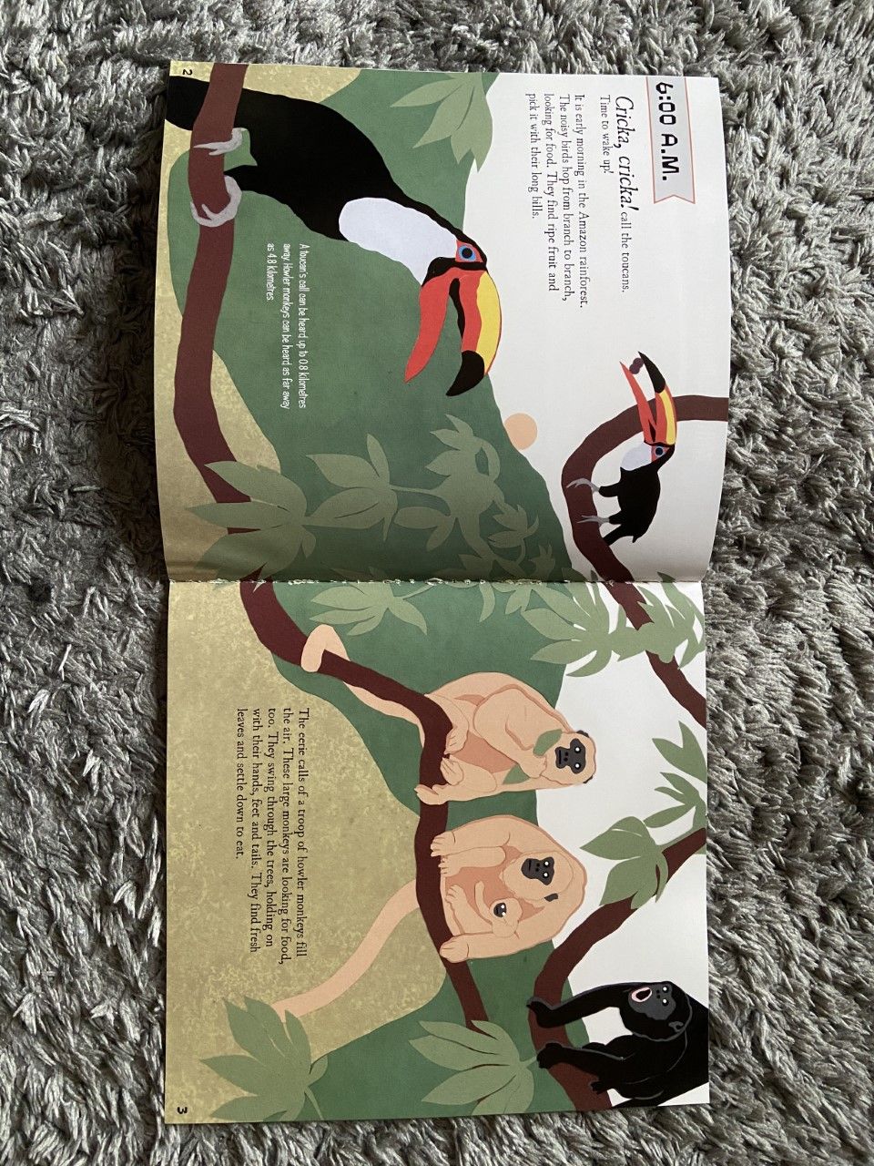
What animal have I chosen to write my poem about?

Slide 10
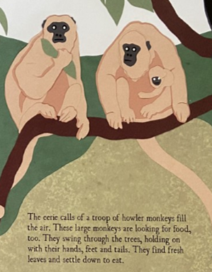
Howler Monkeys!

Slide 11

H | owls echo through the forest.
O | pen mouth and golden fur.
W | ill the baby ever let go?
L | ovely eyes open wide.
E | ating green leaves all the time.
R | eally amazing monkeys!

Slide 12

Your Task
Think about the animal that you wrote your fact file about yesterday.
You should write an acrostic poem about it and then have a go at performing it.
You have 3 options:
Complete the acrostic poem template using PowerPoint and type in your verses in the boxes provided. You can add in photos to make it more exciting to look at.
Print out the acrostic poem template and hand write your poem in the boxes provided. Draw your own pictures to make it exciting.
Create your own acrostic poem on a blank piece of paper based on the template given and add your own pictures.
* You can include questions or exclamations in the poem! Think how you would say these lines out loud.

