Slide 1
Thursday 21st January 2021
LO: To show an understanding of the book ‘A day and night in the Amazon Rainforest’ by responding to comprehension questions.

Slide 2
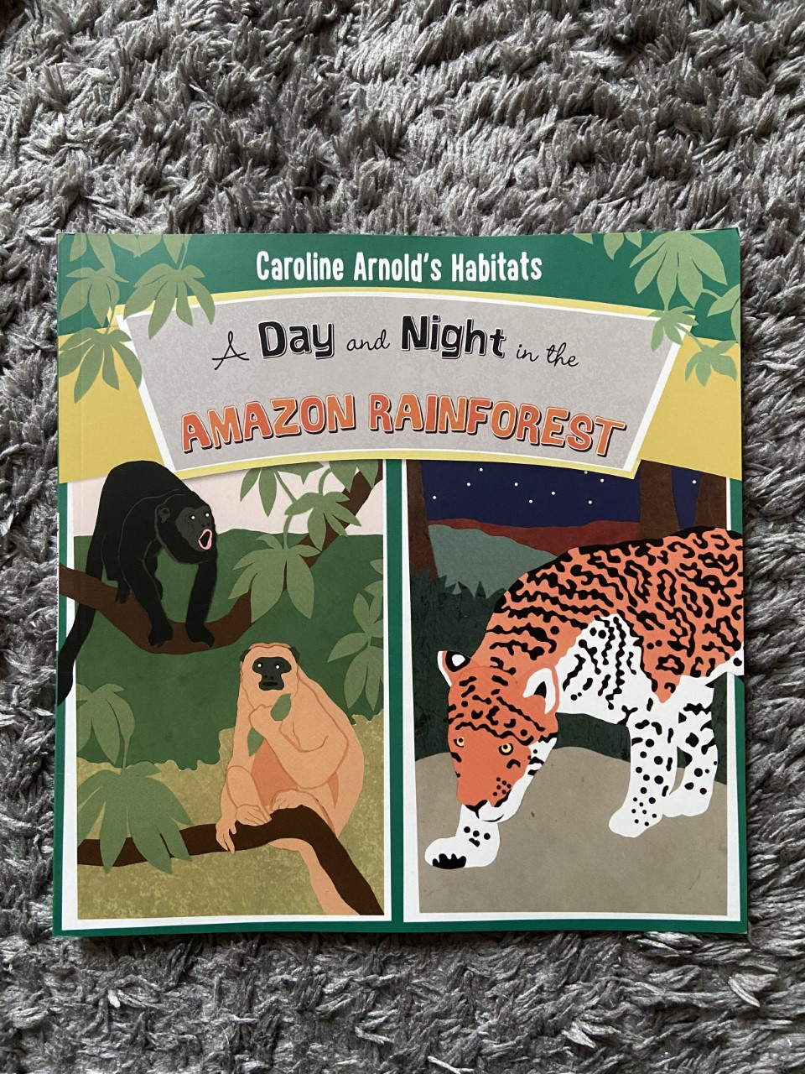

Slide 3
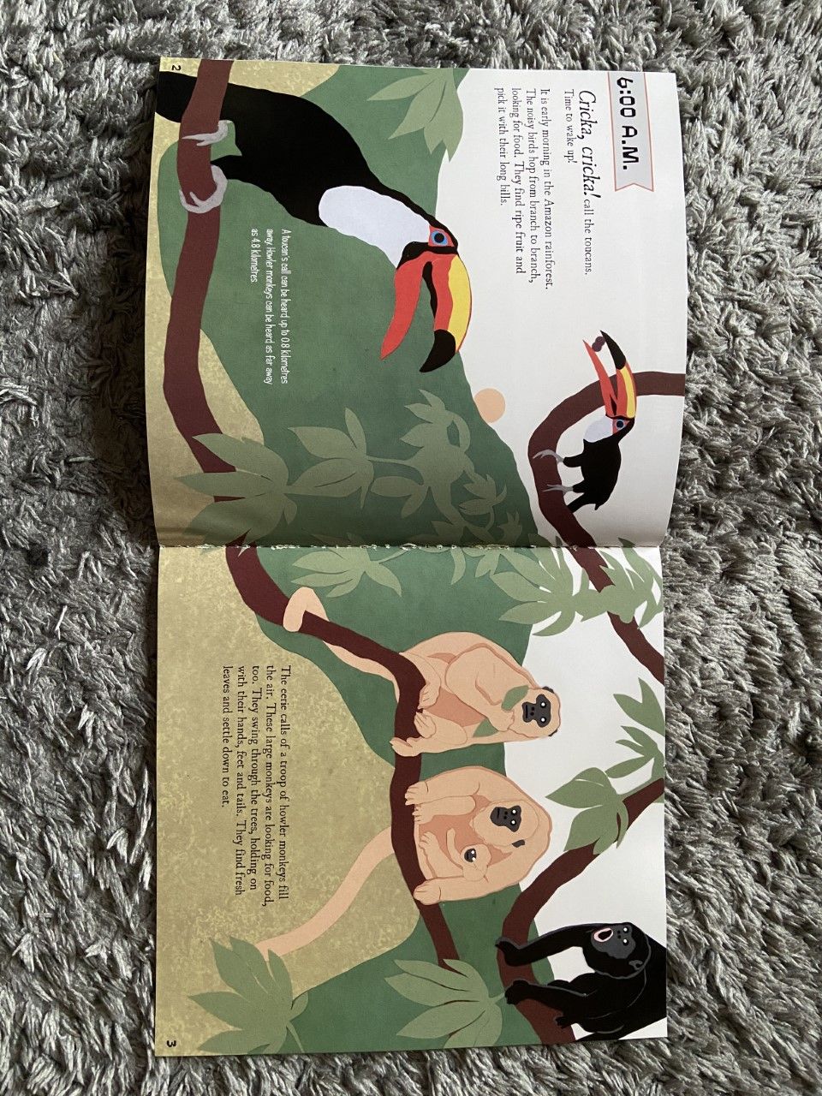

Slide 4
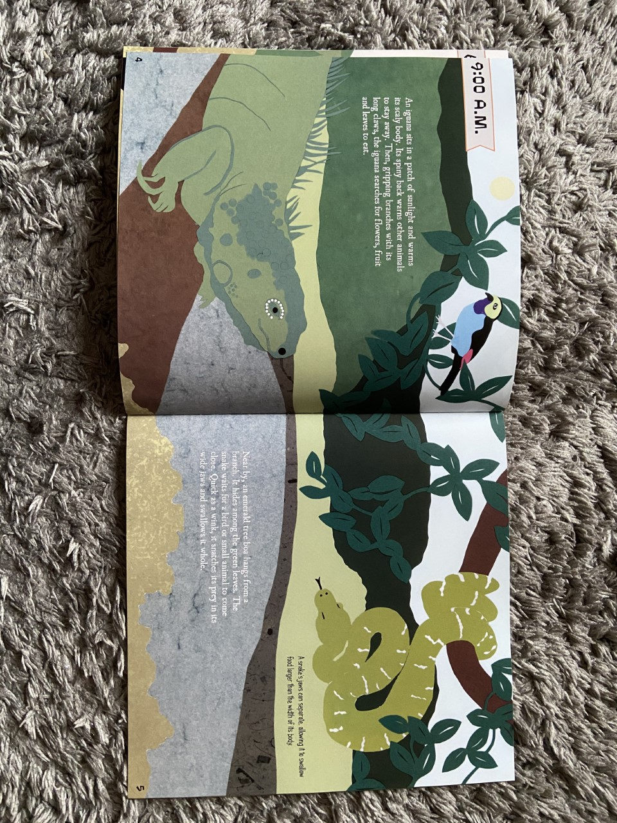

Slide 5
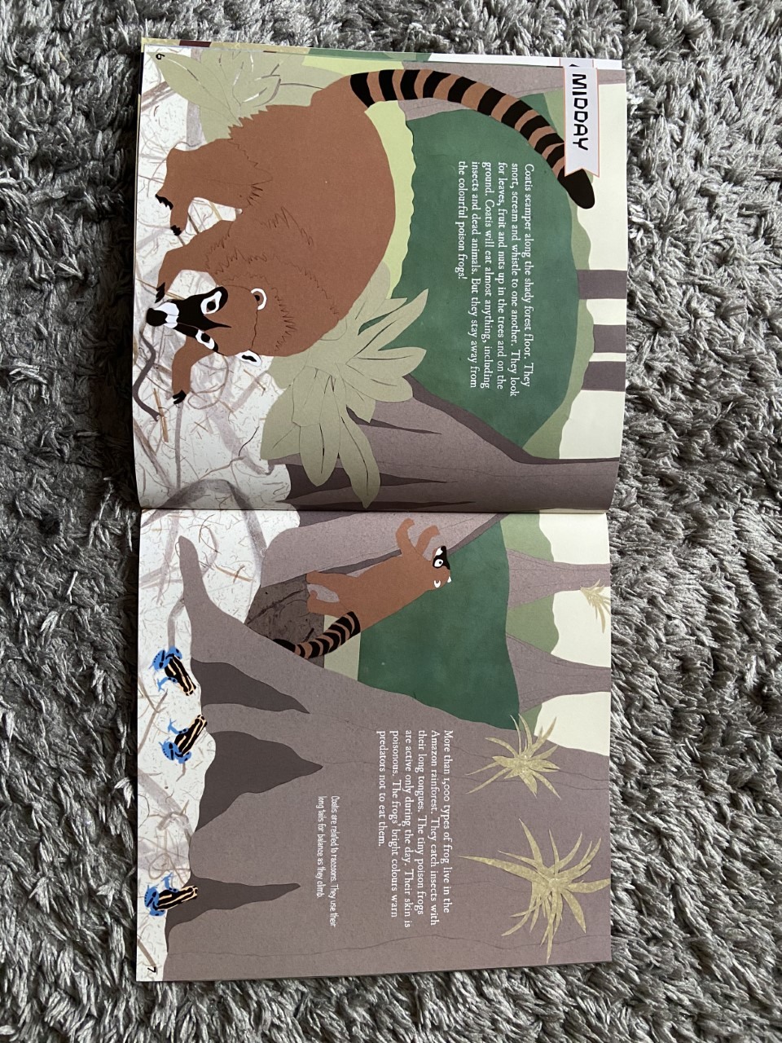

Slide 6
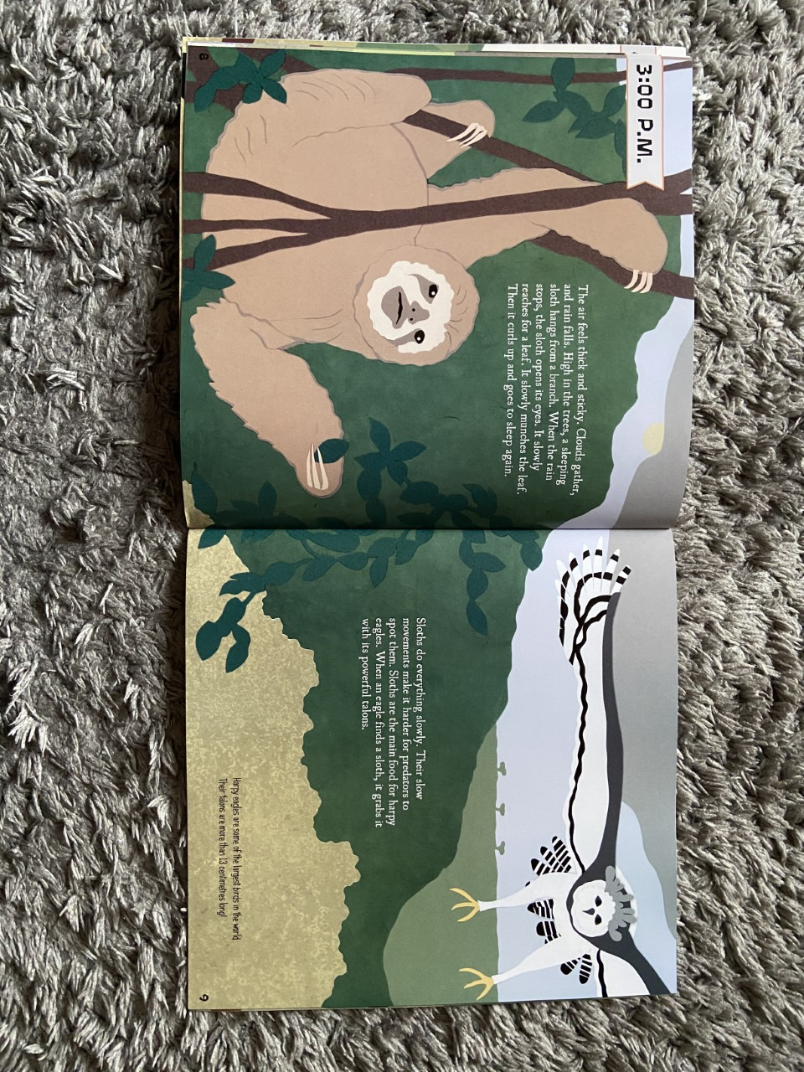

Slide 7
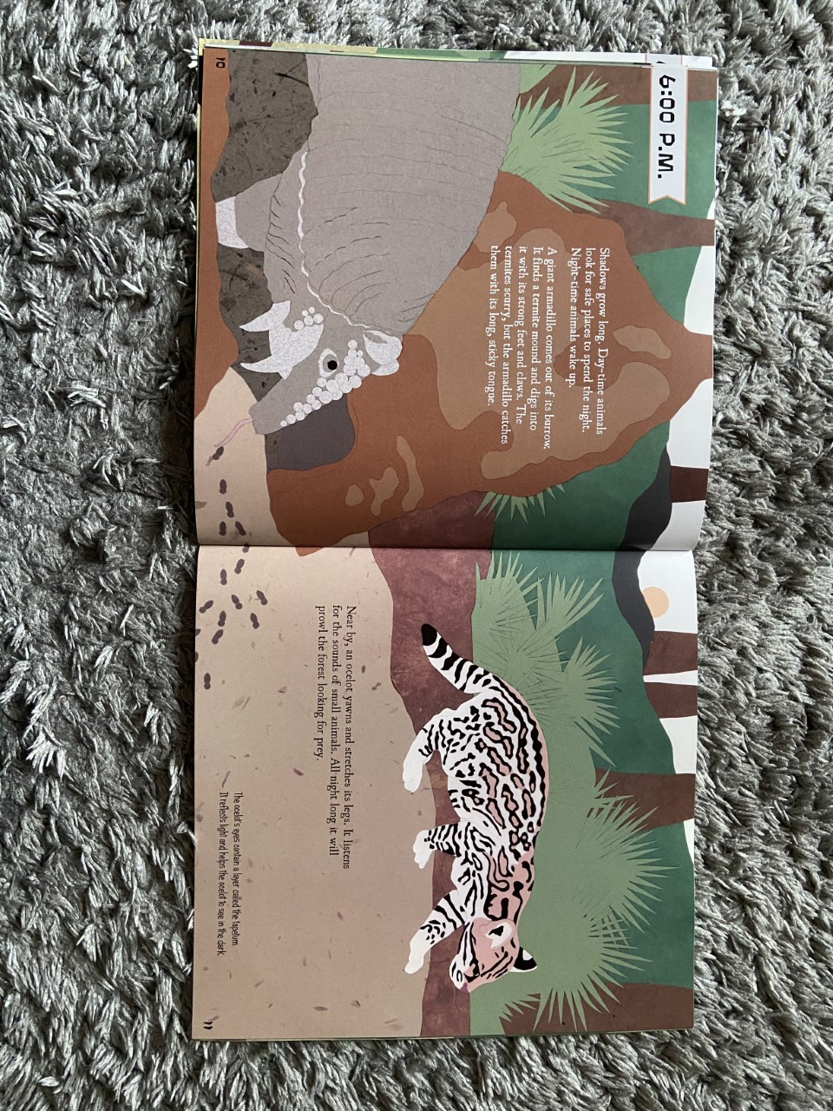

Slide 8
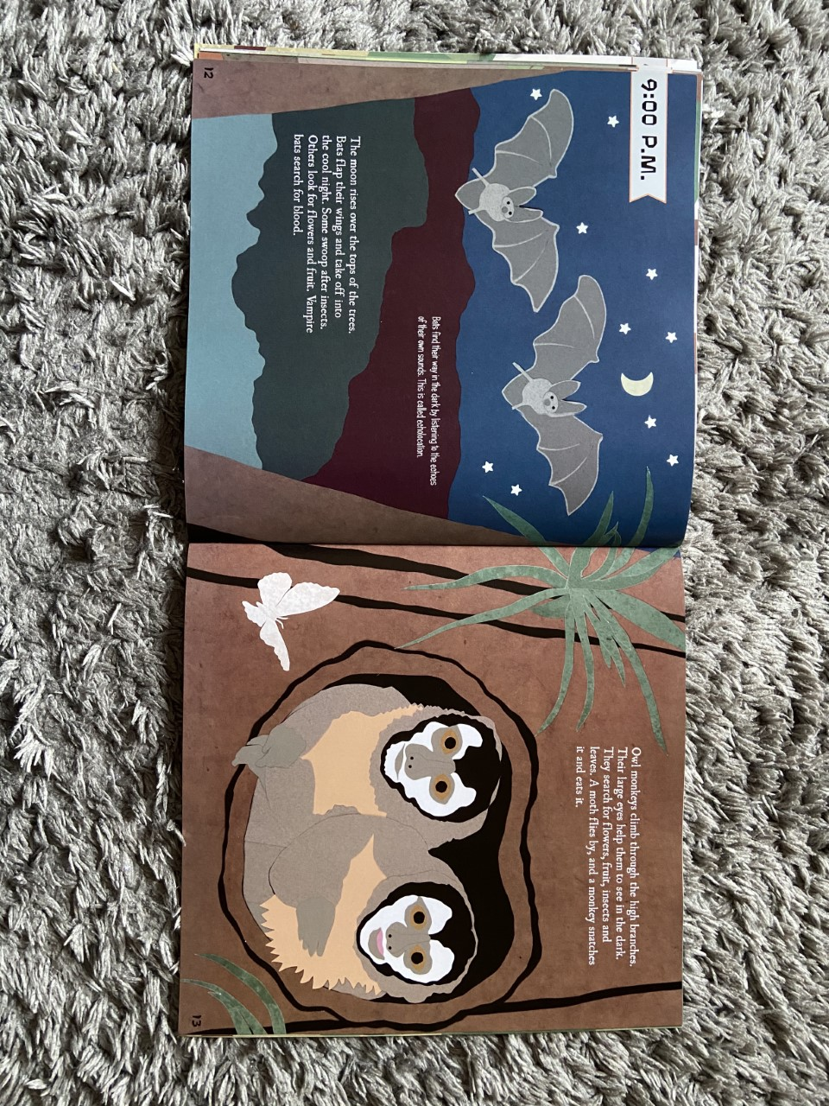

Slide 9
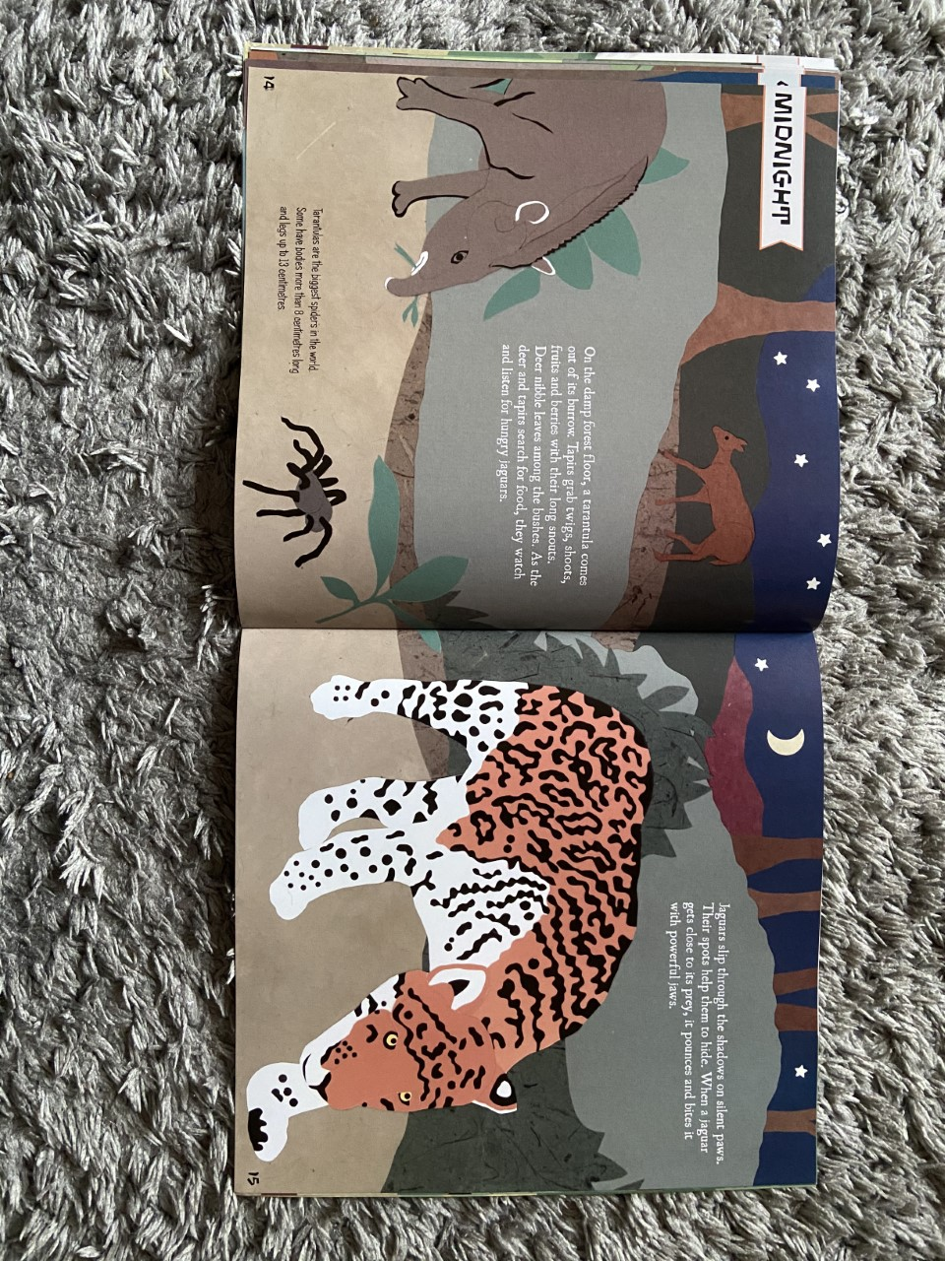

Slide 10
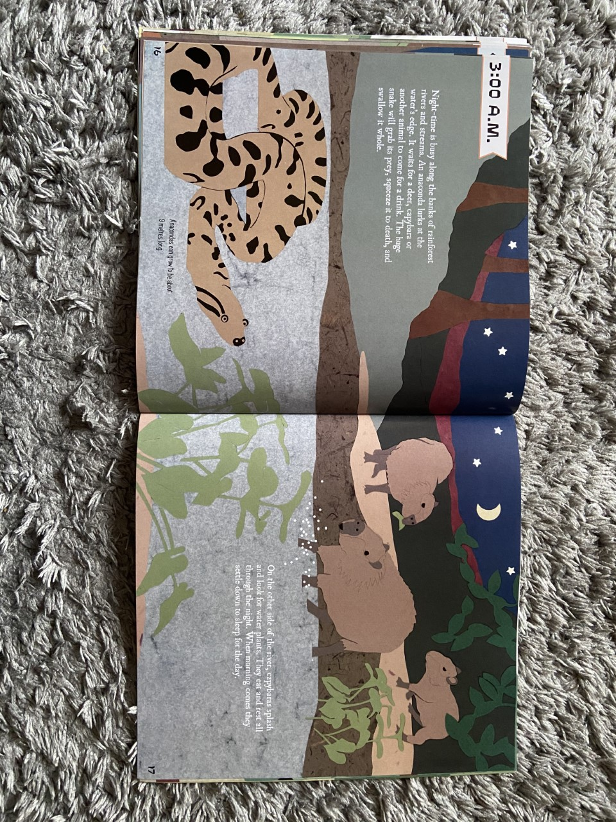

Slide 11
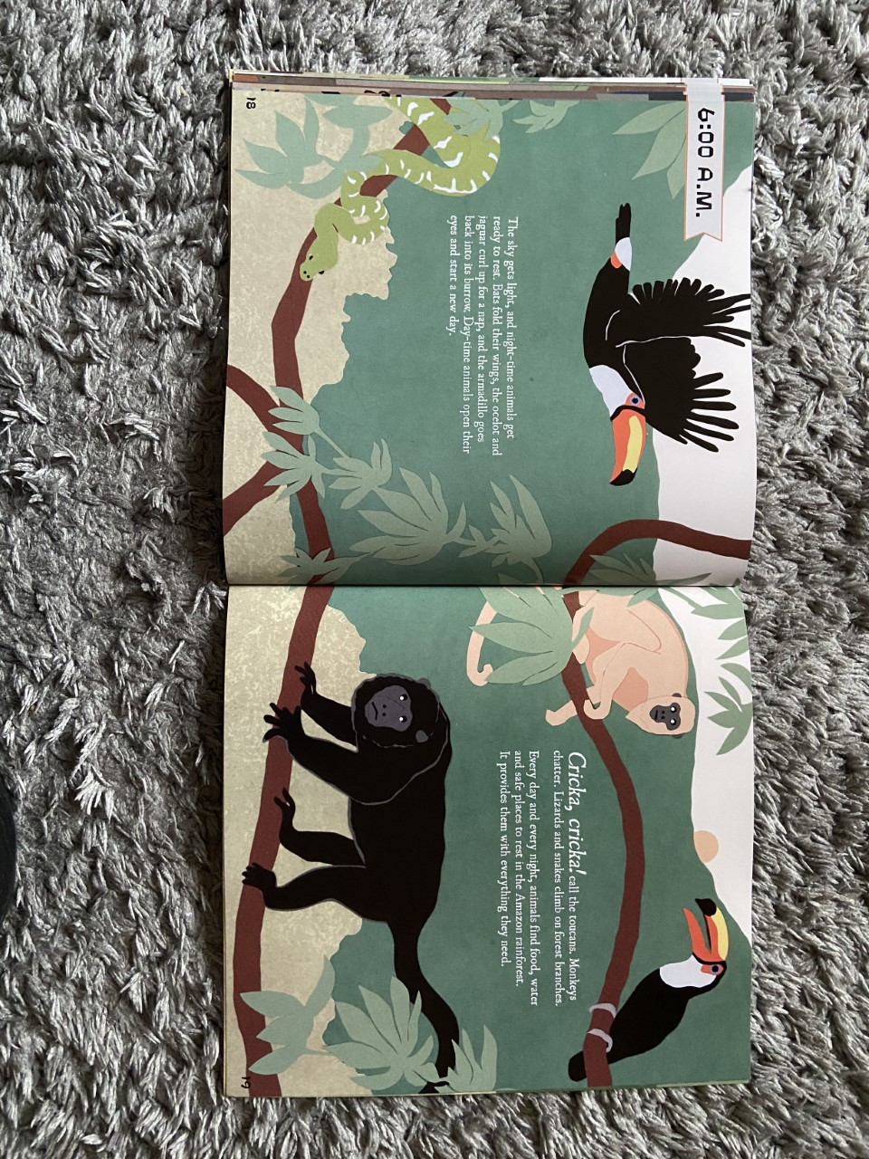

Slide 12
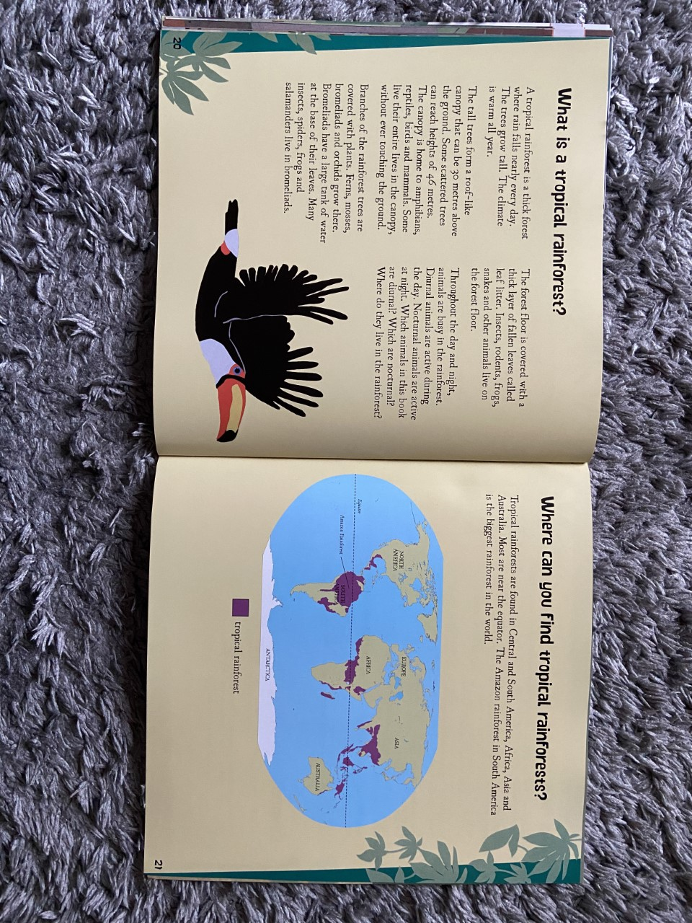

Slide 13
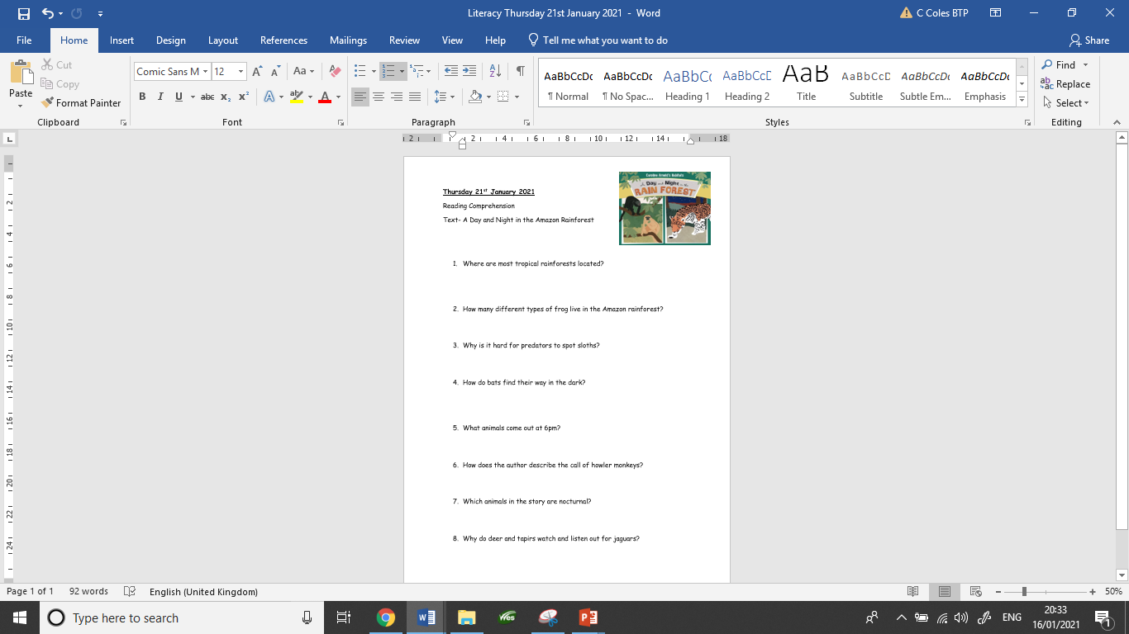
Your Task Today
Show your understanding of the story ‘A day and night in the Amazon Rainforest’ by answering the comprehension questions.
Find the questions on the school website.
Remember to compose & write a full sentence. The words in the question can help you to compose your sentence. Say it out loud first.

Slide 14
Let’s answer one together
Where do anacondas lurk waiting for their prey?
Anacondas lurk at the water’s edge for their prey.

