Slide 1
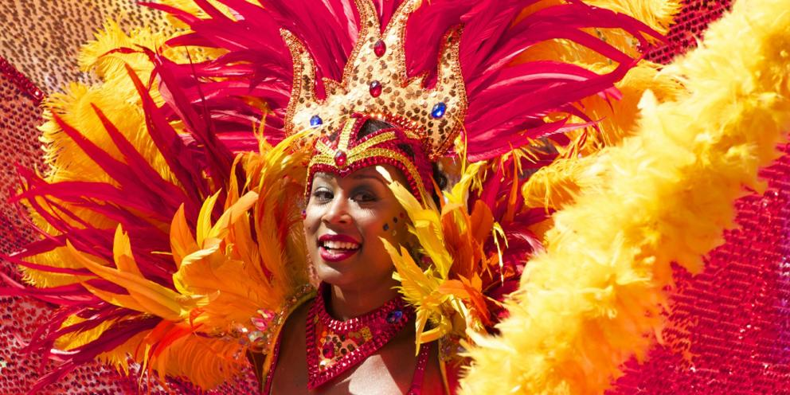
Thursday 21st January 2021
Topic - Geography
LO: To learn about the Notting Hill Carnival and to compare it with the Rio Carnival.

Slide 2
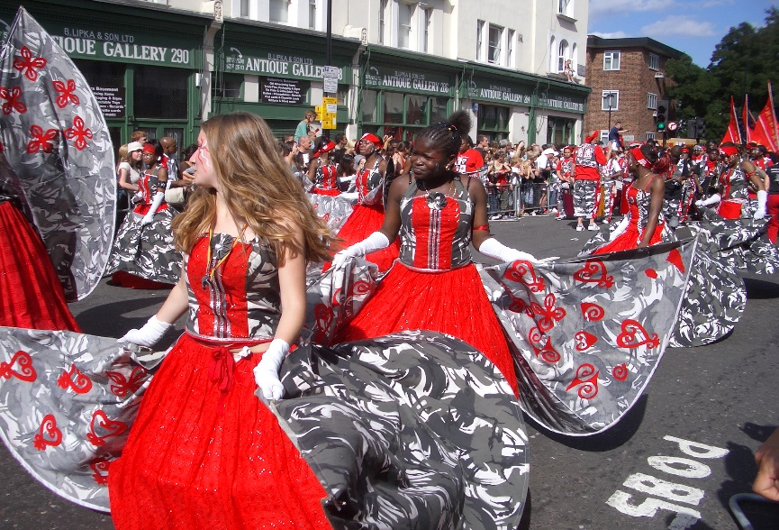
Your Task
Find out about the Notting Hill Carnival in London.
Compare the Notting Hill Carnival with the Rio Carnival that we learnt about last week.

Slide 3
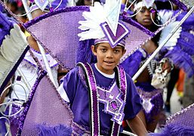
Notting Hill Carnival: useful online links.
Notting Hill Carnival: What is it?
https://www.bbc.co.uk/newsround/49372390
IsisMas 2014 Notting Hill Carnival - Children
https://www.youtube.com/watch?v=wdU7NVRFl5I
Notting Hill Carnival 2019 Batala Mundo Drummers
https://www.youtube.com/watch?v=H5sW8i3ab80

Slide 4
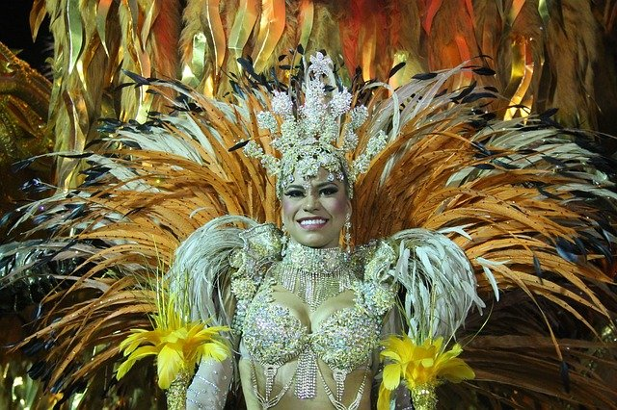
Rio Carnival: useful online links.
Here is a new link with more information about the Rio Carnival.
Sunhills Valley – Around the world: Brazilian Carnival
https://www.youtube.com/watch?v=3-03w8JF8bg
Links from last week for reference
Brazil Carnival: The Rio de Janeiro parade in 1 minute
https://www.youtube.com/watch?v=Py0Tl2PvlJo
Carnival Rio de Janeiro Stunning Parade!
https://www.youtube.com/watch?v=kTc3pv7d5vY
Carnaval de Rio de Janeiro
https://www.youtube.com/watch?v=f2IpnYqoP-Q

Slide 5
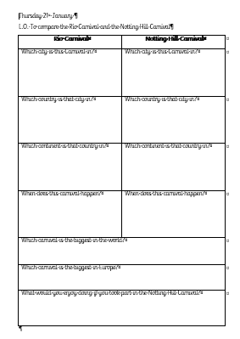
We have now learnt some facts about the Rio Carnival and the Notting Hill Carnival.
Complete the worksheet to compare these two events.
This can be found in the class pages on the school website.

